Slide 1
A functional Medicine Approach to the Microbiome
Deidre Arms, BC-APRN
Desire Wellness Group

Slide 2
Disclosures
NO financial disclosures
Speaker Astellas Pharmaceutical
Speaker PESI healthcare
Desire Wellness Group, Functional Health and Wellness Practice co-founder

Slide 3
Objectives
1. Understanding functional medicine and why we need functional medicine
2. Understanding elements of functional medicine
3. Application of functional medicine in clinical practice
4. Understanding how treating the microbiome improves health
5. Understanding conventional and functional medicine approaches to management of microbiome

Slide 4
What is Functional Medicine?
Shifting the traditional disease-centered focus of medical practice to a more patient-centered approach
Addresses the whole person, not just an isolated set of symptoms.
Looking at the interactions among genetic, environmental, and lifestyle factors that can influence long-term health and complex, chronic disease.

Slide 5
Why we need Functional Medicine
Our society is experiencing a sharp increase in the number of people who suffer from complex, chronic diseases.
The system of medicine practiced by most providers is oriented toward acute care.
The acute-care approach to medicine lacks the proper methodology and tools for preventing and treating complex, chronic disease.
There’s a huge gap between research and the way we practice. The gap between emerging research in basic sciences and integration into medical practice is enormous—as long as 50 years—particularly in the area of complex, chronic illness.
Most physicians are not adequately trained to assess the underlying causes of complex, chronic disease and to apply strategies such as nutrition, diet, and exercise to both treat and prevent these illnesses in their patients.

Slide 6
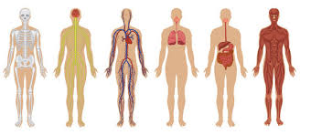
Human Body Systems
This Photo by Unknown author is licensed under CC BY-NC-ND.
In a conventional model, we focus on the body systems and not necessarily how they are connected.

Slide 7
THE CONVENTIONAL FOCUS RISK FACTORS AND DX VS THE FUNCTIONAL FOCUS IDENTIFY AND ADDRESS UNDERLYING ETIOLOGIES
CONVENTIONAL FOCUS
EFFECTS
CAUSES
THE FUNCTIONAL FOCUS
This Photo by Unknown author is licensed under CC BY-NC-ND.

Slide 8
NIH Human Microbiome Project
Project's initiation in 2007.
National Institutes of Health (NIH) primary funding agency.
The Human Microbiome Project (HMP) holds significant importance in advancing our understanding of the microbial communities that inhabit the human body and their impact on health and disease.
Scientific understanding of the gut microbiome has grown exponentially.

Slide 9
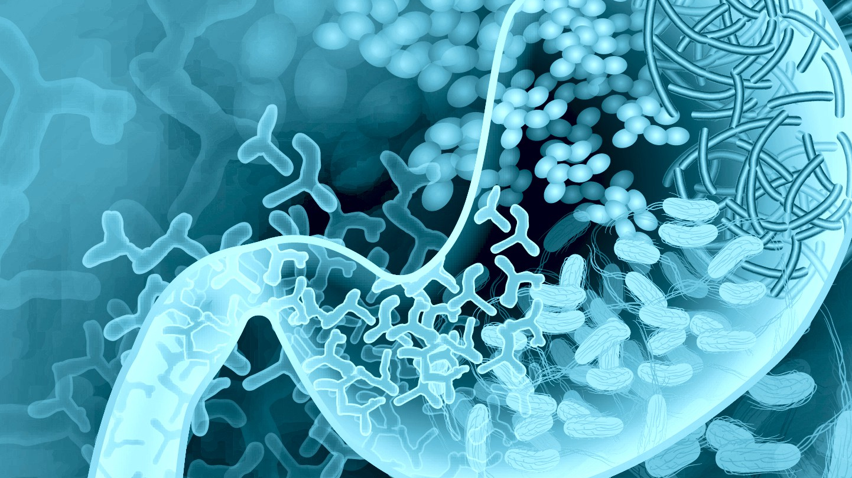
Research in the Microbiome
Explosion of research into gastrointestinal microbiota
Showing linkages between specific patterns of dysbiosis and greater prevalence of specific chronic complex metabolic diseases, including:
Autoimmune conditions
Metabolic disease
Neurodegenerative
This Photo by Unknown author is licensed under CC BY.

Slide 10
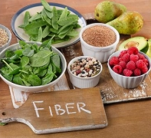
What effects the microbiome?
Stress
Aging
Decreased sleep
Low fiber diet
Diet low in polyphenols
Disruption of circadian rhythm with travel
Menopause
And more....
This Photo by Unknown author is licensed under CC BY.
This Photo by Unknown author is licensed under CC BY-NC.

Slide 11
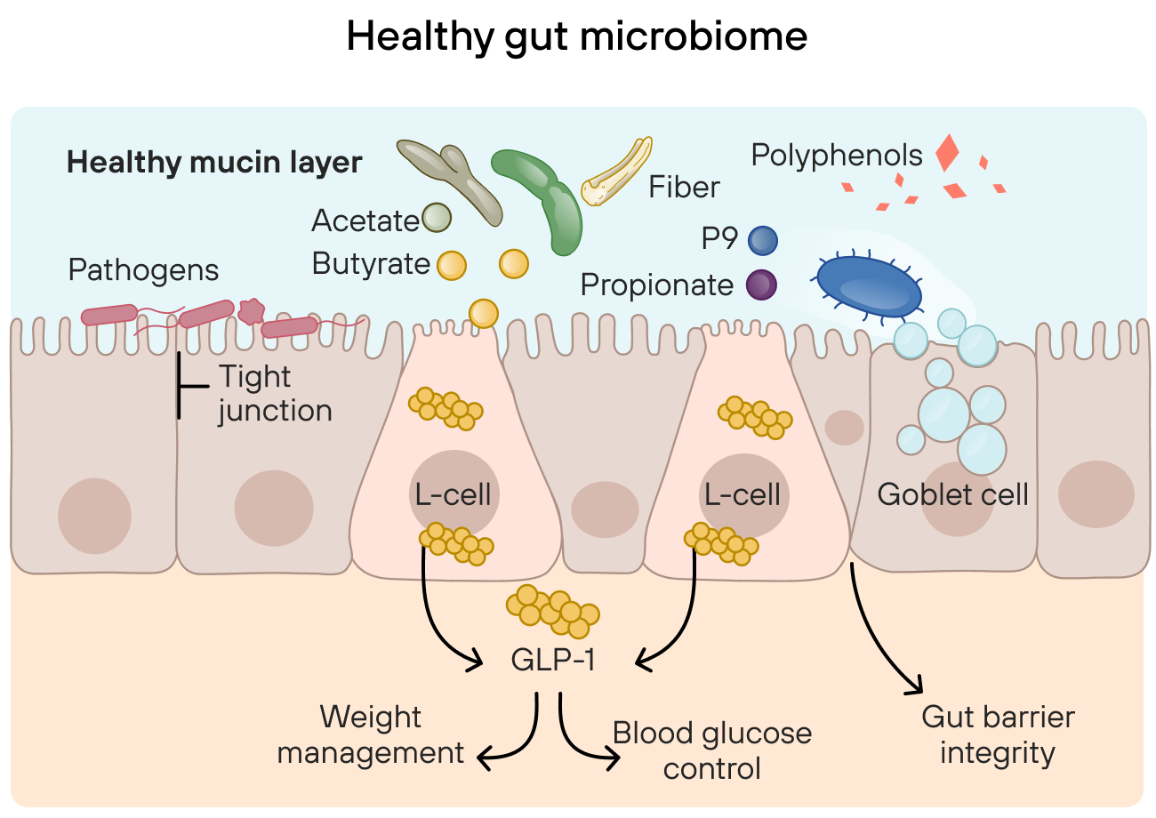
Healthy Gut Microbiome
Has a healthy mucin layer in which akkermansia plays an important role in mucin production
Beneficial bacteria Metabolize fibers into butyrate, acetate, and propionate
Secrete key proteins such as p9
Stimulate mucin rejuvenation

Slide 12
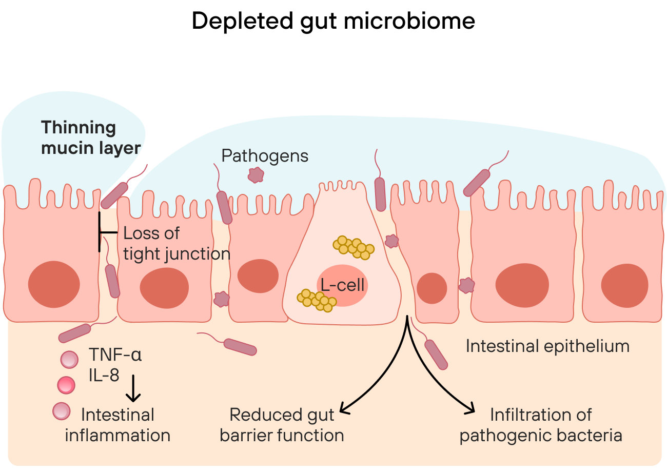
Depleted Microbiome
Decrease in Mucin layer
Loss of tight junction
Reduced gut barrier function
Infiltration of pathogenic bacteria

Slide 13
Barrier Function
The integrity of the mucosal barrier is maintained by a single layer of tightly fitted columnar epithelial cells.
Maintaining proper mucosal barrier function is vital for both GI and system-wide health.
The GI tract is equipped to balance the need for massive absorption of nutrients.
Prevents the passage of unwanted particles or organisms into the body.
Lumen of the gut contains numerous entities that should never reach the bloodstream or lymphatic system, such as large antigenic/ allergenic food particles, toxins, harmful microorganisms and their metabolites.

Slide 14
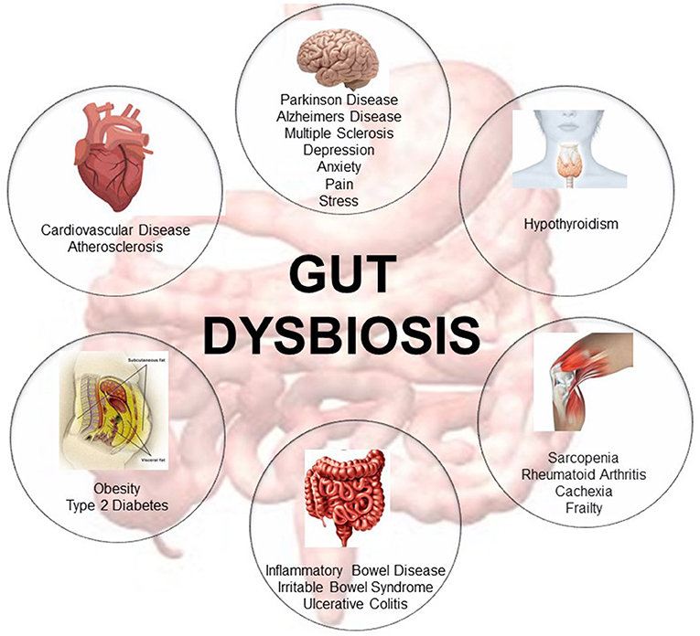
Dysbiosis and metabolic syndrome
Factors, including inflammation caused by gut barrier defects, short-chain fatty acids metabolism, and bile acid metabolism
Evidence indicates that lifestyle interventions (i.e. diet and exercise) for weight loss and metabolic health may depend on the baseline gut microbiota.
This Photo by Unknown author is licensed under CC BY.

Slide 15
Case Study
20 yr old female college student presents with history of PCOS, metabolic syndrome, insulin resistance, anxiety and depression
MEDS: COC, Metformin
ROS:
Acne, food cravings, nausea, stomach cramping, fatigue, diarrhea, suicidal ideation, able to see fat in her stool.
Initial MSQ score 68
Is experiencing sensitivities to foods and food cravings: reports intolerance to dairy, wheat, corn, fatty foods. Her food cravings are for whatever is available to her. Dinner would consist of fast food or campus cafeteria. Skips multiple meals a day
Reports significant stressors and difficulty dealing with stress. Stress of health and family was 8/10, social interaction stress was 5/10
Labs: Low Vitamin D, Low B12, Increase LDL, Increase CRP
GI MAP stool test shows increase hpylori, decrease normal flora, low abundance and diversity, +opportunistic bacteria present.
Bacteria with higher abundance in multiple metabolic disorders compared to healthy subjects tend to be those associated with inflammation

Slide 16
A look into the Microbiome

Slide 19
Integrating best medical practices
Functional Medicine integrates traditional Western medical practices with what are sometimes considered “alternative” or “integrative” medicine
Creating an individualized approach
Prescribed combinations of drugs and/or botanical medicines, supplements, therapeutic diets, detoxification programs, or stress-management techniques
Considering food sensitivity, elimination diet, anti candida diet
This Photo by Unknown author is licensed under CC BY.
This Photo by Unknown author is licensed under CC BY.

Slide 20
5-R Protocol to treating the Microbiome
Remove
Eliminate triggers; improve detoxification
Replace
Restore digestive function
Re-establish
Address the microbiome
Repair
Focus on gut lining, digestion
Rebalance
Connect the gut and the brain for proper nervous system messaging

Slide 21
Treatment:
Remove Gluten
Begin taking mastic gum and anitmicrobial herb blend
Add vitamin D & b12 supplementation
Then reinocculate gut with s. boulardi and beneficial bacteria.

Slide 22
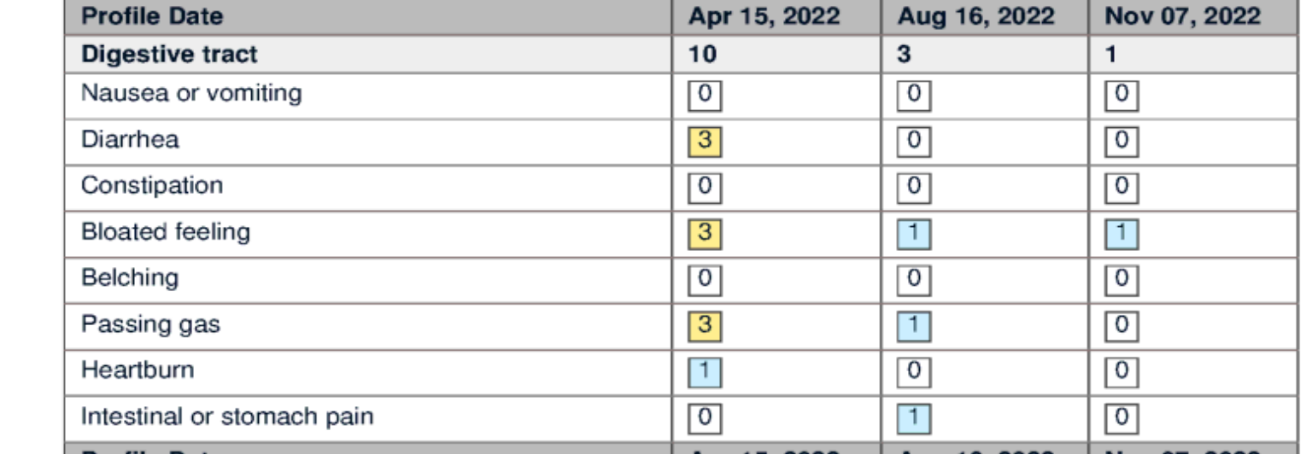
Digestive MSQ Before and After
A significant decrease in symptoms

Slide 23
Follow up:
Mood was stable
Food choices improved, GI symptoms improved. Able to sustain gluten free diet
Continues to feel fatigued, no weight loss
Desired to be off metformin d/t side effects and wanted to add natural agents to help

Slide 24
Butyrate & other SCFA
Anaerobutyricum hallii
Clostridium beijerinckii These strains produce the short-chain fatty acid (SCFA) butyrate which binds to specific receptors within the gut mucosa and stimulates glucagon-like peptide 1 (GLP-1) secretion.
Bifidobacterium infantis (primary fermenter)
Clostridium butyricum Involved with improved digestive health by way of acetate production.
Akkermansia: A keystone species that optimizes the balance of the gut mucin layer and helps to maintain a healthy ecosystem of beneficial bacteria in the microbiome. This strain is linked to improved gut health, and a well-balanced gut microbiome supports a healthy body and healthy weight.

Slide 25
NAC
(NAC) is an amino acid that is a precursor to glutathione, the body’s most powerful antioxidant
NAC limit oxidative damage, improve abnormal pro-inflammatory responses, inhibit lipid accumulation by targeting adipogenic transcription factors (e.g., PPARγ), and improve insulin sensitivity via enhancing the PI3K and AKT pathways in both in vitro and in vivo models of obesity.

Slide 26
A comparison between the effects of metformin and N-acetyl cysteine (NAC)
Method: Study was performed as a randomized double-blind clinical trial on women with diagnosis of PCOS without additional complications. In one group, oral NAC 600 mg, three times a day and in the other group, 500 mg oral metformin, three times a day were prescribed. Duration of treatment was 24 weeks, and after finishing this period of treatment, fasting blood glucose (FBS) and insulin, lipid profile and Homeostasis Model Assessment (HOMA) index were measured (all the blood samples were taken while fasting) and were compared in the two groups.
Conclusion: NAC can improve lipid profile and fasting blood sugar (FBS) and fasting blood insulin better than metformin
This Photo by Unknown author is licensed under CC BY-SA-NC.

Slide 27
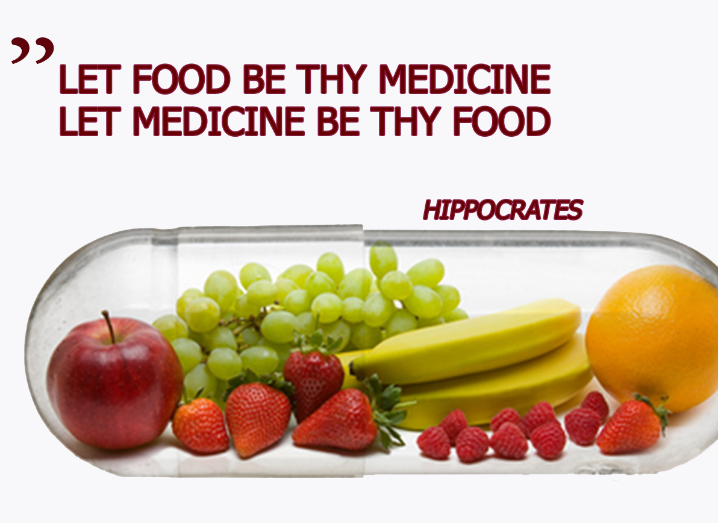
Food As Medicine
We are witnessing food being redefined as "information" that alters cellular function in the post-prandial state
-Michael Stone MD, MS
The earlier we shift to a healthy diet we can decrease the cardiovascular disease burden by 20-30%
Moving patients from the SAD diet (Standard American Diet) to bring in more phytonutrients, more vegetables, more antioxidants, shifting toward a more plant-based diet.
This Photo by Unknown author is licensed under CC BY.

Slide 28
Case Study Conclusion
Root causes of symptoms are resolved and gut health is maintained
Improvement in insulin resistant
Fatigue gone
CRP normalized

Slide 29
Functional Medicine: Why do patients choose it?
Has taken the medication and have no relief or they don’t want to take medication to manage their bowels
They want to understand why they are feeling this way if the tests are negative
Consider functional medicine testing
Exploring their diet at home
What is their lifestyle
Stress, sleep, exposures.

Slide 30
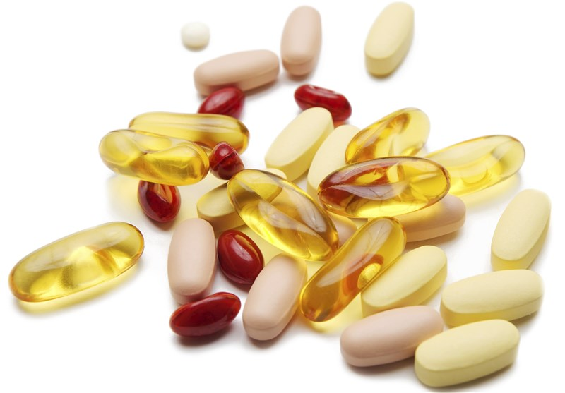
This Photo by Unknown author is licensed under CC BY.
This Photo by Unknown author is licensed under CC BY.

Slide 31
References
Beidelschies M, Alejandro-Rodriguez M, Guo N, et al. Patient outcomes and costs associated with functional medicine-based care in a shared versus individual setting for patients with chronic conditions: a retrospective cohort study. BMJ Open. 2021;11:e048294. doi:1136/bmjopen-2020-048294
Healthy People 2030, U.S. Department of Health and Human Services, Office of Disease Prevention and Health Promotion. Retrieved [date graphic was accessed], from https://health.gov/healthypeople/objectives-and-data/social-determinants-health
Huang, P. L. (2009). A comprehensive definition for metabolic syndrome. Disease models & mechanisms. Retrieved January 31, 2022, from https://www.ncbi.nlm.nih.gov/pmc/articles/PMC2675814/#:~:text=According%20to%20the%20NCEP%20ATP,high%2Ddensity%20lipoprotein%20(HDL)
IFM Website, Cardiovascular lectures with Shilpa Saxena, Michael Stone
N;, J. F. K. M. R. M. S. (2016). A comparison between the effects of metformin and N-acetyl cysteine (NAC) on some metabolic and endocrine characteristics of women with polycystic ovary syndrome. Gynecological endocrinology : the official journal of the International Society of Gynecological Endocrinology. Retrieved January 31, 2022, from
https://pubmed.ncbi.nlm.nih.gov/26654154/
https://www.designsforhealth.com/api/library-assets/journal-article---bacterial-triggers-of-autoimmunity-the-how-and-why-white-paper-brady-d-2019

