Slide 1
Menopause an Integrative Approach
Deidre Arms, BC-APRN, FNP

Slide 2
Disclosures
Co-owner Functional medicine practice
Speaker bureau Astellas

Slide 3
Learning Objectives
Learn Menopause and perimenopausal transition
Learn steroid pathway and hormone roles
Learn risks/benefits to BHRT
Learn alternative solutions to treating menopause

Slide 4
Understanding Menopause
Menopause is a natural transition away from fertility.
It is marked by the end of monthly menstruating (12 months after last menstrual cycle)
Stop releasing egg for fertilization
Ovaries stop giving the body estrogen and progesterone but continue to produce androgens.
Androgen aromatization is the main source of estrogen after menopause

Slide 5
Natural menopause
Is a normal physiological event
Not possible to predict when a woman will experience menopause
There are some associations between age of menopause and certain demographics, health and genetic factors
Estrogen levels decline until they stabilize around 2 years after LMP

Slide 6
Perimenopause
The menopause transition or peri menopause usually begins between 45-55 years of age worldwide.
This transition can last 7-14 years.
Progesterone decreases
Estrogen and progesterone increase and decrease throughout this stage

Slide 7
Hormone steroid pathway
5 main classes of steroid hormones
Progestogens
Glucocorticoids
Mineral corticoids
Androgens
estrogens
Cholesterol is the precursor for all of the steroid hormones

Slide 8
Hormone pathway work by binding and activating receptors
Progestogens
Progesterone
Glucocorticoids
cortisol
Mineral corticoids
aldosterone
Androgens
testosterone
Estrogens
estradiol

Slide 9
Benefits of Estrogen
Growth- estrogen is critical for bone density, muscle mass, and collagen synthesis
• Libido
• Insulin sensitivity
• Support neurotransmitter balance & mood
• Weight management
• Sleep
• Memory & concentration
• Hair & skin health
• Cardiovascular

Slide 10
Signs of low estrogen
Hot flashes
Insomnia
Low sex drive
Mood changes
Brain fog
Vaginal dryness & absence of fertile cervical mucous
Joint pain
Decreased bone mineral density

Slide 11
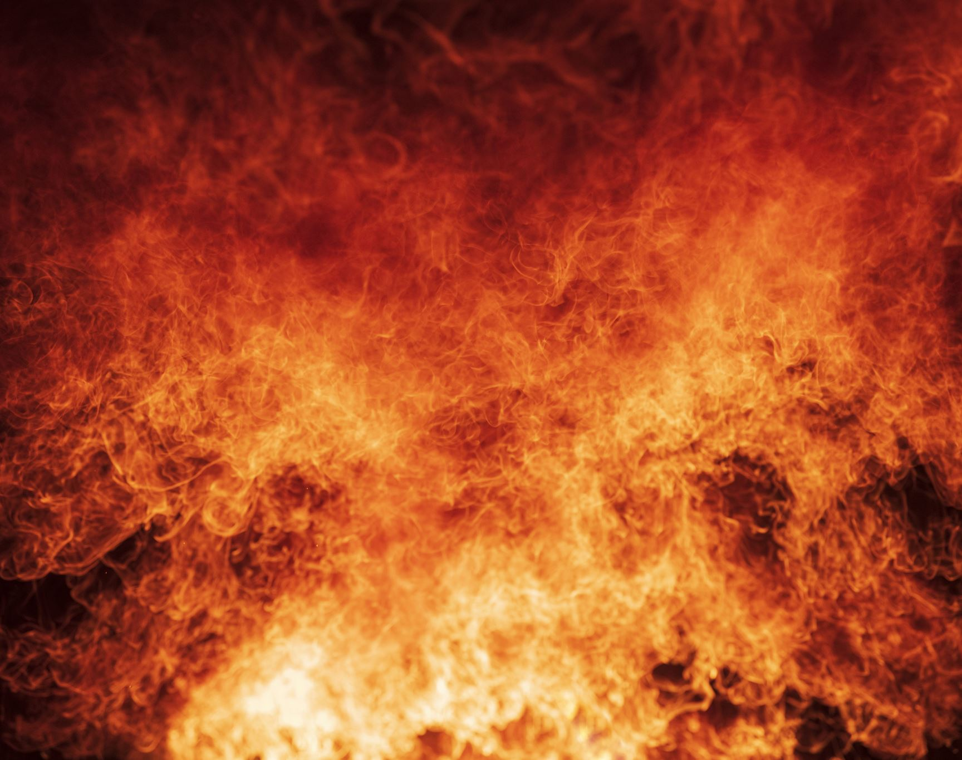
Vasomotor symptoms most common and bothersome symptoms of menopause
Hot flashes
Sudden, intense sensations of heat in the upper body
Lasting 1-5 minutes
Includes sweating, anxiety, heart palpitations
Night sweats
Hot flashes during sleep
May disrupt sleep

Slide 12
Progesterone
Progesterone is an ovarian hormone
Pro-gest: promotes gestation
Most important role is to partner with estrogen to prepare the endometrium for implantation (conception)
E2 and Progesterone working together "brick and mortar"
Estrogen causes growth and proliferation in many tissues, especially the endometrium
Progesterone “Opposes” estrogen stabilizes growth, keeps endometrium from breaking down in the luteal phase

Slide 13
FSH increase
FSH increases, sometimes high enough or long enough to be successful, resulting in irregular cycles and high E2
Lower P, E2 dominance, irregular cycles
FSH helps to signal estrogen
It increases bc your brain is trying to send signals to ovaries

Slide 14
Androgens in Menopause
The major circulating androgens are testosterone and DHEA-s
Androgens are made in the adrenals and ovaries
Androgen concentration is gradual even up to 10 years after menopause.
Postmenopausal oophorectomy reduces T levels by 40%
Adrenals the only sex hormone source post menopause w/ oophorectomy • Postmenopausal E2 made from androgens in circulation
Chronic stress, suppressed HPA axis highly significant for menopausal women
DHEA and Testosterone replacement: • Bone mineral density • Libido • Better mood • Improved sleep • Reduced anxiety

Slide 15
DHEA
Primary estrogen precursor after menopause
Supports muscle & bone health
Supports Sexual function
Supports Brain health
Supports Immune function • Supports cardiovascular health
Androgens like DHEA and testosterone are used as a part of HRT but only vaginal DHEA for vaginal dryness has FDA approval

Slide 16
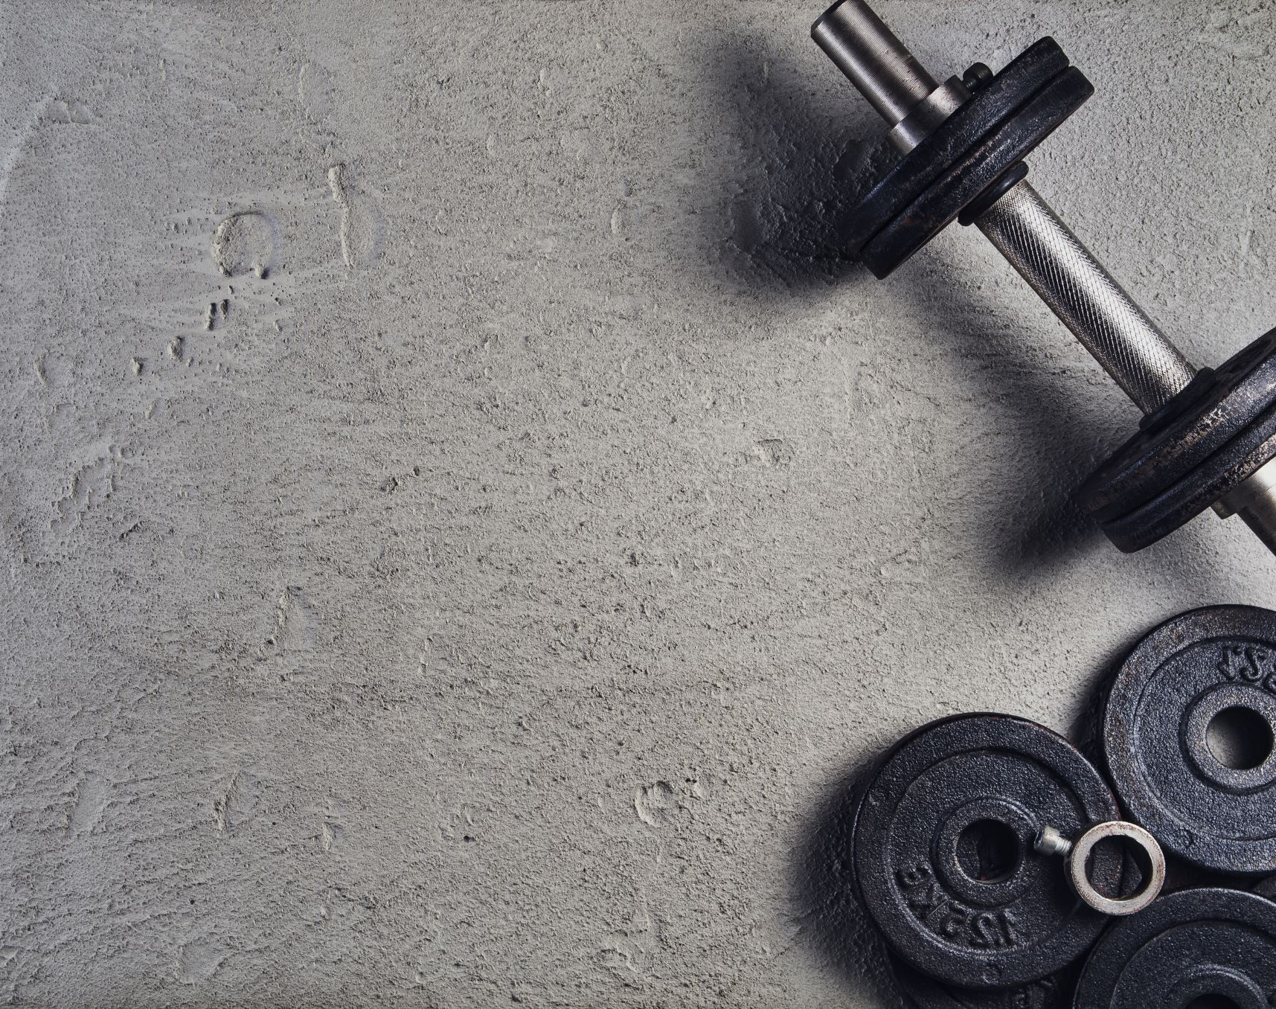
Testosterone
Secondary estrogen precursor after menopause
Growth- muscle mass & stamina • Libido & sexual function
Healthy weight • Healthy bone • Skin, hair health • Mood & memory • Cardiovascular health

Slide 17
Adrenal Health and Menopause
Adrenal production of DHEA is the main source of estrogen in menopause.
In chronic stress your adrenal glands have trouble supporting your stress and inadvertently your hormones.

Slide 18
Recap of what we have learned
Menopause and perimenopause transition
Menopause is a normal physiological event and is determined retrospectively after 12 consecutive months of amenorrhea after final menstruation
Loss of ovarian follicular activity
Perimenopause is the menopause transition in which estrogen and progesterone increase and decrease throughout the stage
Steroid pathway and hormone roles
Cholesterol being the first molecule in the steroid pathway where all hormones are synthesized.
After menopause our estradiol is made in our adrenals

Slide 19
Menopause affects multiple body systems

Slide 20
CNS changes
Sleep disturbances
Mood changes
Anxiety & depression
Changes in cognitive function "brain fog"

Slide 21
Metabolic system
Increased weight gain
Bone mineral
Studies have shown bone loss happens before menopause
Changes in skin and hair
Joint pain

Slide 22
Genitourinary system
Vaginal dryness
Vulvar itching
Urinary symptoms
Burning
Frequency
urgency
UTI
dysparuenia

Slide 23
MENQOL tool
The Menopause Specific Quality of Life Questionnaire (MENQOL) is a validated questionnaire for the assessment of menopausal women’s symptoms and an effective instrument
Self-administered and consists of a total of 29 items in a Likert-scale format
Vasomotor
Psychosocial
Physical
Sexual

Slide 24
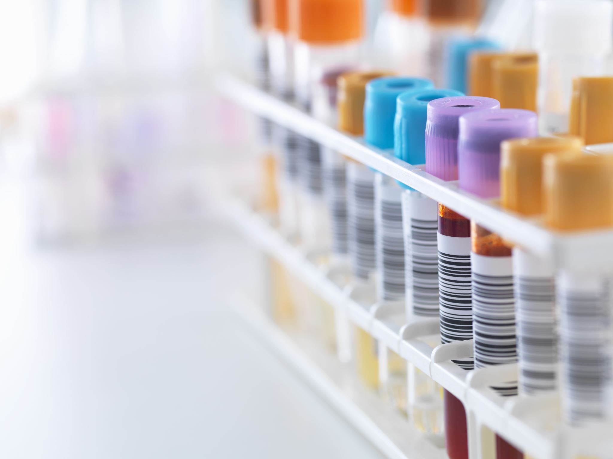
Testing hormones
Foundational basis of basic hormones via serum
Estradiol
Testosterone
Progesterone
Dhea (S)
Cortisol (1 time)

Slide 25
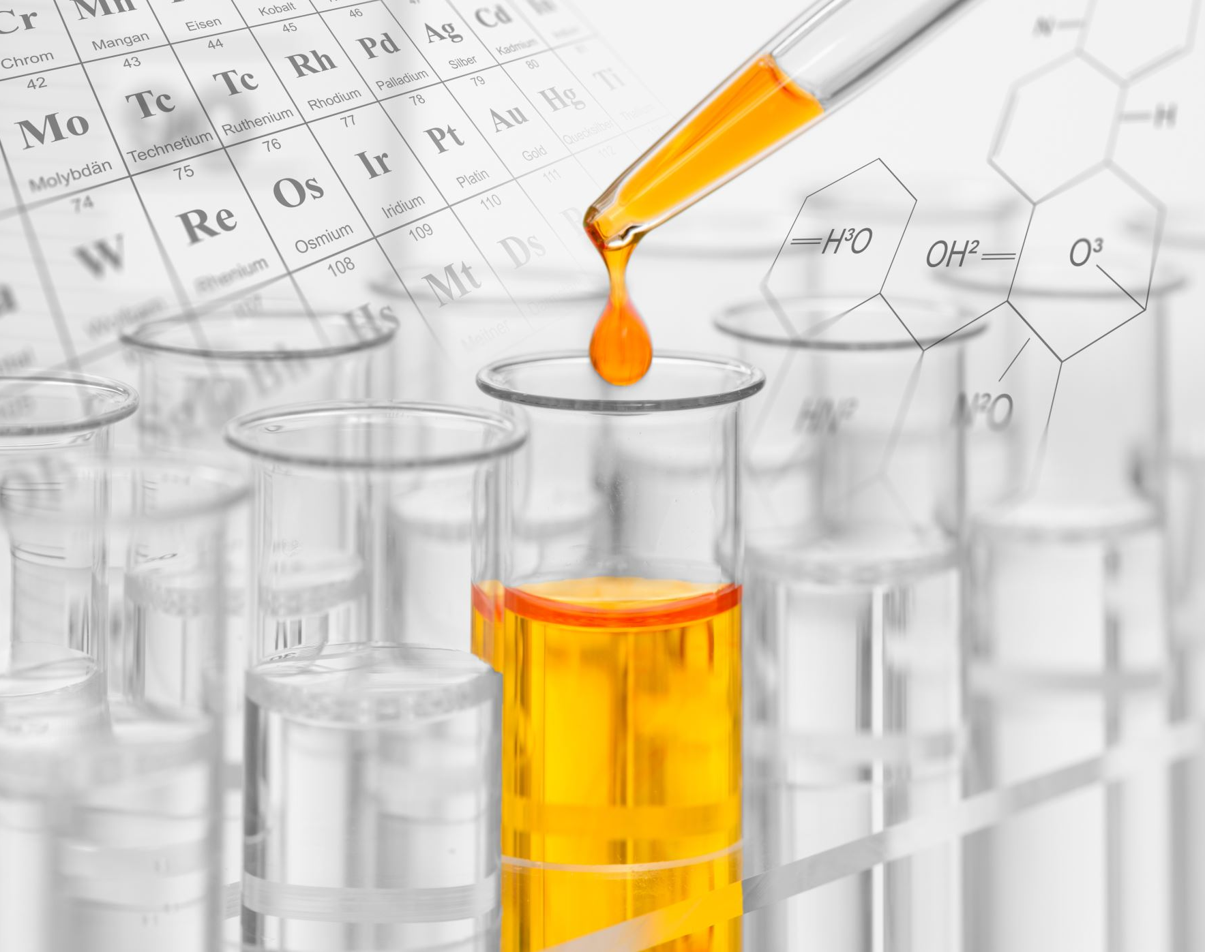
Comprehensive overview of hormones
Dried urine testing
Estrogen metabolites
2-OH
Preferred pathway protective
4-OH
Toxic, DNA damaging
16-OH
Proliferative
Androgen metabolites
DHT
5a/5b testosterone

Slide 26
What happened after WHI study??
Since WHI study in 2002 there has been an 84% reduction in HRT
Subsequent analyses showed that HRT is safe and effective in the appropriate patient however we have not seen an increase in treatment

Slide 27
Understanding bio identical HRT:
The Endocrine Society has defined bioidentical hormones as “compounds that have exactly the same chemical and molecular structure as hormones that are produced in the human body.” This broad definition does not address the manufacturing, source, or delivery methods of the products and thus can include non–FDA-approved custom-compounded products as well as FDA-approved formulations.
HRT considered safe for healthy women <60yr. Who are within 10 yrs menopause

Slide 28
Risks HRT
May increase risks blood clots
heart attacks
Strokes
breast cancer
gall bladder disease
For a woman with a uterus, estrogen increases the chance of getting endometrial cancer, Adding progestin lowers this risk.
DO NOT give unopposed estrogen in women with uterus

Slide 29
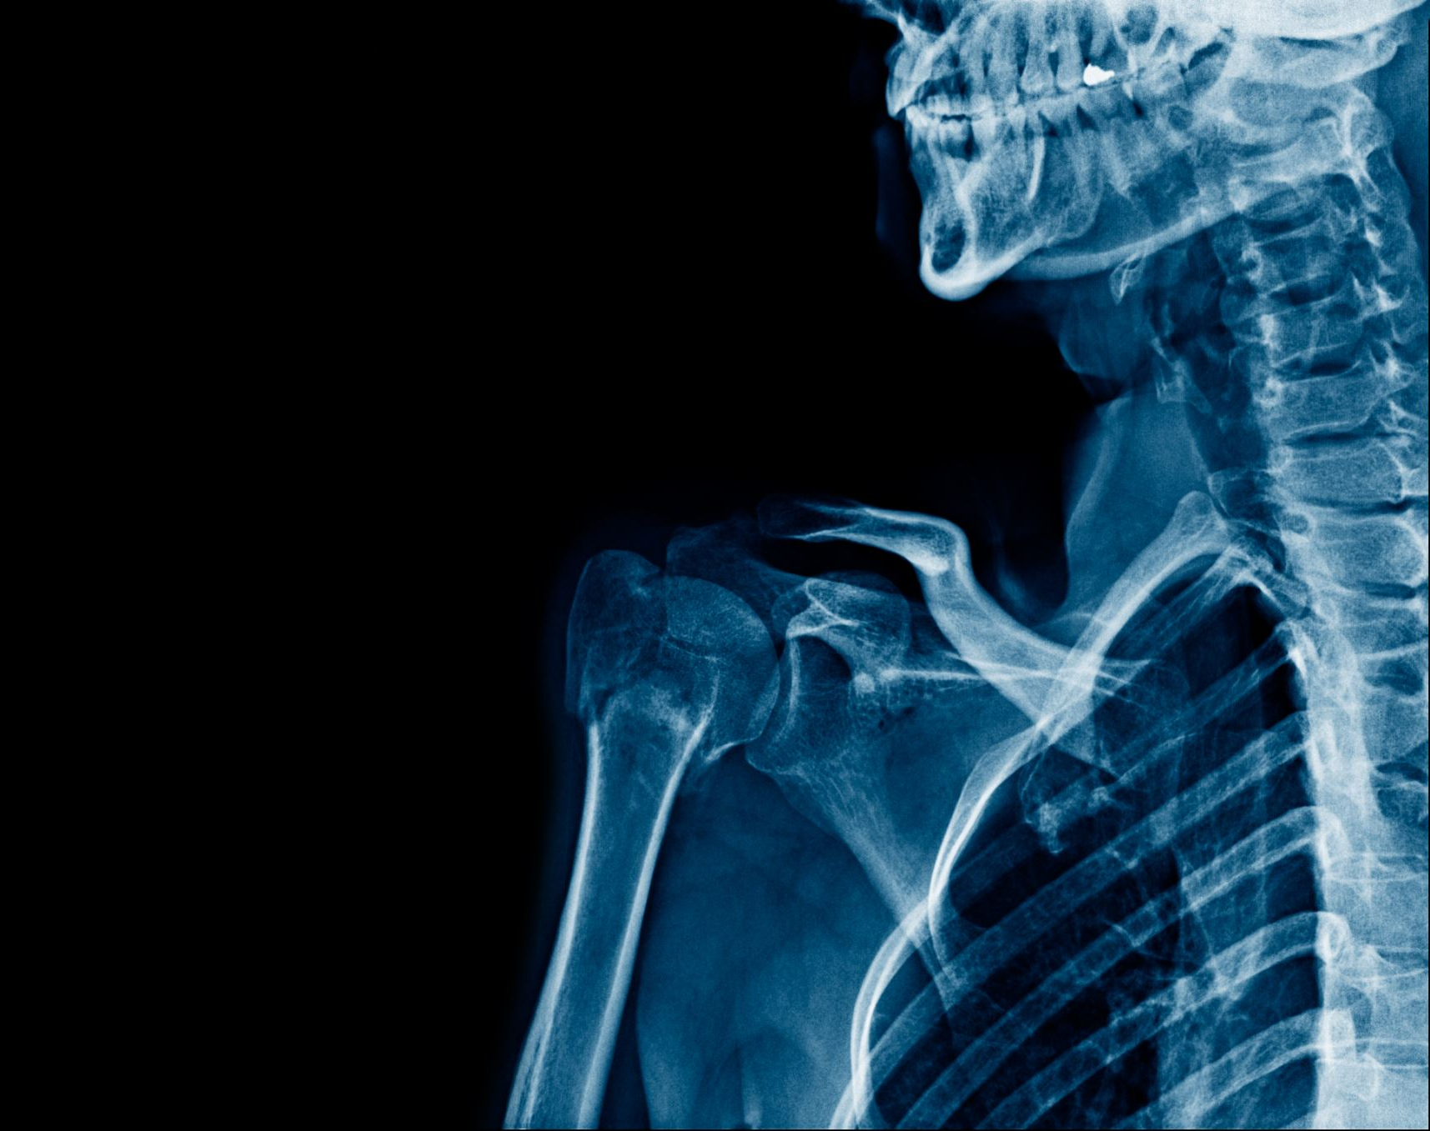
Areas In which HRT has benefits
Vasomotor symptoms
Genitourinary symptoms
Prevention of bone loss
Primary ovarian insufficiency

Slide 30
NAMS hormone positions statement 2022

Slide 31
Conclusion of NAMS position statement
Hormone therapy is recommended as first line therapy for relief of moderate to severe VMS.
Most effective treatment for VMS and GSM
Risks differ for women and taking an individualized approach is recommended
Risks are less favorable for women who start HR 10-20 yrs after menopause

Slide 32
HR replacement: risk/benefit NAMS level I evidence
Various hormone therapy preparations have comparable high efficacy for relieving VMS
Appropriate administration of progestogen is needed to counter the proliferative effects of systemic estrogen on the endometrium.
The absolute risks are reduced for all-cause mortality, fracture, diabetes mellitus, and breast cancer in women aged younger than 60 years
Hormone therapy reduces fracture risk in healthy postmenopausal women.
Women in the WHI and other studies have less joint pain or stiffness with hormone therapy compared with placebo
Hormone therapy significantly reduces the diagnosis of new-onset type 2 DM, but it is not government approved for this indication.

Slide 33
HR risk/benefit NAMS level I evidence
For healthy symptomatic women aged younger than 60 years or within 10 years of menopause onset, the favorable effects of hormone therapy on CHD and all-cause mortality should be considered against potential rare increases in risks of breast cancer, VTE, and stroke.
The risk of breast cancer related to hormone therapy use is low, with estimates indicating a rare occurrence
(less than one additional case per 1,000 women per year of hormone therapy use or three additional cases per 1,000 women when used for 5 years)

Slide 34
HRT replacement and DMII, Insulin resistance improvement
N-46 POSTMENOPAUSAL women with DM, insulin resistance dx. HOMA-IR to evaluate IR.
results show that women taking oral HRT are more insulin sensitive than non-hormone users.

Slide 35
NAMS non hormonal statement 2023
For women who are not good candidates for hormone therapy because of contraindications (eg, estrogen-dependent cancers or cardiovascular disease) or personal preference, it is important for healthcare professionals to be well informed about nonhormone treatment options for reducing vasomotor symptoms that are supported by the evidence.

Slide 36
NAMS non hormonal statement 2023
Evidence-based review of the literature resulted in several nonhormone options for the treatment of vasomotor symptoms
Recommended:
Cognitive-behavioral therapy
clinical hypnosis,
selective serotonin reuptake inhibitors/ serotonin-norepinephrine reuptake inhibitors
SSRIs and SNRIs are associated with mild to moderate improvements in VMS
Gabapentin
900 mg (300 mg three times/d) show that this has improved the frequency and severity of VMS.
fezolinetant

Slide 37
Neurokinin B antagonists
First in class, new non hormonal treatment
KNDy neuron ( kisspeptin, neurokinin B, and dynorphin)
After declines in circulating levels of estradiol across the menopause transition, VMS are triggered by hyperactivity of the KNDy neuron plexus, resulting in hypersecretion of neurokinin B.
Hypersecretion of neurokinin B from the KNDy neurons onto the adjacent thermoregulatory center in the hypothalamus causes disruption of temperature control and the occurrence of VMS

Slide 38
Non hormonal modalities
Acupuncture
Stellate ganglion blockade has emerged as a potential treatment option for VMS
exact MOA of stellate ganglion blockade on VMS remains unclear
CBT has been shown to reduce the bother and interference associated with VMS.
Clinical hypnosis has been shown to reduce VMS frequency and severity.

Slide 39
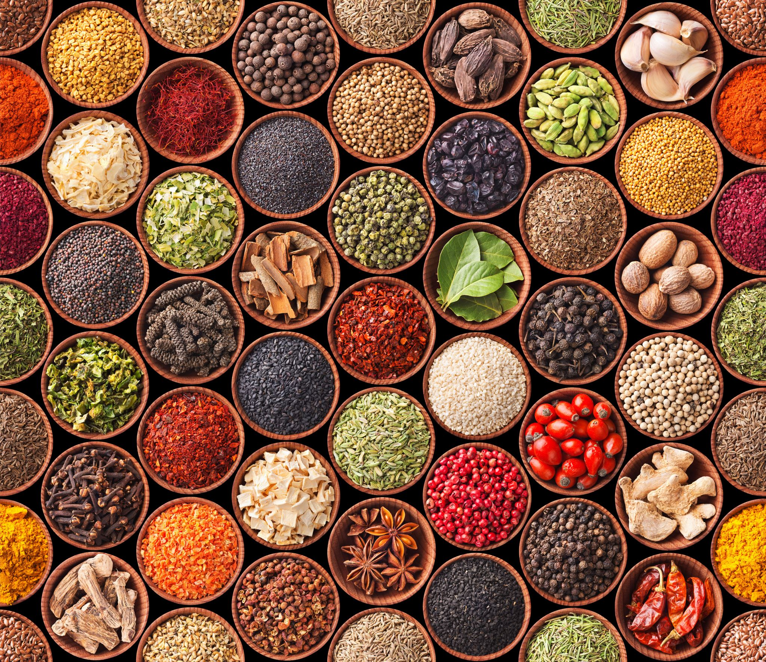
Positive aspects of herbal medicine
Menopause causes various complications; hence, searching for a treatment with less side effects and reasonable effectiveness for menopausal problems seems important and necessary.
Herbal medicines have less side effects than chemical medications.
limited of inconsistence scientific evidence

Slide 40
Menopausal tips
Natural therapies can help ease the transition into menopause
Keep alcohol to a minimum (red wine worst, vodka least)
Increase fiber: flaxseed 2tbsp/day can support healthy estrogen
Maca: mood and sex drive 3g/day for libido
Ashwagandha: sleep, stress various dosages up to 6g/day
Adaptogens
Pueraria mirifica: hot flashes, atrophy.

Slide 41
Black Cohosh (Actaea Racemosa):
Research supports the potential for black cohosh to help during
A long-standing hypothesis is that the triterpenes in black cohosh may have mild estrogenic activity with the potential to selectively inhibit LH secretion without affecting FSH
40 mg/day dosing
most purchased botanical for menopause symptoms

Slide 42
Chaste Tree Extract
Long history of use for balancing estrogen and progesterone levels in individuals to support menopause
180-200mg 1-2x/day
Takes 8-12 weeks to fully know if working
d/c if worsening depression

Slide 43
Diindolylmethane (DIM)
Derived from the primary plant indole found in cruciferous vegetables, indole-3-carbinol
DIM supports the expression of the enzyme CYP1A1 over other enzymes in the CYP family, which play a role in estrogen metabolism.
1 year's supplementation with DIM 100 mg × 1/day in BRCA carriers was associated with a significant decline in fibroglandular breast tissue on MRI.
100-200 mg/day

Slide 44
Chinese (Siberian Rhubarb)
Hot flashes, night sweats
Complex dosing best to use product and follow dosing instructions
Avoid if E+ CA
has been used in Germany for more than 20 years

Slide 45
Vitamin E
influences postmenopausal symptoms like hot flashes and vaginal changes.
It might be used as an alternative compound in symptomatic patients with contraindications to estrogens
500 IU/day
Do not exceed dosing and avoid in smokers

Slide 46
Treating Vaginal Dryness
Vitamin E vaginally
Hyaluronic acid vaginally
Vaginal DHEA
Sex more often
Vaginal estradiol
Pueraria mirifica 25-100mg/day for at least 6 months

Slide 47
Undertreatment of menopausal symptoms
Menopause symptoms can disrupt a women’s overall quality of life and last a mean duration of 7 to 9 years, longer in some women
Despite safety and efficacy of treatments women remain undertreated

Slide 48
In conclusion
Recommend taking an individualized approach to treatment of menopause
Consider contraindications and patient preference when discussing with patient treatment options
Helping women optimize benefits of healthy hormones is vital
Each woman presents with a unique hormone profile, health history and wellness path that should be considered

Slide 49
"The changes, the highs and lows and the hormonal shifts, there is power in that" Michelle Obama
This Photo by Unknown author is licensed under CC BY-SA.

Slide 50
References
Bitoska, I., Krstevska, B., Milenkovic, T., Subeska-Stratrova, S., Petrovski, G., Jovanovska Mishevska, S., Ahmeti, I., & Todorova, B. (2016). Effects of hormone replacement therapy on insulin resistance in postmenopausal diabetic women. Open Access Macedonian Journal of Medical Sciences, 4(1), 83–88. https://doi.org/10.3889/oamjms.2016.024
Brzozowska M, Lewiński A. Changes of androgens levels in menopausal women. Prz Menopauzalny. 2020 Dec;19(4):151-154. doi: 10.5114/pm.2020.101941. Epub 2021 Jan 7. PMID: 33488324; PMCID: PMC7812536.
Commissioner, O. of the. (n.d.). U.S. Food and Drug Administration. https://www.fda.gov/
Feduniw S, Korczyńska L, Górski K, Zgliczyńska M, Bączkowska M, Byrczak M, Kociuba J, Ali M, Ciebiera M. The Effect of Vitamin E Supplementation in Postmenopausal Women-A Systematic Review. Nutrients. 2022 Dec 29;15(1):160. doi: 10.3390/nu15010160. PMID: 36615817; PMCID: PMC9824658.
Masjoudi M, et al. Severity and Frequency of Menopausal Symptoms in Middle Aged Women, Rasht, Iran. J Clin Diagn Res. 2017;11(8):Qc17-qc21.
Naseri R, Farnia V, Yazdchi K, Alikhani M, Basanj B, Salemi S. Comparison of Vitex agnus-castus Extracts with Placebo in Reducing Menopausal Symptoms: A Randomized Double-Blind Study. Korean J Fam Med. 2019 Nov;40(6):362-367. doi: 10.4082/kjfm.18.0067. Epub 2019 May 9. PMID: 31067851; PMCID: PMC6887765.
Regidor PA. Progesterone in Peri- and Postmenopause: A Review. Geburtshilfe Frauenheilkd. 2014 Nov;74(11):995-1002. doi: 10.1055/s-0034-1383297. PMID: 25484373; PMCID: PMC4245250.
Rinat Yerushalmi, Sharon Bargil, Yaara Ber, Rachel Ozlavo, Tuval Sivan, Yael Rapson, Adi Pomerantz, Daliah Tsoref, Eran Sharon, Opher Caspi, Ahuvah Grubsrein, David Margel, 3,3-Diindolylmethane (DIM): a nutritional intervention and its impact on breast density in healthy BRCA carriers. A prospective clinical trial, Carcinogenesis, Volume 41, Issue 10, October 2020, Pages 1395–1401, https://doi.org/10.1093/carcin/bgaa050
Santoro N, Randolph JF Jr. Reproductive hormones and the menopause transition. Obstet Gynecol Clin North Am. 2011 Sep;38(3):455-66. doi: 10.1016/j.ogc.2011.05.004. PMID: 21961713; PMCID: PMC3197715.
The 2022 hormone therapy position statement of The North American Menopause Society. (2022). Menopause, 29(7), 767–794. https://doi.org/10.1097/gme.0000000000002028
The 2023 nonhormone therapy position statement of The North American Menopause Society. (2023). PubMed, 30(6), 573–590. https://doi.org/10.1097/gme.0000000000002200
Ursin, G., London, S., Stanczyk, F. Z., Gentzschein, E., Paganini-Hill, A., Ross, R. K., & Pike, M. C. (1997). A pilot study of urinary estrogen metabolites (16alpha-OHE1 and 2-OHE1) in postmenopausal women with and without breast cancer. Environmental Health Perspectives, 105(suppl 3), 601–605. https://doi.org/10.1289/ehp.97105s3601
Vollmer G, Papke A, Zierau O. Treatment of menopausal symptoms by an extract from the roots of rhapontic rhubarb: the role of estrogen receptors. Chin Med. 2010 Feb 19;5:7. doi: 10.1186/1749-8546-5-7. PMID: 20170496; PMCID: PMC2837008.

