Slide 1
Preoperative cardiovascular risk assessment and perioperative management for noncardiac surgery
Andrew C. Stiff, M.D.

Slide 2
“Cardiac Clearance”

Slide 3
Guidelines
First perioperative management guidelines developed in 1996
4 total updates since that time, last being in 2014
Most recent update seeks to incorporate new data since 2014 and try to simplify perioperative management as well as cardiac risk
Most recent guidelines September 2024

Slide 4
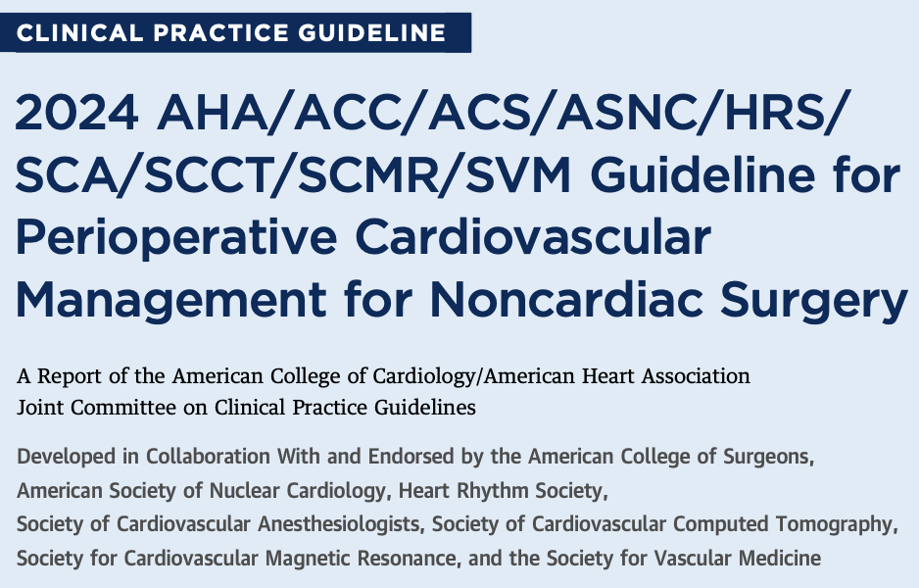

Slide 5
Guidelines
Class 1 Strong
01
Class 2a Moderate
02
Class 2b Weak
03
Class 3 No benefit
04
Class 3
HARM
05
Notes:
LOE

Slide 6
Timing | Definition
Emergency | Immediate threat to life or limb without surgical intervention, where there is very limited or no time for preoperative clinical evaluation, typically <2 h.
Urgent | Threat to life or limb without surgical intervention, where there may be time for preoperative clinical evaluation to allow interventions that could reduce risk of MACE or other postoperative complications, typically ≥2 to <24 h.
Time-sensitive | Surgery may be delayed up to 3 mo to allow for preoperative evaluation and management without negatively impacting outcomes.
Elective | The surgical procedure can be delayed to permit a complete preoperative evaluation and appropriate management.

Slide 7
Cardiac risk
Low
Combined surgical and patient characteristics predict a low risk of MACE <1%
High
Combined surgical and patient characteristics predict an elevated risk of MACE >1%
Choose your favorite risk calculator, RCRI, DASI (2a recommendation)
Notes:
Best used for patients that do not need other stuff done
No data for one of the other
Few studies for which is better

Slide 8
What’s new?
Perioperative
Risk assessment
Systematic approach to perioperative risk assessment
Very selective use of stress testing
Utilization of biomarkers
Medications
SGLT2i
OAC
Notes:
Biomarkes can predict post op death and mi

Slide 9
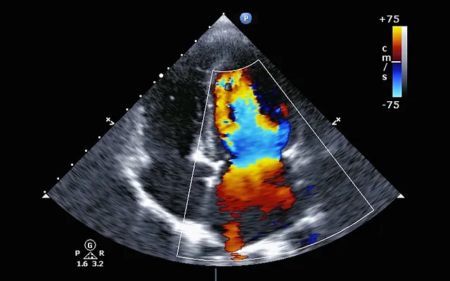

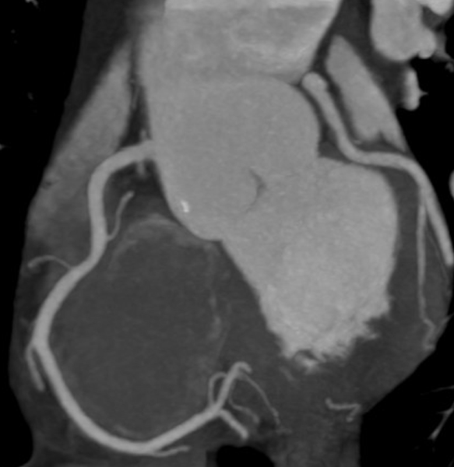
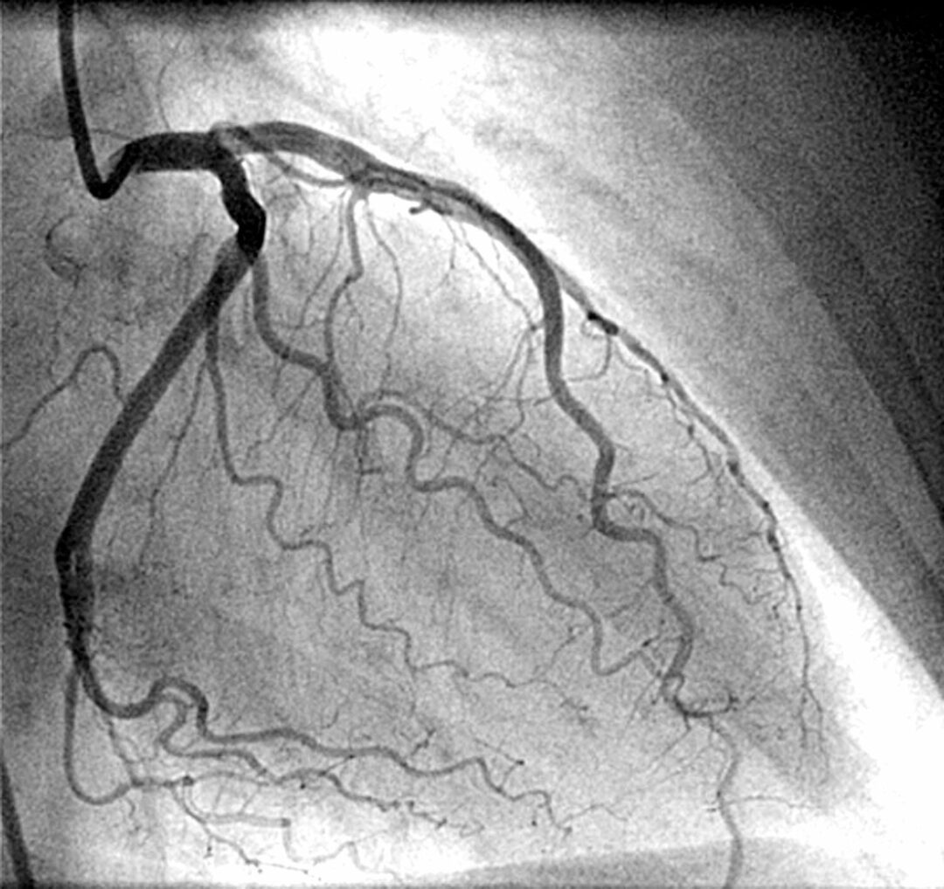
Preoperative cardiac testing
ECG
Echo
Stress Testing
Coronary CTA
Coronary angiogram
Notes:
More controversial
just

Slide 10
EKG
COR | LOE | Recommendations
2a | B-NR | For patients with known coronary heart disease, significant arrhythmia, peripheral arterial disease, cerebrovascular disease, other significant structural heart disease, or symptoms* of CVD undergoing elevated-risk surgery, a preoperative resting 12-lead electrocardiogram (ECG) is reasonable to establish a preoperative baseline and guide perioperative management.
2a | B-NR | In patients undergoing NCS with a preoperative ECG exhibiting new abnormalities†, further evaluation is reasonable to refine assessment of cardiovascular risk.
2b | B-NR | For asymptomatic patients undergoing elevated-risk surgeries without known CVD, a preoperative resting 12-lead ECG may be considered to establish a baseline and guide perioperative management.
3: No benefit | B-NR | For asymptomatic patients undergoing low-risk surgical procedures, a routine preoperative resting 12-lead ECG is not recommended to improve outcomes.
Notes:
Just the way we do it not good enough anymore
Not what the data shows
3b no data that it improves outcomes

Slide 11
Echo
COR | LOE | Recommendations
1 | B-NR | In patients undergoing NCS with new dyspnea, physical examination findings of HF, or suspected new/worsening ventricular dysfunction, it is recommended to perform preoperative evaluation of LV function to help guide perioperative management.
2a | C-LD | In patients with a known diagnosis of HF with worsening dyspnea or other change in clinical status undergoing NCS, preoperative assessment of LV function is reasonable to help guide perioperative management.
3: No Benefit | B-NR | In asymptomatic and clinically stable patients undergoing NCS, routine preoperative evaluation of LV function is not recommended due to lack of benefit.
Notes:
CHF class I
Worse symptoms its ok
Do not do with no symptoms
2a- can do if the BNP is elevated, that’s where biomarkers come into play

Slide 12
Stress Testing
COR | LOE | Recommendations
2b | B-NR | For patients undergoing elevated-risk NCS with poor or unknown functional capacity and elevated risk for perioperative cardiovascular events based on a validated risk tool, stress testing may be considered to evaluate for inducible myocardial ischemia.
3: No benefit | B-R | In patients who are at low risk for perioperative cardiovascular events, have adequate* functional capacity with stable symptoms, or who are undergoing low-risk procedures, routine stress testing before NCS is not recommended due to lack of benefit.
No Class 1 indications for stress testing
Notes:
Really reserved for patients with poor functional status as we all know
If need to do it exerciseis preferred
More data coming on PET and other modalities like mri stress testing
Mod to high risk can predit post events
Normal is low risk
Fixed defects
Jury is still out
More data
1.
Diagnosis of adult patients with intermediate pretest probability of CAD.
2.
Prognostic assessment of patients undergoing initial evaluation for suspected or proven CAD; evaluation of subjects with significant change in clinical status.
3.
Demonstration of proof of myocardial ischemia before coronary revascularization.
4.
Evaluation of adequacy of medical therapy; prognostic assessment after an acute coronary syndrome (if recent evaluation unavailable).
Class IIa
Evaluation of exercise capacity when subjective assessment is unreliable.
Class IIb
1.
Diagnosis of CAD patients with high or low pretest probability: those with resting ST depression less than 1 mm, those taking digitalis therapy, or those with ECG criteria for left ventricular hypertrophy.
2.
Detection of restenosis in high-risk asymptomatic subjects within the initial months after percutaneous coronary intervention (PCI).
Class III
1.
For exercise stress testing, diagnosis of patients with resting ECG abnormalities that preclude adequate assessment, e.g., pre-excitation syndrome, electronically paced ventricular rhythm, rest ST depression greater than 1 mm, or left bundle-branch block.
2.
Severe comorbidity likely to limit life expectancy or candidacy for revascularization.
3.
Routine screening of asymptomatic men or women.
4.
Investigation of isolated ectopic beats in young patients

Slide 13
Coronary CTA
COR | LOE | Recommendations
2b | B-NR | For patients undergoing elevated-risk surgery with poor* or unknown functional capacity, and elevated risk for perioperative cardiovascular events based on a validated risk tool, coronary computed tomography angiography (CCTA) for the detection of high-risk coronary anatomy† may be considered.
3: No benefit | B-NR | In patients who are at low risk for perioperative cardiovascular events, have adequate* functional capacity with stable symptoms, or who are undergoing low-risk procedures, routine CCTA before NCS is not recommended due to lack of benefit.
Notes:
No benefit if low risk

Slide 14
Invasive Coronary Angiography
COR | LOE | Recommendation
3: No benefit | C-LD | In patients undergoing NCS, routine preoperative invasive coronary angiography (ICA) is not recommended to improve perioperative outcomes.
Notes:
Old school
No benefit to this
CARP trial showed no benefit to pci prior to surgery rather than no stents
Class IIa
1.
Multiple markers of intermediate clinical risk† and planned vascular surgery (noninvasive testing should be considered first).
2.
Moderate to large ischemia on noninvasive testing but without high-risk features and lower left ventricular ejection fraction.
3.
Nondiagnostic noninvasive test results in patients at intermediate clinical risk† undergoing high-risk* noncardiac surgery.
4.
Urgent noncardiac surgery while convalescing from acute MI

Slide 15
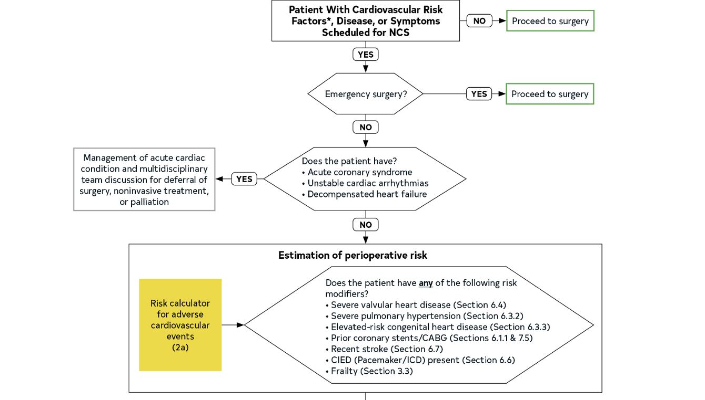
Risk Modifiers
Notes:
Emergecny proceed
Decomeposnated conditions pause
No emergency surgery?→ take a look at patients baseline risk.
Use a risk calculator RCRI the most commonly used
Cardiac risk modifiers listed as above as risk calcuators don’t adequately address these issues

Slide 16
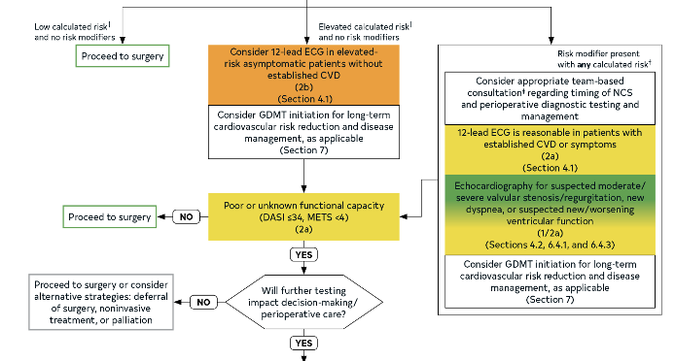
Notes:
Low calculated risk and none of the risk modifiers?
Proceed to surgery
Elevated cardiac risk and no risk modifiers
Consider ECG and GDMT prior to next step
Risk modifier present with any calculated risk
Additional workup may be necessary
Elevated risk consider ecg, biomarkers, etc
Poor functional capacity, consider further testing
At this point patient has probably seen cardiology

Slide 17
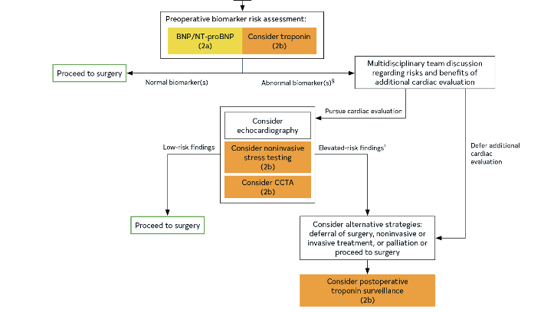
Notes:
Differences
Biomarkers
Stress testing is further down the algorithm
Major change
Demphasize dedicatec cardiac testing
GUIDELINES SAY HERE IF BIOMARKERS NORMAL CAN PROCEED TO SURGERY!!!
ABNORMAL, HAVE ANOTHER DISCUSSION
TAKE HOME POINT- WAY DOWN THE LIST CONSIDER DOING IMAGING

Slide 18



Slide 19
Preoperative assessment; keep it simple
No risk factors, emergency surgery, or low cardiac risk with good functional status?
Proceed to surgery
Low risk surgery/procedure (endoscopy, lap chole, etc)
Proceed to surgery
Presence of patient modifiers
Consider additional workup
Frailty and poor functional status
Consider additional workup
Cardiac symptoms
Routine workup/management regardless of their need for surgery
Biomarkers
Routine coronary intervention for SIHD prior to surgery
Not recommended (3)
Left main (2a)
Recent CVA or TIA
Delay surgery 3 months
Notes:
Revasc to “reduce events”

Slide 20
Perioperative medication management
Statin
Continue to reduce MACE (1b)
Statin naïve, if patient meets guidelines based on ascvd history of 10 year risk, initiate statin (1b)
Renin-Angiotensin-Aldosterone System Inhibitors
If on for chronic HFrEF, continue (2a)
In select patients undergoing high risk surgery reasonable to hold for 24 hours (2b)
Poor surgical outcomes if systolic >180 mm Hg
Clonidine- Do not begin perioperatively (3b)
Antiplatelets
Timing is important
Prior CAD with remote pci continue aspirin
ACS with recent coronary intervention recommendations remain to continue for 12 months to minimize perioperative MACE (1)
PCI for chronic SIHD for elective surgery, reasonable to delay surgery 6 months (2a)
Other scenarios time sensitive surgery, 3 months (2b)
Notes:
People with chf don’t do well
Keep meds on as much as u can except for the sglt2
RAAS- cv surgery stops

Slide 21
Perioperative medication management
Beta Blockers
Patients on stable beta blockers should be continued (1b)
New indication for bb? OK to begin if far enough out from surgery, >7 days (2b)
In patients with no immediate need for beta blocker, they should not be initiated on the day of surgery due to increased post operative mortality (3b HARM)
Oral anticoagulation
Not high risk, ok to hold
High risk?
Recent VTE (<3 months)
AF--> Elevated CHADSVASC >7 or score 5-6 with recent neuro event
AF with rheumatic heart disease
Mechanical mitral valve
Any mechanical vale with recent TIA/CA
Caged ball or tilting disc valve
LV thrombus (<3 months)
Recent cardioembolic stroke (<3 months)
Severe thrombophilia
Active cancer with high VTE risk
Notes:
BB need to have adequate time, 7 days or more prior if new good indication
Don’t stop if stably on drug
Deficiency of protein C, protein S, or antithrombin; homozygous factor V Leiden or prothrombin gene G20210A mutation or double heterozygous for each mutation, multiple thrombophilias.
Active cancer associated with high VTE risk
LV thrombus (within last 3 mo)
Severe thrombophilia‡
Antiphospholipid antibodies

Slide 22
Bridging?
2a | C-LD | In patients with CVD and high thrombotic risk (Table 14) undergoing NCS where interruption of vitamin K antagonist (VKA) is required, preoperative bridging with parenteral heparin can be effective to reduce thromboembolic risk.
3: Harm | C-LD | In most patients with CVD who are undergoing elective NCS where OAC interruption is warranted, routine periprocedural bridging is not recommended due to increased bleeding risk.
OAC Resumption
2a | C-LD | In patients with preoperative OAC interruption, resumption of OAC is reasonable after hemostasis is achieved.

Slide 23
Perioperative medication management
SGLT2i should be discontinued 3-4 days prior to non cardiac surgery to reduce risk of perioperative metabolic acidosis (1C)
OK to continue metformin (2A)

Slide 24
Take home messages
1. Stepwise approach.
2. Cardiovascular screening and treatment of patients undergoing NCS should adhere to the same indications as nonsurgical patient.
3. Stress testing should be performed judiciously in patients undergoing NCS and only in patients in whom testing would be appropriate independent of planned surgery.
4. Team-based care.
5. SGLT2i should be discontinued 3 to 4 days before surgery to minimize the risk of perioperative ketoacidosis.
6. Patients with newly diagnosed atrial fibrillation (AF) identified during or after NCS have an increased risk of stroke. These patients should be followed closely.
7. Bridge only in high risk patients.
Notes:
Top Take-Home Messages
The following Top Take-Home Messages are taken directly from the AHA/ACC/Multisociety Perioperative Guideline. The ACC Perioperative Guideline Dissemination Workgroup selected 3 of the Top Take-Home Messages (in bold) as key themes for this Guideline-at-a-Glance as they represent the most impactful recommendation changes compared to previous guidelines and address known gaps in clinical practice.
1.A stepwise approach to perioperative cardiac assessment assists clinicians in determining when surgery should proceed or when a pause for further evaluation is warranted.
2.Cardiovascular screening and treatment of patients undergoing NCS should adhere to the same indications as nonsurgical patients, carefully timed to avoid delays in surgery and chosen in ways to avoid overscreening and overtreatment.
3.Stress testing should be performed judiciously in patients undergoing NCS, especially those at lower risk, and only in patients in whom testing would be appropriate independent of planned surgery.
4.Team-based care should be emphasized when managing patients with complex anatomy or unstable cardiovascular disease.
5.New therapies for management of diabetes, heart failure, and obesity have significant perioperative implications. Sodium-glucose cotransporter 2 inhibitors (SGLT2i) should be discontinued 3 to 4 days before surgery to minimize the risk of perioperative ketoacidosis associated with their use.
6.Myocardial injury after noncardiac surgery (MINS) is a newly identified disease process that should not be ignored because it portends real consequences for affected patients.
7.Patients with newly diagnosed atrial fibrillation (AF) identified during or after NCS have an increased risk of stroke. These patients should be followed closely after surgery to treat reversible causes of arrhythmia and to assess the need for rhythm control and long-term anticoagulation.
8.Perioperative bridging of oral anticoagulant therapy should be used selectively only in those patients at highest risk for thrombotic complications and is not recommended in the majority of cases.
9.In patients with unexplained hemodynamic instability and when clinical expertise is available, emergency focused cardiac ultrasound can be used for perioperative evaluation; however, focused cardiac ultrasound should not replace comprehensive transthoracic echocardiography

Slide 25
References
Thompson et al. 2024 AHA/ACC/ACS/ASNC/HRS/SCA/SCCT/SCMR/SVM Guideline for Perioperative Cardiovascular Management for Noncardiac Surgery: A Report of the American College of Cardiology/American Heart Association Joint Committee on Clinical Practice Guidelines. JACC. 2024 Nov, 84 (19) 1869–1969.
UofL Dept. of Medicine Grand Rounds. University of Louisville Department of Medicine. Oct. 10, 2024.
AHA Science. 2024 Guideline for Perioperative Cardiovascular Management for Noncardiac Surgery. Sep. 24, 2024.
Bhave SD, et al. JACC. 2024; 10.1016/j.jacc.2024.08.018

Slide 26








If questions feel free to call your friendly FHP cardiologist
If questions feel free call your friendly FHP cardiologist!

