Slide 1
Management of Venous Thromboembolism
Jason André, MD Cardiovascular Symposium November 13th, 2024

Slide 2
OBJECTIVES
Why VTE Important
When To Be Concerned About VTE
Medical Management Of VTE
When Do You Need Vascular Surgery
What We Provide At Fairfield Medical Center

Slide 3
WHY IS VTE IMPORTANT
900,000 case of VTE yearly (0.1% of population)
Patients we see are higher risk
Less active (obese?)
Cancer
Surgery
COVID-19
60,000-100,000 patients die each year from VTE
Center for Disease Control May 15, 2024
BUT WHAT HAPPENS TO THE PATIENTS WHO SURVIVE

Slide 4
POST THROMBOTIC SYNDROME
20-50% of patients develop PTS
Studies with longer follow up found even higher rates over time
5-10% develop severe PTS
Venous ulcers
Annual healthcare cost for PTS patients $7000

Slide 5
POST THROMBOTIC SYNDROME
Symptoms | Clinical Signs
Pain | Edema
Sensation of swelling | Telangiectasia
Cramps | Venous dilatation/ectasia
Heaviness | Varicose veins
Fatigue | Redness
Itching | Cyanosis
Pruritis | Hyperpigmentation
Bursting pain | Eczema
Venous claudication | Pain during calf compression
 | Lipodermatosclerosis
 | Atrophie blanche
 | Open or healed ulcers

Slide 6
POST PULMONARY EMBOLISM SYNDROME
Not as well studied
Broken down into two categories
Chronic Thromboembolic Pulmonary Disease (CTEPD)
Chronic Thromboembolic Pulmonary Hypertension (CTEPH)
Persistent dyspnea, cardiac dysfunction, pulmonary hypertension
Up to 3% of patients who survive from PE will develop CTEPH

Slide 7



Long-term Consequences of PE: “Post-PE Syndrome”
Meta-analysis including nearly 3,700 PE patients
(18-month median follow-up):
PERT Consortium 2020 data
18%
ongoing RV dysfunction¹
11%
moderate or severe functional impairment (NYHA III-IV)¹
5th percentile
6-minute walk test scores (vs. population norms) ¹
24%
30-day all-cause readmission²
“Mechanistically, rapid unloading of the right ventricle and increased thrombus clearance may prevent maladaptive cardiopulmonary remodeling.”¹
Sista AK, et al. Persistent right ventricular dysfunction, functional capacity limitation, exercise intolerance, and quality of life impairment following pulmonary embolism: Systematic review with meta-analysis. Vasc Med. 2017 Feb;22(1):37-43
PERT Consortium Registry Data. Interim results on 3,400 Patients presented at PERT Symposium October 2020
Notes:
Keep all content

Slide 8
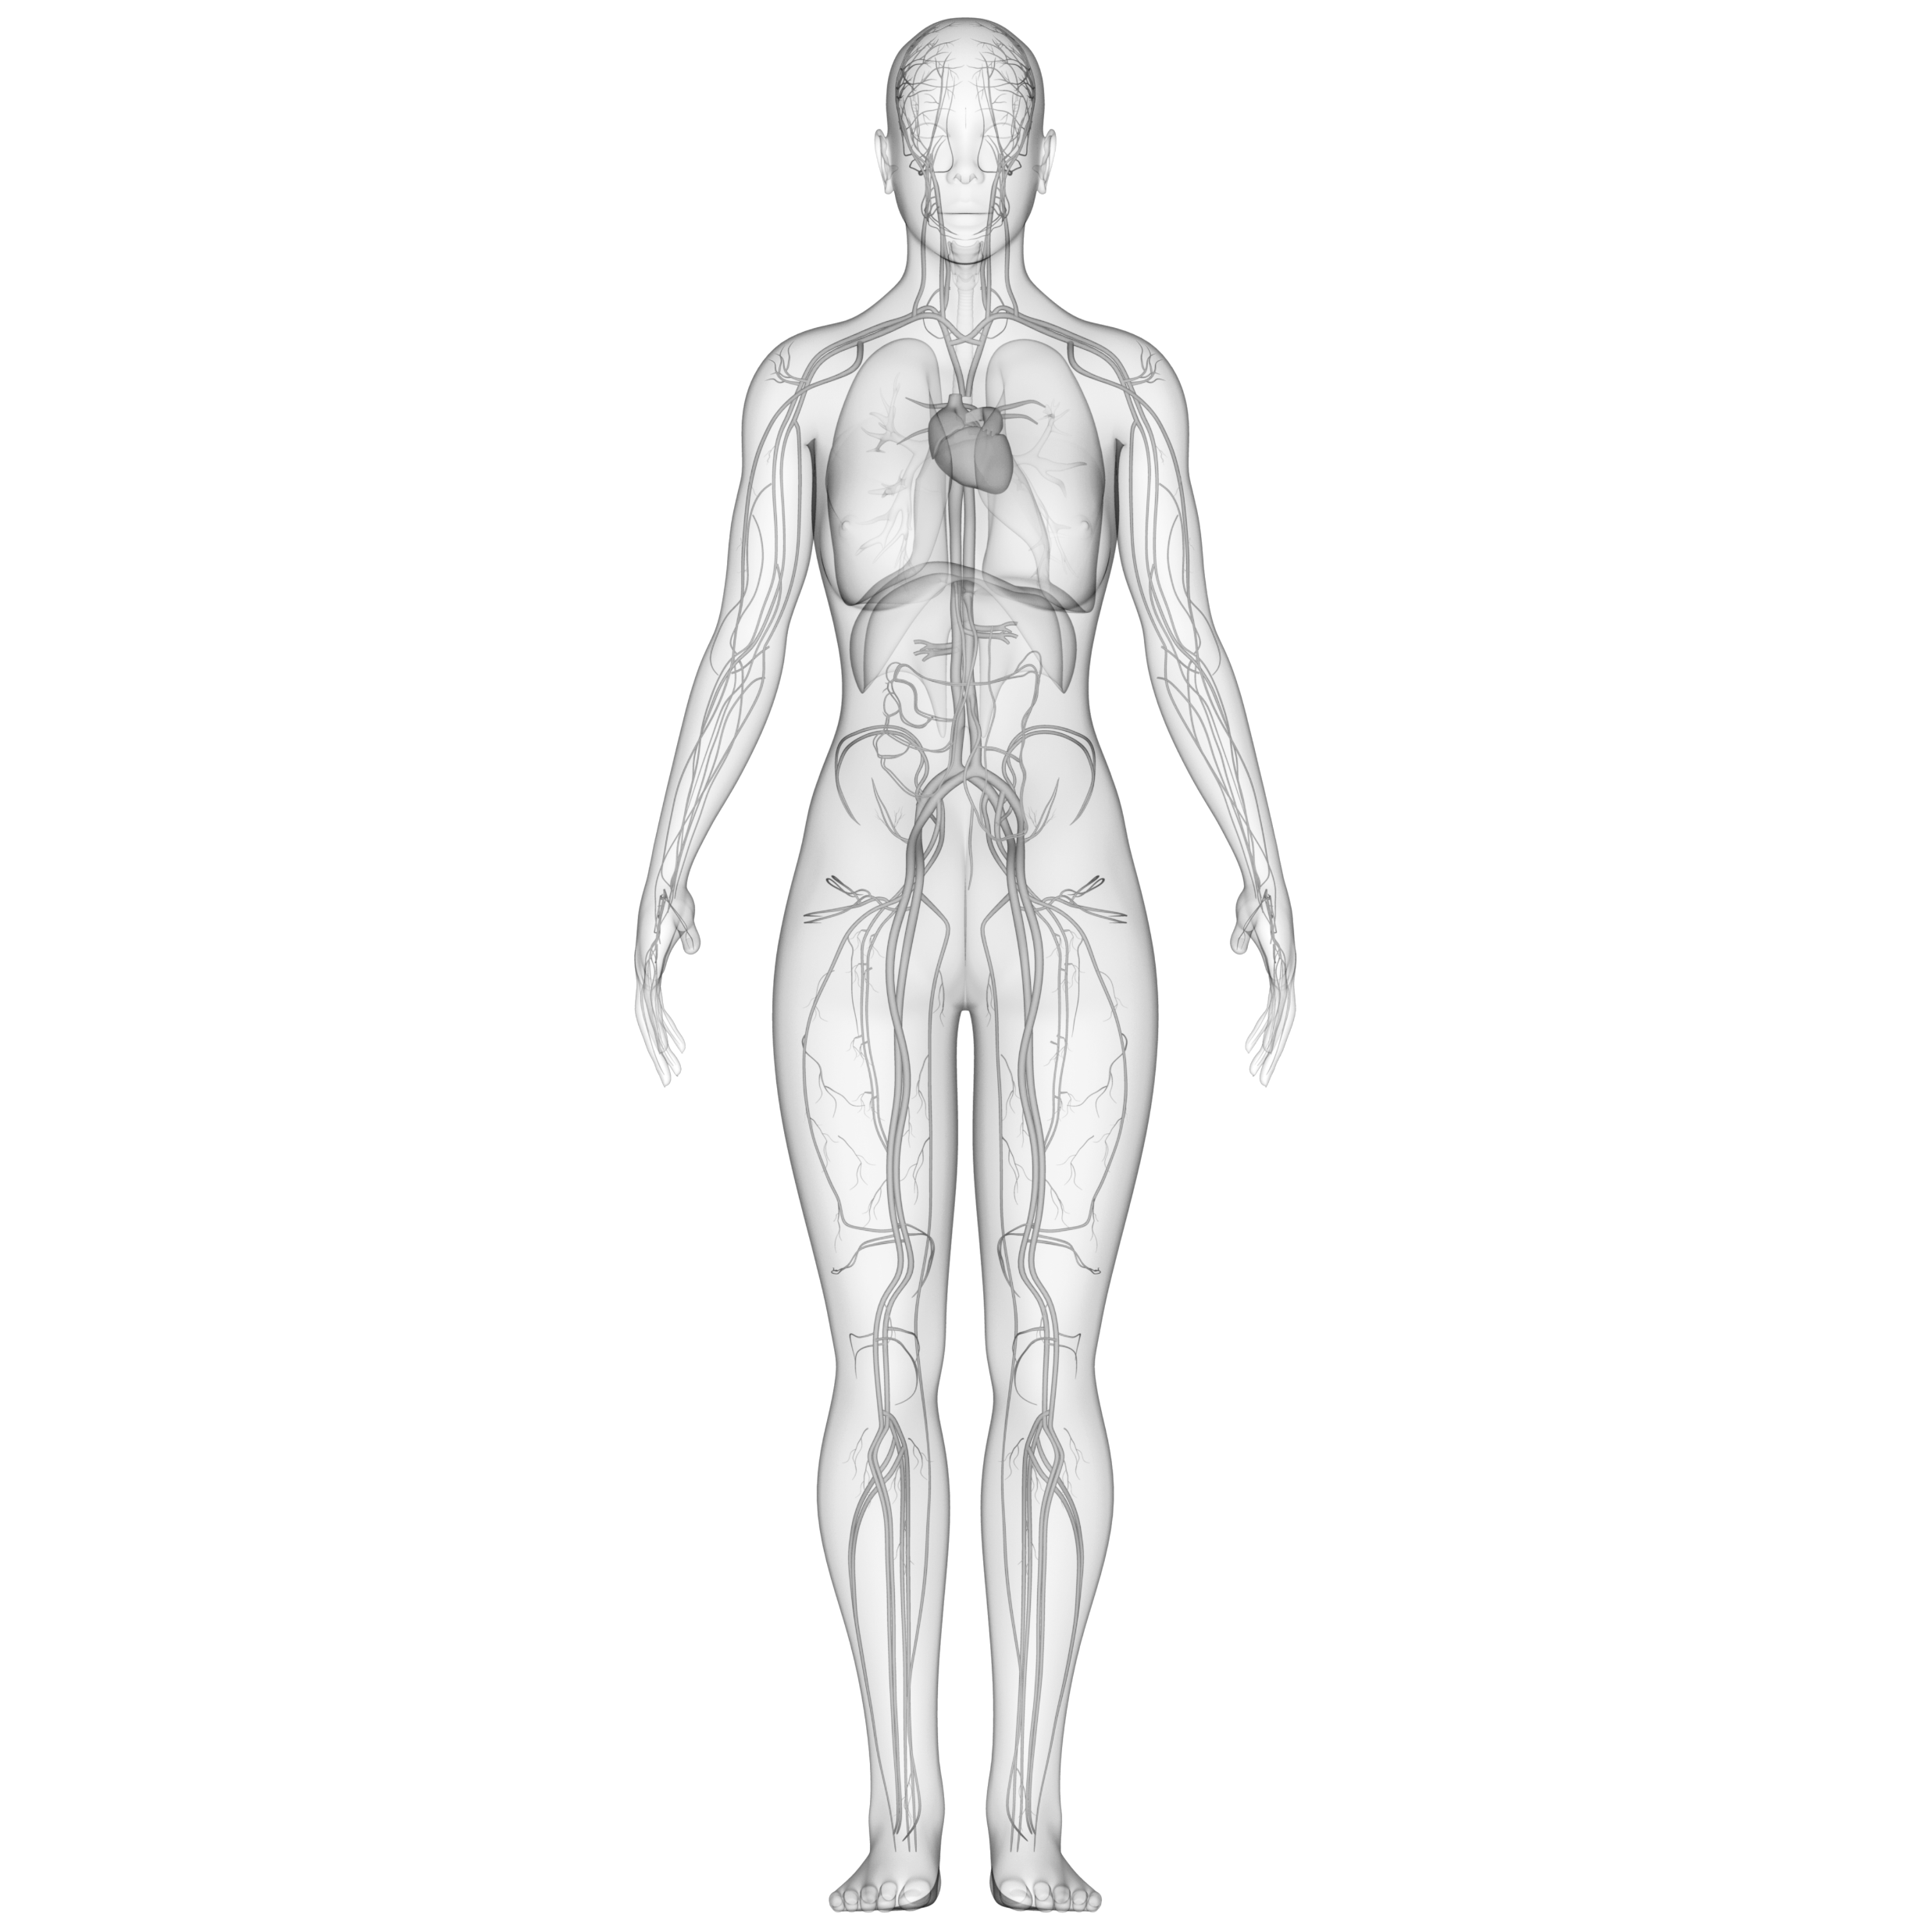
VTE Long Term
PE
#3
leading cause of cardiovascular death⁵ (and a leading cause of preventable deaths in hospital)
DVT
Up to 15%
Up to 50%
develop post-thrombotic syndrome (PTS) within 2 years of
a proximal DVT¹
30-day all-cause mortality^{6,7} (28% for high-risk PE⁶)
Up to 50%
~90%
have residual vascular obstruction⁸⁻¹⁰ and long-term complications are common¹¹
of PTS patients are unable to work 10 years after diagnosis²
of PTS patients develop venous leg ulcers.³ Patients w/ severe PTS have QoL comparable to congestive heart failure or cancer⁴
>10%
Kahn, Susan R. Hematology Am Soc Hematol Educ Program. 2016 Dec 2; 2016(1): 413–418
Kahn, et al. Arch Intern Med. 2004;164:17-26
Galanaud, et al. Thromb Haemost 2018; 118(02): 320-328
Office of the Surgeon General (US); National Heart, Lung, and Blood Institute (US). Office of the Surgeon General (US); 2008.
“Pulmonary Embolism in 2017: Increasing Options for Increasing Incidence”, National Center for Biotechnology Information, May 2017.
PERT Consortium® Registry Data. Interim results on 5,048 Patients presented at PERT Symposium October 2021
Schultz J, et al. Pulm Circ. 2019 Jan 11;9(3):2045894018824563;
Chopard et al. 2017. Ame J of Cardiol. Volume 119, Issue 11, 1883–1889
Miniati et al. 2006 Medicine. 85. 253-62. 10.1097/01.md.0000236952.87590.c8
Mrozek et al. Biomed Pap Med Fac Univ Palacky Olomouc Czech Repub. 2018 162(2):121-126. doi: 10.5507/bp.2018.001
Sista AK, et al. Vasc Med. 2017 Feb;22(1):37-43

Slide 9
WHEN TO THINK DVT
Acute leg swelling
Chronic swelling PTS?
Calf pain with standing or walking
If a more chronic symptom and only with walking consider PAD as well
Calf pain with foot dorsiflexion
Previous history of VTE
Cancer, recent surgery, recent travel, family history

Slide 10
WHEN TO THINK PE
Chest pain
Shortness of breath
Coughing
Hemoptysis
Flank/rib pain
Dizziness lightheadedness
Tachycardia
Hypoxia and associated symptoms

Slide 11


Concomitant DVT in Setting of PE
Diagnosing DVT during PE treatment may reduce PE-related mortality, and prompt timely prevention of post-thrombotic syndrome (PTS) symptoms.
50-65%
Of patients with PE also have proximal DVT^{1-3.}
>4X
Risk of 90-day PE-related mortality in PE patients with proximal DVT⁴
>4X
Risk of 90-day recurrent VTE in PE patients with proximal DVT⁴
1. Becattini, et al. Risk Stratification of Patients With Acute Symptomatic Pulmonary Embolism Based on Presence or Absence of Lower Extremity DVT: Systematic Review and Meta-analysis. Chest. 2016 Jan.
2. Hirmerova, et al. The Prevalence of Concomitant Deep Vein Thrombosis, Symptomatic or Asymptomatic, Proximal or Distal, in Patients With Symptomatic Pulmonary Embolism. Clin Appl Thromb Hemost. 2018 Nov.
3. Nishiwaki, et al. Impact of Concomitant Deep Vein Thrombosis on Clinical Outcomes in Patients With Acute Pulmonary Embolism. American Heart Association. 2019 Nov.
4. Jiménez, et al. Prognostic significance of deep vein thrombosis in patients presenting with acute symptomatic pulmonary embolism. Am J Respir Crit Care Med. 2010 May

Slide 12
MEDICAL MANAGEMENT OF VTE
CHEST GUIDELINES!
Panel of physicians using evidence-based medicine to give guidelines for management of VTE
Give a multitude of clinical scenarios and give their recommendation
None of the panelist are vascular surgeons
Link on UpToDate

Slide 13
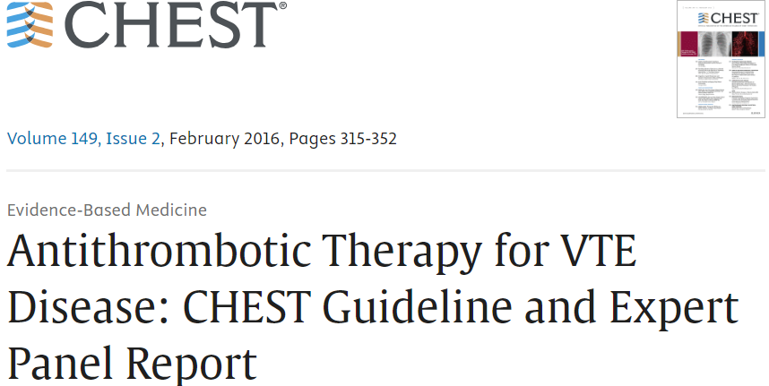

Slide 14
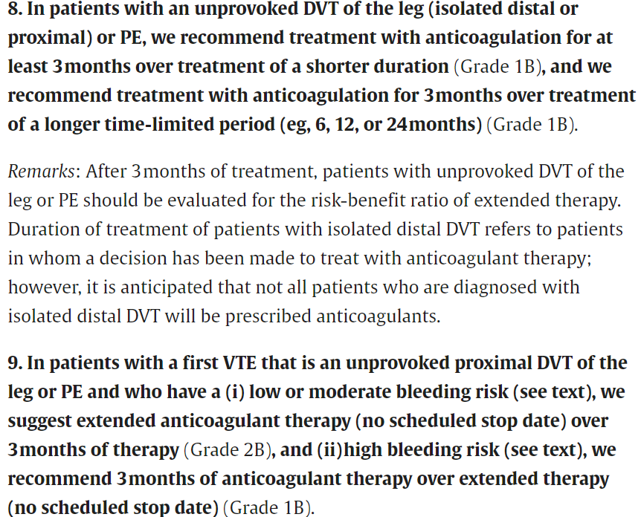

Slide 15
INTERVENTIONS FOR DVT
IVC filter
CHEST guidelines
Proximal occlusive DVT
Iliac or COMMON femoral vein DVT
Subclavian vein
Chronic DVT with PTS/venous hypertension symptoms

Slide 16
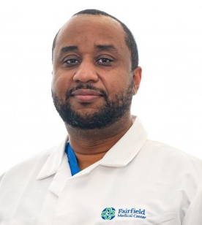
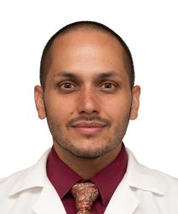
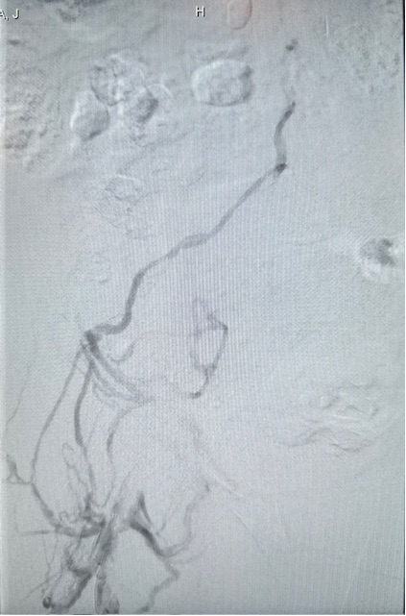
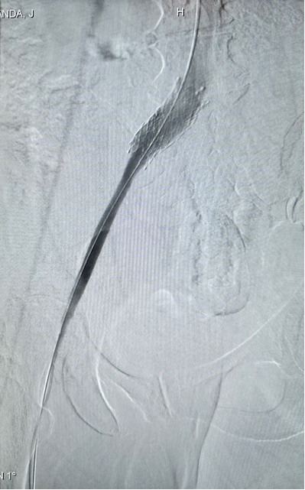
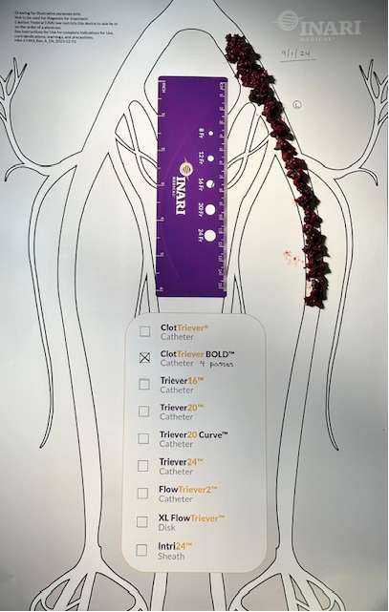
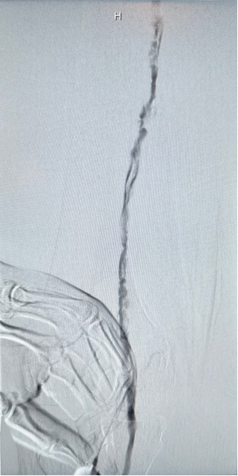
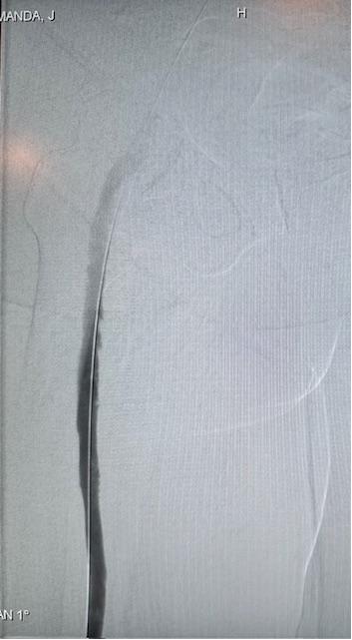
Vascular Surgery Team| Fairfield Medical Center
Mechanical Thrombectomy for DVT via Inari Medical ClotTriever
PRESENTATION | September 1st, 2024
54-year-old female presented to the ED with left lower
extremity pain & swelling.
Duplex US confirmed extensive left iliofemoral DVT
Single Session Thrombectomy Intervention with NO
thrombolytics or ICU stay
CASE RESULTS
20-min device time & 60-min stick-to-stitch
Post thrombectomy venography confirmed 100%
clot removal & restored vessel patency

Slide 17

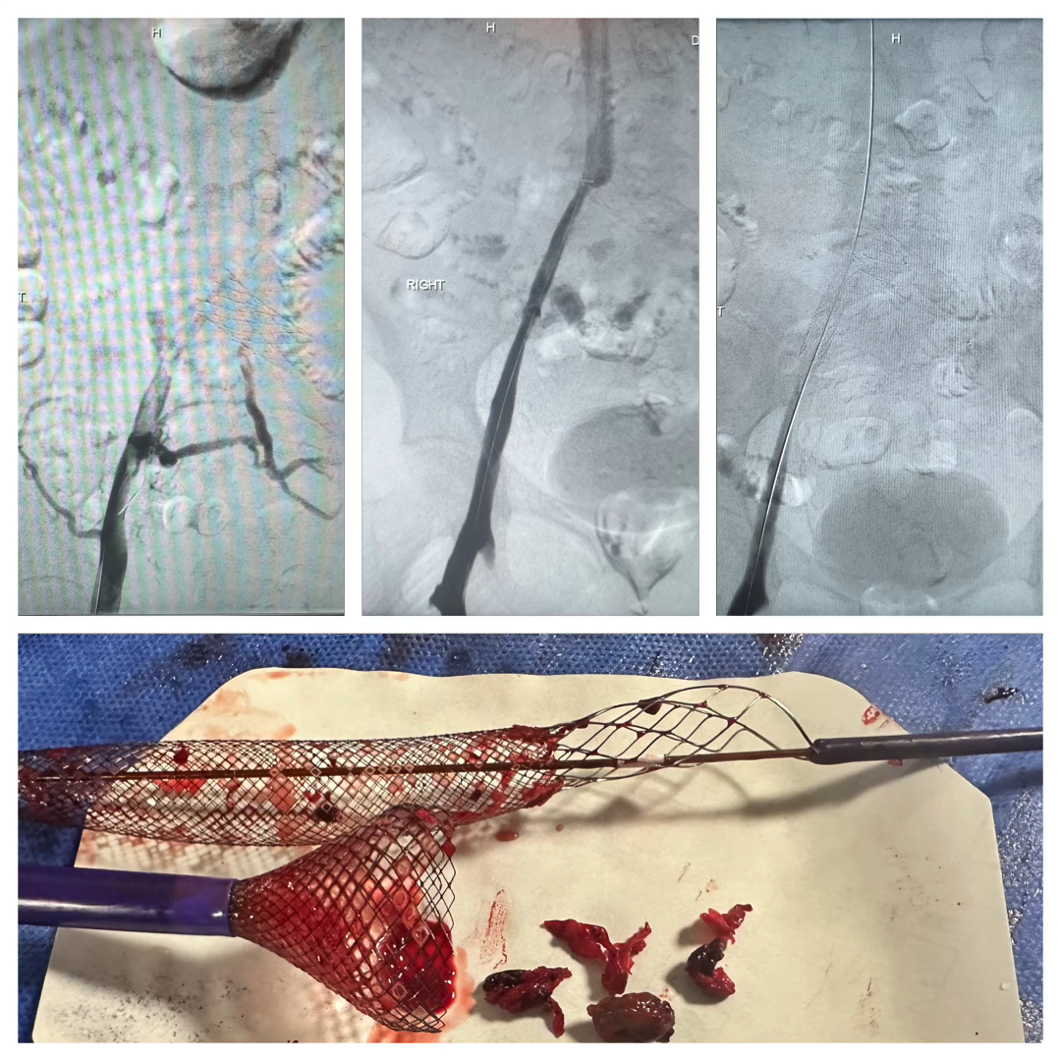
Endovascular Treatment of:
Deep Vein Thrombosis
Inari Medical ClotTriever BOLD® w/Protrieve
Procedure Date: 09/16/2024
Vascular Surgery Team
Patient History
Patient: 79-year-old female
History: Presented to the ED with right lower extremity pain & swelling. Duplex confirmed right iliac DVT.
Procedure Notes
Patient positioned supine for R.CFV & R.IJ access
The occlusion was successfully crossed by working from above and below.
Inari Protrieve sheath inserted into the R.IJ for embolic protection
16Fr ClotTriever Sheath placed into the patients R.CFV
Multiple passes with ClotTriever BOLD from the groin removed large chunks of chronic thrombus
Post thrombectomy venograms confirmed 100% clot removal and restored vessel patency
An Abre stent was placed to treat the remaining compression
30-min device time, 120-min stick-to-stitch
Single session, NO TPA, NO ICU

Slide 18
INTERVENTION FOR PE
IVC filter
Saddle pulmonary embolism
Intermediate risk PE
Cor pulmonale
FMC PERT Protocol

Slide 19
Mortality in PE patients has not improved much over 20 years
30-day all-cause Mortality by risk level:
6-15%
for submassive PE patients
25-50%
in massive PE patients
1
2
3
4,5
2,454 patients
95.6% Int-risk,
4.4% High-risk
338 patients
86% Int-risk,
14% High-risk
416 patients
19% Low-risk,
34% Int-Low risk
35% Int-High risk
12% High-risk
5,048 patients
18% Low-risk
67% Int-risk
15% High-risk
1. Kucher N, et al. Massive pulmonary embolism. Circulation. 2006 Jan 31;113(4):577-82. doi: 10.1161/CIRCULATIONAHA.105.592592. Epub 2006 Jan 23. PMID: 16432055 2. Secemsky E, et al. Contemporary Management and Outcomes of Patients with Massive and Submassive Pulmonary Embolism. Am J Med. 2018 Dec;131(12):1506-1514.e0 3. Schultz J, et al. A Multidisciplinary Pulmonary Embolism Response Team (PERT) - Experience from a national multicenter consortium. Pulm Circ. 2019 Jan 11;9(3):2045894018824563 4. PERT Consortium Quality Database. October 2021 (Presented by Secemsky E) 5. Darki A & Jaber WA. Endovascular Today. July 2022 Supplement (PERT Updates)

Slide 20
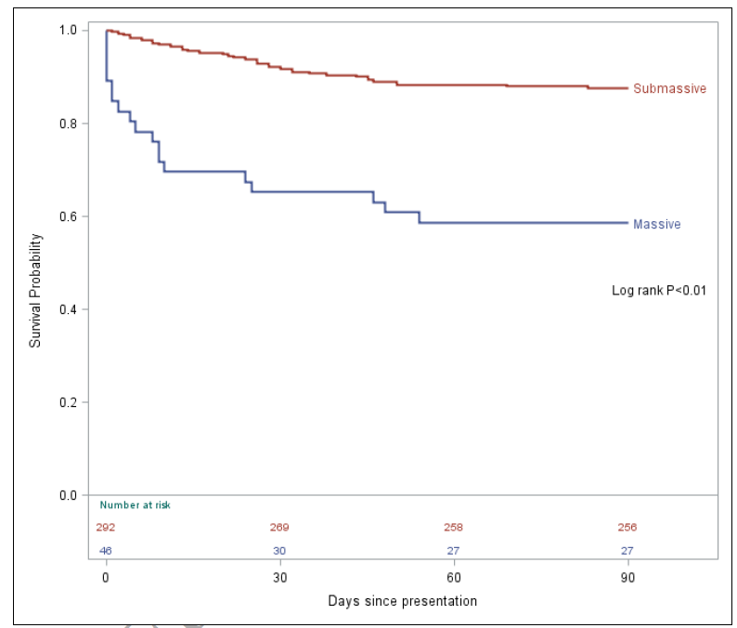
MGH PERT Data: acute submassive mortality happening after discharge
Survival Probability
1.0 -
Submassive
Nearly half
0.8 -
of submassive 30-day mortality occurred after the patient left the hospital
0.6 -
Massive
& nearly 2/3 of 90-day mortality
0.0 -
|
0
|
30
|
60
|
90
Days Since Presentation
Secemsky et al., Contemporary Management and Outcomes of Patients with Massive and Submassive Pulmonary Embolism, The American Journal of Medicine (2018), doi: https://doi.org/10.1016/j.amjmed.2018.07.035

Slide 21
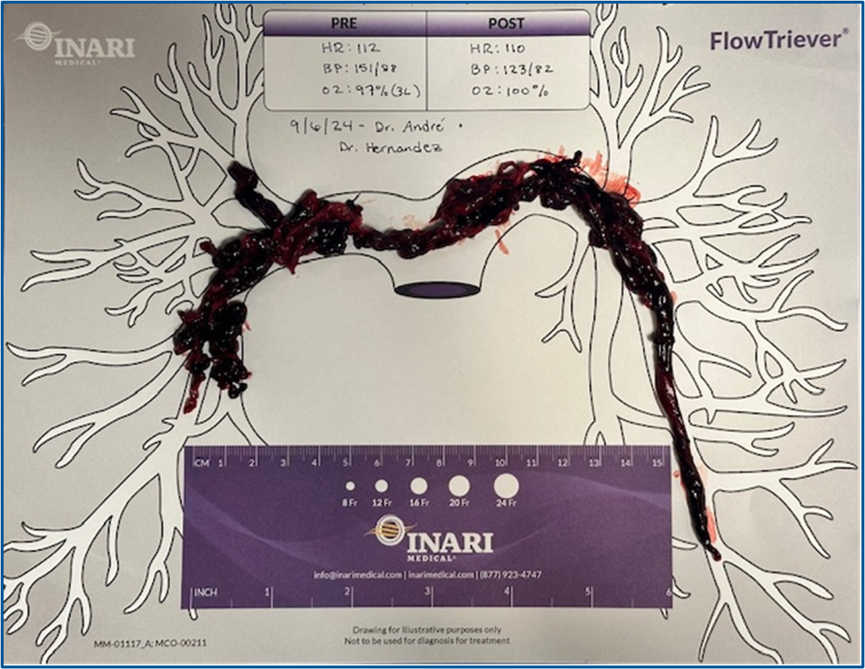
Dr. Jason Andre & Dr. Josh Hernandez – VS | Fairfield Medical Center
Pulmonary Embolism Thrombectomy via Inari FlowTriever
PRESENTATION | September 6th, 2024
82-year-old female presented to the ED shortness of
breath, and was tachycardic into the one-teens
CT showed large bilateral & saddle embolus with RV
strain
Single Session Thrombectomy Intervention with NO
Thrombolytics
CASE RESULTS
30-min device time & 60-min stick-to-stitch
Post angiography confirmed 100% clot removal
50cc total EBL: 95% blood returned with FlowSaver

Slide 22
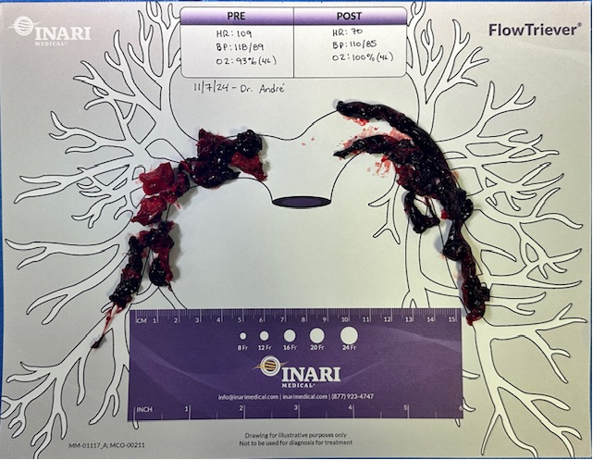
Vascular Surgery Team | Fairfield Medical Center
Pulmonary Embolism Thrombectomy via Inari FlowTriever
PRESENTATION | November 8th, 2024
73-year-old female presented to the River Valley ED with
chest pain & shortness of breath.
CT showed large bilateral & saddle embolus and right
heart strain
Single Session Thrombectomy Intervention with NO
Thrombolytics
CASE RESULTS
30 min device time & 60 min stick-to-stich
Post CT angiography confirmed 100% clot removal
100cc total EBL | 95% blood returned with FlowSaver

Slide 23
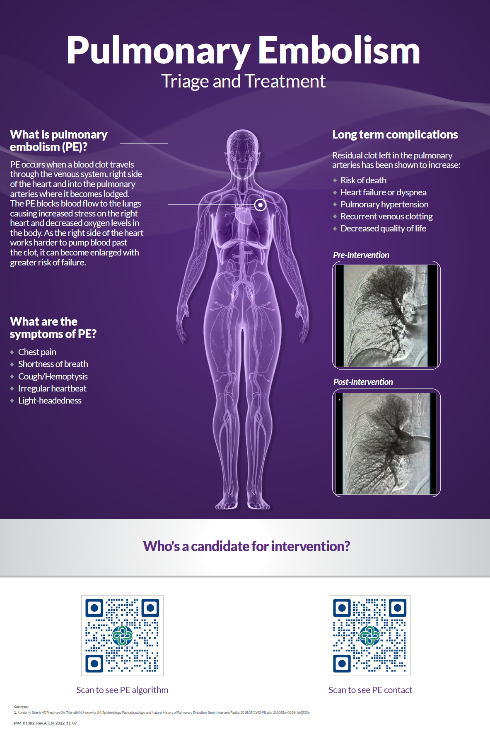
PE Care Pathway

Slide 24

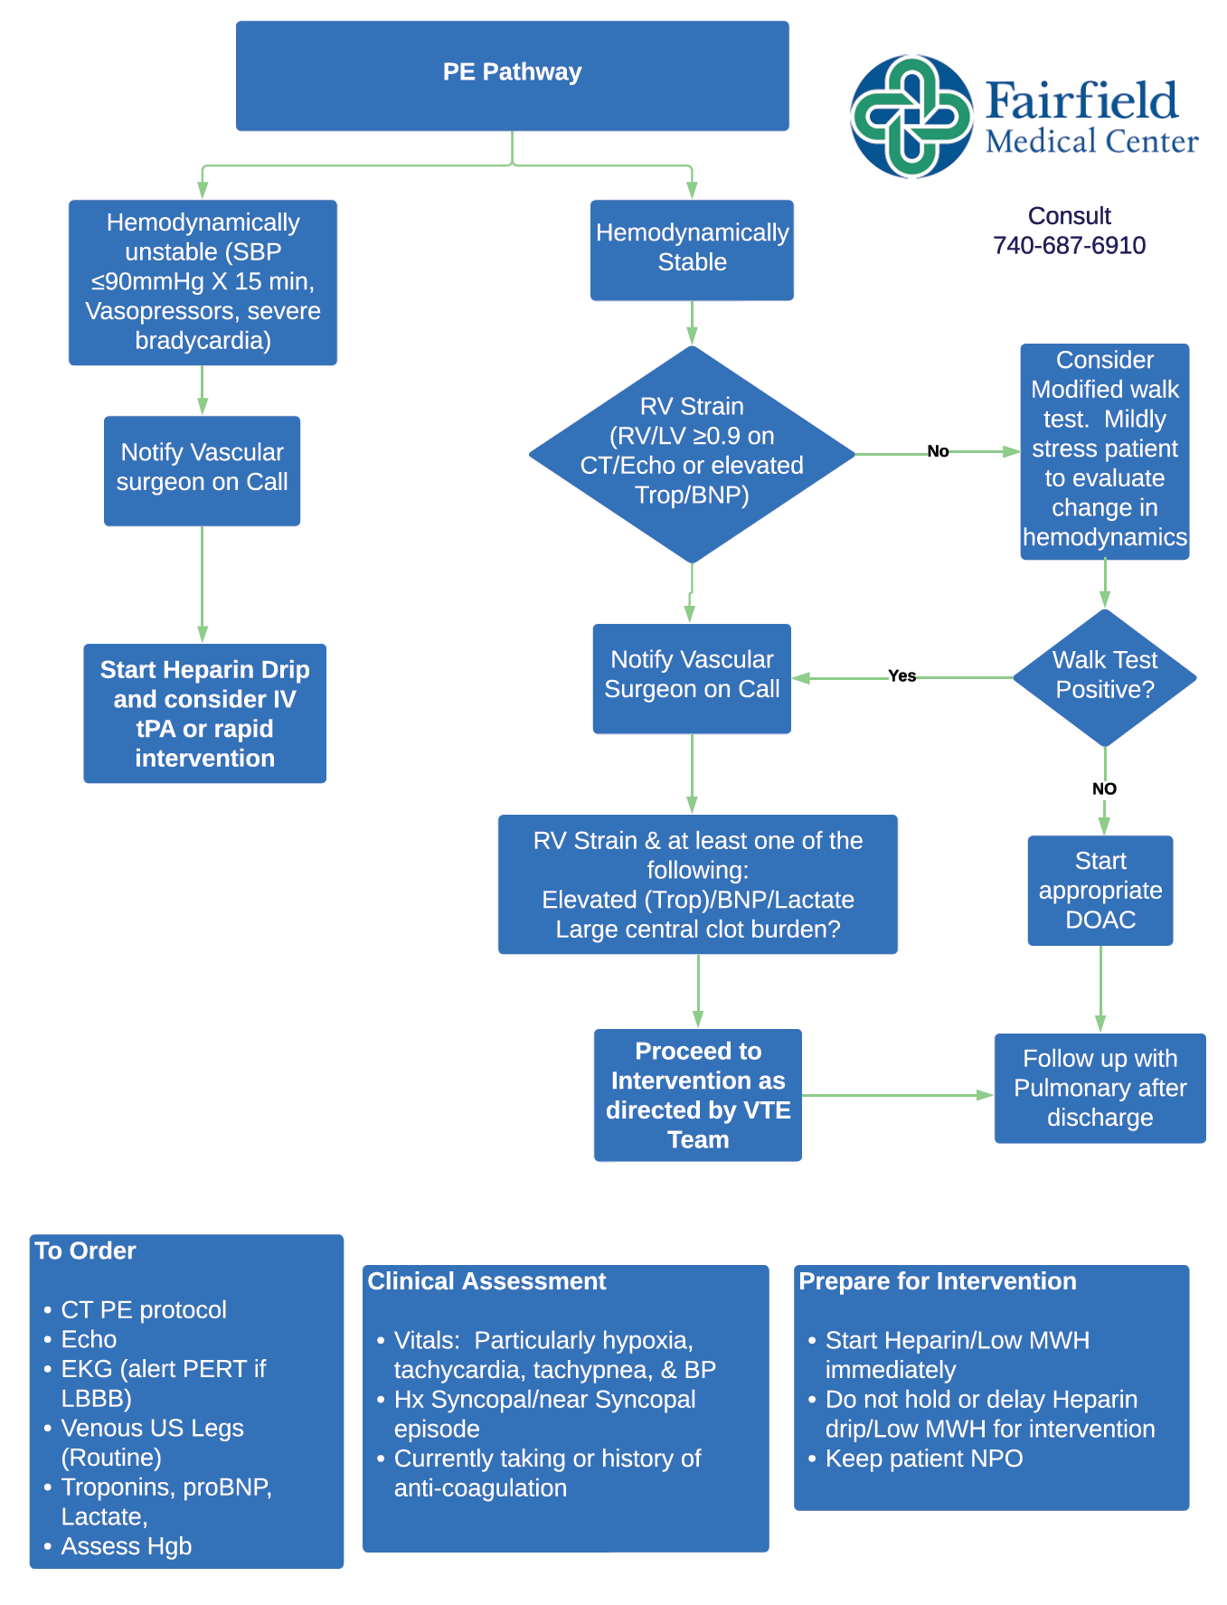
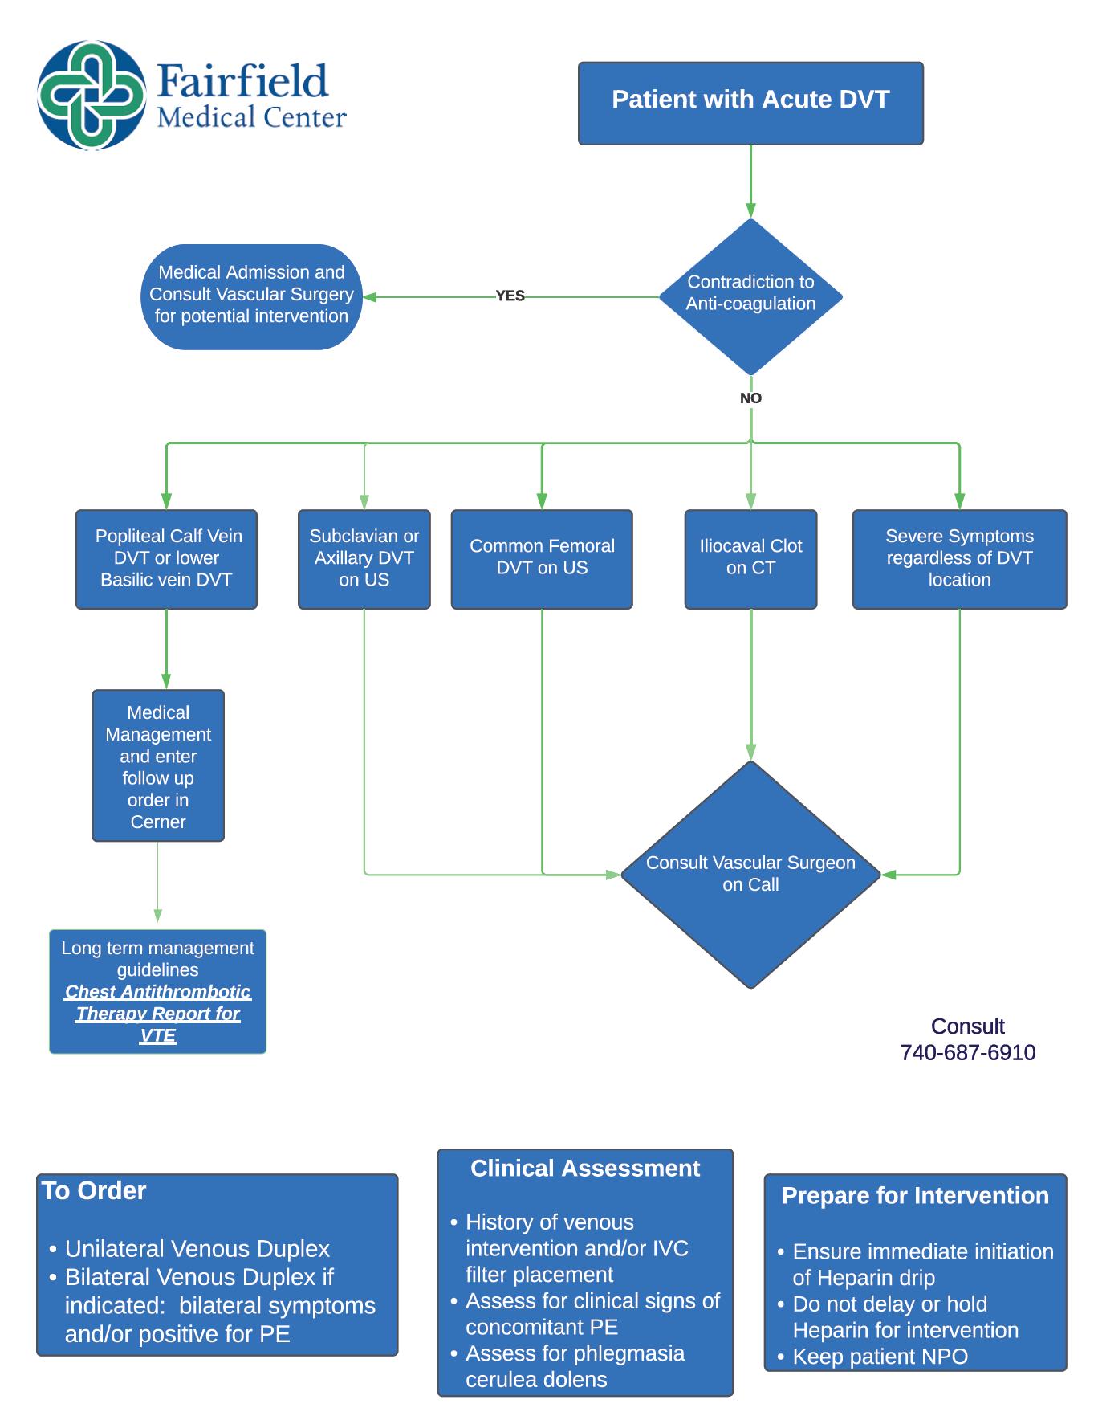
VTE Program Algorithms

Slide 25

Thank You

