Slide 1
Innovation in Carotid Revascularization
By Joshua N. Hernandez, MD
Department of Vascular Surgery
Fairfield Medical Center

Slide 2
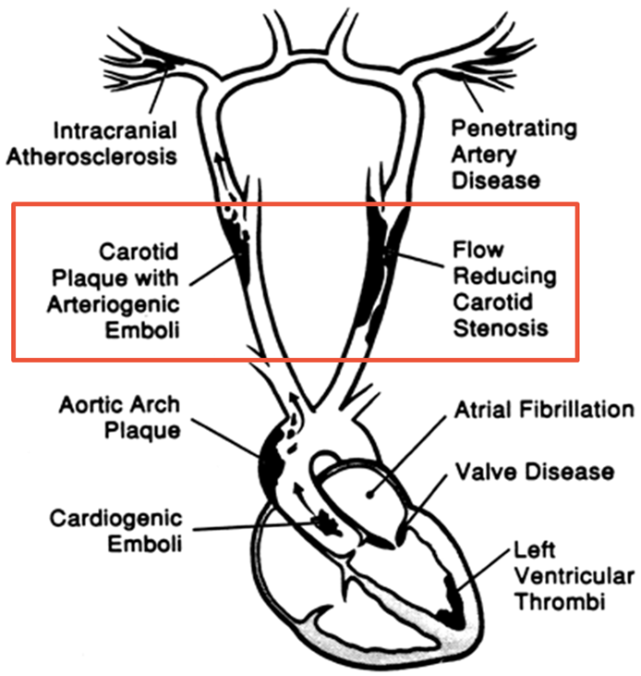
Carotid Artery Stenosis
Nearly 800,000 people in the US have a CVA every year; 3 of 4 are 1st time CVA.
85% ischemic
Up to 52% from carotid
50% preceded by TIA
15-33% are fatal

Slide 3
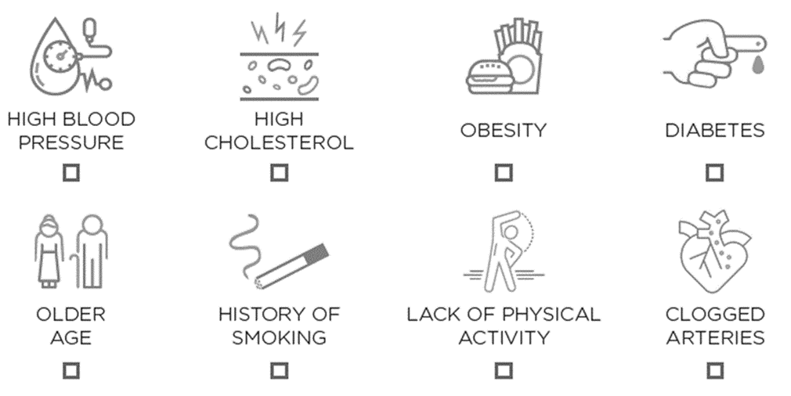
Optimal Medical Therapy
Goal is to prevent CVA & stabilize plaque.
Addressing modifiable risk factors.
Antiplatelet, statin, antihypertensives, glycemic control.
DAPT/AC?
Notes:
To prevent plaque rupture and atheroembolization.
Low-Na+ and DASH diet
Weight loss for BMI>30
Smoking cessation
Reduction/elimination of EtOH in heavy drinkers
bASA 75-150mg QD vs Plavix 75mg QD
High-intensity statin (Atorvastatin 40-80mg QD vs Rosuvastatin 20-40mg QD) w/goal LDL<70
SBP<140/90 or <130/80 if diabetic; ACEi & ARBs have benefit in CVA prevention particularly in patients at high-risk for cardiovascular disease.
Strict glycemic control w/goal A1C<7% & blood Glu<180
No evidence for DAPT in primary CVA-prevention; however, for minor CVA DAPT can be started early w/in12-24hrs and continued 3wk-3mo followed by SAPT
AC for non-valvular AF w/CHA2DS2-VASc >=2

Slide 4
Diagnosis: Clinical
Bruit
Less than 1/3 hemodynamically significant
Good predictors of overall atherosclerotic risk
Symptoms
Unilateral Weakness (crossed)
Unilateral Numbness (crossed)
Amaurosis Fugax (transient monocular blindness) (ipsilateral)
Expressive aphasia (left hemispheric)
Receptive aphasia (left hemispheric)
USUALLY NOT
Dizziness, Loss of consciousness, Seizures, Bilateral weakness
Drop attacks, Syncope

Slide 5
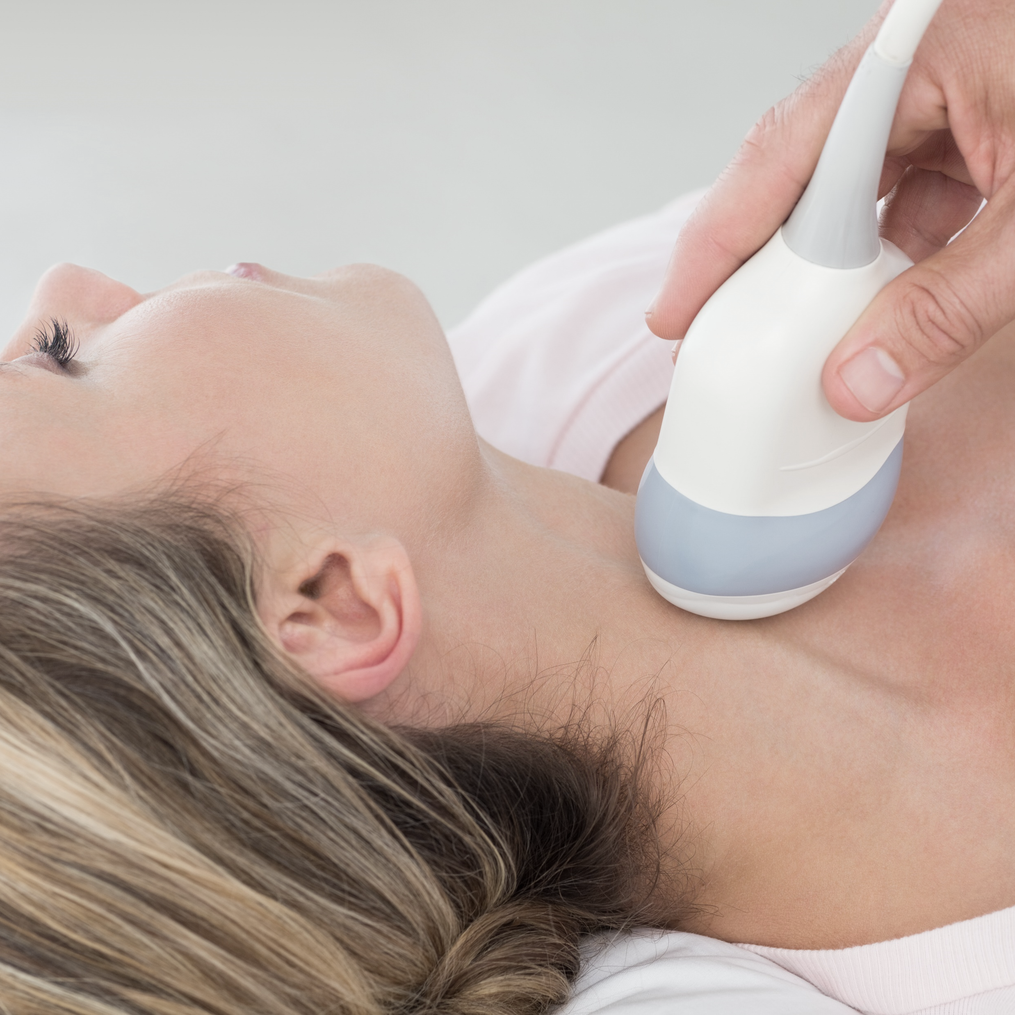
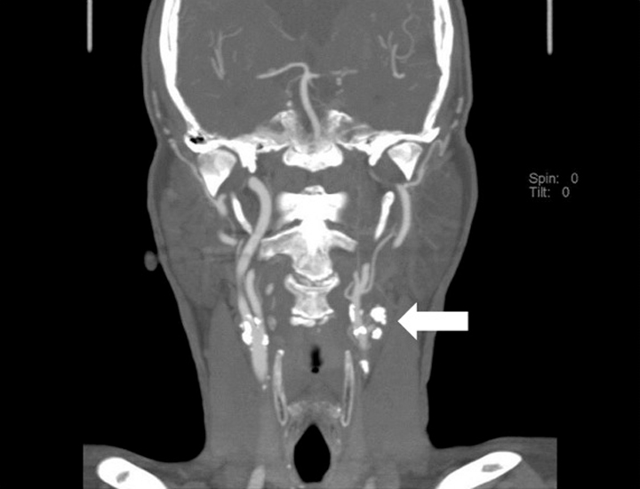
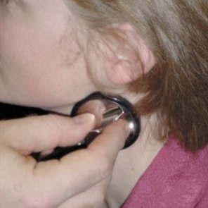
Carotid Screening Options
DUPLEX ULTRASOUND
CT
ANGIOGRAM
CAROTID
BRUIT

Slide 6
SVS 2021 Screening Guidelines
Recommend against routine screening for clinically asymptomatic CAS.
Patients who are at increased risk of CAS, especially if they are willing to consider carotid intervention, include patient with:
PAD, DM, HTN, CAD
Undergoing CABG
>55yo w/2+ traditional atherosclerotic risk factors
>55yo active cigarette smokers
Clinically occult CVA on imaging
Recommend CDU over CTA, MRA, or other imaging modality.

Slide 7
SVS 2021 Treatment Guidelines
LSR patients w/asymptomatic stenosis >70%, rec CEA + BMT; 1B
LSR-SSR patients w/symptomatic stenosis >50%, rec CEA over TF-CAS; 1A
Patients w/symptomatic stenosis >50% & Rankin 0-2, rec revascularization 48hrs-14days after onset of Symptoms; 1B
Patients undergoing revasc w/in 14days after onset of Symptoms, rec CEA over TF-CAS; 1B
Rec against revasc in patients w/disabling stroke, Rankin >=3, area of infarct >30% of ipsi MCA territory, or who are altered to minimize risk of post-op hemorrhage. Re-eval later; 1C
Notes:
LSR – Low Surgical Risk
SSR – Standard Surgical Risk
CAS –Carotid Artery Stenosis
CEA – Carotid Endarterectomy
BMT – Best Medical Therapy
TF-CAS – Transfemoral Carotid Artery Stenting

Slide 8
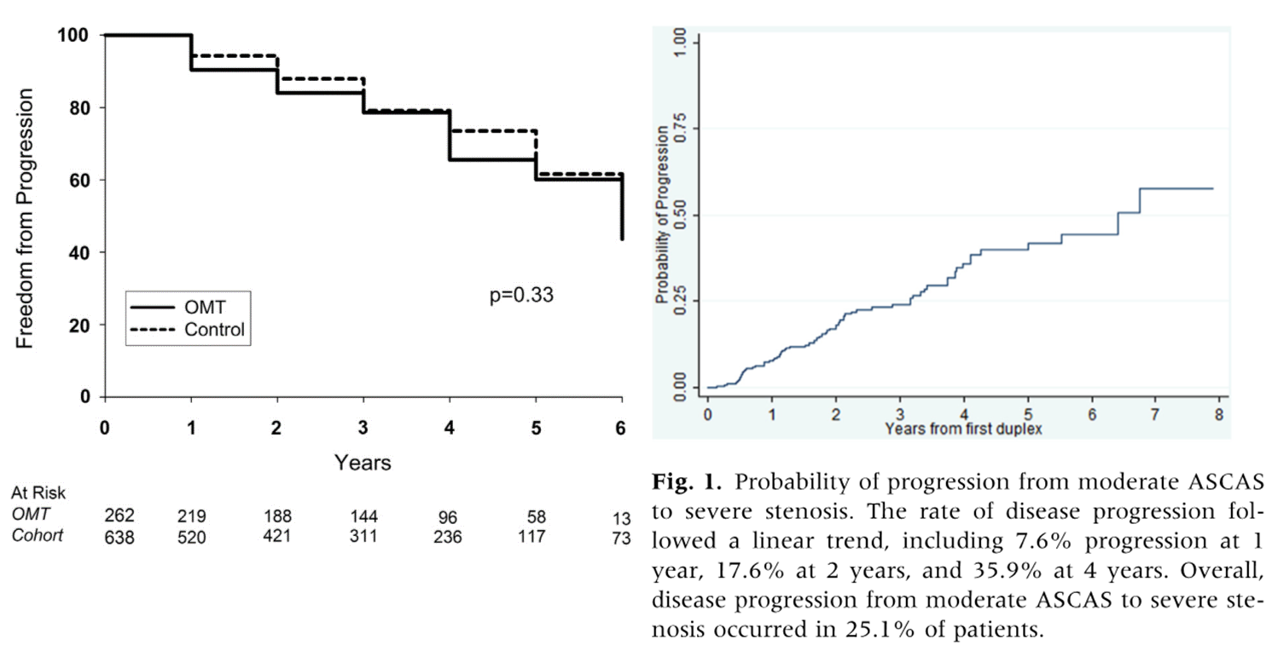
Asymptomatic
Notes:
Conrad et al. JVS 2013
Single-center retrospective study of patients w/moderate ACAS by CDUS identified between 01/2005-12/2006 w/at least 5yr f/u & f/u CDUS. Looked to determine natural Hx of ACAS as function of medical Tx.
Endpoints included progression to 70-100% stenosis, ipsilateral CVA/TIA, and death.
900 carotids in 794 patients, 241 on OMT, rest considered control.
5yr freedom from plaque progression was 61.2% w/no advantage w/OMT.
5yr survival was 81.9% w/no advantage w/OMT.
5yr freedom from INS was 88.4%; Diabetes and Warfarin were predictive; statins were protective.
- Concluded that OMT failed to prevent carotid disease progression in 45% of patients w/mod ACAS.
Hicks et al. AVS 2015
Single-center retrospective study from 01/2005-05/2012 looked at patients w/mod ACAS identified on CDUS to evaluate incidence of and risk factor for disease progression.
Endpoints were disease progression to severe stenosis, incidence of Sx, need for operative intervention, all-cause mortality.
282 carotids in 258 patients w/mean f/u 2.6yrs
showed progression of 36% @4yrs.
Risk of progression was higher in patients receiving DAPT (HR 1.85, P 0.02) and smokers (HR 1.85, P 0.05)
Non-significant trend toward increased mortality in patients that progressed (P 0.07)

Slide 9
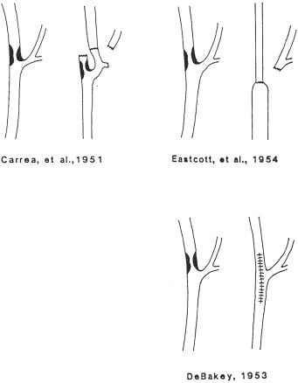
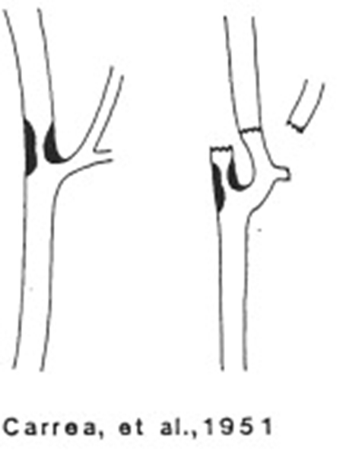
Carotid Endarterectomy
Notes:
- 1951 Dr. Raul Carrea did 1st successful carotid artery reconstruction for occlusive disease; a partial ICA resection with transposition to ECA.
41M w/aphasia & R hemiparesis admitted to the Institute of Experimental Medicine in Buenos Aires by Neurosurgeon Carrea. Patient did well post-op and had normal neurologic findings 39mo later.
- 1954 Dr. Felix Eastcott modified Carrea’s procedure by resecting diseased portion and sewing end to end.
The 1st case to be reported in medical literature in ‘The Lancet’ by Dr. Eastcott a consultant surgeon and deputy director of the surgical unit at St. Mary’s Hospital in London, UK.
- 1956 Dr. Denton Cooley claimed to do 1st successful CEA; patient’s head was immersed in crushed ice, was shunted with a polyvinyl shunt with needles at both ends, and endarterectomy was done through a transverse incision at the bifurcation which was then repaired primarily.
71M w/swishing noise in his L ear for 4mo, found to have carotid bifurcation stenosis on angiogram. Noises resolved but was aphasic and had R hemiparesis post-op resolved by 6mo f/u. Cooley later confessed misgivings about doing surgery in a patient w/o neuro symptoms and using external brain cooling.
- 1975 Dr. Michael DeBakey published a 19yr f/u report in JAMA of the actual 1st successful CEA in 1953 based on endartectomy techniques in other vessels and closed primarily.
53M bus driver w/2yr h/o TIAs. Patient survived 19yrs w/o another neuro event. DeBakey provided a copy of the original op note and a paper of a lecture on the operation w/Cooley as a coauthor establishing him as the true 1st successful CEA as we understand it now.

Slide 10
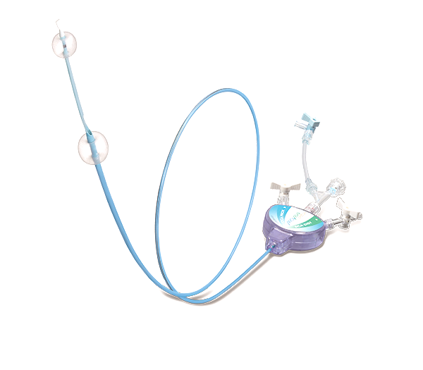
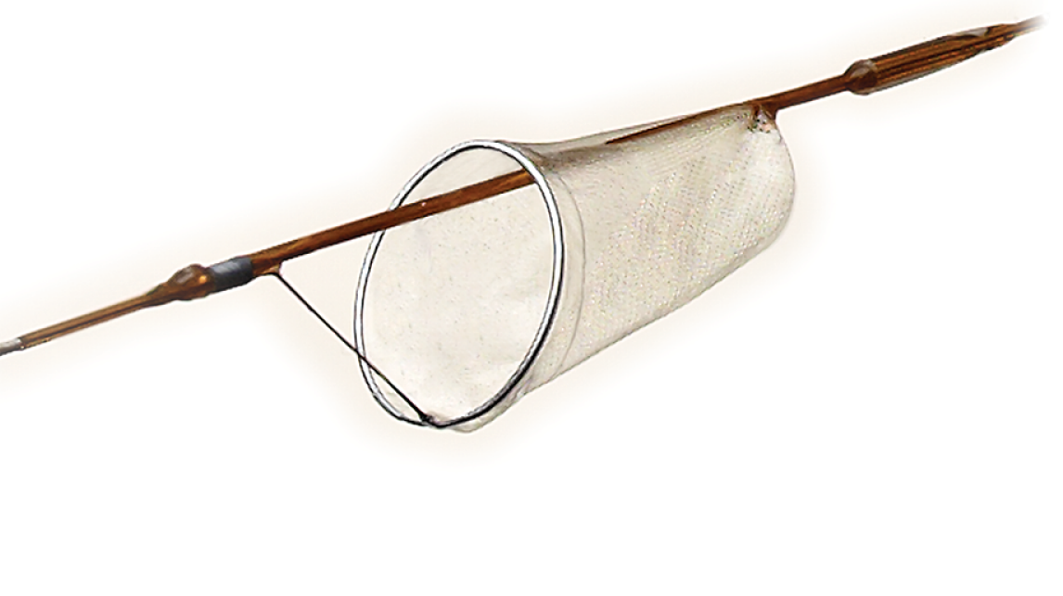
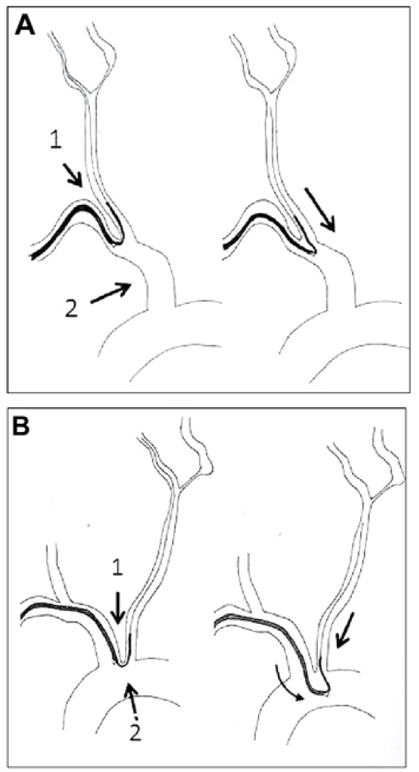
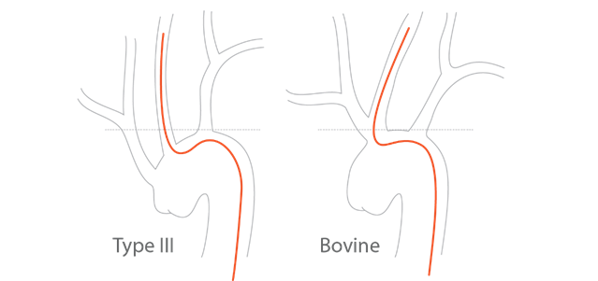
Carotid Artery Stenting
TF-CAS
TR/TB-CAS
High lesions (@ or above C2)
Hx of neck radiation
Tracheostomy
Hx of prior CEA (higher risk of CNI not CVA)
Notes:
Initial experience was w/balloon-expandable Palmaz-Schatz stents.
Later replaced by self-expanding rolling membrane Wallstent.
Newer stents are made of Nitinol and have various design characteristics.
DAPT was adopted.
1990 1st EPD used during CAS.
- Ballon-expandable stents are susceptible to external compression, have unsuitable lengths, low comformability to deal with carotid bifurcation anatomy, and risk dissection.
Self-expanding stents return to original shape even if suffering external pressures and able to cover long lesions w/a single stent.
Nitinol transition temperature is body temperature so when exposed to the body the stent expands to nominal dimensions and shape.
Tapered stents allow for consideration of the diameter difference between ICA and CCA, applying a homogeneous radial force.
Initial EPD was a balloon occlusion w/aspiration of trapped debris; reduced stroke rate by >50%.

Slide 11
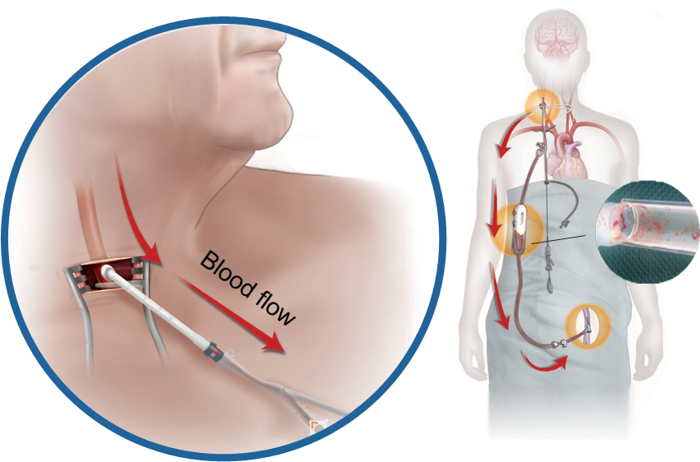
Transcarotid Arterial Revascularization
>5cm working distance
>6mm CCA diameter
CCA free of significant disease
DAPT
Statin
Notes:
~70-85% of patients are anatomically optimal for TCAR
DAPT >=3d prior to procedure optimal (ASA 75-325 QD vs P2Y12-I; Plavix 75 QDor Brillinta 90 BID)
If <3d prior, load (ASA 650, Plavix 300-600, or Brillinta 180); min 4hrs prior
*** DAPT mismanagement was #1 cause of stroke in TCAR
Statin >5d prior to procedure optimal (atorvastatin or rosuvastatin)
If <5d prior, load (Atorvastatin 80, Rosuvastatin 40); min 12hrs prior
Direct carotid access bypassing arch
Flow reversal establishes neuroprotection prior to crossing lesion
Less radiation and contrast
Short learning curve
No increase stroke rate in females and elderly

Slide 12
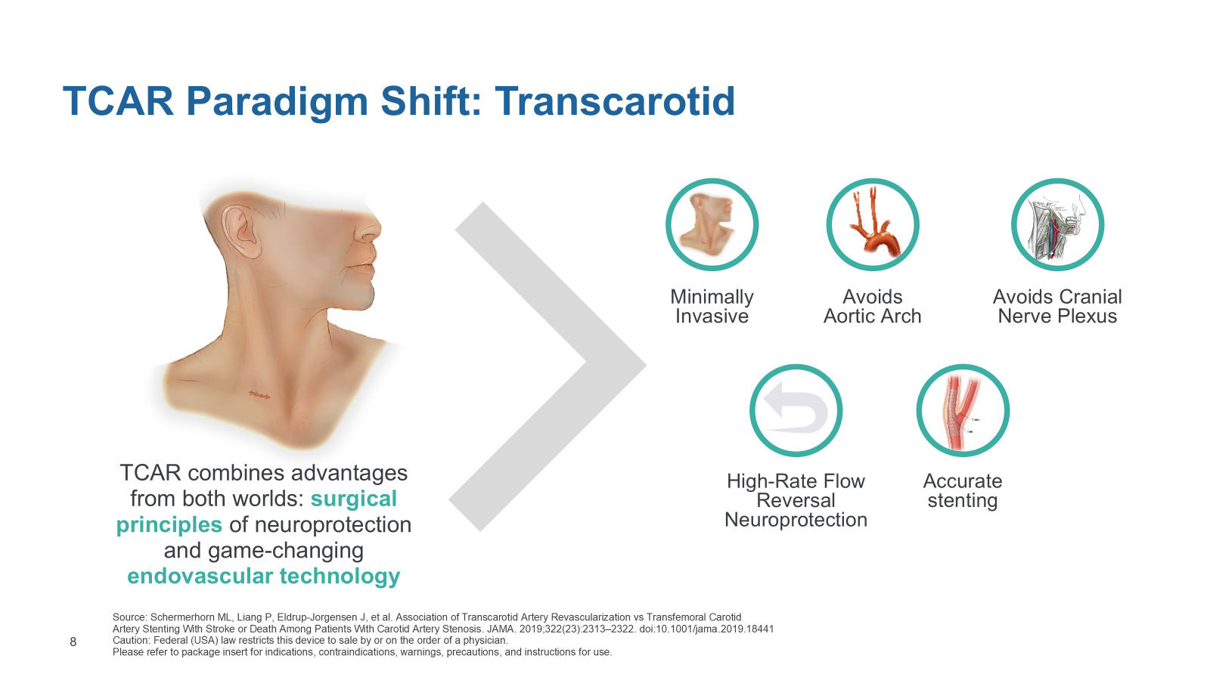

Slide 13
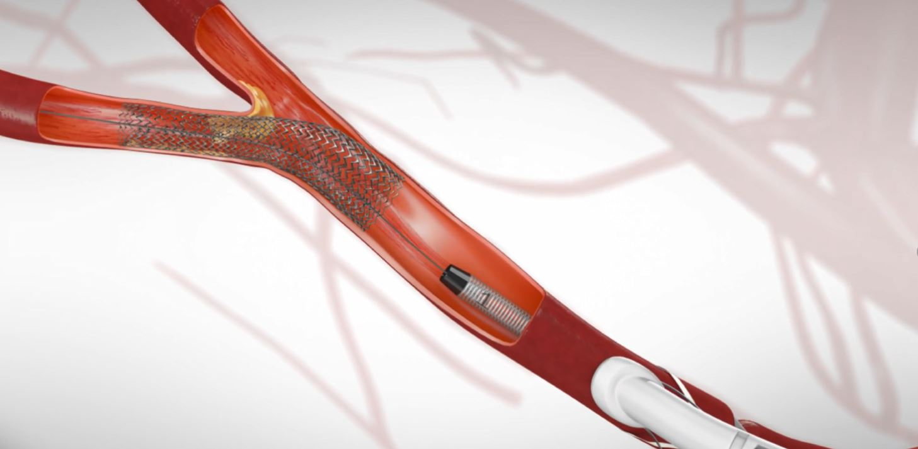

Slide 14
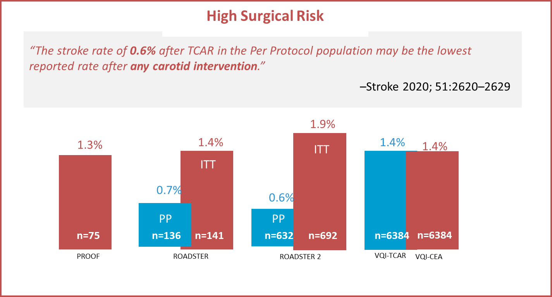
TCAR Periprocedural Stroke Rates
Notes:
PROOF
ROADSTER
ROADSTER 2
VQI-TSP

Slide 15
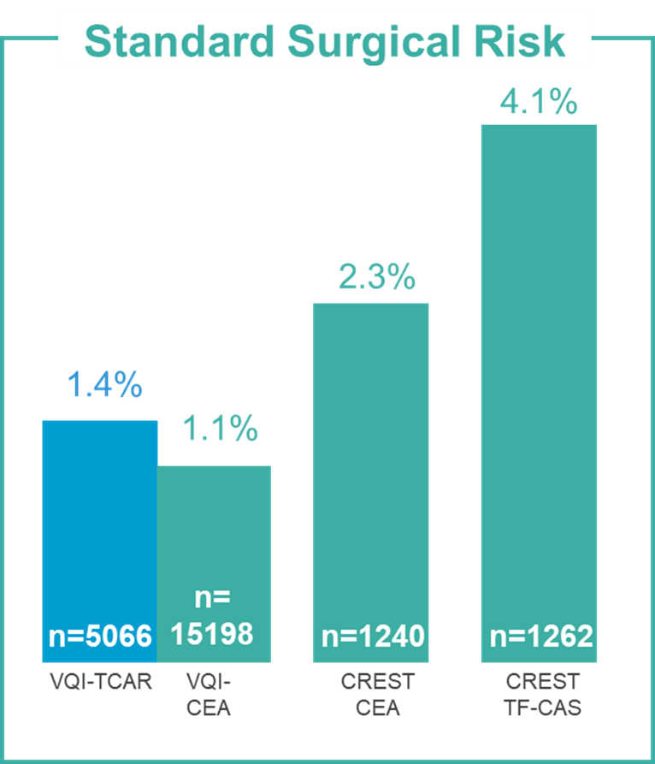
Periprocedural Stroke Rates

Slide 16
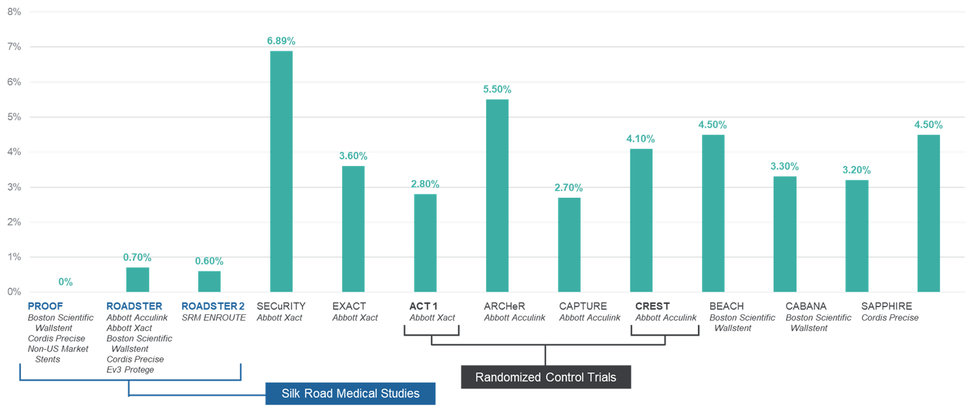
Stroke rates across CAS studies

Slide 17
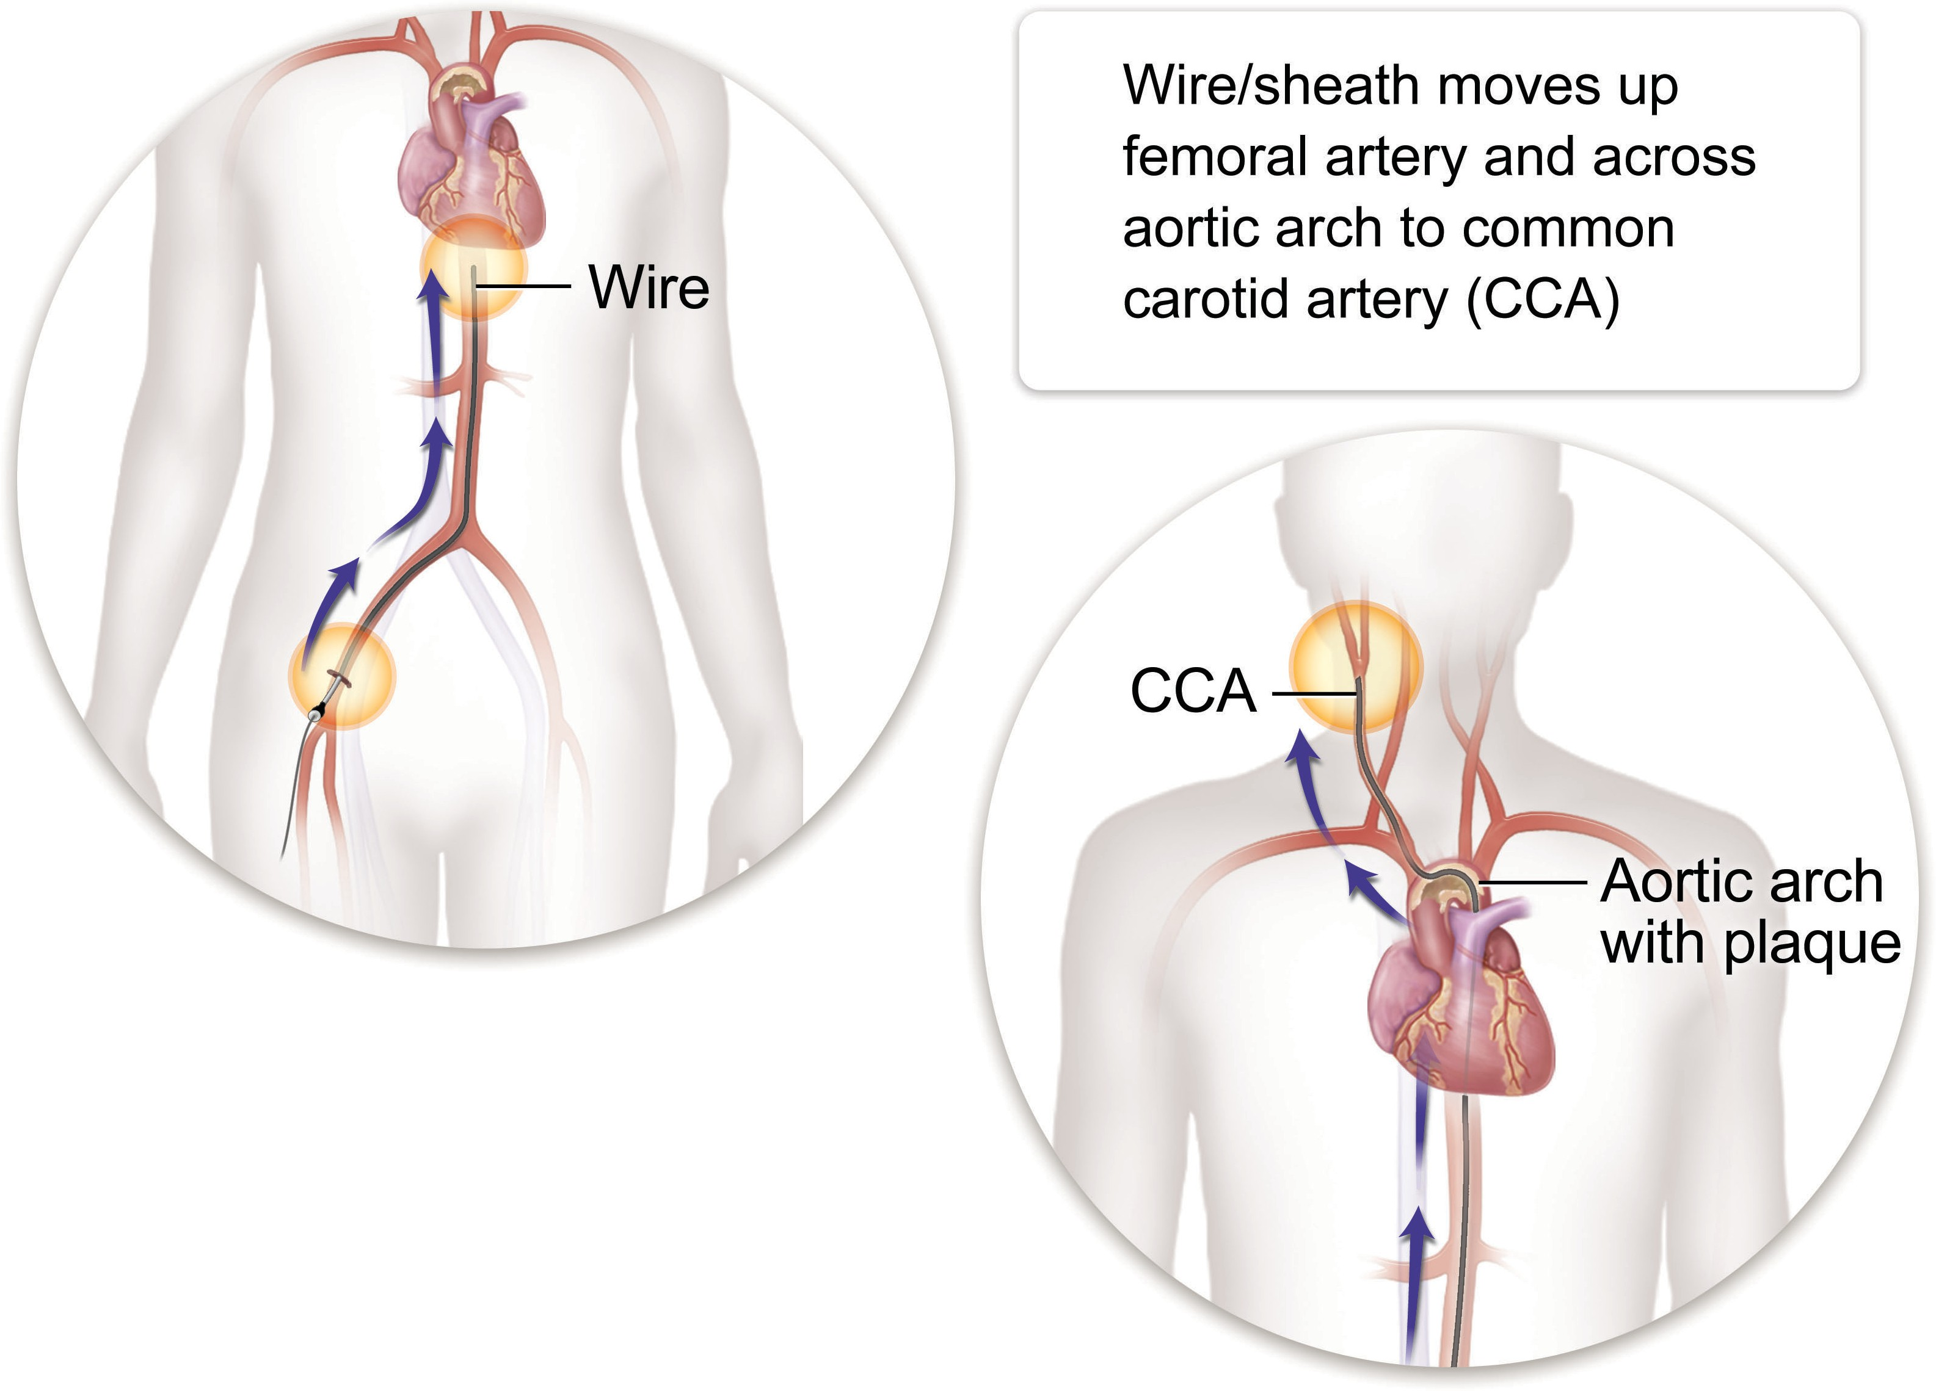
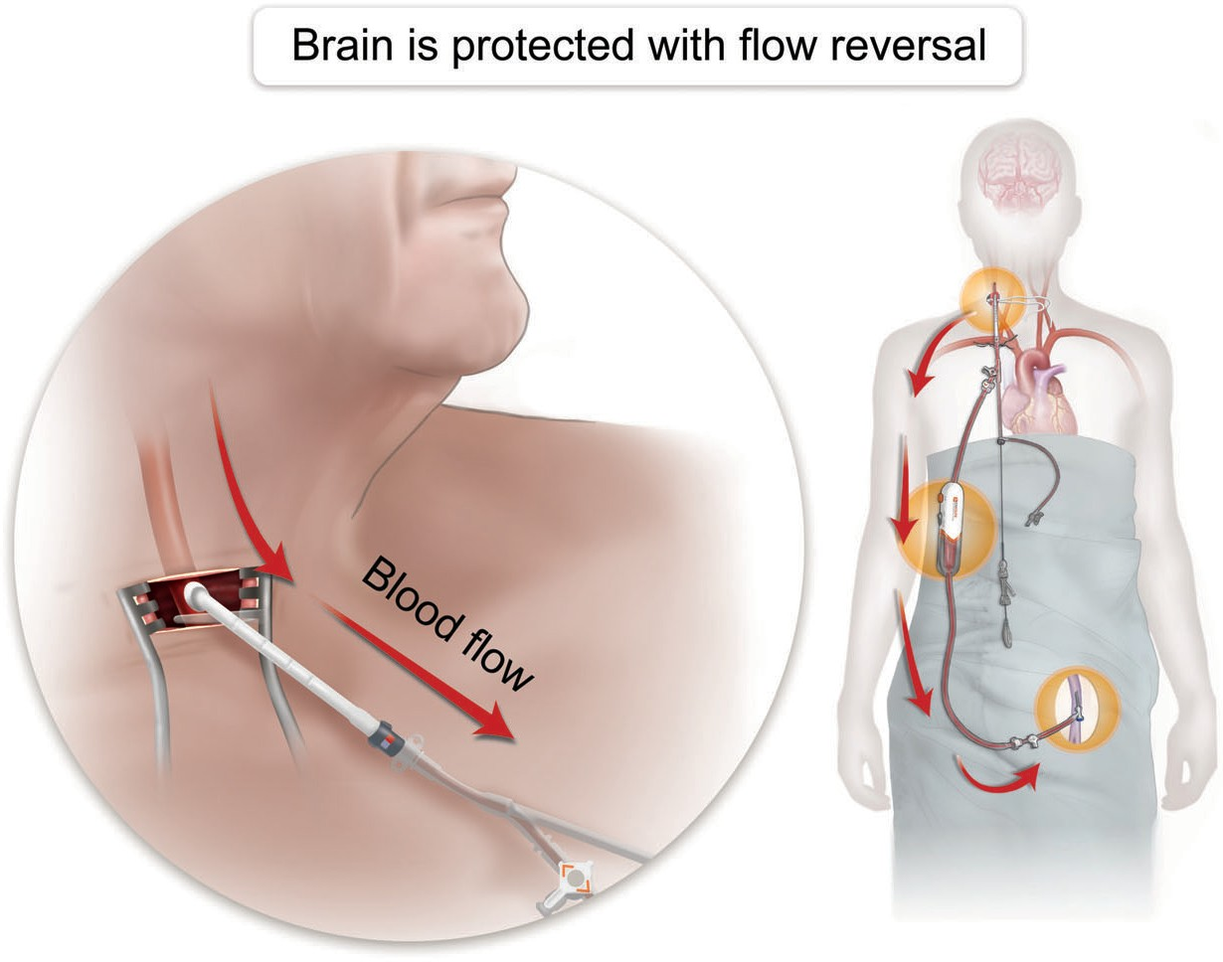

TCAR vs. TFCAS
Benefits of Direct Access
Brain is protected with flow reversal
Wire/sheath moves up femoral artery and across aortic arch to common carotid artery (CCA)
Distal embolic device is deployed which can sometimes create more problems.
TCAR
TF-CAS
Notes:
Besides the minimal scar, TCAR has additional benefits that patients experience with CEA such as numbness, tugging, and inability to shave.

Slide 18
Challenge: “Delivery”, Not “Performance Durability”
Long-Term Results of Stenting versus Endarterectomy for Carotid-Artery Stenosis
Carotid stents are effective long-term!!!
CREST (10 years data): NO difference in postprocedural ipsilateral stroke or restenosis
CREST Trial: N Engl J Med 2016;374:1021-31

Slide 19
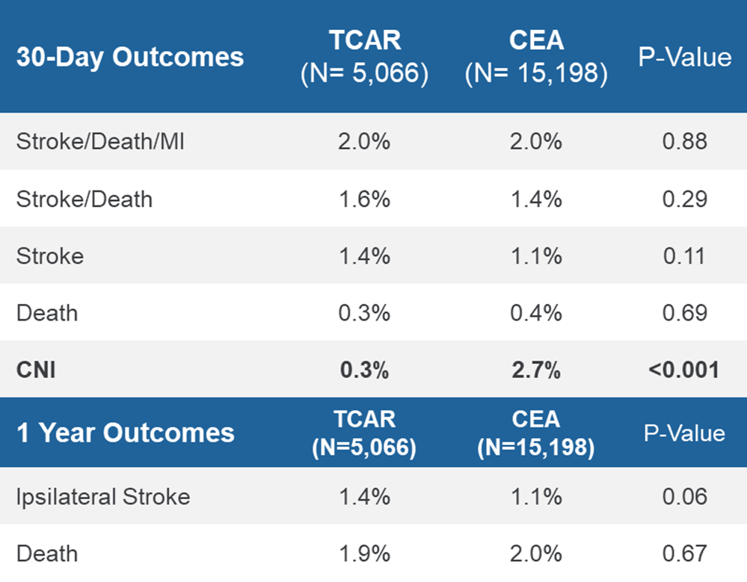
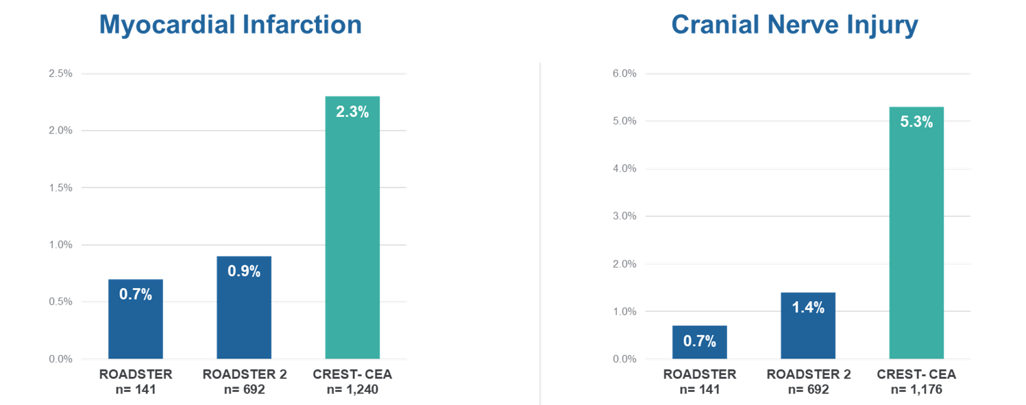
TCAR vs CEA
Notes:
Smaller scar
Shorter procedure
Liang P. et al did a retrospective analysis using VQI-TCAR Surveillance Project data from 09/2016-10/2020 comparing outcomes after TCAR vs CEA in SSR patients.
TCAR and CEA have equivalent risk of periop stroke, death, or MI and ipsilateral stroke through 1yr
Less incidence of CNI

Slide 20
Match the Patient with the Procedure
CEA
TCAR
CEA & TCAR
EXPANSION OF THE LABEL
High Lesions
Lesions with
Prohibitive Calcium
Hostile Neck
Reoperative
site
Expands patient options and fits the procedure to the patient
Significant Liquid Thrombus
Frail Patients/
High Risk for GA

Slide 21
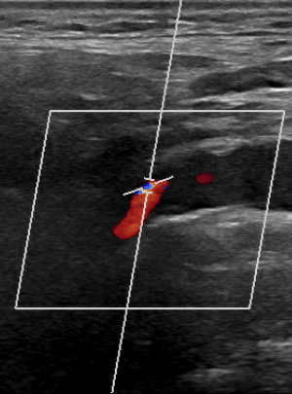
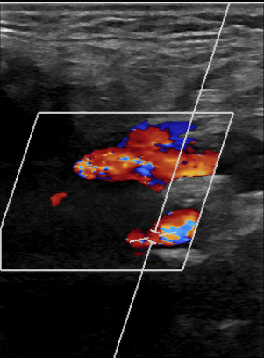
Patient
Laterality | Right | Left
PSV (cm/s) | 753 | 457
EDV (cm/s) | 292 | 220
ICA/CCA ratio | 10.90 | 4.81
65M
PMH: HTN, HLD
Tonsillectomy and neck XRT for CA
Right hand dominant
Asymptomatic severe bilateral CAS diagnosed on screening US performed by PCP
→ staged TCAR with 6-week interval
Right
Left

Slide 22
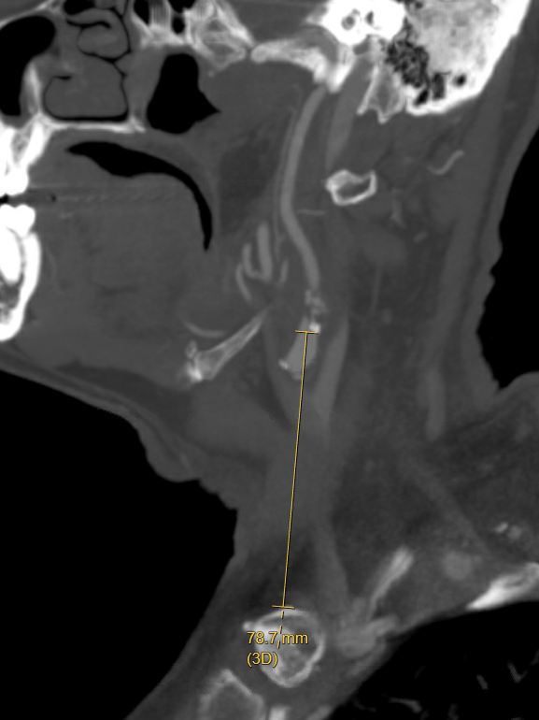

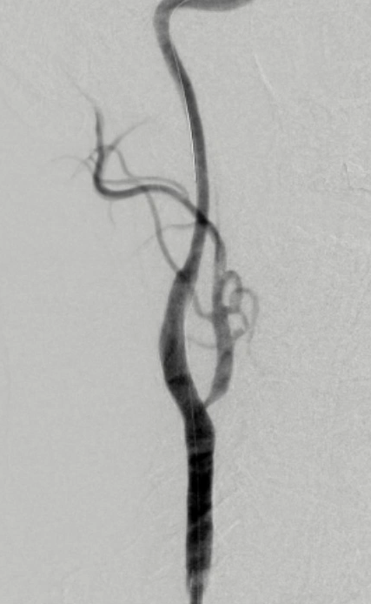
Pre-procedural CTA | Carotid angiogram | Completion
STOP short
6mm pre-dilation
10x40mm stent

Slide 23
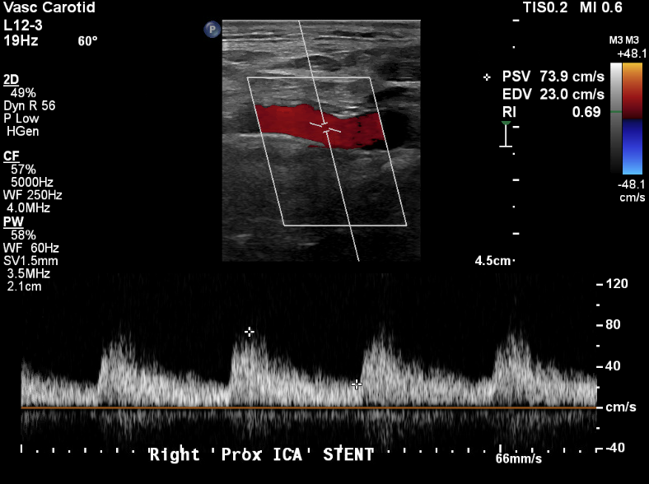
Patient
Pre-procedural CTA | Carotid angiogram | Completion
4-week follow-up

Slide 24
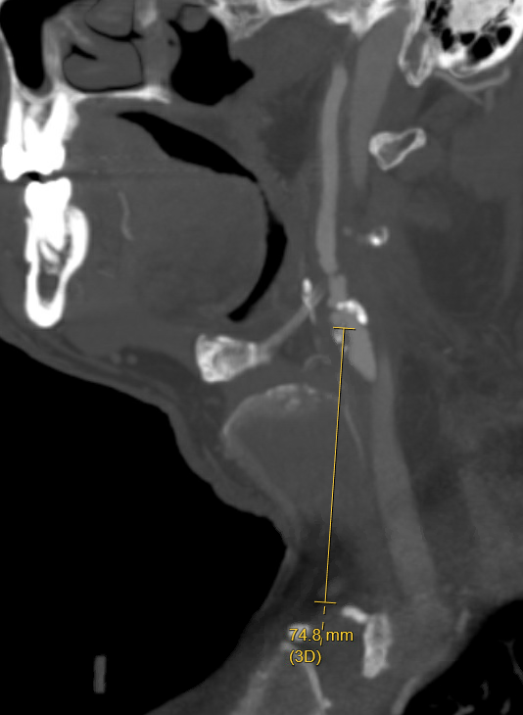
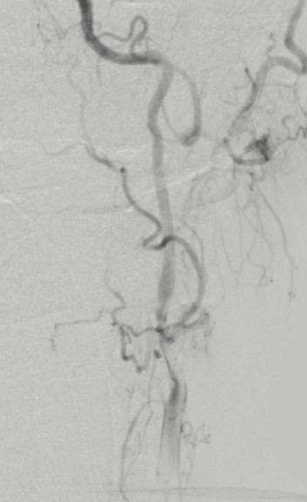

Pre-procedural CTA | Carotid angiogram | Completion
5mm pre-dilation
10x40mm stent
5.5mm post-dilation

Slide 25
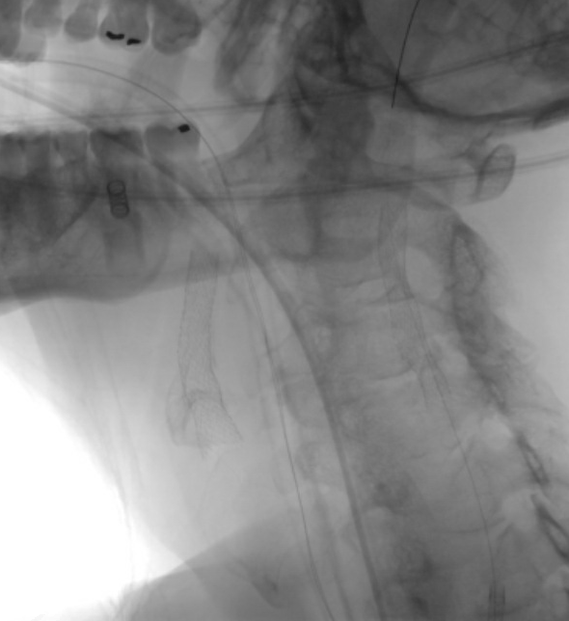
Patient
Pre-procedural CTA | Carotid angiogram | Completion

Slide 26
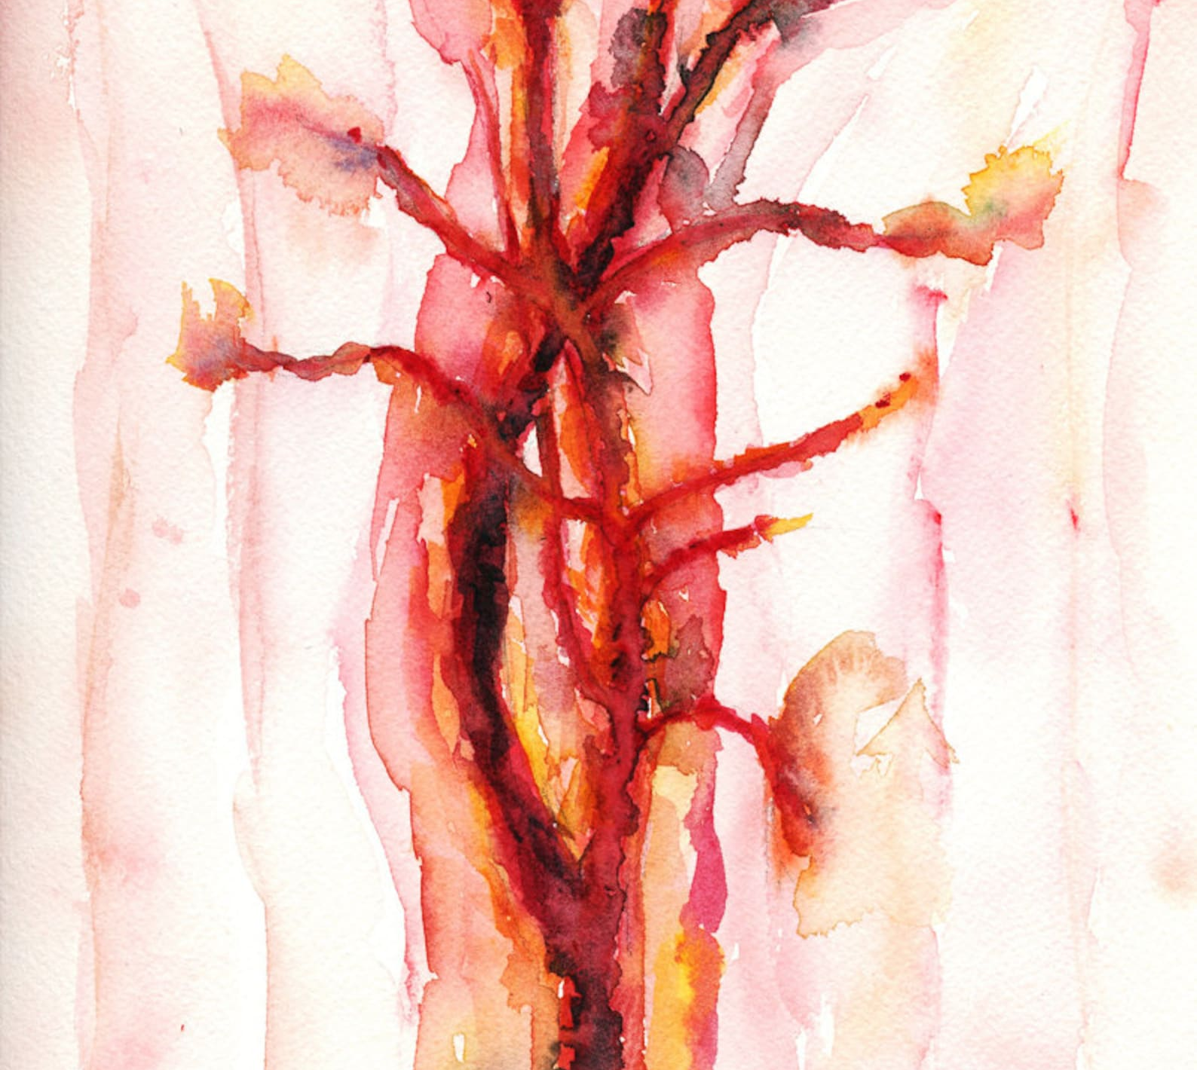
Thank you

