Slide 1

Innovative solutions to sudden cardiac arrest in our community
John Lazarus MD PhD

Slide 2
Sobering Statistics of Cardiac Arrest
Incidence of 356,461-405,000 cardiac arrests in the United States
Only 1/2 of these are treated with ACLS
29.5% of patients were examined in the ED within 90 days prior to cardiac arrest

Slide 3
Sobering statistics of Cardiac Arrest
Location of Cardiac arrest
Residence (69.5%),
Public settings (18.8%)
Nursing homes (11.7%)
Sports-related cardiac arrest accounts for 39% of sudden cardiac death <18 years
Common causes include HCM, coronary artery anomalies, WPW, Long QT syndrome

Slide 4
Sobering statistics of Cardiac Arrest
Survival to Hospital Discharge 10.4%
Survival with good neurologic function was 8.4%
Age-adjusted survival
African Americans (6.0%)
Hispanics (8.6%)
Caucasian (11.3%)

Slide 5
Rural Challenges in cardiac arrest response
Response times often 15-20 minutes or more due to:
  Long travel distances
  Delays in mobilize volunteers
  Crews tied up at other emergencies
  Poor road conditions
  Weather-related delays
Lower bystander intervention due to:
  More sparse population
  Lack of training resources
  Beliefs to wait for professionals to arrive
Fewer community-based AEDs

Slide 6
AED Access Issues
Most are not accessible after business hours
Bystanders do not know where AEDs are located
AED owners do not know when arrest occurs nearby
Few AEDs in homes where most arrests occur
Few AEDs in rural areas
Bulky and heavy -- not easily portable
Expensive
Some are not properly maintained
Better Access = More Lives Saved!

Slide 7
Local cardiac arrest statistics
      10+ cardiac arrests in our community per month
      80% of cardiac arrests occur at homes where there is no AED access
      Recent arrests in local public places include:
      Tiki Lanes (3), Lancaster HS (3), Liberty Union MS, Thornville AmVets, Thornville Moose, Chieftain Center, Kroger, Meijer, Matt Taylor Kia, Old Man’s Cave, New Dimensions Gym

Slide 8
Community Heart Watch Mission
Improve cardiac arrest survival
in Fairfield, Hocking and Perry Counties by:
Increasing Awareness and early recognition
Training First responders in CPR
Increasing access to AEDs
  Documenting AED locations
  Mobile AED in rural communities
  Neighborhood AED program
  Enhancing

Slide 9
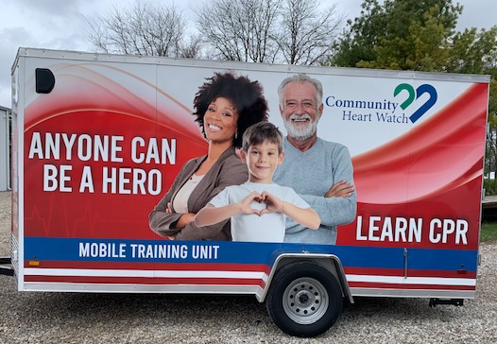
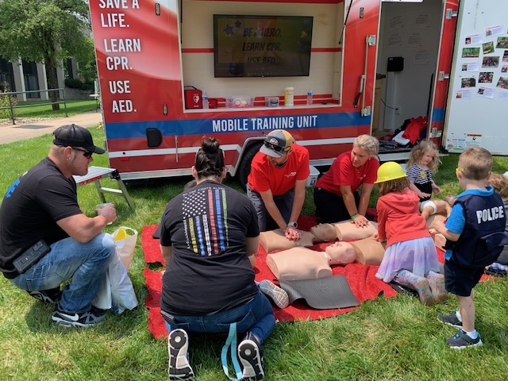
our mobile training unit!
Training locations
-Schools
-Business
-Fairs
-Parks

Slide 10
Community Heart Watch Mission
Improve cardiac arrest survival
in Fairfield, Hocking and Perry Counties by:
Increasing Awareness and early recognition
Training First responders in CPR
Increasing access to AEDs
  Documenting and optimize AED location
  Mobile AED in rural communities
  Neighborhood AED program
  Next generation “SMART” AED technology

Slide 11
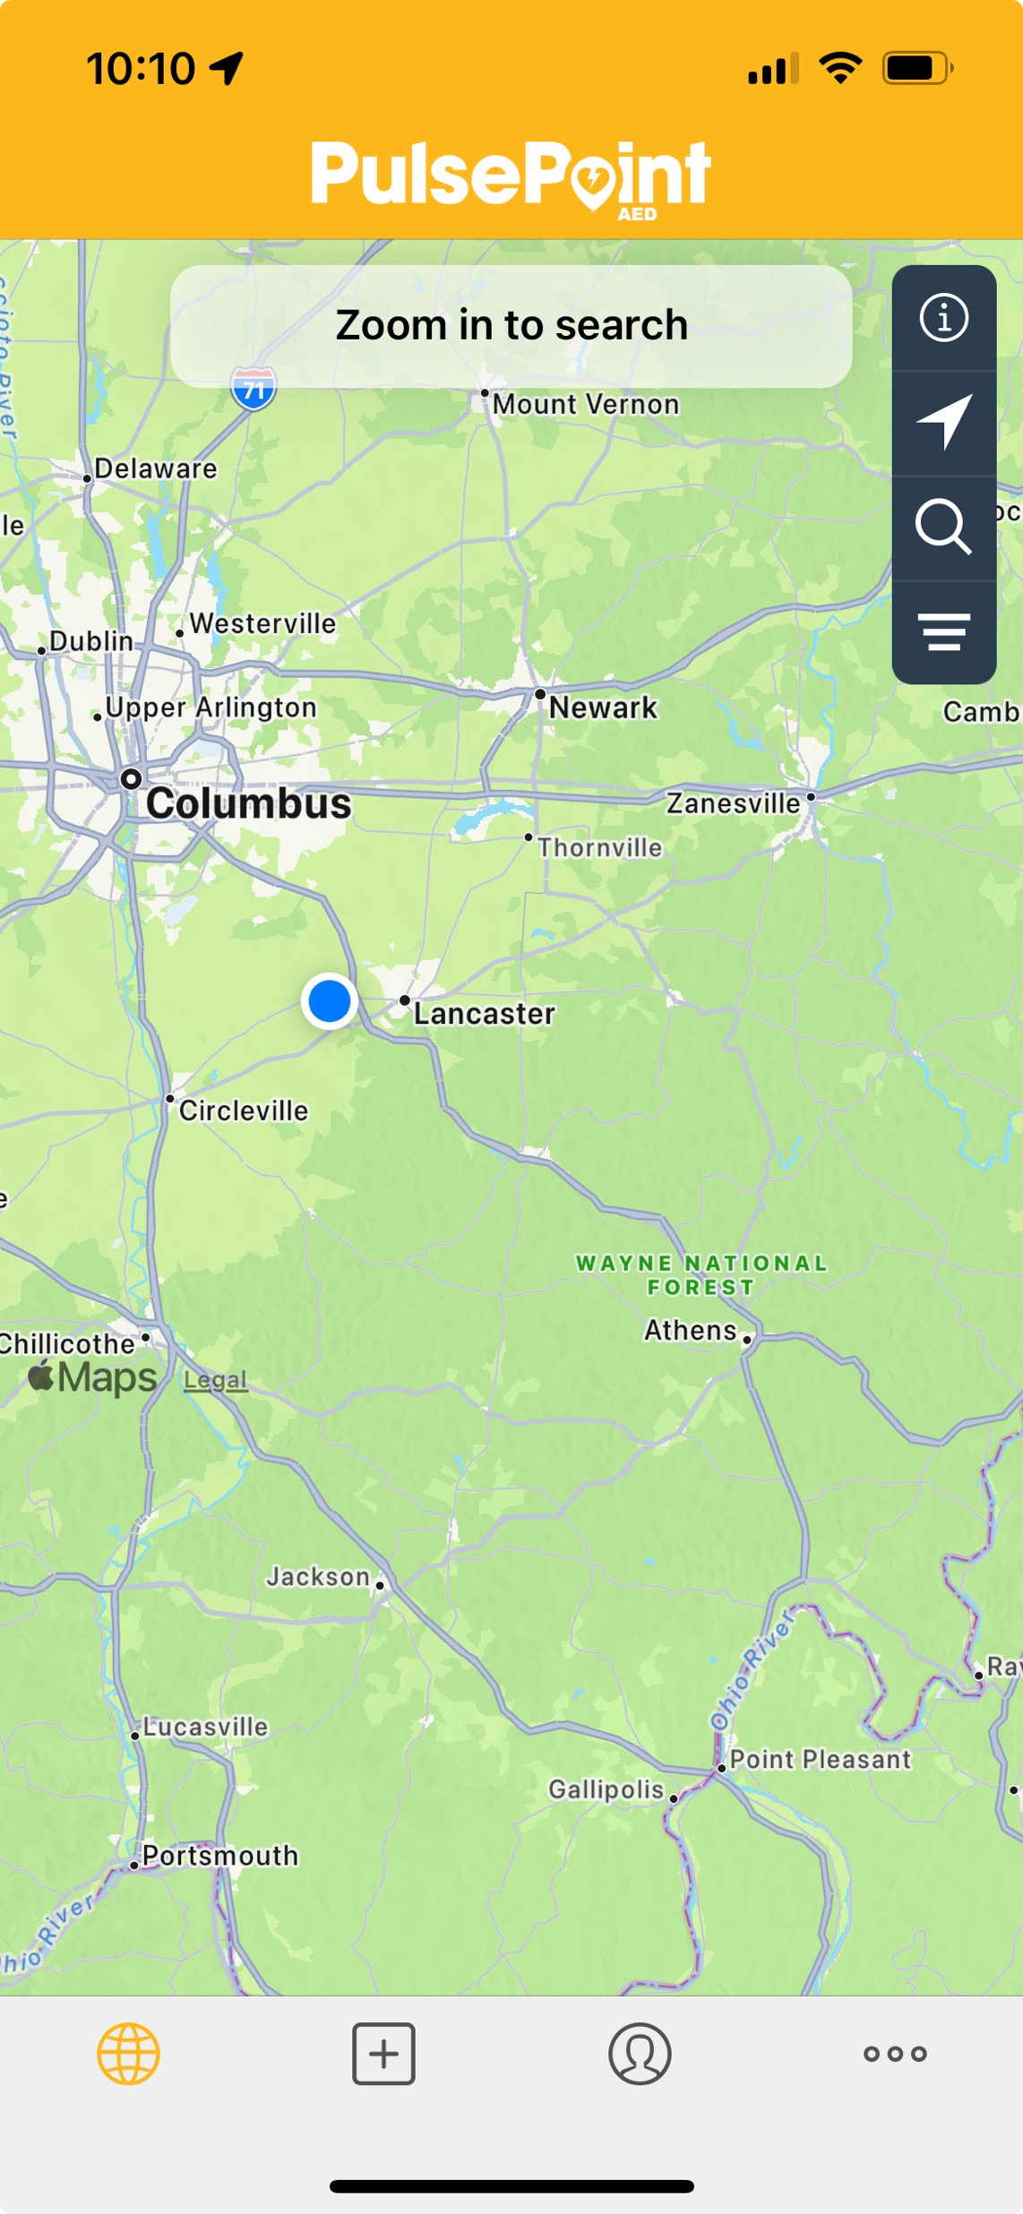
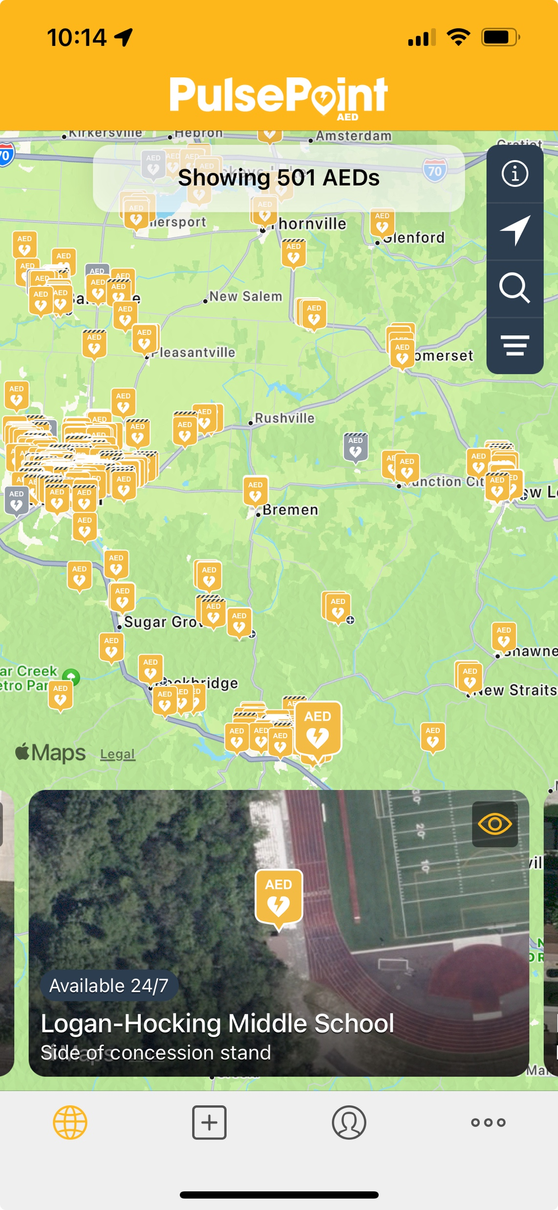
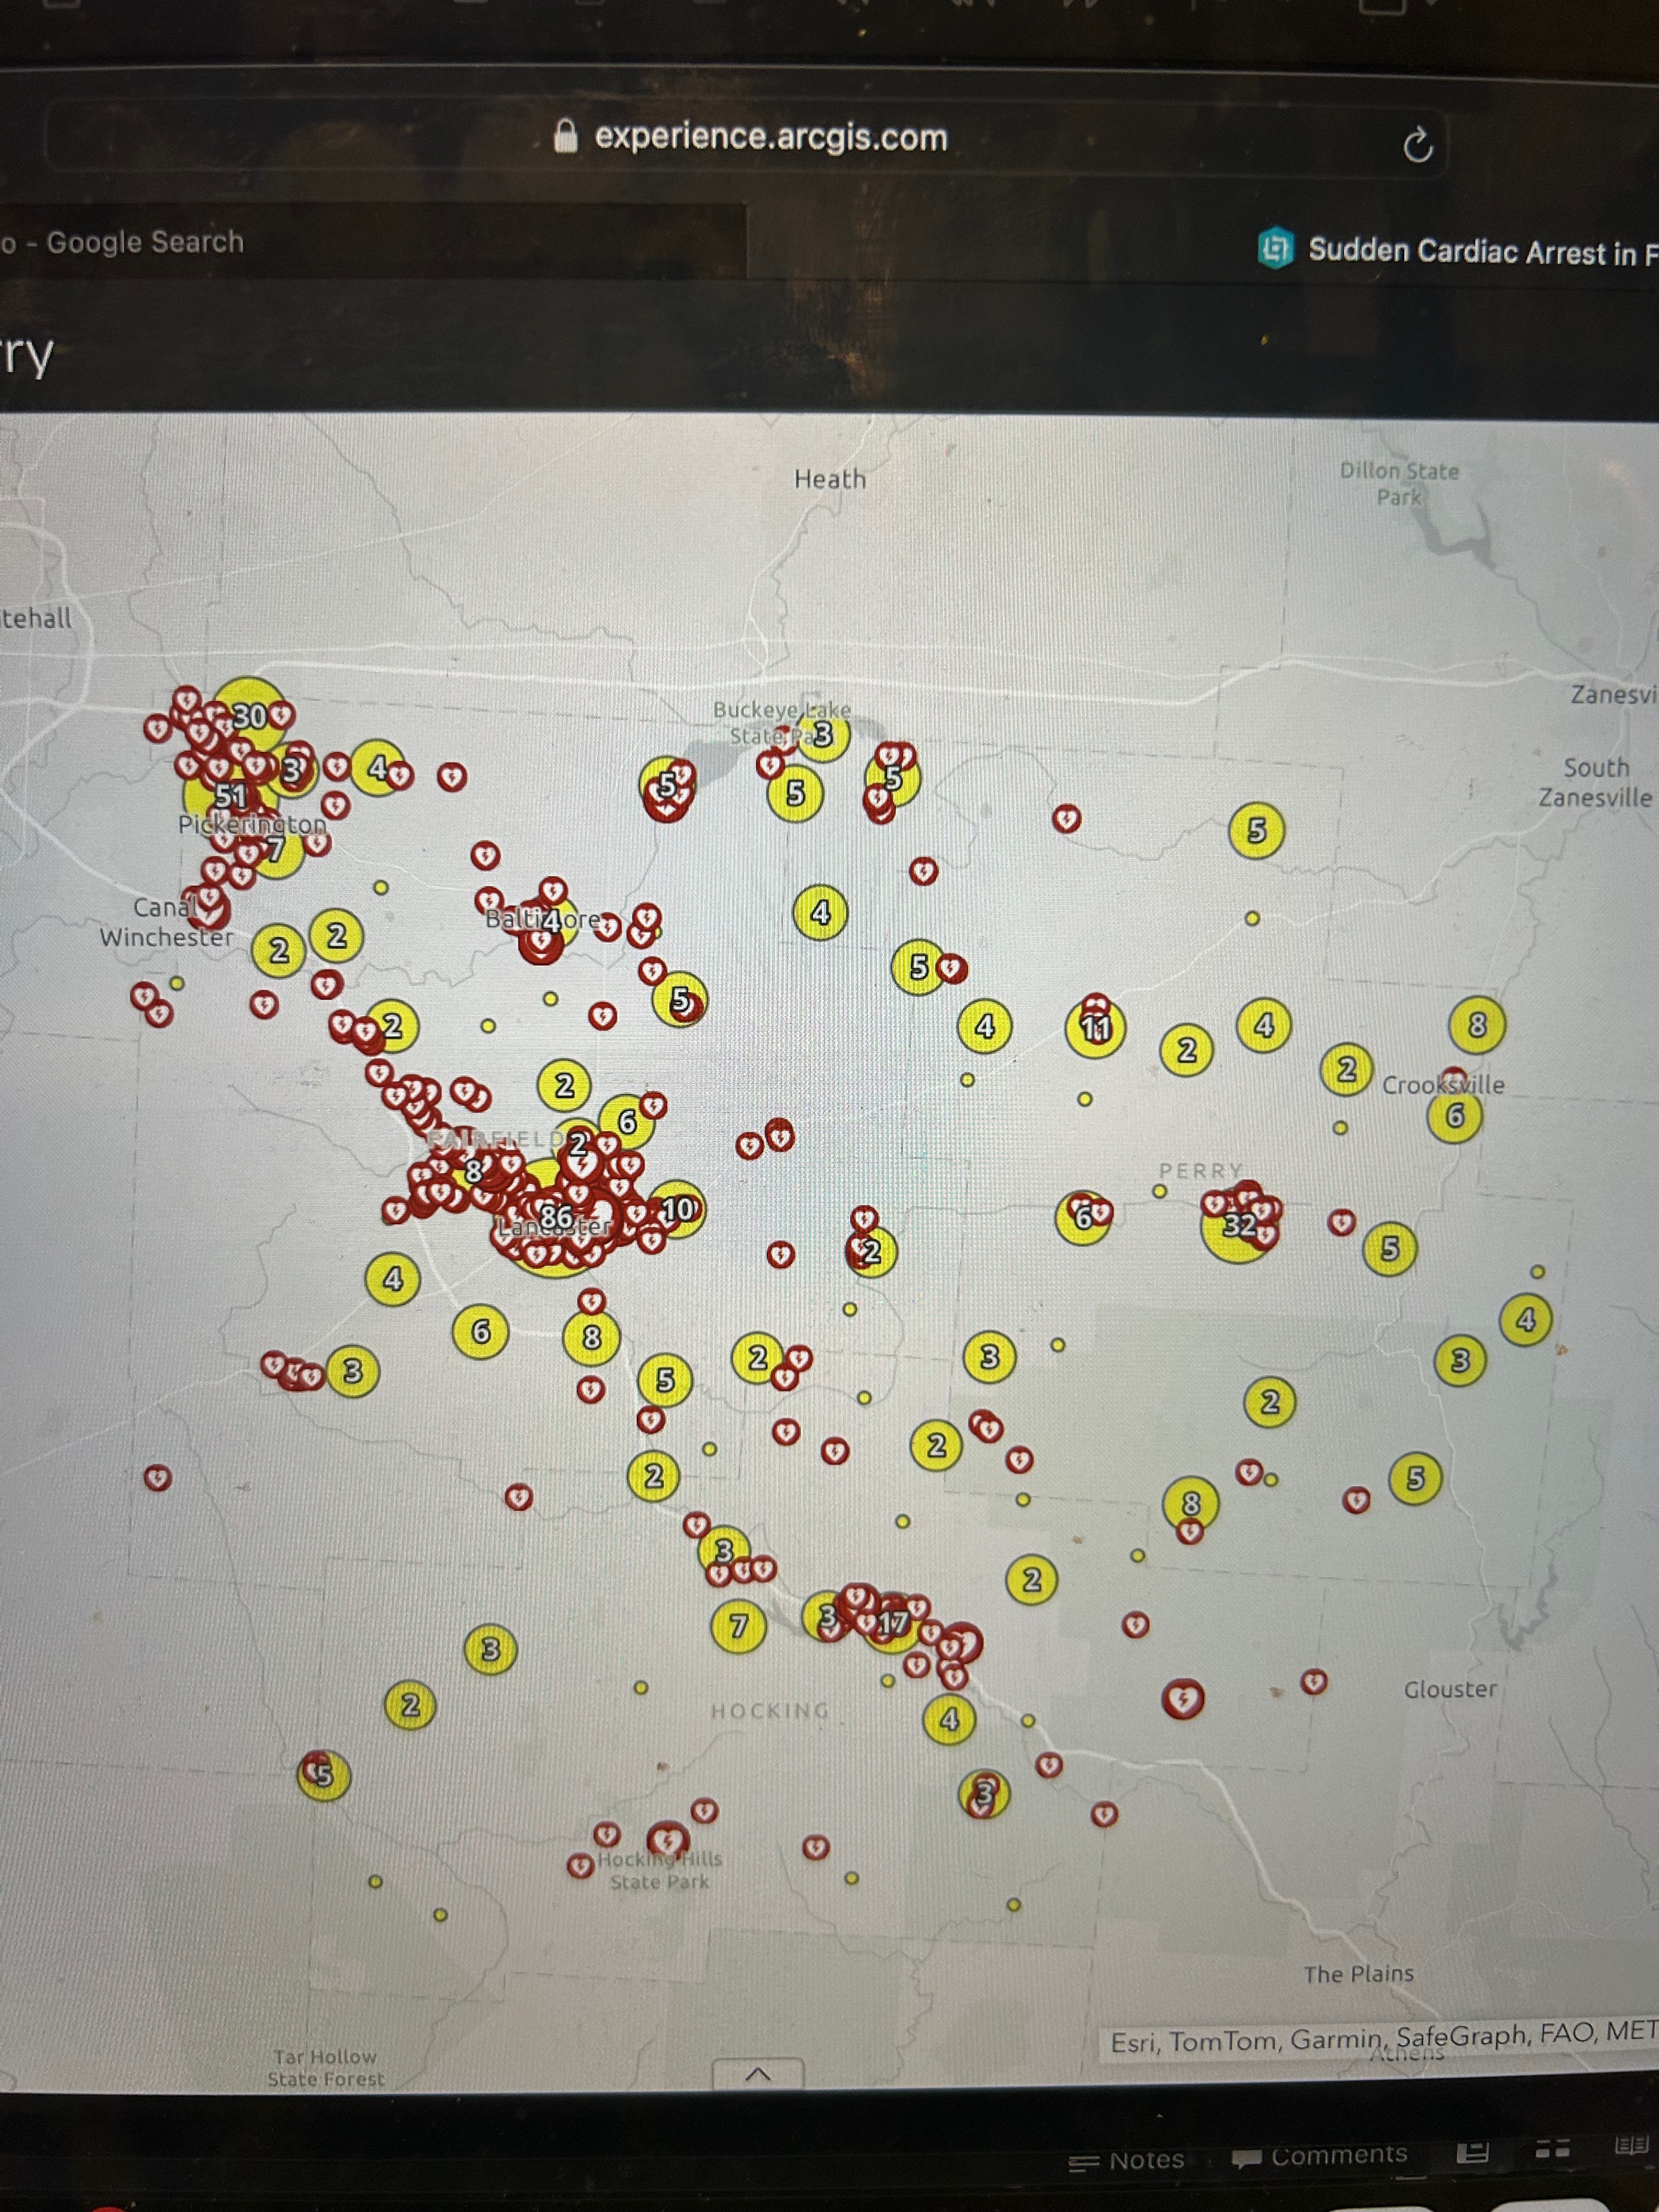
Pulse point AED

Slide 12
Mobile AEDs
  Law enforcement AEDs – AEDs placed in law enforcement vehicles which often arrive first on scene in rural areas:
      Perry County Sheriff (9 AEDs)
  Neighbors Saving Neighbors: AEDs placed with volunteer medics to bring directly to the scene:
      Shawnee Volunteer Fire (3)
      New Lexington Fire (5)

Slide 13
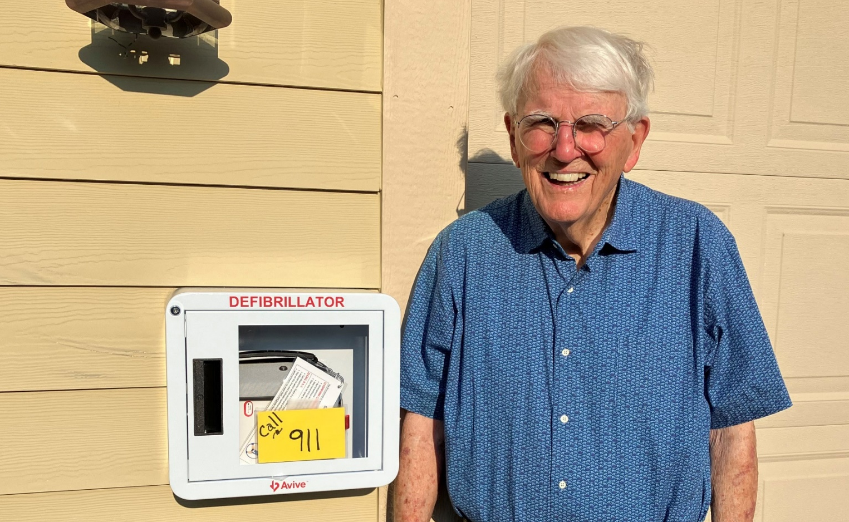
Neighborhood AED Program
First neighborhood: Stone Glen -- Dr Gordon Snider

Slide 14
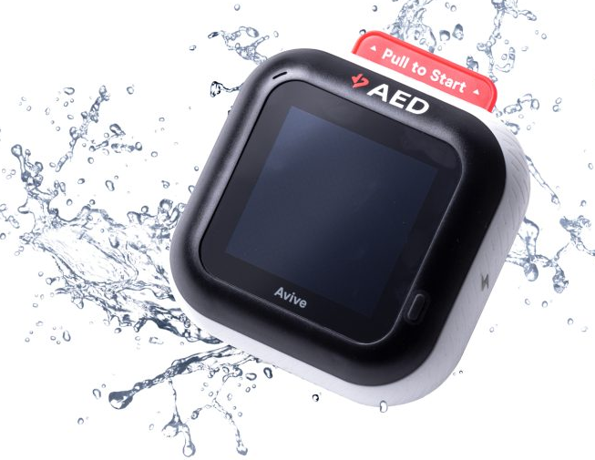
Avive = SMART AED Technology

Slide 15
Avive = Smart AED
Wi-Fi, Cellular, GPS, Blue Tooth Connectivity
  Interfaced with 911 so Avives near an arrest can be activated by dispatcher to send an alert to bring the AED to the scene
  Immediate access to incident reports
  Notifications to owner when Avive is at risk
  GPS tracking if Avive is lost or stolen

Slide 16
Other Attractive Features
  Rechargeable battery
  Universal adult/pediatric pads
  Audio and visual instructions
  Includes 1 set of pads per year
  Easily converts to trainer
  Smallest, most portable AED (2.2 pounds)

Slide 17
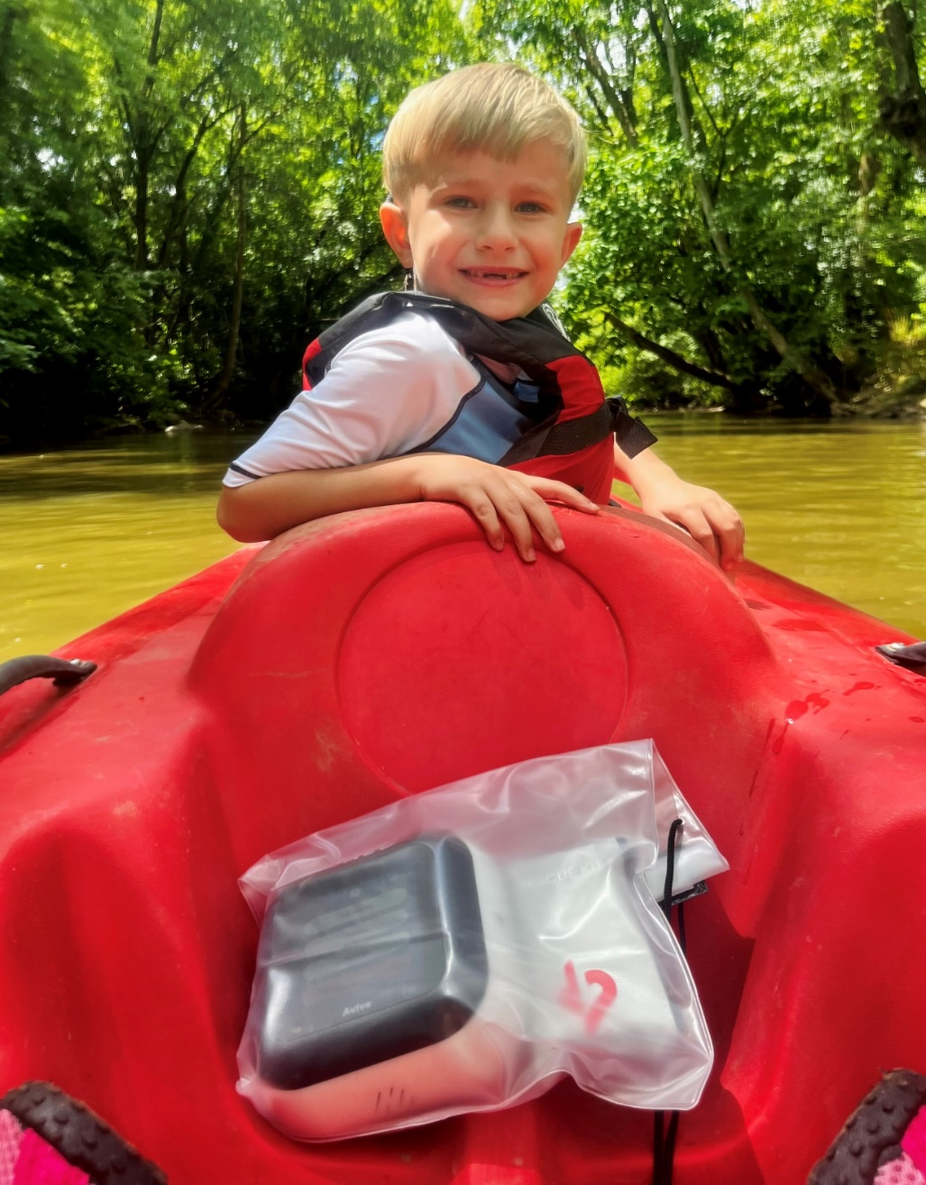
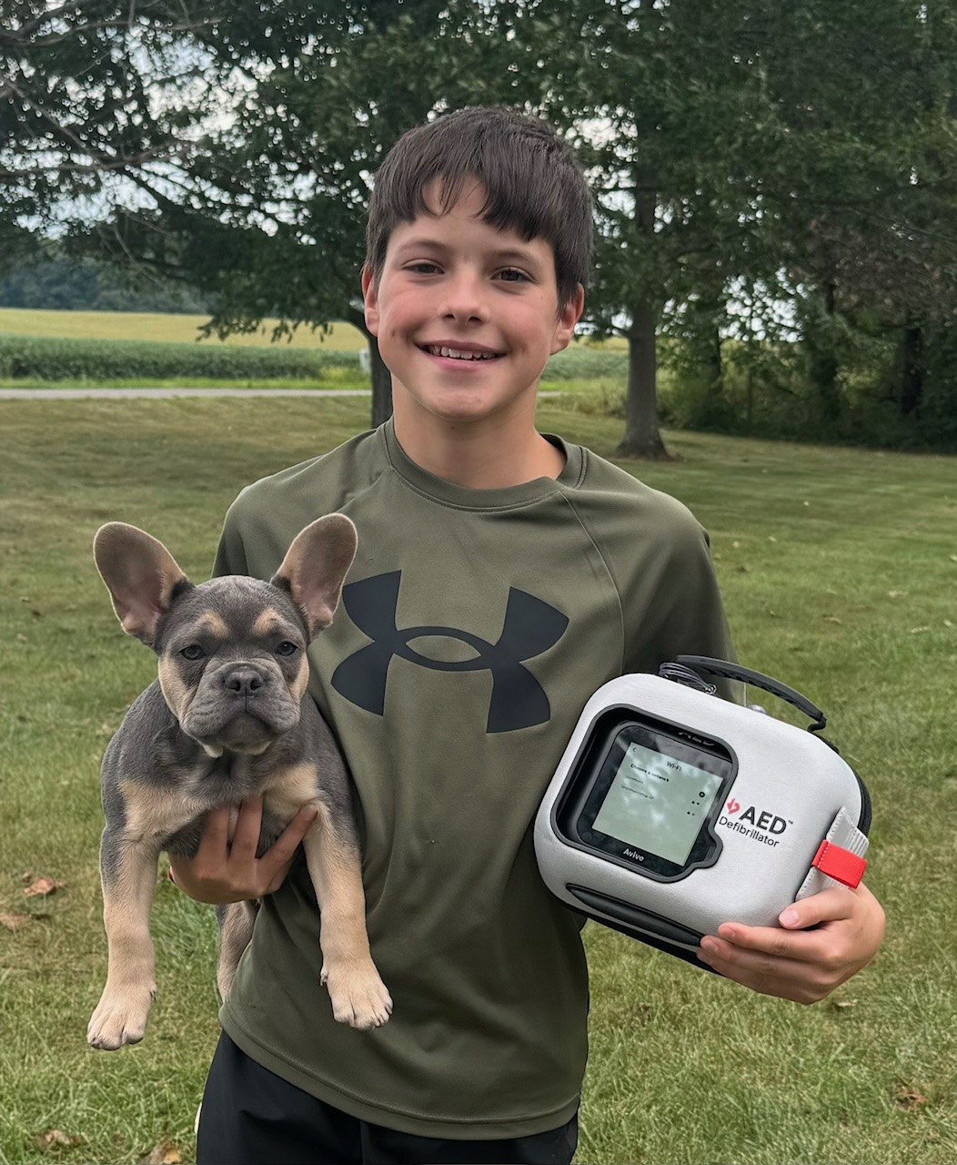
Take it Anywhere!

Slide 18
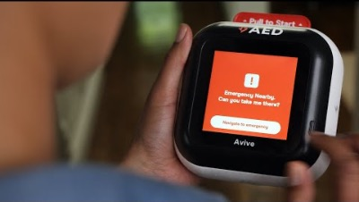
https://www.youtube.com/watch?v=2p4zfOWo62E

Slide 19
Our Goal – Heart Smart Community
Avives – 200
  Currently at 162
  Grow “Neighborhood AED” program
  Grow “Heart Safe Youth Sports” program
Traditional Stand-Alone AEDs – 800+
  Interface PulsePoint with dispatch system
  Convert to Avive as devices become obsolete

Slide 20
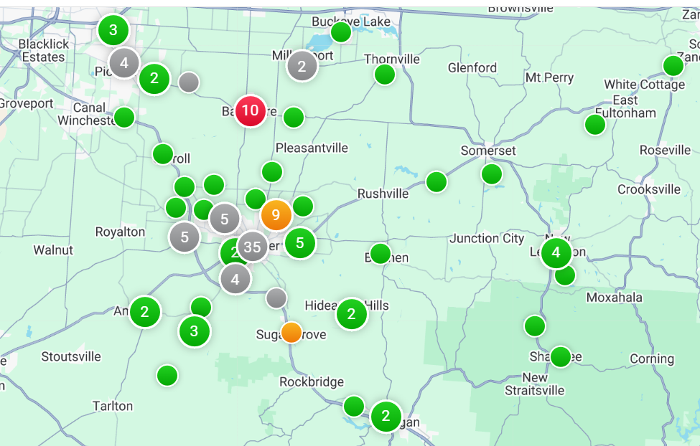
Avive Locations

Slide 21
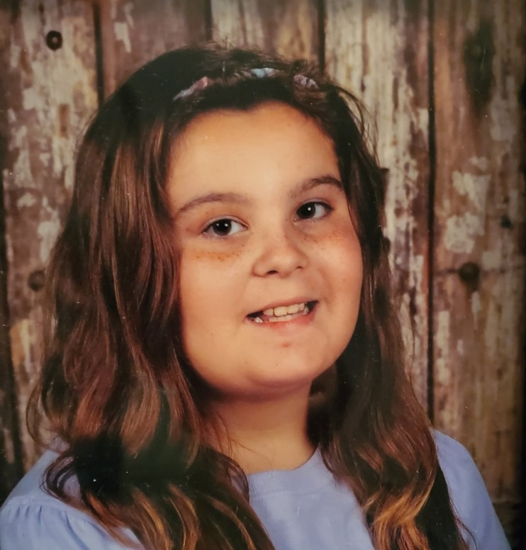
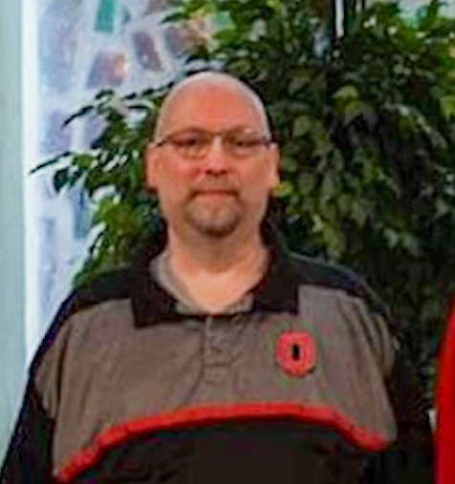
Many Lives Saved
Kylie Alkire, Age 10
Liberty Union Middle School Dance
David Kemmerling, Age 56
Bowling at Tiki Lanes

Slide 22
Thank You to Community Partners
  Donated 30 Avive to local non-profits
      Fairfield Federal
      Park National Bank
      Friendly Bremen Banking Center
  Grant from PNC/Martens Charitable Trust for 15 Avive
  Fairfield County -- Commissioners and staff

Slide 23
Thank You to Community Heart Watch members
  Teri Watson, Chair
  John Lazarus, Clinical Chair
  Brad Smith, EMS Chair
  Jeremy Young, EMS Co Chair
  Jim Mickey, EMS Co Chair
  Sarah Mcgraw Thimmes, School Chair
  Matt Wideman, Business Chair
  Deserae Belcher, Hospital Chair

Slide 24
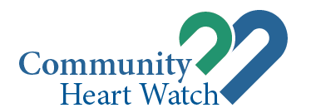

Slide 25
8 Year Cost -- Avive
 | Lease | Purchase*
Cost | $2, 792 | $2,438
Average cost per year | $350 | $305
Traditional, stand-alone AED = $3,676 ($460 per year)
* Purchase = $1,395 for Avive with 1 free year of connectivity + 7 years connectivity at $150 per year

Slide 26
Our Members
EMS: Lancaster, Greenfield Twp, Bloom Twp, Violet Twp, Basil Joint, Walnut Twp, Hocking Twp, Pleasant Twp, Thorn Twp, Hocking County, Berne Twp, New Lexington, Amanda Twp
Schools: Lancaster City, Bloom Carroll
Public Health: Fairfield County Health Department, Perry County Health Department, Fairfield County EMA, Fairfield County Dispatch Center
Hospitals: Fairfield Medical Center, Somerset ED
Businesses: Fairfield Federal Savings & Loan, Park National Bank, Vinton County Bank, Lancaster Fairfield County Chamber of Commerce, Pickerington Chamber of Commerce

