Slide 1

Novel Risk Factors For Cardiovascular Disease
Ali O. Malik MD., MSc.

Slide 2
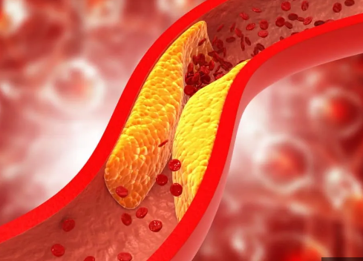
Prevention: Traditional Risk Factors
Blood Pressure <130/80
Lipids
Glycemia
Smoking

Slide 3
Prevention: Novel Risk Factors
Psychosocial Stress
Psychosocial Stress
Ambient Air Pollution
Ambient Air Pollution

Slide 4
What is Stress?
Perceived Ability to Cope
Perceived Threat
Secondary Appraisal
Perceived Inability to Cope
Situation
Primary Appraisal
STRESS
No Perceived Threat
Lazarus and Folkman Transactional Model of Stress. Stress Appraisal and Coping 1984

Slide 5
4-point Perceived Stress Scale
Scores 0 ➔16
↑ score indicates higher stress
No “cut-off”
Patient scores compared to normative score from general population
Normative score in English population was 6
Scores 0 ➔16
↑ score indicates higher stress
No “cut-off”
Patient scores compared to normative score from general population
Normative score in English population was 6
The questions in this scale ask you about your feelings and thoughts during the last month. In each case, please indicate with a check how often you felt or thought a certain way.
 | 0 | 1 | 2 | 3 | 4
1. In the last month, how often have you felt that you were unable to control the important things in your life?
2. In the last month, how often have you felt confident about your ability to handle your personal problems?
3. In the last month, how often have you felt that things were going your way?
4. In the last month, how often have you felt difficulties were piling up so high that you could not overcome them?
Cohen S, 1983
Warttig SL, 2013
Warttig SL, 2013

Slide 6

Stress in Cardiovascular Disease: Mechanisms
Stress
Direct Physiological Effects
↑ DM, HTN, Lipids
↑inflammation
↑ Hormonal Activity
Lifestyle
↑ smoking, alcohol, drugs
↓ Sleep
↓ Nutrition
Disease Specific Behavior
↓ compliance
Delays in seeking care
Obscure symptom profile
Lifestyle
↑ smoking, alcohol, drugs
↓ Sleep
↓ Nutrition
Disease Specific Behavior
↓ compliance
Delays in seeking care
Obscure symptom profile
Bad Outcome
Hamer M., J Am Coll Cardiol. 2008

Slide 7
Stress and Cardiovascular Risk: Outcomes
↑ Risk of MI
2 X higher risk
Rosengren A. et al. Lancet 2004
↑ Mortality in CAD
↑ Mortality in CAD
2 X higher risk (women)
Iso H et al. et al Circulation 2002
Iso H et al. et al Circulation 2002
↑ Mortality after MI
↑ Mortality after MI
Higher risk
(OR 1.4)
Arnold SV. et al. JACC 2012
Arnold SV. et al. JACC 2012

Slide 8
Contemporary Outcome Data: PORTRAIT study
2015-19: Multiple Sites across USA
New PAD
Symptoms
Baseline
Assessment
3-month
Follow-up
6-month
Follow-up
1-year
Follow-up
Chronic Assessment of Psychosocial Stress
Malik AO. et al. JAMA Netw Open. 2020 Jun

Slide 9
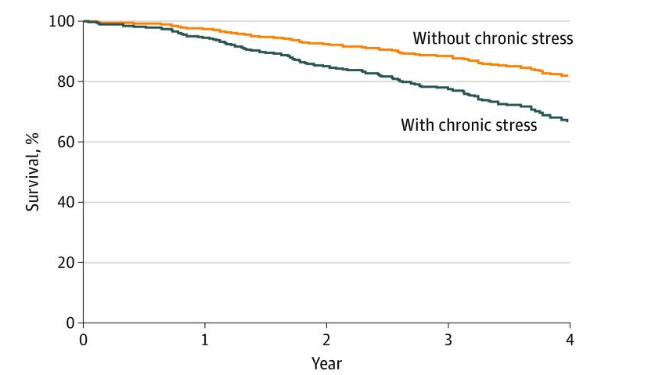
Mortality: Impact of Chronic Stress
Malik AO. et al. JAMA Netw Open. 2020 Jun

Slide 10
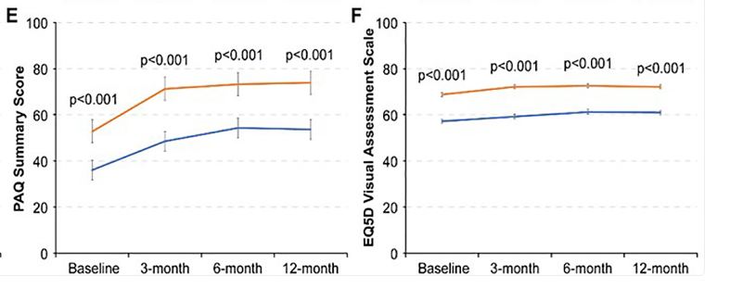
Quality of Life: Impact of Chronic Stress
Malik AO. et al. J Psychosom Res. 2021 Jan

Slide 11
Psychosocial Stress: What can we do?
Traditional Risk Factors
Smoking cessation
HTN, DM
Physically inactive
Assessment of Risk
Patient Encounter
Risk of Bad
Outcome

Slide 12
4-point Perceived Stress Scale
The questions in this scale ask you about your feelings and thoughts during the last month. In each case, please indicate with a check how often you felt or thought a certain way.
 | 0 | 1 | 2 | 3 | 4
1. In the last month, how often have you felt that you were unable to control the important things in your life?
2. In the last month, how often have you felt confident about your ability to handle your personal problems?
3. In the last month, how often have you felt that things were going your way?
4. In the last month, how often have you felt difficulties were piling up so high that you could not overcome them?
Scores >6
Cohen S, 1983
Warttig SL, 2013
Warttig SL, 2013

Slide 13
Psychosocial Stress: What can we do?
Traditional Risk Factors
Smoking cessation
HTN, DM
Physically inactive
Traditional Risk Factors
Smoking cessation
HTN, DM
Physically inactive
Psychosocial Stress
Assessment of Risk including PSS-4
Patient Encounter
Risk of Bad
Outcome
Coping Skills for Stress
Cognitive Behavioral Therapy
Transcendental Meditation

Slide 14
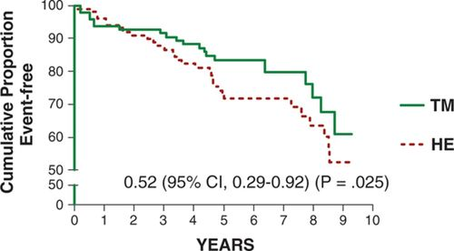
Coping Mechanisms: Transcendental Meditation
Black patients with stable CAD
Transcendental Meditation vs Health Education
  Six 1-2 hour sessions
  Then weekly, biweekly, monthly sessions
Outcome: composite of all-cause death, non-fatal MI and non-fatal stoke
Schneider RH., et al. Circ Cardiovasc Qual Outcomes. 2012 Nov

Slide 15
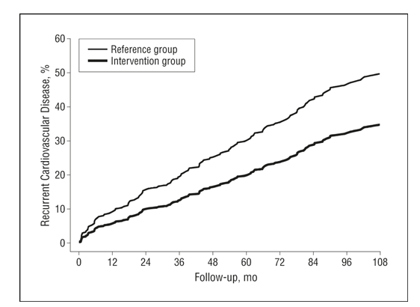
Coping Mechanisms: Cognitive Behavioral Therapy
Patient discharged after MI, PCI or CABG
CBT vs Standard Care
  20 two-hour sessions over 1-year
  Behavioral Exercises on stress management, coping,
  Highly structured and standardized
Outcome: All cause death, non-fatal MI/stroke, revascularization,
CV events in patients discharged with diagnosis of CAD
Gulliksson M., et al. Arch Intern Med. 2011 Jan

Slide 16
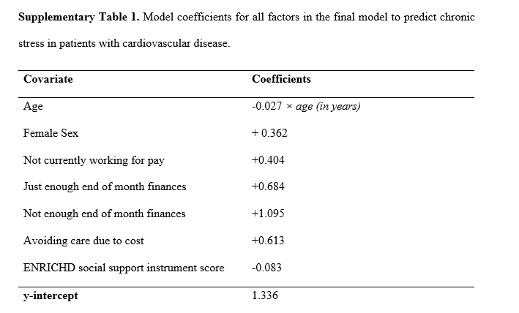
Coping Mechanisms: Real Life
Malik AO. et al. PLoS One. 2022 Oct

Slide 17
Local Resources
Kim Kohli PhD., MHA.
Transcendental Meditation
Mediate America: Free programs online: https://live.meditateamerica.org/
TM Columbus: https://www.tm.org/en-us/contact-us

Slide 18

Thank You

