Slide 1
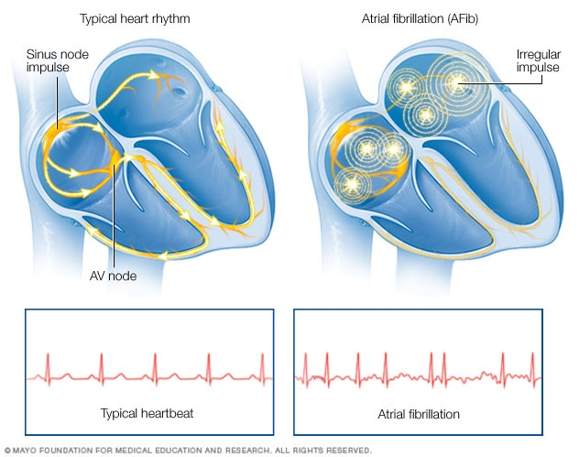
Atrial fibrillation: an update
P Aryeh Cohen MD
CV symposium 2024

Slide 2
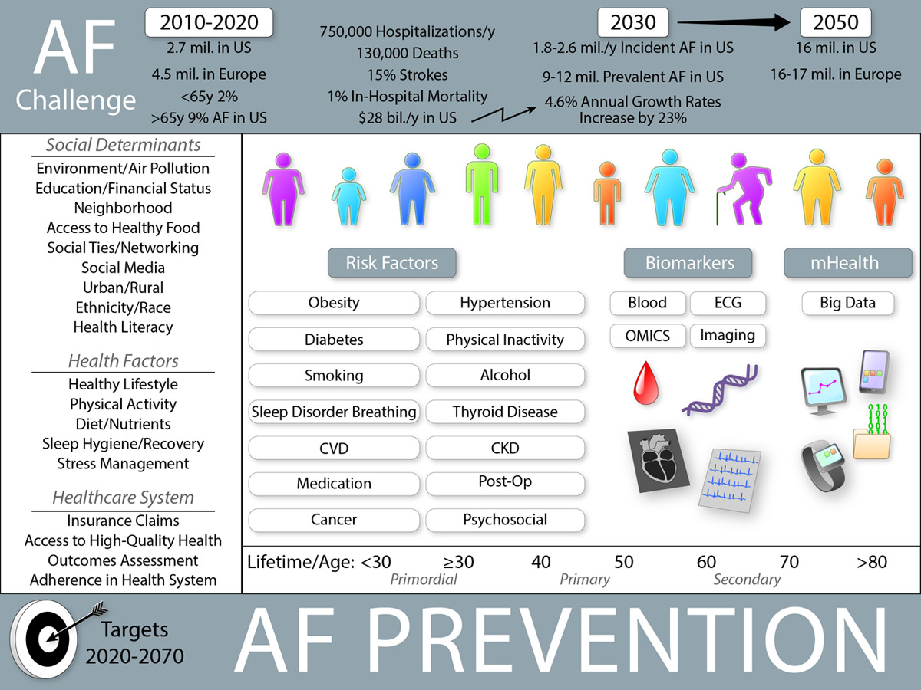

Slide 3
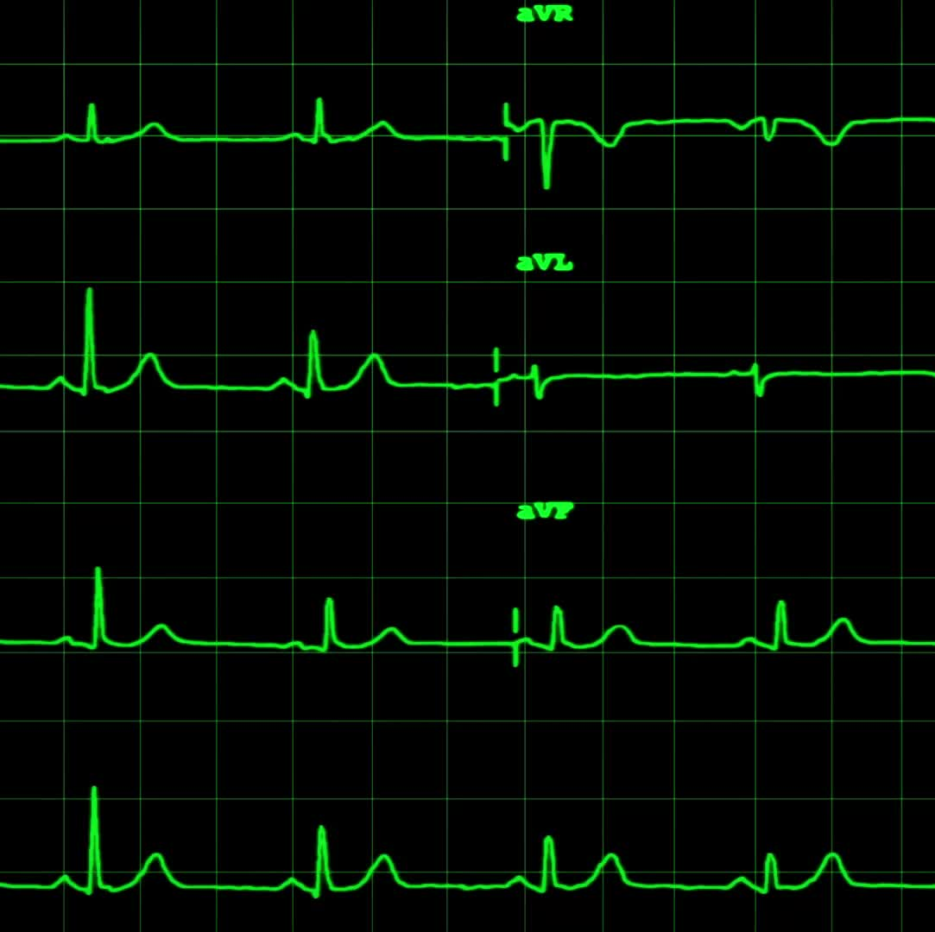
Atrial Fibrillation
Why do we do surgical ablation
EP technology did not always exist, and surgeons had access to the heart

Slide 4
Sinus vs Atrial Fibrillation

Slide 5
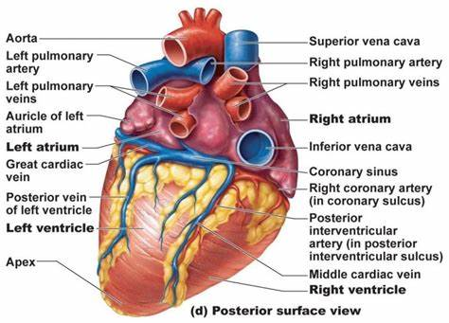
Heart anatomy

Slide 6
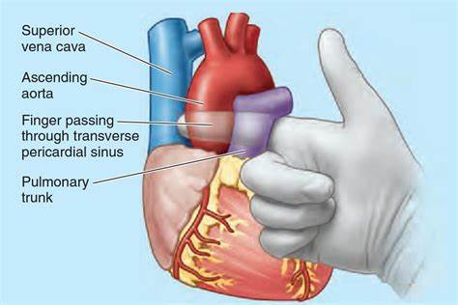
Transverse sinus of heart

Slide 7
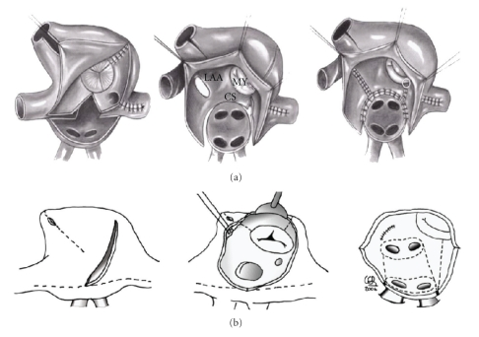
Surgical Cut and sew Cox maze

Slide 8
Ablation of aberrant pathways
Cut and sew
Cryo
Microwave
Radiofrequency
All must create transmural lesions

Slide 9
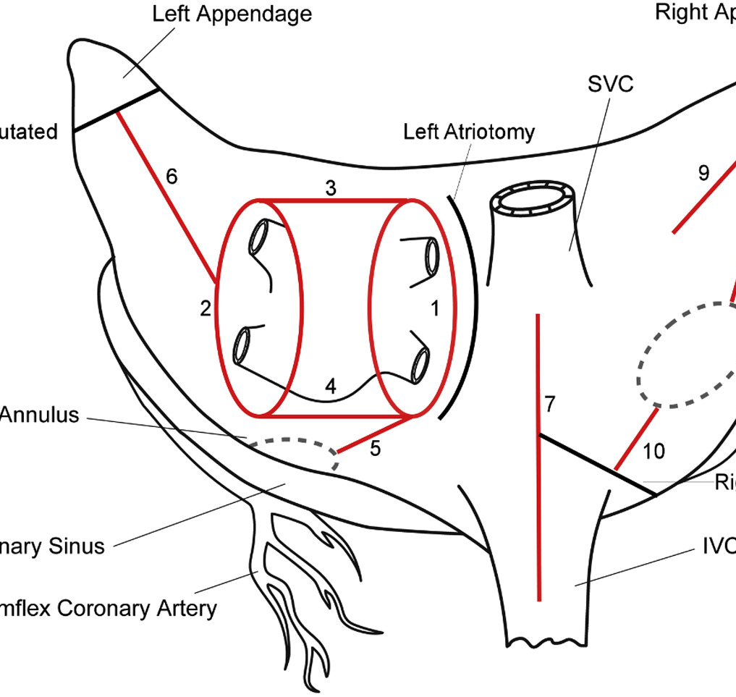
Volume 110, Issue 6P1933-1939December 2020 annals of thoracic surgery
Bipolar Radiofrequency Ablation on Explanted Human Hearts:
How to Ensure Transmural Lesions
Ralph J. Damiano, Jr., MD
Figure 2 Lesions used for the study. Red line denoting bipolar radiofrequency (RF) clamp ablation lines. Black line denoting incision sites. The ablation lines are ordered numerically in the order by which they were performed. Numbers correspond to the order of the lesions as they were performed. (IVC, inferior vena cava; LAA, left atrial appendage; RAA, right atrial appendage; RF, radiofrequency; SVC, superior vena cava.)

Slide 10
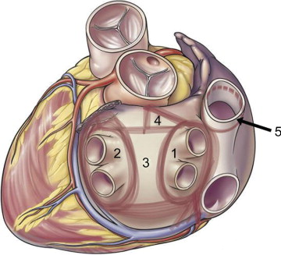
P986-989September 2010
Annals of thoracic Surgery
The Five-Box Thoracoscopic Maze Procedure
John Sirak, MD
Fig 4 The complete five-box lesion pattern encompasses four contiguous compartments: the two pulmonary antra (1,2), the posterior left atrium (3), and an enclosed triangle on the dome of the left atrium incorporating the connection the anterior trigone of the mitral annulus (4), as well as the superior vena cava (5). Additional linear lesions connect both the left pulmonary antrum and the transmitral line to the base of the left atrial appendage, and the right pulmonary antrum to the coronary sinus.

Slide 11
Advancement of EP
With mapping technology and minimally invasive techniques is there a role for surgical ablation?

Slide 12
Practice Guideline | Clinical Practice GuidelineVolume 118, Issue 2 p291-310, August 2024, Annals of Thoracic Surgery
Moritz C. Wyler von Ballmoos, MD, PhD¹ mcwvb@post.harvard.edu ∙ Dawn S. Hui, MD² ∙ J. Hunter Mehaffey, MD, MSc³∙ … ∙ A. Marc Gillinov, MD⁶ ∙ Thoralf M. Sundt, MD⁷ ∙ Vinay Badhwar, MD
In 2017, the STS published a comprehensive clinical practice guideline for the surgical treatment of patients with atrial fibrillation.¹
Over the last 5 years, additional evidence supporting the use of surgical ablation (a landmark trial on the benefits of left atrial appendage occlusion/obliteration in patients with atrial fibrillation) and ongoing developments in the treatment of patients with structural heart disease, who often present with atrial fibrillation, warrant the revisitation of the 2017 recommendations.

Slide 13
Practice Guideline | Clinical Practice GuidelineVolume 118, Issue 2 p291-310, August 2024, Annals of Thoracic Surgery
Moritz C. Wyler von Ballmoos, MD, PhD¹ mcwvb@post.harvard.edu ∙ Dawn S. Hui, MD² ∙ J. Hunter Mehaffey, MD, MSc³∙ … ∙ A. Marc Gillinov, MD⁶ ∙ Thoralf M. Sundt, MD⁷ ∙ Vinay Badhwar, MD
Atrial fibrillation is a substantial public health concern with an increasing incidence and high prevalence in the general population.^{2,3}
It is particularly common among patients with other cardiovascular pathologies, especially those with valvular heart disease.⁴
From 30% to 50% of patients undergoing surgical or transcatheter aortic valve replacement present with atrial fibrillation, which has been associated with a worse prognosis

Slide 14
Practice Guideline | Clinical Practice GuidelineVolume 118, Issue 2 p291-310, August 2024, Annals of Thoracic Surgery
Moritz C. Wyler von Ballmoos, MD, PhD¹ mcwvb@post.harvard.edu ∙ Dawn S. Hui, MD² ∙ J. Hunter Mehaffey, MD, MSc³∙ … ∙ A. Marc Gillinov, MD⁶ ∙ Thoralf M. Sundt, MD⁷ ∙ Vinay Badhwar, MD
Numerous studies have investigated different energy sources, lesion sets, comprehensive procedural outcomes, and specific clinical indications.
The success of surgical ablation is dependent on the lesion set and the tools used to create the lesions.

Slide 15
Practice Guideline | Clinical Practice GuidelineVolume 118, Issue 2 p291-310, August 2024, Annals of Thoracic Surgery
Moritz C. Wyler von Ballmoos, MD, PhD¹ mcwvb@post.harvard.edu ∙ Dawn S. Hui, MD² ∙ J. Hunter Mehaffey, MD, MSc³∙ … ∙ A. Marc Gillinov, MD⁶ ∙ Thoralf M. Sundt, MD⁷ ∙ Vinay Badhwar, MD
In patients with primary mitral regurgitation, surgical ablation resulting in sustained restoration of sinus rhythm has become an established method for eliminating long-term anticoagulation therapy in patients with atrial fibrillation.
The rate of surgical ablation performed concomitantly in patients with atrial fibrillation at the time of mitral valve repair in the United States has risen from 52% to 61.5% over the last decade,^{11,12}

Slide 16
Practice Guideline | Clinical Practice GuidelineVolume 118, Issue 2 p291-310, August 2024, Annals of Thoracic Surgery
Moritz C. Wyler von Ballmoos, MD, PhD¹ mcwvb@post.harvard.edu ∙ Dawn S. Hui, MD² ∙ J. Hunter Mehaffey, MD, MSc³∙ … ∙ A. Marc Gillinov, MD⁶ ∙ Thoralf M. Sundt, MD⁷ ∙ Vinay Badhwar, MD
In a recent review of the STS Adult Cardiac Surgery Database, the adoption of surgical ablation and surgical left atrial appendage occlusion has not changed substantially in the last 5 years, again demonstrating substantial room for changes in cardiac surgery practice to align more with current guidelines. In 2022, only 43% of all patients with documented atrial fibrillation undergoing first-time, nonemergent cardiac surgery were treated with surgical ablation plus surgical left atrial appendage occlusion, whereas 30% received neither a surgical ablation nor any left atrial appendage management (Figure 1). The undertreatment of atrial fibrillation, including left atrial appendage occlusion, is particularly evident among patients undergoing isolated coronary artery bypass grafting or aortic valve replacement, with generally greater treatment of both surgical ablation and left atrial appendage occlusion/obliteration among patients receiving a mitral valve procedure (Figure 1).¹³ Clearly, this represents an area in need of further education and better implementation of guideline-recommended practice. Barriers to this process and potential solutions were recently identified in a survey across 2 statewide quality collaboratives.¹⁴

Slide 17
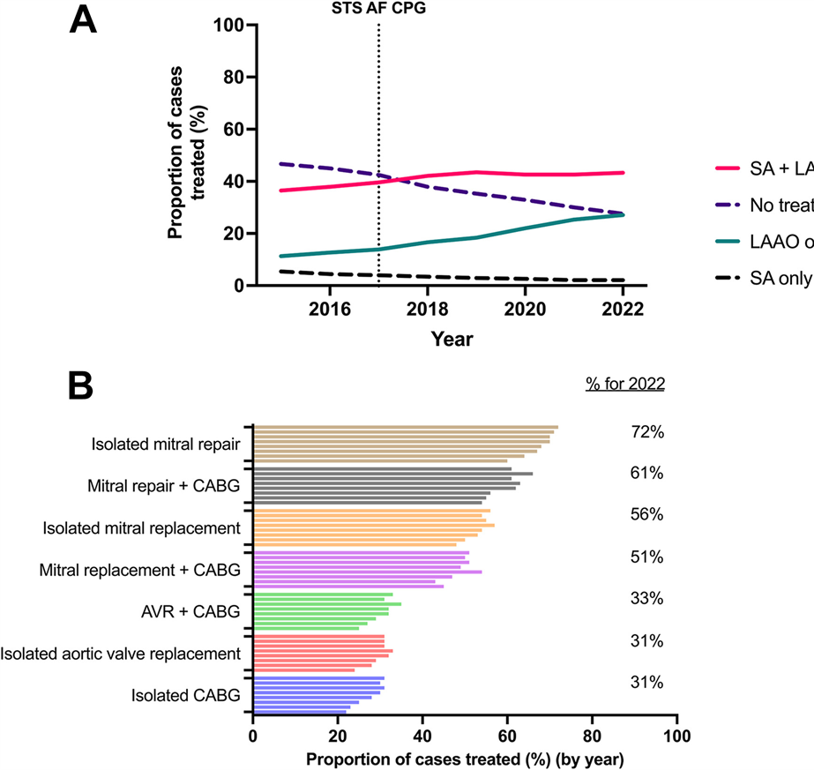
Figure 1 Adoption of surgical ablation and left atrial appendage occlusion at first-time, nonemergent heart surgery. (A) Shows the percentage of patients with documented atrial fibrillation undergoing first-time, nonemergent cardiac surgery being treated with surgical ablation (SA), SA + left atrial appendage occlusion (LAAO), LAAO alone, or no treatment. (B) Shows the adoption of complete treatment (SA+ LAAO of atrial fibrillation in the same cohort) and by procedure type for each year between 2015 and 2022 (each year represented by one bar). The 2022 percentage of treatment is also listed numerically on the righand side of the figure. (AVR, aortic valve replacement; CABG, coronary artery bypass grafting; STS AF CPG, The Society of Thoracic Surgeons 2017 Clinical Practiceuidelines on the Surgical Treatment of Atrial Fibrillation.)
1/2Hide CaptionSee figure in Article

Slide 18
Practice Guideline | Clinical Practice GuidelineVolume 118, Issue 2 p291-310, August 2024, Annals of Thoracic Surgery
Moritz C. Wyler von Ballmoos, MD, PhD¹ mcwvb@post.harvard.edu ∙ Dawn S. Hui, MD² ∙ J. Hunter Mehaffey, MD, MSc³∙ … ∙ A. Marc Gillinov, MD⁶ ∙ Thoralf M. Sundt, MD⁷ ∙ Vinay Badhwar, MD
The gold standard of surgical ablation has remained the Cox maze procedure and its iteration, based on the original work of Dr Cox. Over the years, the operation evolved into the Cox maze III, or the “cut-and-sew” maze,¹⁵ which has been applied extensively in clinical practice.¹⁶ Modifications of the atrial lesion sets evolved as new energy sources were developed,^{17,18} and Damiano and associates^{19,20} used a combination of radiofrequency energy and cryoablation to replace several of the maze III cut-and-sew lesions, calling this facilitated procedure the Cox maze IV. The safety and effectiveness of the Cox maze III/IV procedure have been substantiated by several studies, regardless of the chosen energy source for ablation or the surgical access.²¹⁻²³

Slide 19
Practice Guideline | Clinical Practice GuidelineVolume 118, Issue 2 p291-310, August 2024, Annals of Thoracic Surgery
Moritz C. Wyler von Ballmoos, MD, PhD¹ mcwvb@post.harvard.edu ∙ Dawn S. Hui, MD² ∙ J. Hunter Mehaffey, MD, MSc³∙ … ∙ A. Marc Gillinov, MD⁶ ∙ Thoralf M. Sundt, MD⁷ ∙ Vinay Badhwar, MD
Epicardial surgical ablation performed as a stand-alone procedure or in combination with staged hybrid catheter-based ablation.^{24,25} Based on the performance and durable rhythm success even in patients with longstanding, persistent atrial fibrillation, adoption of surgical ablation as a stand-alone procedure, especially using minimally invasive and robotic-assisted techniques, has increased.²⁶⁻²⁸

Slide 20
Practice Guideline | Clinical Practice GuidelineVolume 118, Issue 2 p291-310, August 2024, Annals of Thoracic Surgery
Moritz C. Wyler von Ballmoos, MD, PhD¹ mcwvb@post.harvard.edu ∙ Dawn S. Hui, MD² ∙ J. Hunter Mehaffey, MD, MSc³∙ … ∙ A. Marc Gillinov, MD⁶ ∙ Thoralf M. Sundt, MD⁷ ∙ Vinay Badhwar, MD
A study of the STS Adult Cardiac Surgery Database investigating the results of stand-alone surgical therapy for isolated atrial fibrillation between 2011 and 2017 noted a 7% annual growth rate in stand-alone surgical ablation, with a 4% annual increase in the number of centers performing these procedures.²⁹

Slide 21
Mitral Valve Operations and Concomitant Surgical Ablation
Mitral valve replacement or repair, is the most common surgery requiring the opening of the left atrium
Patients with mitral valve disease have a high incidence of atrial fibrillation at the time of presentation for surgery, ranging from 20% to 42%,^{33,34}

Slide 22
Mitral Valve Operations and Concomitant Surgical Ablation
Several randomized clinical trials of mitral patients have established surgical ablation as an effective intervention to reduce the prevalence of early postoperative atrial fibrillation by more than 50%.⁴⁰⁻⁴³ In addition, randomized clinical trials and meta-analyses predominantly including mitral patients have consistently shown a substantial reduction in atrial fibrillation burden at the 1-year follow-up,⁴⁴⁻⁴⁶ with some studies extending early success into the longer-term.^{47,48} In the Cardiothoracic Surgical Trials Network randomized clinical trial, 260 patients with persistent or long-standing persistent atrial fibrillation underwent pulmonary vein isolation, a biatrial maze procedure, or no ablation during concomitant mitral valve surgery. Ablation resulted in significant higher freedom from atrial fibrillation at 12 months (63% vs 29%), a higher risk of permanent pacemaker implantation, and lower mortality (6.8% vs 8.7%), although this did not reach statistical significance.⁴⁶

Slide 23
Mitral Valve Operations and Concomitant Surgical Ablation
Duration of atrial fibrillation, left atrial size, and advanced patient age all influence success rates.⁴⁹⁻⁵¹
In most studies, patients achieving sinus rhythm demonstrate improved symptoms as well as quality of life. Irrespective of survival benefit, evidence of improved long-term quality of life appears to be documented as one of the consistent and compelling benefits of effective surgical ablation for atrial fibrillation.⁵⁷⁻⁵⁹

Slide 24
Mitral Valve Operations and Concomitant Surgical Ablation
A propensity-matched study demonstrated significant survival benefits after surgical ablation with successful restoration of sinus rhythm.⁶²
Several studies have documented better recovery of left ventricular function after successful sinus rhythm restoration, and left atrial size usually decreases.^{65,66}
Surgical ablation also may be associated with superior long-term freedom from stroke compared with nontreatment,⁶⁷⁻⁶⁹

Slide 25
Mitral Valve Operations and Concomitant Surgical Ablation
There is also increasing evidence for the long-term benefits of surgical ablation in patients undergoing mitral valve surgery and other concomitant procedures. Recently, a national registry study from the Republic of Poland including 3568 patients undergoing mitral valve surgery with a median follow-up of 5 years showed reduced all-cause mortality with surgical ablation (hazard ratio, 0.82; 95% CI, 0.7-0.96).⁷¹ Similar long-term survival benefits were found in an institutional study of patients with rheumatic mitral valve disease by Kim and associates.⁶⁹ monitoring 1229 patients for more than 5 years, as well as by several national registry studies from Taiwan, Korea, Poland, and the United States, including mitral valve, coronary artery bypass grafting, and other procedures (Supplemental Figure D).^{72,73}

Slide 26
Mitral Valve Operations and Concomitant Surgical Ablation
Variables that are consistently found to be associated with lower rates of conversion to sinus rhythm after surgical ablation include
large left atrium
advanced age
cumulative atrial fibrillation burden
a less extensive ablation procedure

Slide 27
Mitral Valve Operations and Concomitant Surgical Ablation
The substantial variability in pacemaker implantation after surgical ablation is likely explained by differences in surgical technique and practice patterns leading to pacemaker implantation, such as proactive evaluation for sick sinus syndrome, which is associated with the duration of atrial fibrillation.
Several studies with 2 or more years of follow-up cited previously evaluated the association of surgical ablation with the long-term risk of requiring permanent pacemaker implantation, showing an increase in permanent pacemaker implantation over time (Supplemental Figure H).

Slide 28
Mitral Valve Operations and Concomitant Surgical Ablation
Recommendations for mitral valve operations:1.
Surgical ablation for atrial fibrillation is recommended for first-time nonemergent concomitant mitral operations to restore sinus rhythm and improve long-term outcomes.•
Class of recommendation: I
•
Level of evidence: A

Slide 29
Surgical Ablation During Concomitant Closed-Atrial Nonmitral Valve Surgery
In patients with structural, nonmitral heart disease and patients with coronary artery disease, atrial fibrillation is common and associated with an increased risk of early and late mortality and morbidity.⁸²⁻⁸⁵
Preexisting atrial fibrillation at the time of surgical aortic valve replacement is strongly associated with increased cardiovascular morbidity and all-cause mortality.^{84,86,87}
surgical ablation at the time of coronary artery bypass grafting, valve procedures, aortic procedures, and combinations thereof have been associated with improved outcomes, including long-term survival.^{67,77,88}

Slide 30
Surgical Ablation During Concomitant Closed-Atrial Nonmitral Valve Surgery
In patients with aortic stenosis specifically, the benefits of surgical aortic valve replacement plus surgical ablation over transcatheter aortic valve replacement alone have also been demonstrated.⁸⁹

Slide 31
Surgical Ablation During Concomitant Closed-Atrial Nonmitral Valve Surgery
An early study of the Cox maze III procedure in coronary artery bypass grafting patients with atrial fibrillation produced a 98% sinus rhythm rate at 5 years.⁹⁰
As in the mitral valve population, cumulative atrial fibrillation burden and left atrial size were predictors of ablation failure.⁹¹⁻⁹³
A single randomized study of 35 patients with paroxysmal atrial fibrillation having isolated coronary artery bypass grafting vs coronary artery bypass grafting with concomitant pulmonary vein isolation (PVI) is available.⁹⁴ At 18 months, 89% of patients in the PVI group were atrial fibrillation-free vs 47% in the coronary artery bypass grafting-only group.

Slide 32
Surgical Ablation During Concomitant Closed-Atrial Nonmitral Valve Surgery
In surgical aortic valve replacement patients with atrial fibrillation, freedom from atrial fibrillation off antiarrhythmic drugs is better with surgical ablation than without.⁹⁵⁻⁹⁷

Slide 33
Surgical Ablation During Concomitant Closed-Atrial Nonmitral Valve Surgery
A 2014 randomized study compared coronary artery bypass grafting plus a Cox maze III/IV procedure and coronary artery bypass grafting with PVI to coronary artery bypass grafting alone and reported no in-hospital mortality or difference in major morbidity.⁹⁵
In the longer-term, surgical ablation is associated with an increased incidence of permanent pacemaker implantation but improved long-term survival.

Slide 34
Surgical Ablation During Concomitant Closed-Atrial Nonmitral Valve Surgery
Recommendations for operations other than mitral valve surgery1.
Surgical ablation for atrial fibrillation is recommended for any first-time nonemergent concomitant nonmitral operation to restore sinus rhythm and improve long-term outcomes.•
Class of recommendation: I
•
Level of evidence: B-NR

Slide 35
Stand-Alone Surgical Ablation for Atrial Fibrillation
The presence of symptomatic atrial fibrillation refractory to at least 1 class I or III antiarrhythmic drug has been established in several prior societal guidelines as the primary indication for ablation in stand-alone patients.^{1,105}
Most patients also have had at least 1 unsuccessful catheter-based ablation before referral for stand-alone surgical ablation.¹⁰⁵

Slide 36
Stand-Alone Surgical Ablation for Atrial Fibrillation
One systematic review suggested the efficacy of bipolar radiofrequency plus cryoablation (Cox maze IV) to complete the lesion set was equivalent to the Cox maze III technique for stand-alone surgical ablation, if both were applied meticulously.^{97,106}
Most surgical studies of surgical ablation in stand-alone patients have used minimally invasive approaches, including direct visualization, thoracoscopy, and robotic-assisted procedures. Thoracoscopic off-pump radiofrequency PVI plus left atrial appendage amputation has been studied in several studies.¹⁰⁷⁻¹¹² For the 60% to 80% of patients who attain the rhythm end point, antiarrhythmic and anticoagulant agents are eventually discontinued, with associated improved quality of life.¹¹³

Slide 37
Stand-Alone Surgical Ablation for Atrial Fibrillation
The surgical approaches in most of the studies was found to be more successful in restoring and maintaining sinus rhythm than catheter-based ablation,^{24,115-120} but at the cost of higher periprocedural morbidity.

Slide 38
Stand-Alone Surgical Ablation for Atrial Fibrillation
Isolated PVI has not performed as well as minimally invasive versions of the full on-pump endocardial maze procedure.¹²²⁻¹²⁴
Ganglionic ablation has been minimally efficacious and is no longer considered as an additive application to surgical ablation.¹²⁵ In a randomized clinical trial, additional ganglionic ablation did not result in greater procedural success but significantly increased major morbidity, including bleeding, sinus node dysfunction, and need for permanent pacemaker implantation.^{58,126}

Slide 39
Stand-Alone Surgical Ablation for Atrial Fibrillation
Most studies suggest the relative superiority of extended left atrial and biatrial lesion sets over PVI, with more extensive ablation patterns producing the best atrial fibrillation conversion rates.^{96,127}
Surgeons should be aware that incomplete lesion sets can be proarrhythmic and have been implicated in the induction of atypical macro-reentrant atrial flutter.¹²⁸

Slide 40
Stand-Alone Surgical Ablation for Atrial Fibrillation
Similarly, studies using a hybrid minimally invasive PVI or various methods and techniques of left atrial posterior wall ablation, followed by interval catheter-based mapping and focal ablation completion, have been studied for several years, producing encouraging but mixed short-term results
Recently, a series of randomized clinical trials have produced more robust data demonstrating the superiority of a hybrid ablation approach over catheter-based ablation alone.

Slide 41
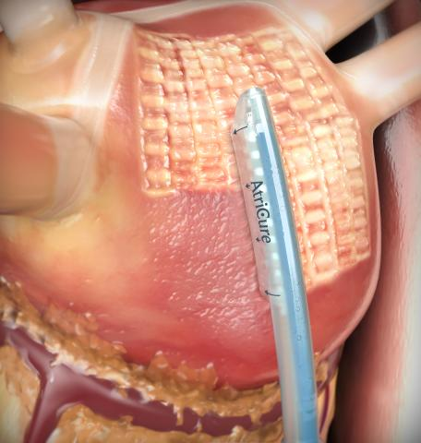
Hybrid ablation

Slide 42
Stand-Alone Surgical Ablation for Atrial Fibrillation
There has been substantial heterogeneity in the definition and application of hybrid atrial fibrillation procedures, but in general, the percutaneous endocardial technique is combined with a minimally invasive epicardial nonsternotomy ablation that does not include cardiopulmonary bypass.¹³²
A systematic review of durable sinus conversion and complications from hybrid procedure or catheter ablation revealed that at 12 months or more, the hybrid procedure achieved a significantly higher rate of freedom from atrial arrhythmias, with and without the use of antiarrhythmic drugs, compared with atrial fibrillation catheter ablation alone in patients with persistent or long-standing persistent atrial fibrillation.¹³³

Slide 43
Stand-Alone Surgical Ablation for Atrial Fibrillation
The Combined Endoscopic Epicardial and Percutaneous Endocardial Ablation Versus Repeated Catheter Ablation in Persistent and Longstanding Persistent Atrial Fibrillation (CEASE-AF) randomized clinical trial comparing hybrid ablation against catheter ablation alone in patients with persistent atrial fibrillation showed significantly higher effectiveness with hybrid ablation (71% vs 39%), with no significant difference in major complications at 30 days.²⁵
Similarly, the Hybrid Versus Catheter Ablation in Persistent AF (HARTCAP-AF) and the Convergence of Epicardial and Endocardial Ablation for the Treatment of Symptomatic Persistent AF (CONVERGE) trials, both randomized clinical trials in patients with persistent atrial fibrillation, demonstrated the superiority of the hybrid ablation strategy (89% and 65% success at 12 months) over catheter ablation (41% and 37%), with comparable adverse events in both groups.^{24,134} The benefit of hybrid ablation over catheter ablation alone is further documented by several meta-analyses.¹³⁵⁻¹³⁷

Slide 44
Stand-Alone Surgical Ablation for Atrial Fibrillation
Considering the totality of the evidence, more complete lesion sets, particularly a biatrial Cox maze III/IV procedure, applied through a minimally invasive approach, may provide the greatest benefit overall.²⁸ An increasing number of stand-alone surgical ablation studies using cryoablation and a minimally invasive thoracoscopic or robotic-assisted approach have recently shown improved outcomes in safety and effectiveness, with >90% of patients being free from atrial fibrillation at 1 year and ≥80% at 5 years of follow up.^{26,138-142}

Slide 45
Stand-Alone Surgical Ablation for Atrial Fibrillation
the field awaits more homogeneous or randomized evidence on hybrid or epicardial ablation procedures that adhere to the concept of the Cox maze lesion set.

Slide 46
Stand-Alone Surgical Ablation for Atrial Fibrillation
Recommendations regarding stand-alone surgical ablation
1. Surgical ablation for symptomatic atrial fibrillation in the absence of structural heart disease refractory to class I/III antiarrhythmic drugs, catheter-based therapy, or both, is reasonable as a primary stand-alone procedure to restore sinus rhythm.•
Class of recommendation: IIa
•Level of evidence: B-NR
2. Surgical ablation for symptomatic persistent or longstanding persistent atrial fibrillation in the absence of structural heart disease is reasonable as a stand-alone procedure using the Cox maze III/IV lesion set as the preferred procedure.•
Class of recommendation: IIa
•Level of evidence: B-NR
3. Surgical ablation for symptomatic atrial fibrillation in the setting of left atrial enlargement (≥4.5 cm) or more than moderate mitral regurgitation by pulmonary vein isolation alone is not recommended.•
Class of recommendation: III
•Level of evidence: C

Slide 47
Left Atrial Appendage Management
Left atrial appendage occlusion/obliteration is one part of the comprehensive surgical management of atrial fibrillation, and its aim is to reduce early and late risk of stroke.
Initial observational studies have suggested atrial appendage management is associated with >50% reduction in thromboembolic morbidity and a modest survival benefit.⁷⁶
In most series of surgical ablation, left atrial appendage management has become a routine component
Complete left atrial appendage obliteration is recommended in all surgical ablation subsets.

Slide 48
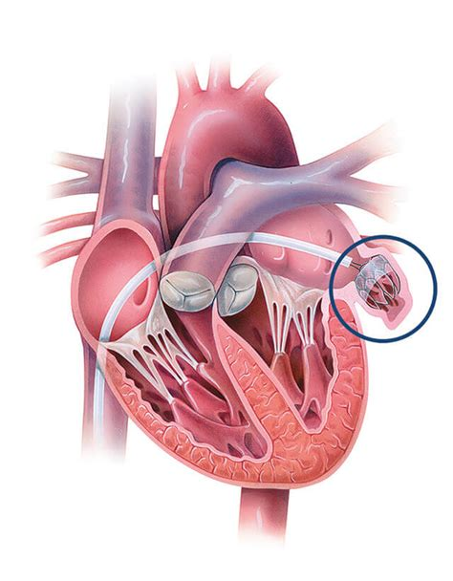
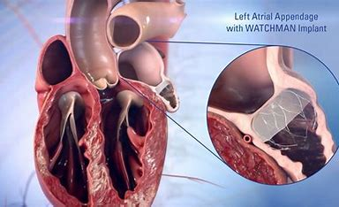
Watchman: internal closure

Slide 49
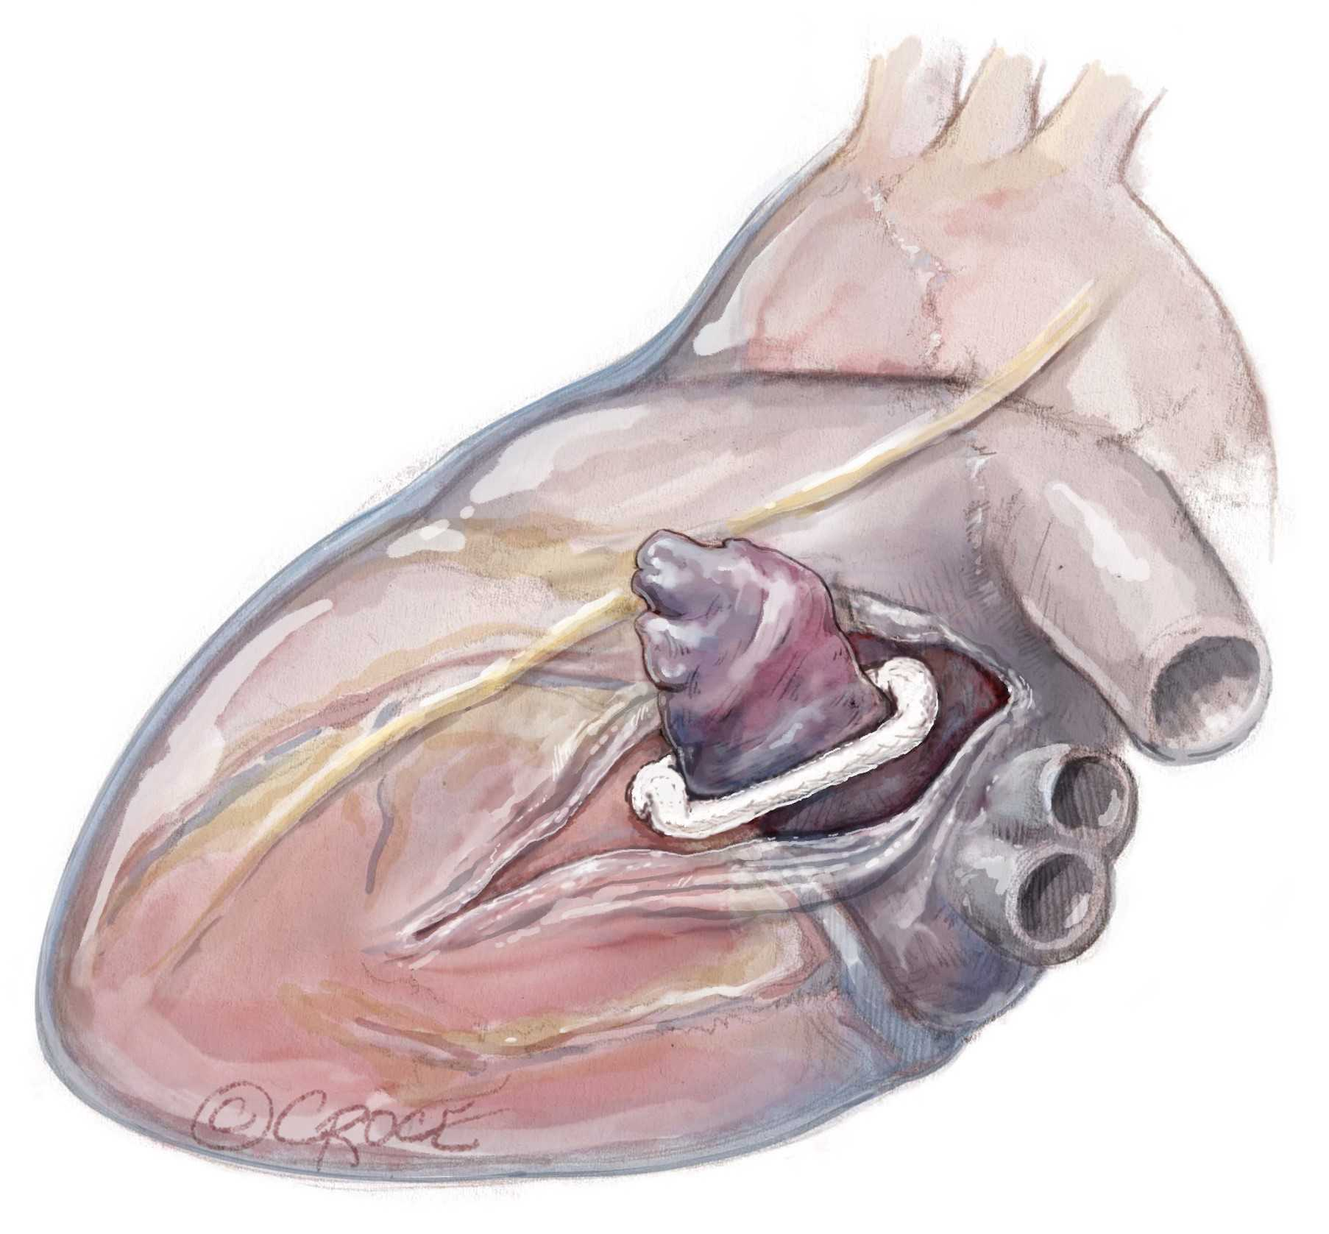
Atriclip: External Closure

Slide 50
Left Atrial Appendage Management
A large study by Friedman and associates¹⁴⁷ of 10,524 Medicare beneficiaries with atrial fibrillation undergoing a variety of elective cardiac surgery procedures showed an association of left atrial appendage occlusion with lower all-cause mortality (HR, 0.88; 95% CI, 0.79-0.55) and thromboembolic complications (HR, 0.67; 95% CI, 0.56-0.81) over a median follow-up of 2.6 years.

Slide 51
Left Atrial Appendage Management
A third Medicare data study evaluated left atrial appendage occlusion in 8590 patients with and without atrial fibrillation undergoing coronary artery bypass grafting and/or valve procedures.¹⁴⁹
In the no-atrial fibrillation cohort, left atrial appendage occlusion had no effect on mortality and stroke, but it was associated with a significantly increased risk of atrial fibrillation-related hospitalizations during follow-up, presumably related to a higher incidence of new-onset postoperative atrial fibrillation seen in patients with no prior history of atrial fibrillation receiving left atrial appendage occlusion.

Slide 52
Left Atrial Appendage Management
Stapling only has had poor outcomes, with most patients having a residual stump and recanalization of the appendage, which can be thrombogenic.^{157,158}
Complications from surgical left atrial appendage occlusion are rare but most frequently are related to the manipulation of the appendage, causing bleeding, and incorrect placement of the epicardial clip, leaving a residual stump or potentially impinging the circumflex coronary artery.¹⁵⁹

Slide 53
Left Atrial Appendage Management
Robust randomized data of concomitant left atrial appendage occlusion in patients with atrial fibrillation has only recently become available with the publication of the long-term outcomes of the Left Atrial Appendage Closure During Open Heart Surgery (LAACS) randomized clinical trial and a landmark trial by Whitlock and colleagues¹⁶⁰ and Madsen and colleagues.¹⁶¹ LAACS was a relatively small study (n = 186) of patients with predominantly no history of atrial fibrillation (87%), showing no statistically significant reduction in stroke (RR, 0.62; 95% CI, 0.27-1.43) and mortality (RR, 0.78; 95% CI, 0.44-1.39) at 6 years of follow-up.

Slide 54
Left Atrial Appendage Management
The larger Left Atrial Appendage Occlusion Study III (LAAOS III) randomized clinical trial enrolled 4770 patients with atrial fibrillation undergoing concomitant cardiac surgery procedures to receive left atrial appendage occlusion or not with routine use of oral anticoagulation postoperatively and a mean follow-up of 3.8 years.

Slide 55
Left Atrial Appendage Management
Approximately one-third of patients also underwent a surgical ablation procedure, 92% of the individuals received the allocated left atrial appendage management, and 77% were compliant with oral anticoagulation at 3 years.
Despite ongoing oral anticoagulation in most of the patients, left atrial appendage occlusion significantly reduced the primary end point (ischemic stroke or systemic thromboembolism),
A secondary analysis of LAAOS III further found the reduction in thromboembolic complications with left atrial appendage occlusion was independent of the use of oral anticoagulation.¹⁶²

Slide 56
Left Atrial Appendage Management
Recommendations for concomitant left atrial appendage management:1.
Left atrial appendage obliteration for atrial fibrillation is recommended for all first-time nonemergent cardiac surgery procedures, with or without concomitant surgical ablation, to reduce morbidity from thromboembolic complications.•
Class of recommendation: I
•
Level of evidence: A

Slide 57
Stand-Alone Left Atrial Appendage Occlusion
Left atrial appendage occlusion using a clip has been found to be safe, effective with a ≥95% success rate of complete left atrial appendage occlusion based on cardiac computed tomographic imaging, and reproducible in most hands.¹⁶⁴⁻¹⁶⁶

Slide 58
Stand-Alone Left Atrial Appendage Occlusion
Endocardial devices for appendage occlusion may not always be anatomically feasible or appropriate, given unique aspects of appendage anatomy.

Slide 59
Stand-Alone Left Atrial Appendage Occlusion
studies have suggested a higher incidence of bleeding complications with percutaneous left atrial appendage occlusion and longer length of stay with surgical left atrial appendage occlusion.¹⁶⁹

Slide 60
Stand-Alone Left Atrial Appendage Occlusion
The safety of complete suspension of anticoagulation (including antiplatelet therapy) was also described in a small cohort of consecutive patients with high bleeding and stroke risk.¹⁷⁰
The benefit of complete suspension of anticoagulation that is possible with surgical left atrial appendage occlusion may be of particular benefit in patients with the highest bleeding risk or those requiring invasive procedures that cannot be performed safely with ongoing anticoagulation.

Slide 61
Stand-Alone Left Atrial Appendage Occlusion
Contemporary data of percutaneous left atrial appendage occlusion shows a high degree of left atrial appendage patency and peridevice leaks, which have been associated with an increased risk of thromboembolism.
In a recent meta-analysis of 48 studies investigating residual leaks after percutaneous left atrial appendage occlusion, peridevice leak was seen on transesophageal echocardiography in 26.1% of patients and in 57.3% of patients when computed tomography was used as the diagnostic study. Peridevice leak was associated with a higher risk of thromboembolism (odds ratio, 2.04; 95% CI, 1.03-1.22) compared with no peridevice leak, suggesting a large proportion of patients may have to continue anticoagulation.¹⁷¹

Slide 62
Stand-Alone Left Atrial Appendage Occlusion
A meta-analysis including 6 studies of surgical left atrial appendage occlusion showed a low incidence of complications, perioperative mortality, and stroke rates at 1 year of follow-up and no substantial difference compared with the percutaneous left atrial appendage occlusion approach.¹⁷²

Slide 63
Stand-Alone Left Atrial Appendage Occlusion
A prospective registry is currently evaluating the comparative effectiveness of thoracoscopic surgical left atrial appendage occlusion, percutaneous left atrial appendage occlusion, and a hybrid approach (LARIAT device, SentreHEART) in 400 patients with a high thromboembolic and bleeding risk (Stand-alone Left Atrial Appendage Occlusion for Thromboembolism Prevention [SALAMANDER]; NCT05144958).¹⁷³
Randomized controlled trials between surgical left atrial appendage occlusion and percutaneous left atrial appendage occlusion, as well as between surgical left atrial appendage occlusion and oral anticoagulation, including direct thrombin or factor Xa inhibitors, are currently missing.

Slide 64
Stand-Alone Left Atrial Appendage Occlusion
Adequately powered randomized clinical trials are needed to inform better which patients with relative or absolute contraindications for novel oral anticoagulation truly benefit from surgical left atrial appendage occlusion and how it compares with other anticoagulation regimens (eg, single antiplatelet therapy).
Further, more research is needed to define the best method to document the completeness of left atrial appendage occlusion postoperatively and the optimal anticoagulation strategy after surgical left atrial appendage occlusion, especially when the exclusion of the left atrial appendage occlusion trabeculation may not be complete.

Slide 65
Stand-Alone Left Atrial Appendage Occlusion
Recommendations regarding stand-alone left atrial appendage management:1.
Isolated surgical left atrial appendage obliteration may be considered in patients with longstanding persistent atrial fibrillation, a high stroke risk, and contraindications for or failure of long-term oral anticoagulation.•
Class of recommendation: IIb
•
Level of evidence: B-NR

Slide 66
Patients with Atrial Fibrillation Under Consideration for Transcatheter Valve Repair or Replacement
Recommendations for patients being considered for transcatheter valve therapies:1.
For patients with symptomatic valve disease and atrial fibrillation, who are deemed of low to intermediate surgical risk, surgical valve repair or replacement with concomitant surgical ablation and left atrial appendage occlusion is reasonable over isolated transcatheter valve repair or replacement alone to restore sinus rhythm and improve long-term outcomes.•
Class of recommendation: IIa
•
Level of evidence: B-NR

Slide 67
Additional Considerations for Patients with Atrial Fibrillation
Most patients undergoing surgical ablation are administered perioperative class I or III antiarrhythmic drugs, such as amiodarone,¹⁸⁰ and these are often continued for 2 to 3 months after surgical ablation.¹⁸¹
Most patients who achieve stable sinus rhythm after surgical ablation eventually can discontinue all antiarrhythmic agents.¹¹⁵
A good follow-up is essential,¹⁸² and at least periodic 24-hour Holter monitoring should be routine.
Atrial fibrillation recurrence should prompt consideration for catheter-based assessment and possible ablation.¹⁸³

Slide 68
Additional Considerations for Patients with Atrial Fibrillation
Similar challenges exist for the use of anticoagulation after surgical ablation and left atrial appendage occlusion. Balancing the risk of postoperative bleeding, oral anticoagulation is often initiated early postoperatively in patients after atrial fibrillation surgery because of the endothelial damage caused during ablation.
Some centers have adopted single-antiplatelet therapy with no oral anticoagulation after surgical ablation and left atrial appendage occlusion, reporting stroke rates of less than 1%.¹⁸⁴
Currently, factors to consider in the decision to use oral anticoagulation or not after surgical ablation and left atrial appendage occlusion are documented freedom from atrial fibrillation, completeness of left atrial appendage occlusion, and the patient’s bleeding risk and stroke risk (CHA₂DS₂-VASc score).

Slide 69
Additional Considerations for Patients with Atrial Fibrillation
Multidisciplinary collaboration between cardiothoracic surgeons having clinical interest and experience with surgical ablation and electrophysiologists experienced in the pharmacologic and catheter-based management of atrial fibrillation can enhance patient outcomes.¹⁶⁸

Slide 70
Additional Considerations for Patients with Atrial Fibrillation
There is no literature specifically addressing the clinical questions surrounding surveillance and follow-up after surgical ablation. However, as outlined previously, studies delineating the differences in long-term outcomes, including effectiveness of sinus conversion, survival benefit, or the need for a permanent pacemaker, extend to 5 years of follow-up and beyond.
To detect the late recurrence of atrial fibrillation and the development of new conduction abnormalities, continued surveillance for up to 5 years is suggested.

Slide 71
Additional Considerations for Patients with Atrial Fibrillation
Recommendations for all patients with atrial fibrillation:1.
Multidisciplinary heart team assessment and treatment planning as well as long-term follow-up using periodic continuous electrocardiographic monitoring for rhythm assessment are recommended to optimize patient outcomes.•
Class of recommendation: I
•
Level of evidence: C

