Slide 1
Early Ablation of Atrial Fibrillation: Advances, Approaches, and Outcomes
Exploring innovations and clinical results in AF treatment
Suveer Bagwe, MD
FMC CV symposium 2025
Notes:
---
This presentation focuses on the early ablation of atrial fibrillation (AF), exploring its advances, different approaches, and clinical outcomes. We will cover the background of AF, traditional management, evolution of ablation techniques, and future directions to improve patient care.

Slide 2
Disclosure
NOne

Slide 3

Presentation Agenda
Understanding Atrial Fibrillation and Its Clinical Significance
Conventional Management Strategies for Atrial Fibrillation
Evolution and Rationale for Early Ablation
Outcomes, Benefits, and Future Directions
Notes:
---
We will begin by understanding atrial fibrillation and its clinical significance. Then, review conventional management strategies before discussing the rationale and evolution of early ablation. We will also examine ablation techniques, procedural advances, and conclude with outcomes and future research directions.
Image source: Microsoft 365 content library

Slide 4
Understanding Atrial Fibrillation and Its Clinical Significance
Notes:
Atrial fibrillation is a common cardiac arrhythmia with significant health implications. This section covers its definition, pathophysiology, symptoms, risk factors, diagnosis, and complications if left untreated.

Slide 5
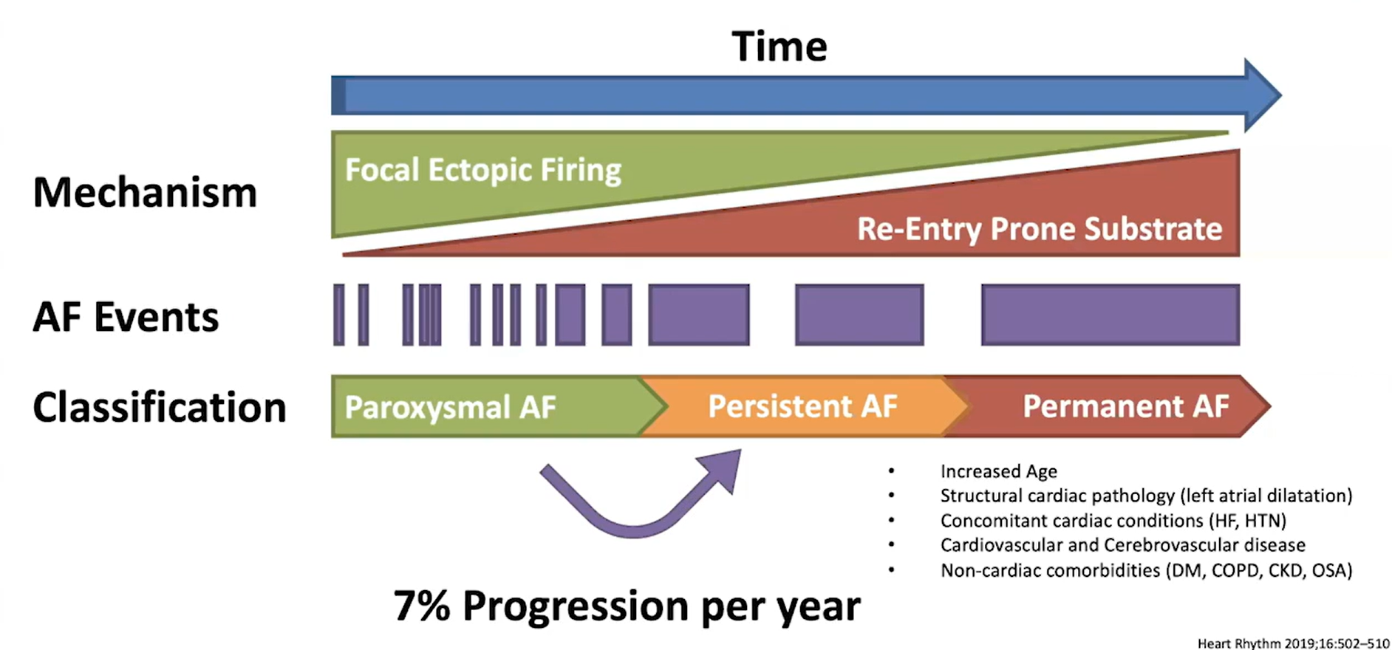
AF IS A CHRONIC PROGRESSIVE DISEASE

Slide 6
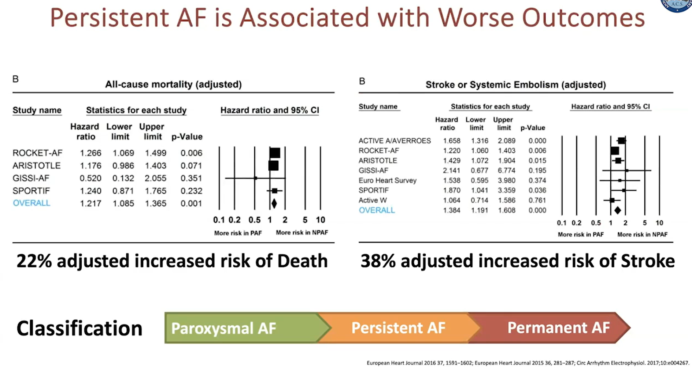

Slide 7
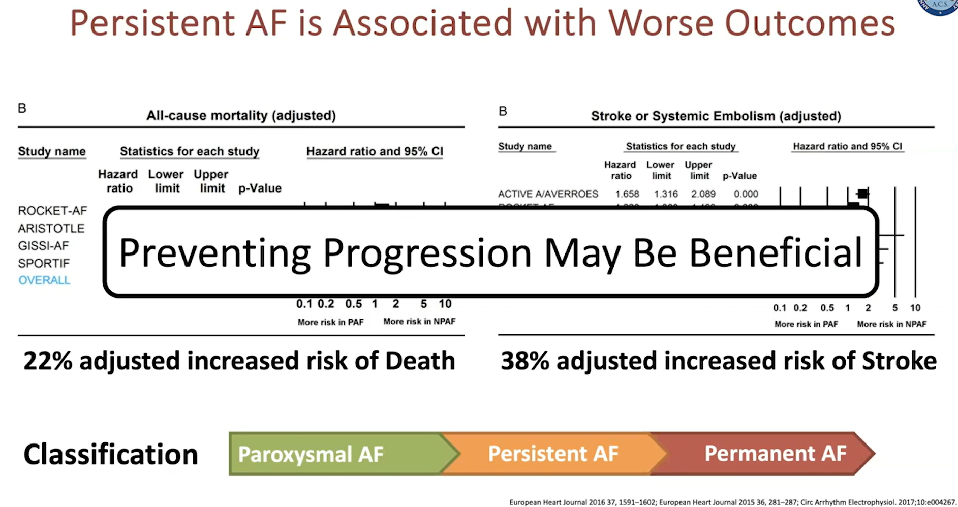

Slide 8
Management Options
Anti Arrhythmic drugs
or
Ablation- RF/Cryo/PFA
or
Rate Control

Slide 9
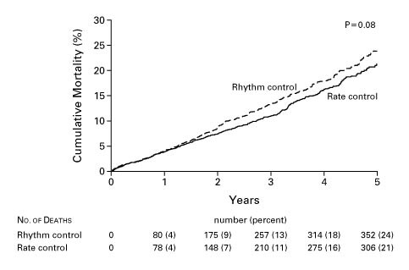
RATE VS RHYTHM
AFFIRM TRIAL
Rate VS Rhythm control
2002
4000 patients
AAD vs rate control
Amiodarone/Sotalol
14 patients underwent ablation
Primary endpoint - all cause mortality
FU 42 months
Maintenance of Sinus rhythm WAS NOT the OBJECTIVE
N Engl J Med 2002;347:1825-1833

Slide 10
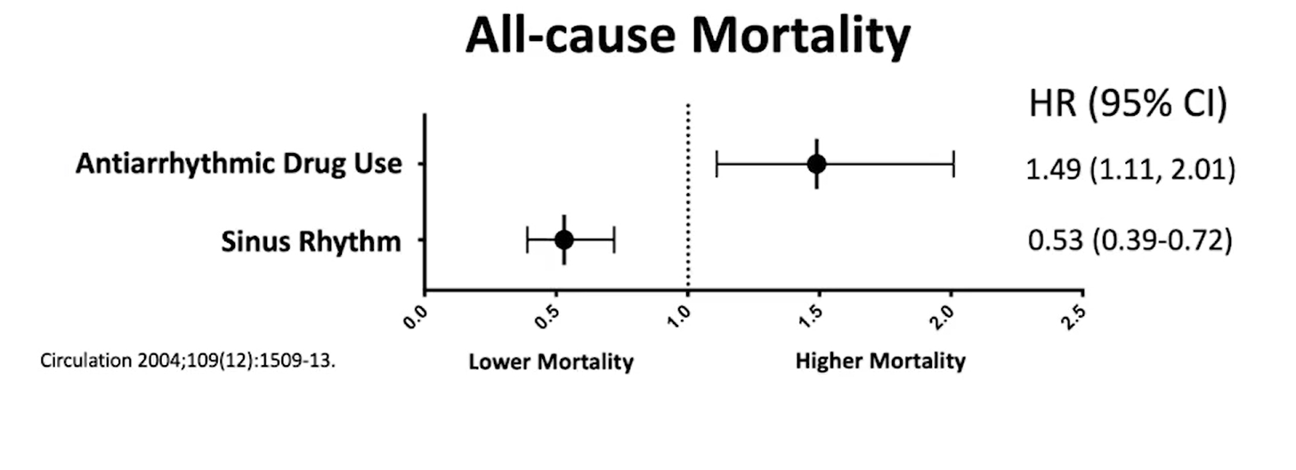
Anti Arrhythmic Drugs
AFFIRM TRIAL

Slide 11
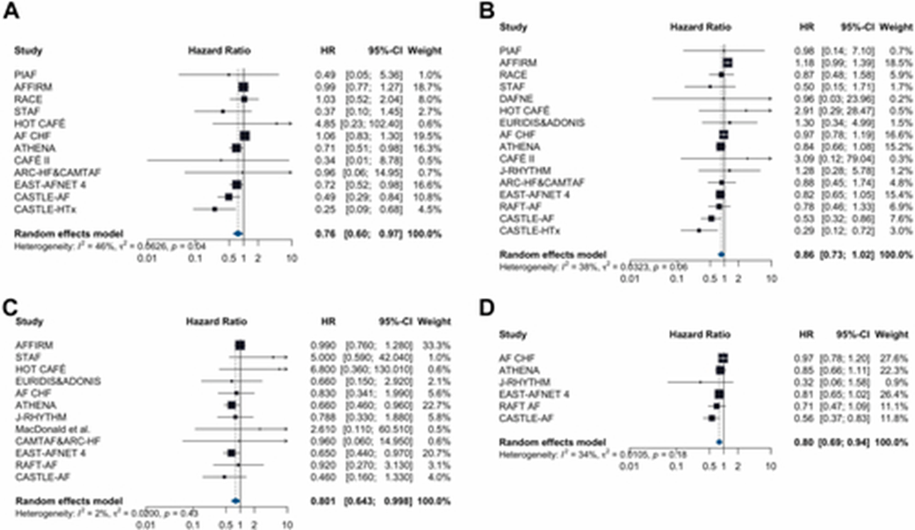
Rhythm vs Rate Control Strategy for Atrial Fibrillation:
A Meta-Analysis of Randomized Controlled Trials
CV Death
All cause Death
Stroke
HF hospitalization
J Am Coll Cardiol EP 2024; 10:1395-1405

Slide 12
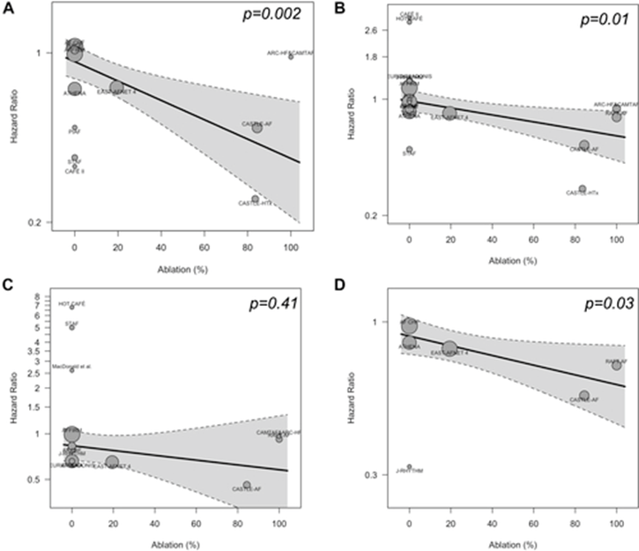
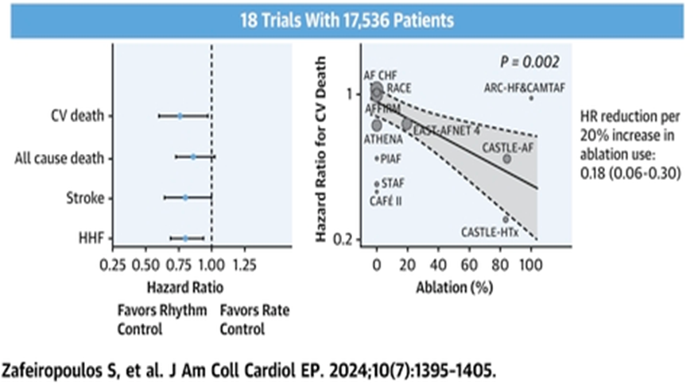
CV Death
All cause Death
Stroke
CV Death
HF hospitalization

Slide 13
EDITORIAL
“In conclusion, contemporary trials comparing the effect of early rhythm control by modern antiarrhythmic drugs and catheter-based AF ablation procedures compared with rate control are driving the conceptual paradigm shift that moves rhythm control from a symptom-improving “lifestyle therapy” to a treatment to reduce CV death, stroke, and heart failure hospitalization. ”
J Am Coll Cardiol EP 2024; 10:1395-1405

Slide 14
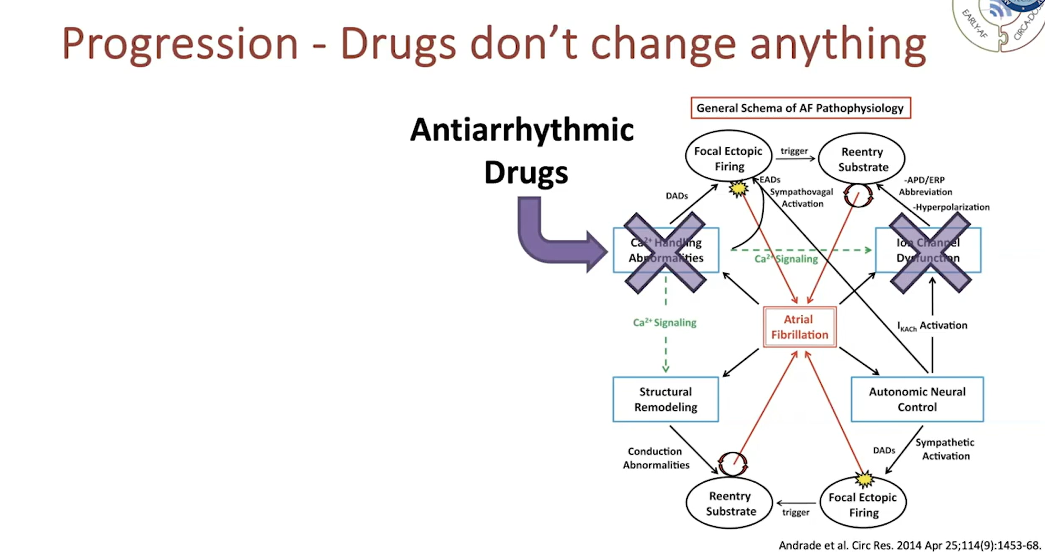

Slide 15
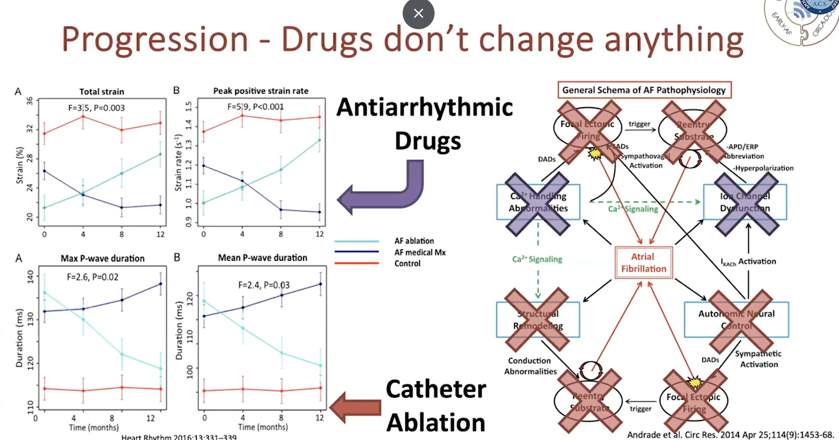
Heart Rhythm 2016:13:331-339

Slide 16
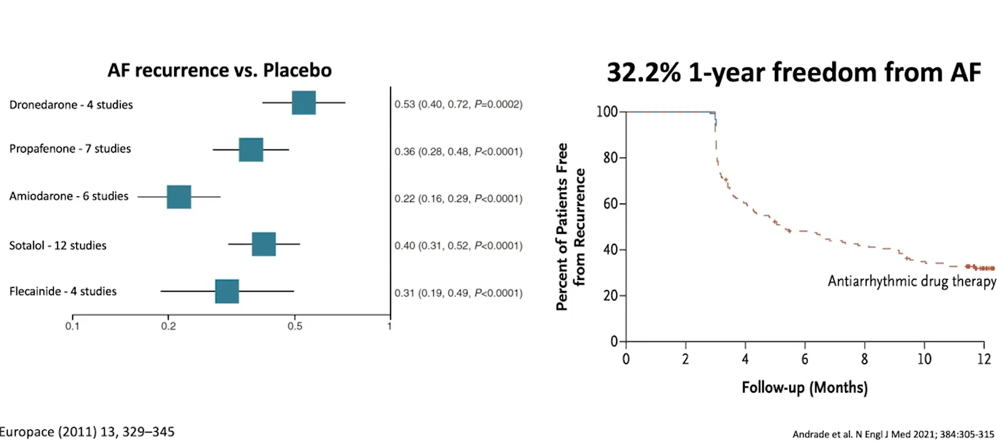
Anti Arrhythmic Drugs

Slide 17
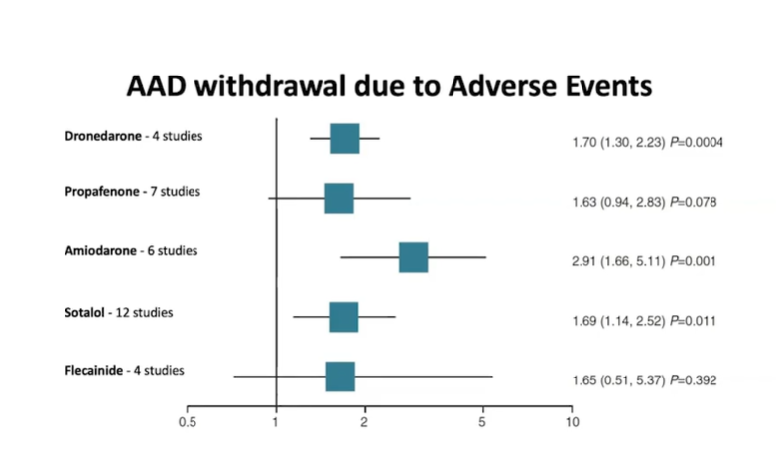
Anti Arrhythmic Drugs

Slide 18
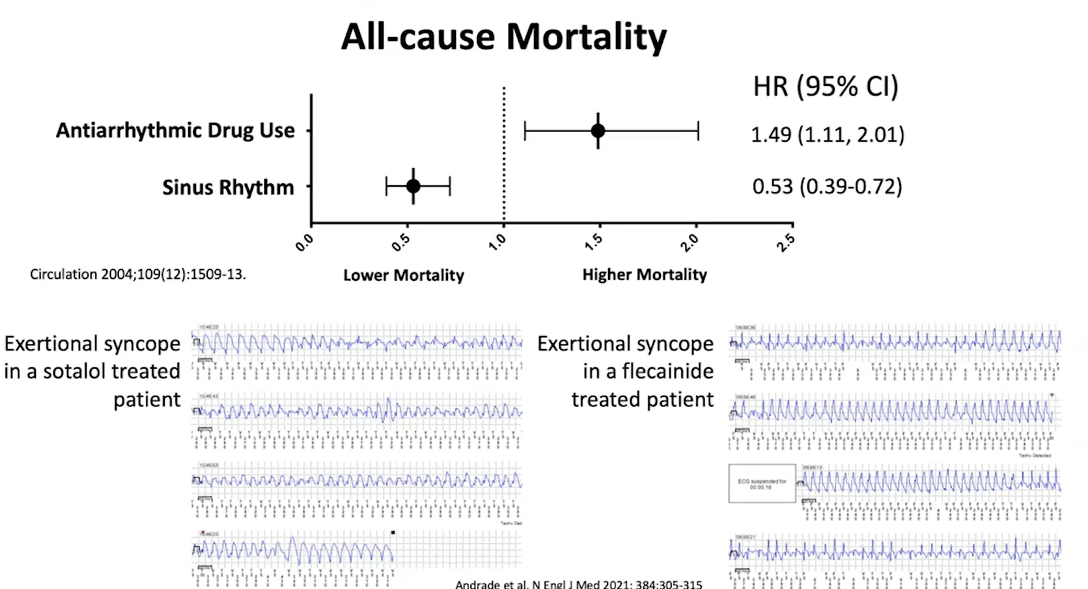

Slide 19
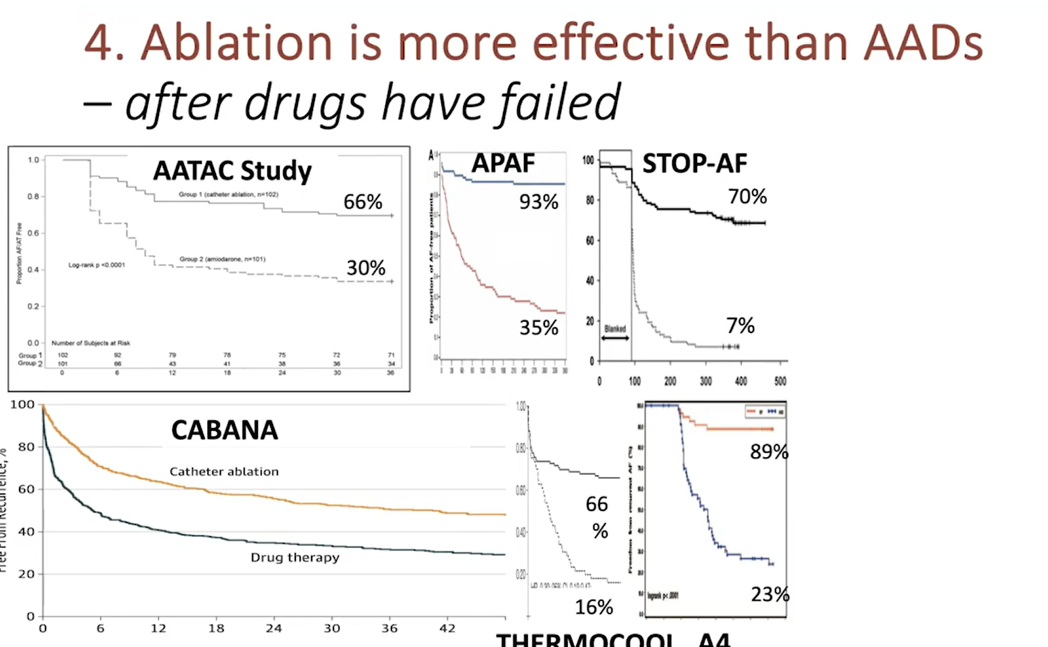
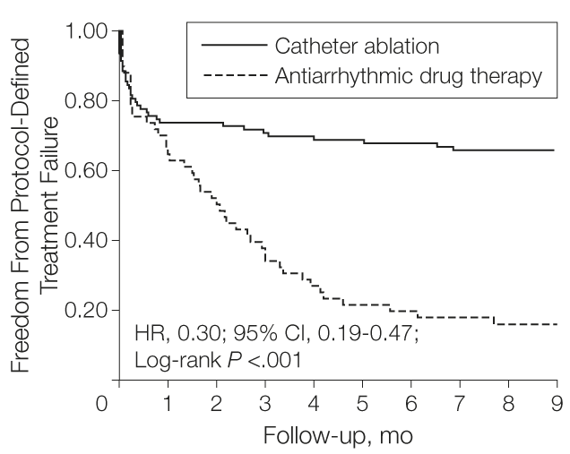
THERMOCOOL A4

Slide 20
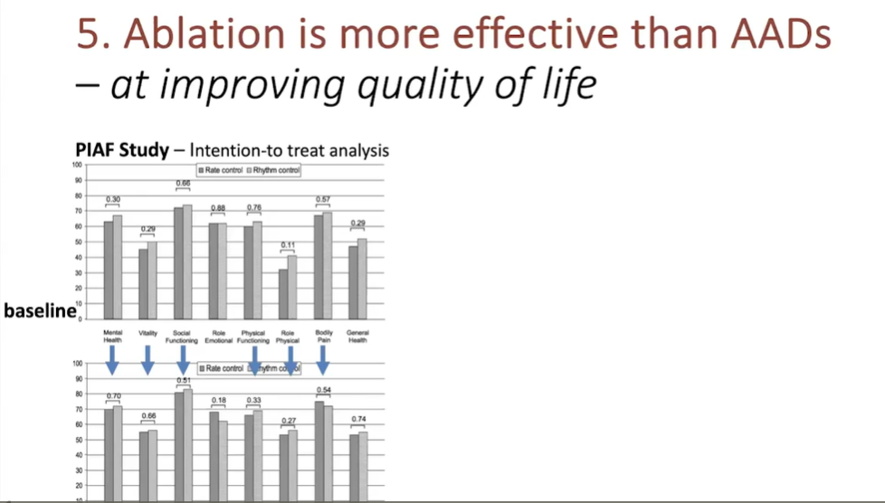
Trial of rate and rhythm control with AAD
Essentially showing AAD made no difference in improving Quality of Life
Lancet . 2000 Nov 25;356(9244):1789-94.

Slide 21
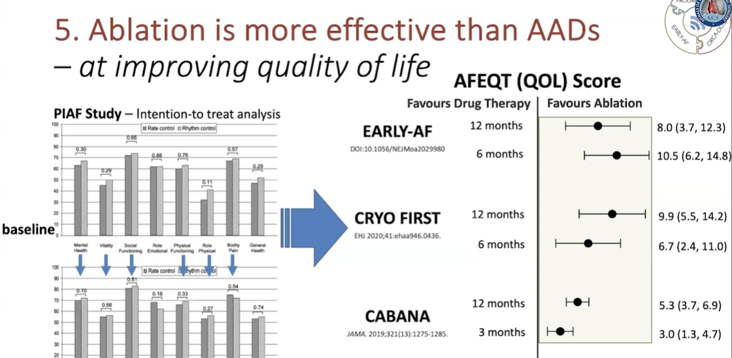
Lancet . 2000 Nov 25;356(9244):1789-94.

Slide 22
Trial Data
Early Ablation: Early in course of disease?
or
Early ablation after diagnosis??
or
Early ablation in specific subgroups,
like CHF???HCM???
or
Just EARLY in life?????

Slide 23
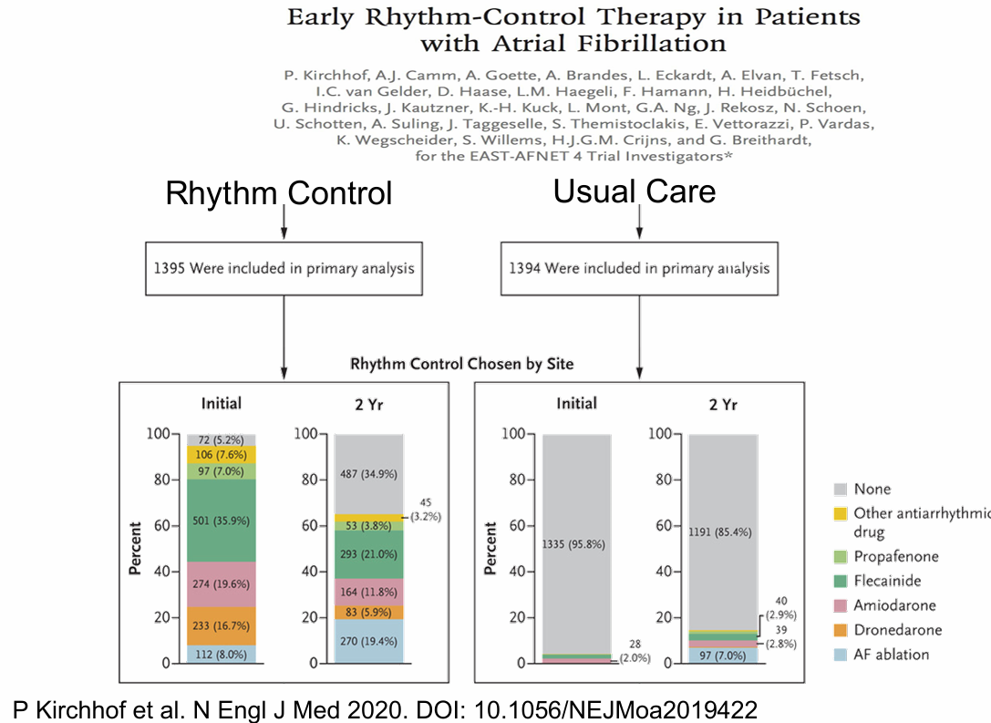
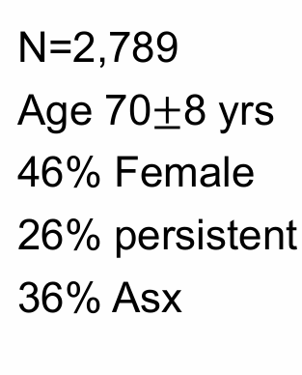
CHADS 2 VASC-3.4

Slide 24
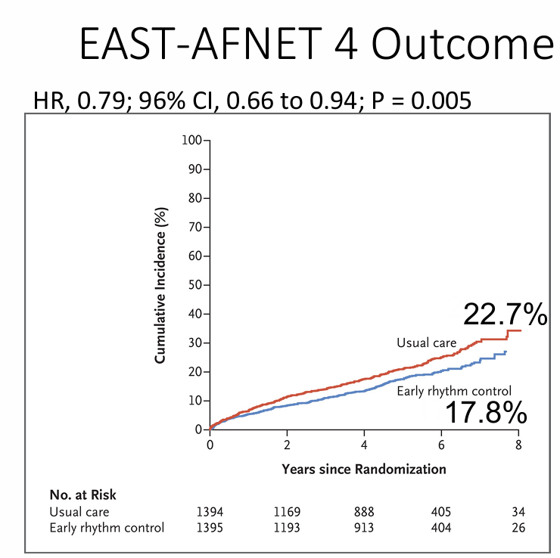
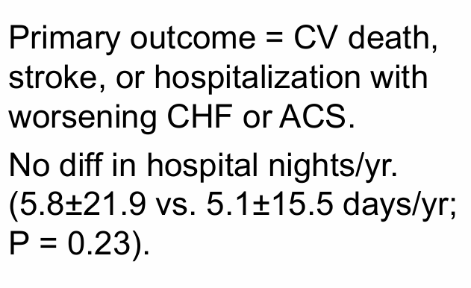
Limitation
Median time in AF- 36 days
No data on success of strategy
Probably most symptomatic patients were not included

Slide 25
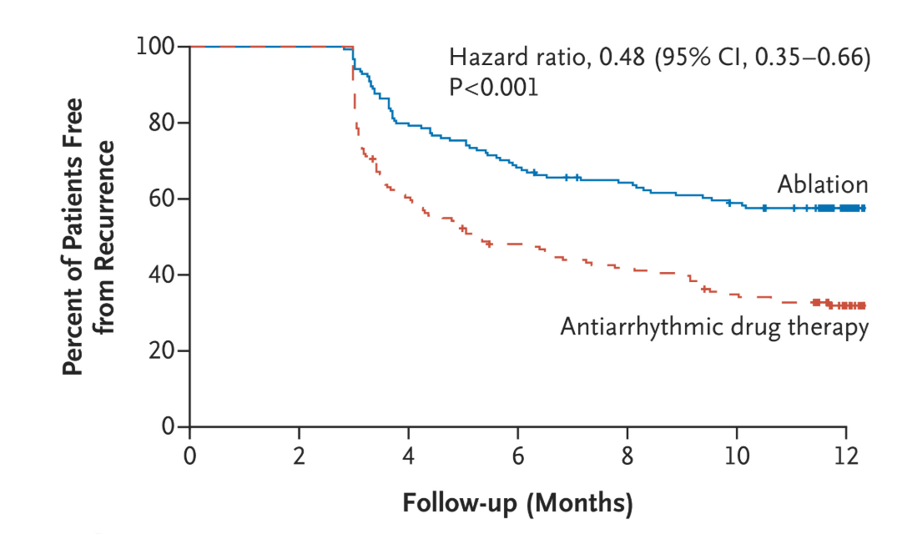
EARLY AF Trial
Ablation as First Line without AAD failure
Mean age - 60
CHADS 2 VASC - 2
BMI - 30
PAF - 95%
Female - 30%
Use of AAD - 30%
Median time in AF - 1 year
N Engl J Med 2021;384:305-315

Slide 26
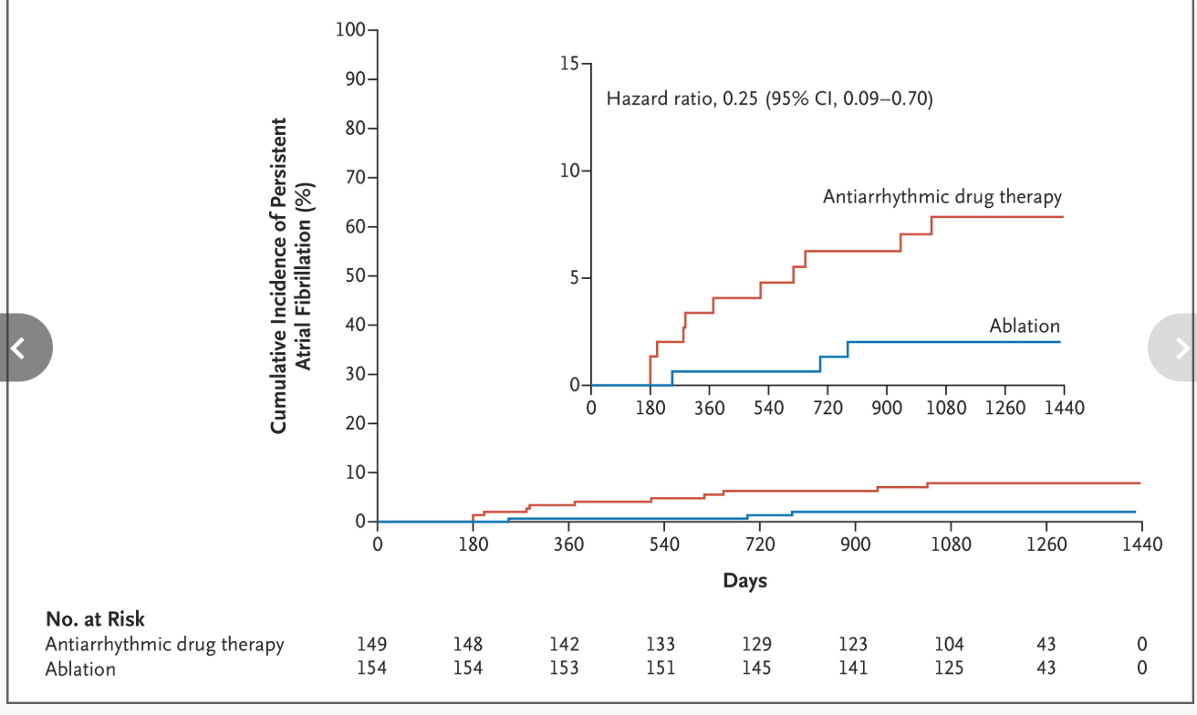
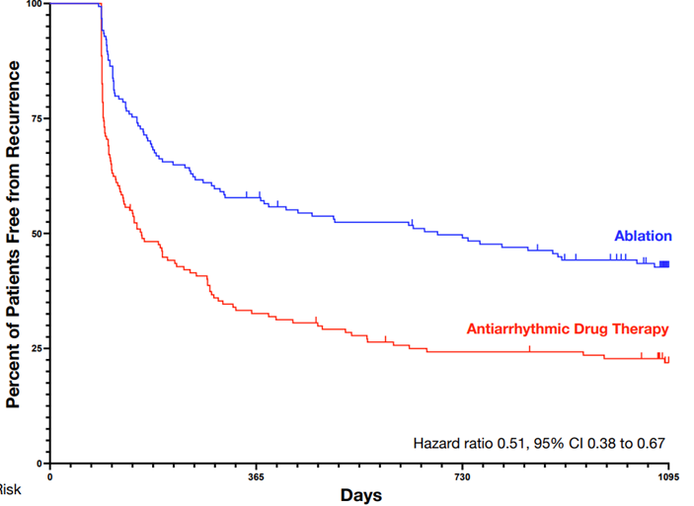
Progression to persistent AF
Freedom from any Atrial arrhythmia

Slide 27
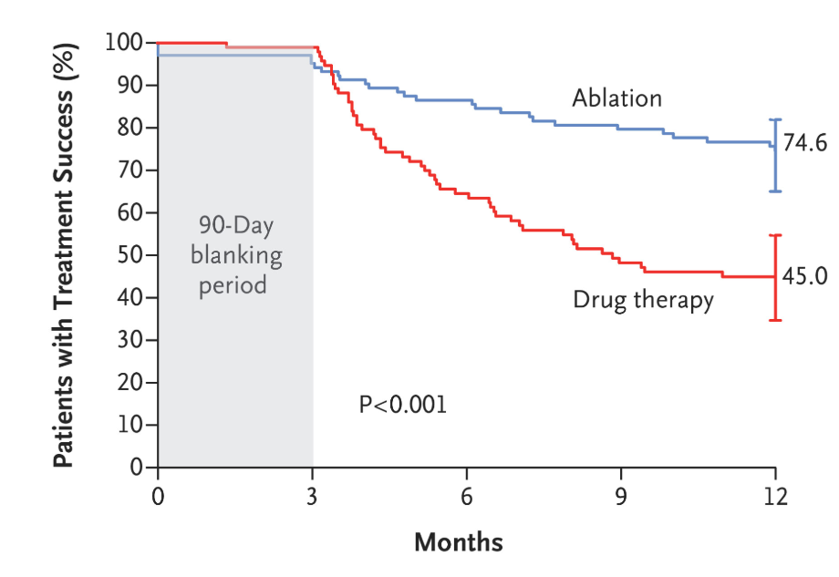
STOP AF Trial
Ablation as First Line without AAD failure
Mean Age - 60
CHADS 2 VASC - 2
BMI - 25-30
Median time in AF - 1.3 years
PAF - 60%
Female - 40%
N Engl J Med 2021;384:316-324

Slide 28
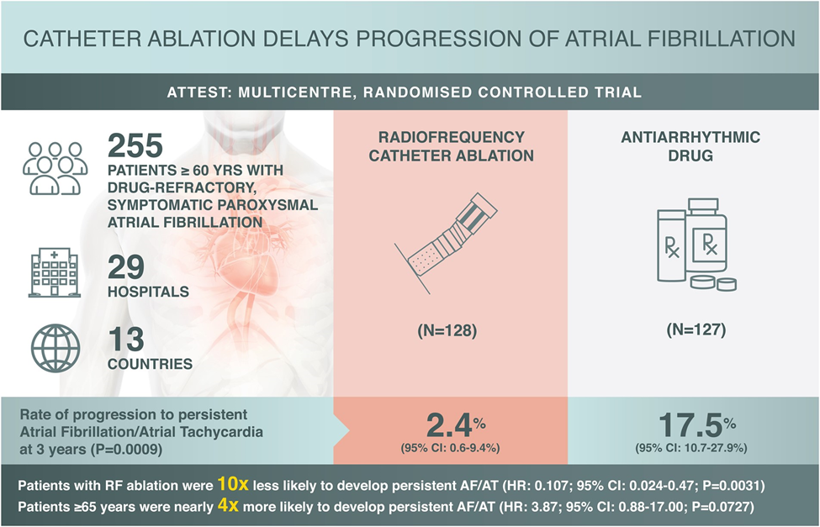
Catheter ablation or medical therapy to delay progression of atrial fibrillation:
The randomized controlled atrial fibrillation progression trial (ATTEST)
EP Europace, Volume 23, Issue 3, March 2021

Slide 29
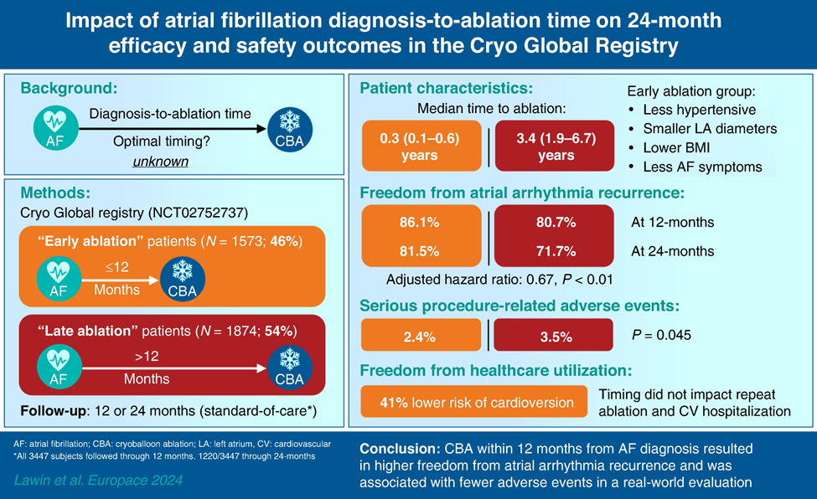
Cryo Global Registry
EP Europace, Volume 27, Issue 2, February 2025, euaf008

Slide 30
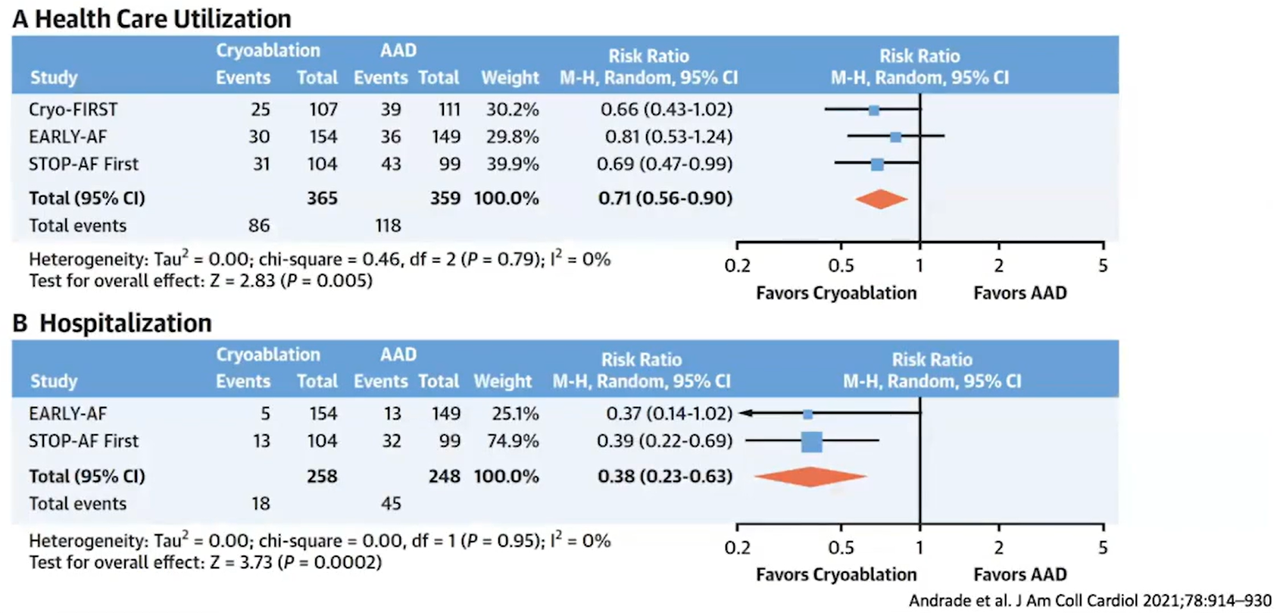
Ablation Reduced Health Care Utilization

Slide 31
ALL THESE TRIALS in PAF ARE NOT POWERED
TO DETECT MORTALITY/CV mortality/CHF or STROKE benefit
WE CAN show reduction in symptoms and
progression to persistent AF
CLASS I/IIA indication in 2023 ACC/HRS Guidelines

Slide 32
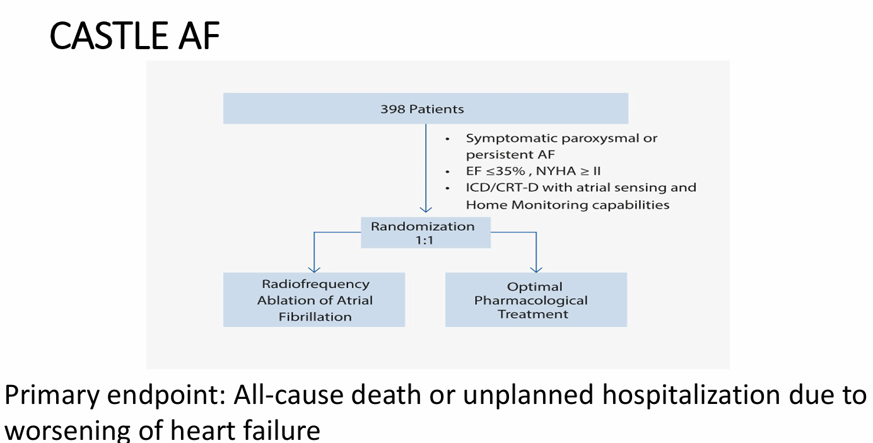
Catheter Ablation for Atrial Fibrillation
with Heart Failure-CASTLE HF
Age - 64
BMI- 29
CHF - Class 2-60%
NICM - 60%
Persistent AF - 70%
LVEF - 32%
Amio failure - 45%
ICD/CRTD - 100%
N Engl J Med 2018;378:417-427

Slide 33
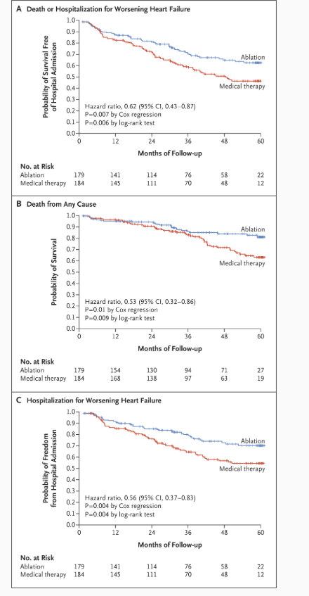
N Engl J Med 2018;378:417-427

Slide 34
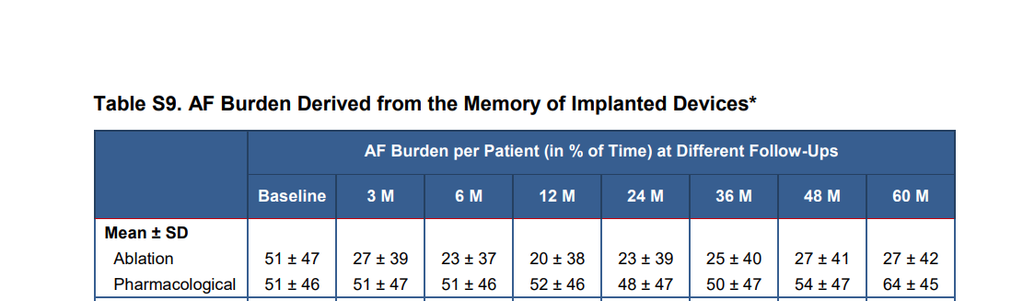
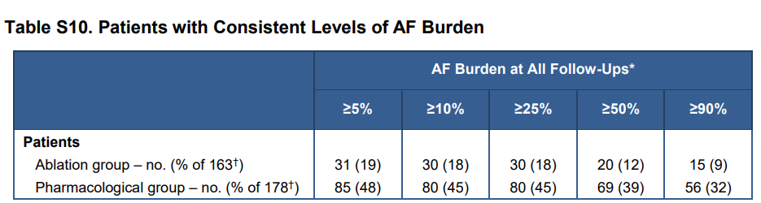
N Engl J Med 2018;378:417-427

Slide 35
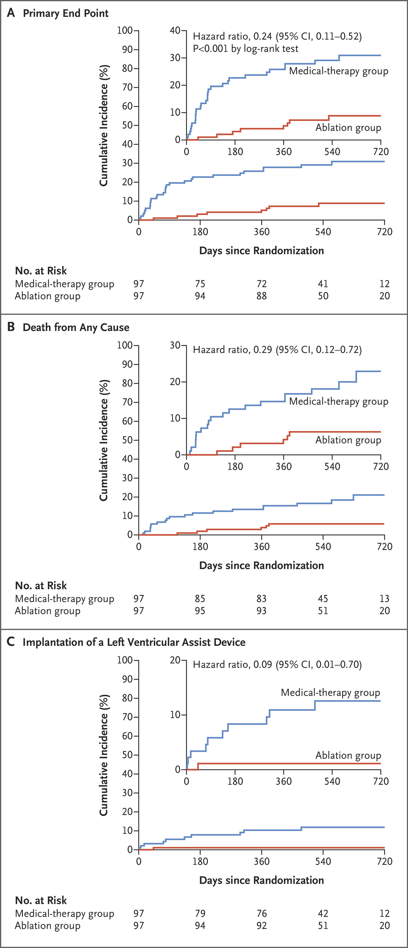
CASTLE HTX Trial
Death/LVAD/HT
Age - 62
NYHA Class – 3/4
Patients with end stage CHF
Referred for LVAD/HT
LVEF - 25%
NICM - 60%
Persistent AF - 56%
Duration of AF - 4 years
N Engl J Med 2023;389:1380-1389

Slide 36
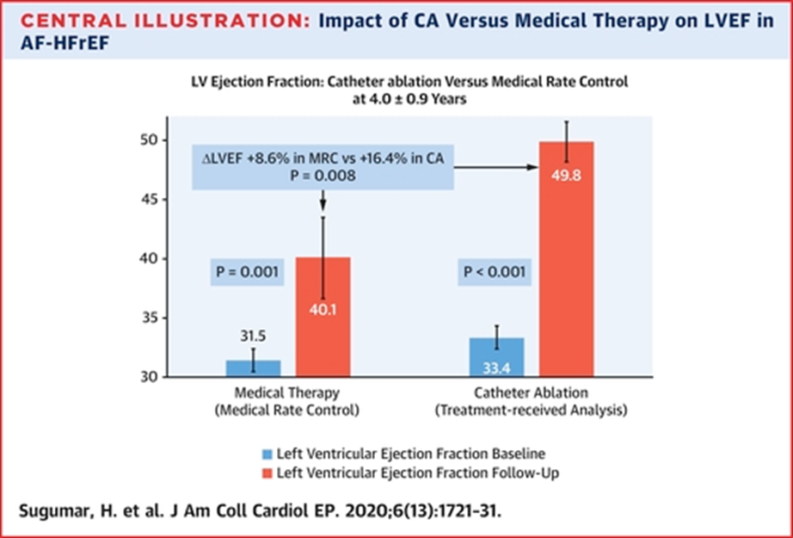
CAMERA-MRI Study
66 Patients
Ablation vs rate control
CHF - Class 2/3
On GDMT - 98%
Persistent AF median duration - 2.3 years
LVEF - 32%
½ rate control group crossed over to ablation

Slide 37
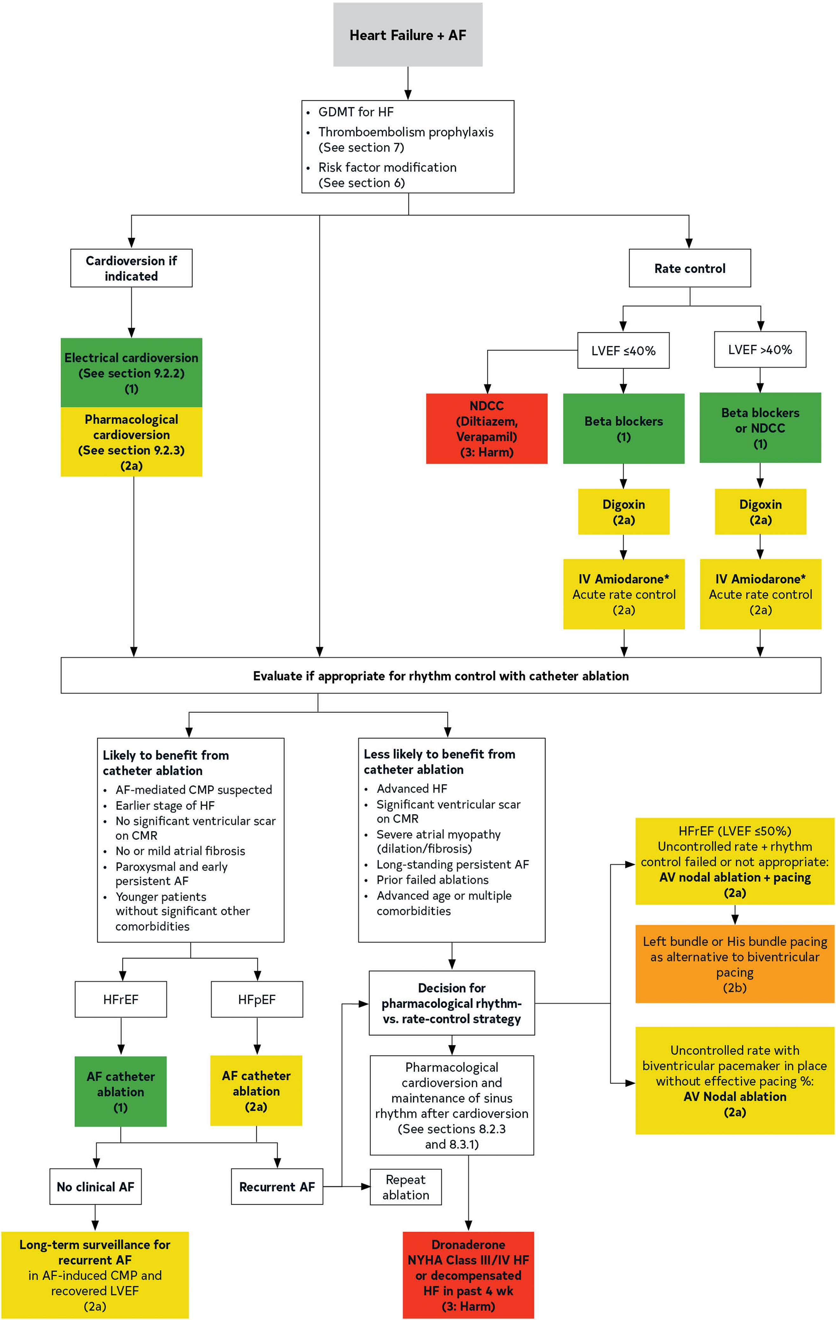
AF ablation may show mortality/morbidity benefit in CHF
Class I/II A indication in guidelines
2023 ACC/AHA/ACCP/HRS Guideline for the Diagnosis and Management of Atrial Fibrillation

Slide 38
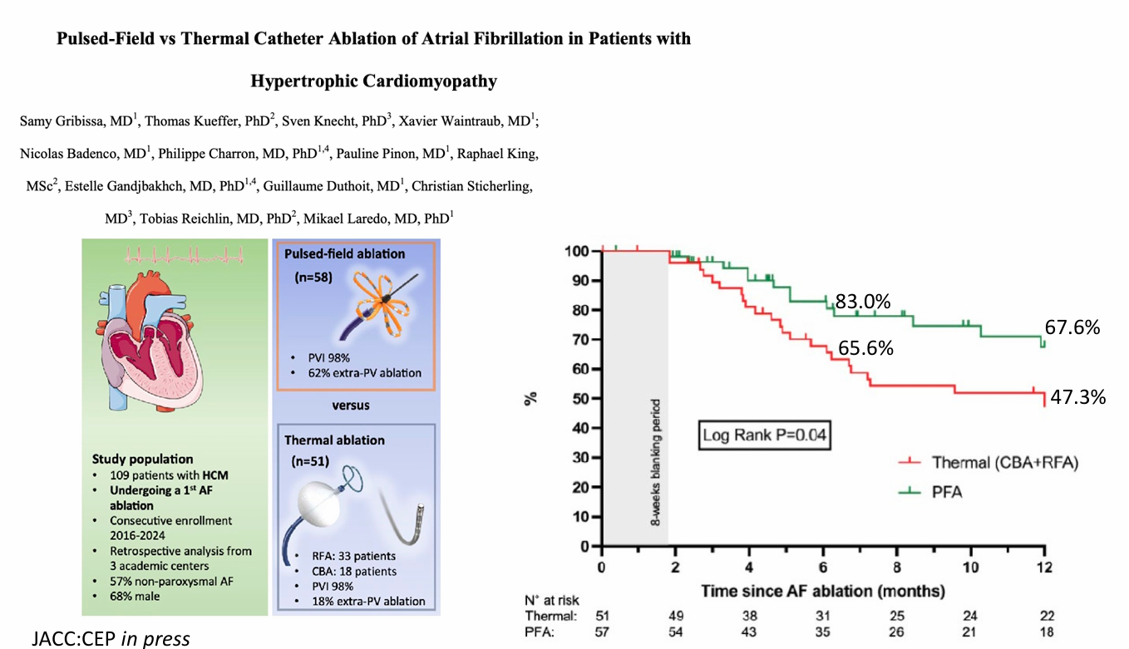

Slide 39
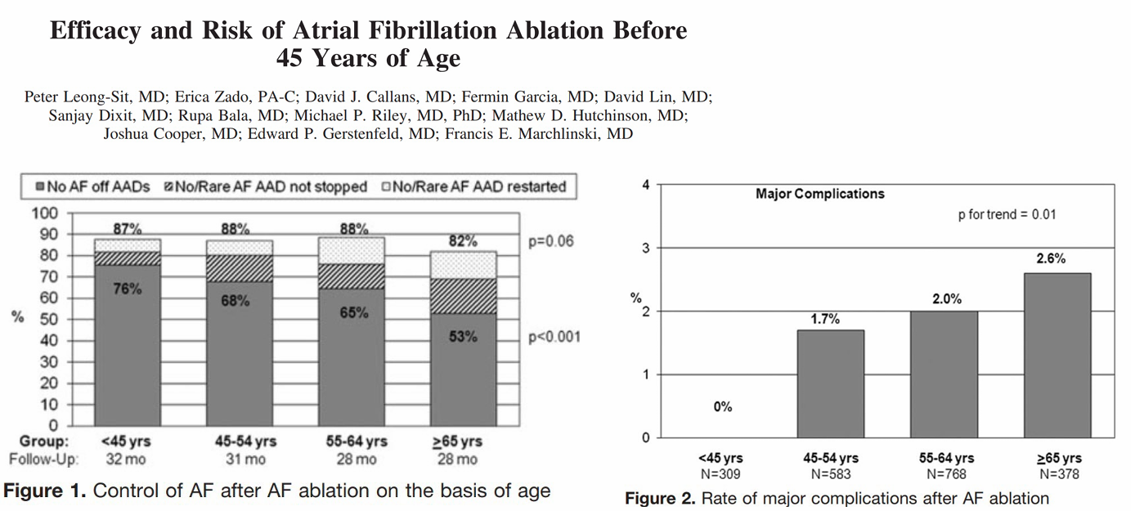
Circ Arrhythm Electrophysiol. 2010 Oct;3(5):452-7.

Slide 40
Ablations are getting safer

Slide 41
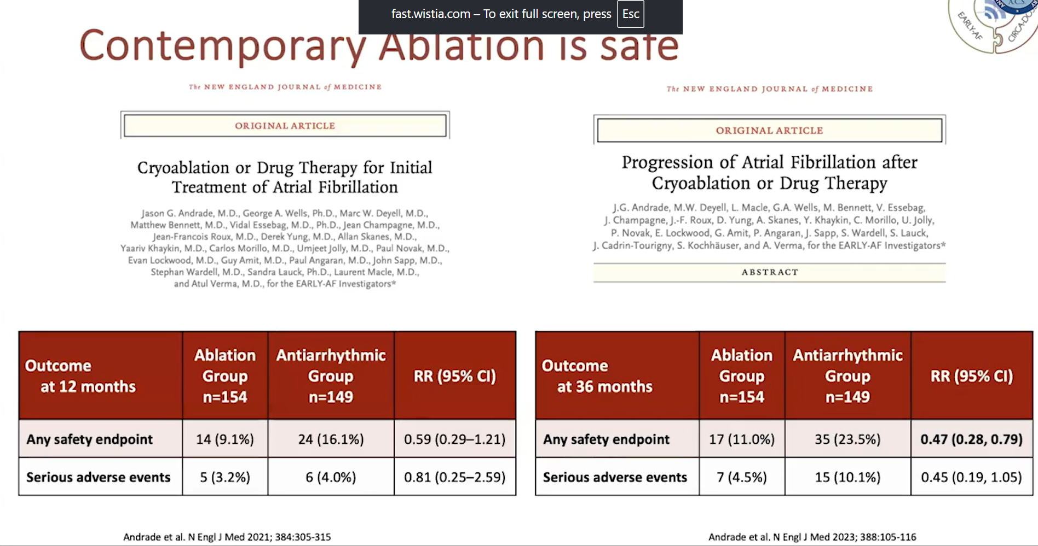
Contemporary ablation is safe

Slide 42
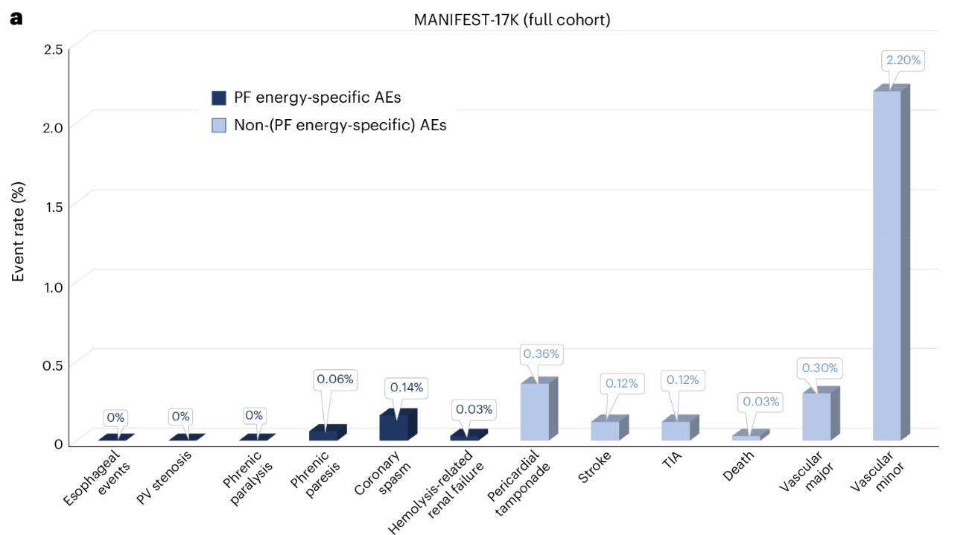
Safety of pulsed field ablation in more than 17,000 patients with atrial fibrillation in the MANIFEST-17K study
Nature Medicine volume 30, pages2020–2029 (2024)

Slide 43
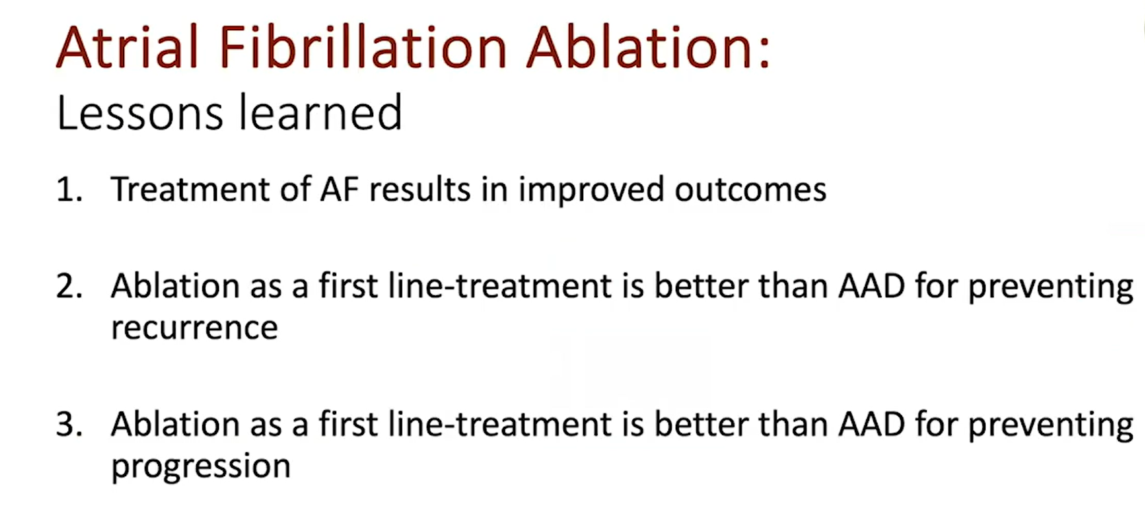

Slide 44

Thank You

