Slide 1
Screening and Management of Aortic Aneurysmal Disease
By:
Joshua N. Hernandez, MD
FMC Vascular Surgery

Slide 2
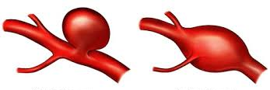
Types of Aortic Aneurysms
Aneurysm vs Ectasia
By Morphology
Saccular
Fusiform
By Pathology
Degenerative
Inflammatory
Infectious
Chronic Dissection
Congenital
Pseudoaneurysm
Notes:
Aneurysm = dilation that is 1.5x normal vessel diameter; Ectasia is between normal and aneurysmal.
Degenerative, most common, associated with increased MMPs (Matrix Metalloproteinase); MMP is essential in the process of arterial remodelling and repair, however with increased activity and not balanced with their inhibitors (TIMPs) they excessively break down key ECM components like elastin and collagen leading to a weakening of the aortic wall and loss of elasticity resulting in the wall no longer able to withstand normal aortic BP and stretching.
Inflammatory = ~5% of all aortic aneurysms, especially challenging, all aneurysms have associated inflammation but these are exaggerated. Other theories include chronic subacute rupture and some variant form of retroperitoneal fibrosis.
Infectious, ~90% have a preceeding infection (saccular), ~5% aneurysm proceeds infection (fusiform). Associated pathogens = Salmonella & S. aureus. Syphilitic Aortitis (T. pallidum)/Tertiary Syphilis most commonly involves ascending aorta and arch.
Chronic Dissection, ~40% of all chronic type B dissections will degenerate overtime.
Congenital, associated w/ED type 4, Marfans, Loeys Dietz, Pseudoxanthoma elasticum (GS syndrome), Familial Aortic Syndrome.
Pseudoaneurysm, contained rupture/hematoma of extravasated blood by connective tissue and adventitia; rupture, trauma, but also associated with Acute Aortic Syndromes.

Slide 3
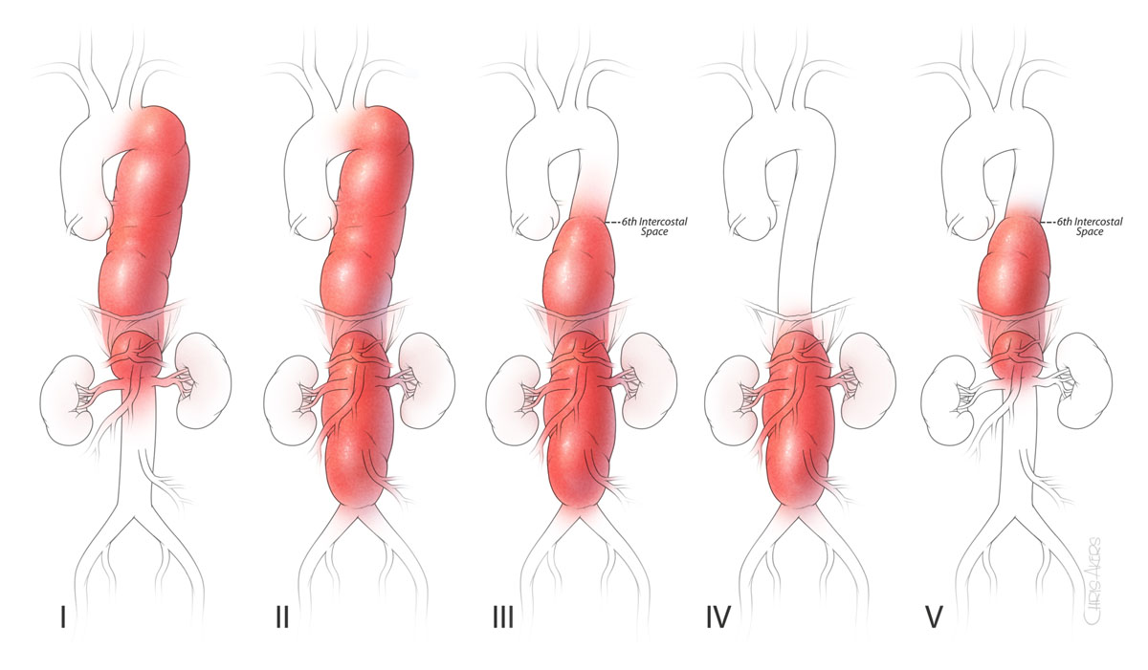
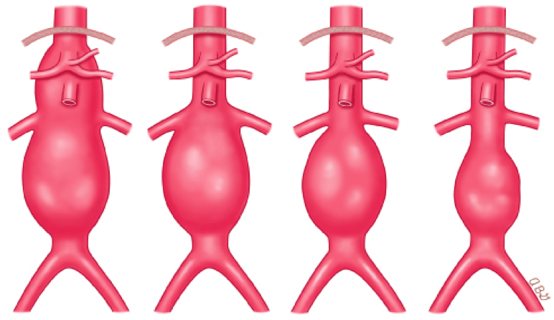
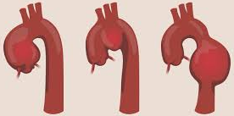
Types of Aortic Aneurysms
By Location
Ascending Thoracic Aortic Aneurysm
Aortic Arch Aneurysm
Descending Thoracic Aortic Aneurysm
Abdominal Aortic Aneurysm
Suprarenal
Pararenal
Juxtarenal
Infrarenal
Thoracoabdominal Aortic Aneurysm
Crawford Classification

Slide 4
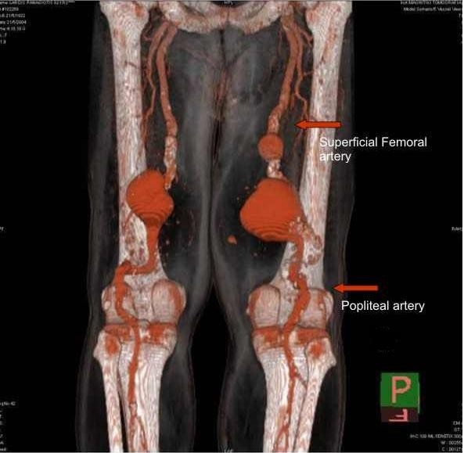
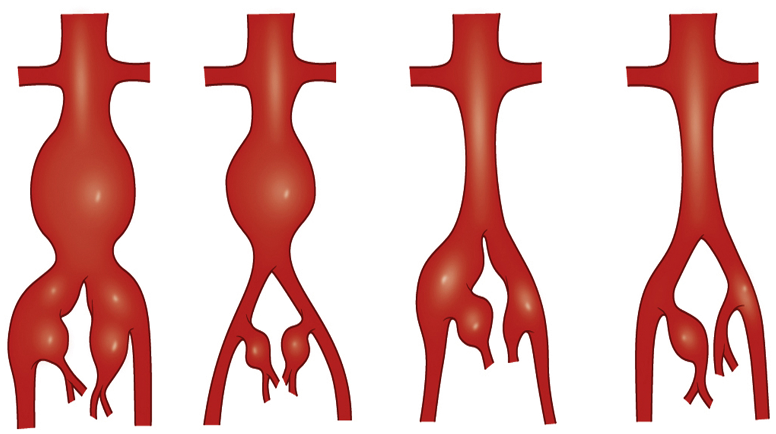
Associated Aneurysms
Iliac Aneurysm
Femoral Aneurysm
Popliteal Aneurysm
Notes:
Iliac – 85% w/CIAA will have concomitant or prev. treated AAA
Fermoral – 80% will have AAA
Popliteal – 50% of unilateral & 75% of bilateral PAA patients will have AAA, 15% of patients w/AAA will have PAA

Slide 5
Risk Factors, Prognosis, Surveillance, & Screening
Formation & Growth
Age
Male
Smoking Hx*
Family Hx
Fluoroquinolones
Low B6 levels
Rupture
Size
Growth rate
Smoking
HTN
COPD
Female
Saccular morphology
Diabetes (especially T1DM) is protective
Risk of Rupture (annual):
3-5.4cm ~2%
5.5-6cm ~5% (<risk of repair)
6.1-7cm 5-10%
>7cm >10%
Risk of rupture far exceeds risk of thromboembolic complications.
6% of all AAA present as rupture.
Surveillance:
2.5-3cm Q10yr
3.-3.9cm Q3yr
4-4.9cm Q1yr
5-5.4cm Q6mo
Aortic Duplex; CTA once 5+ cm for operative planning.
Screening: (SVS) 65-75yo w/any Hx of tobacco use

Slide 6
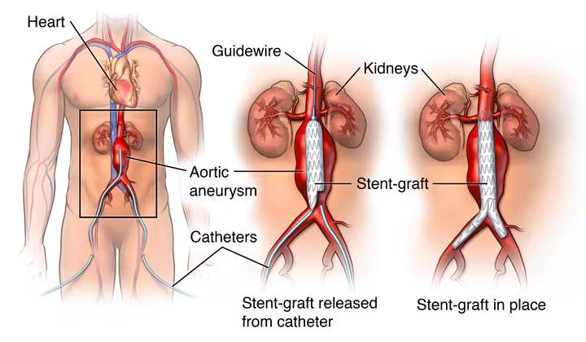
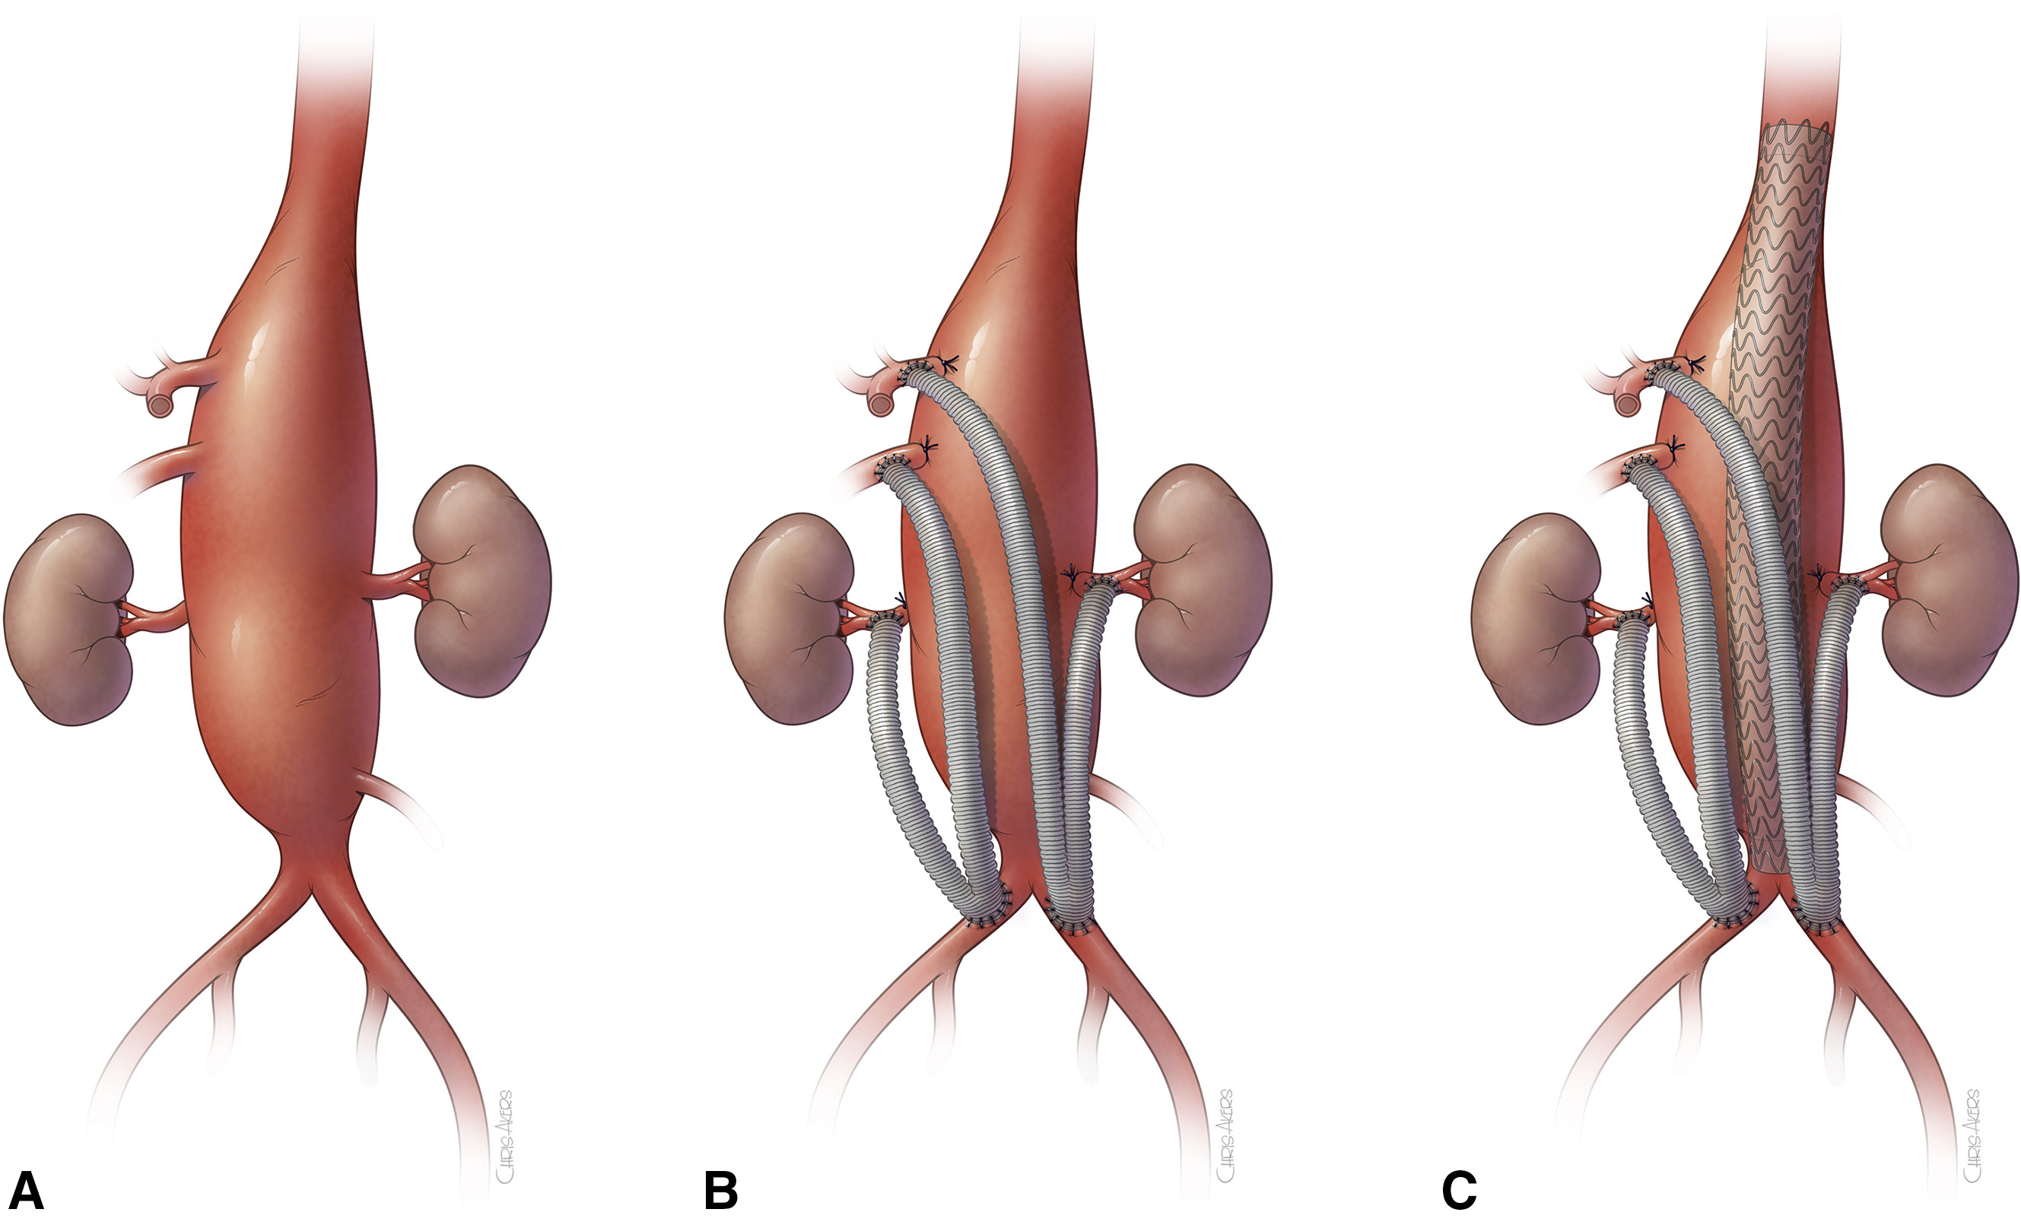
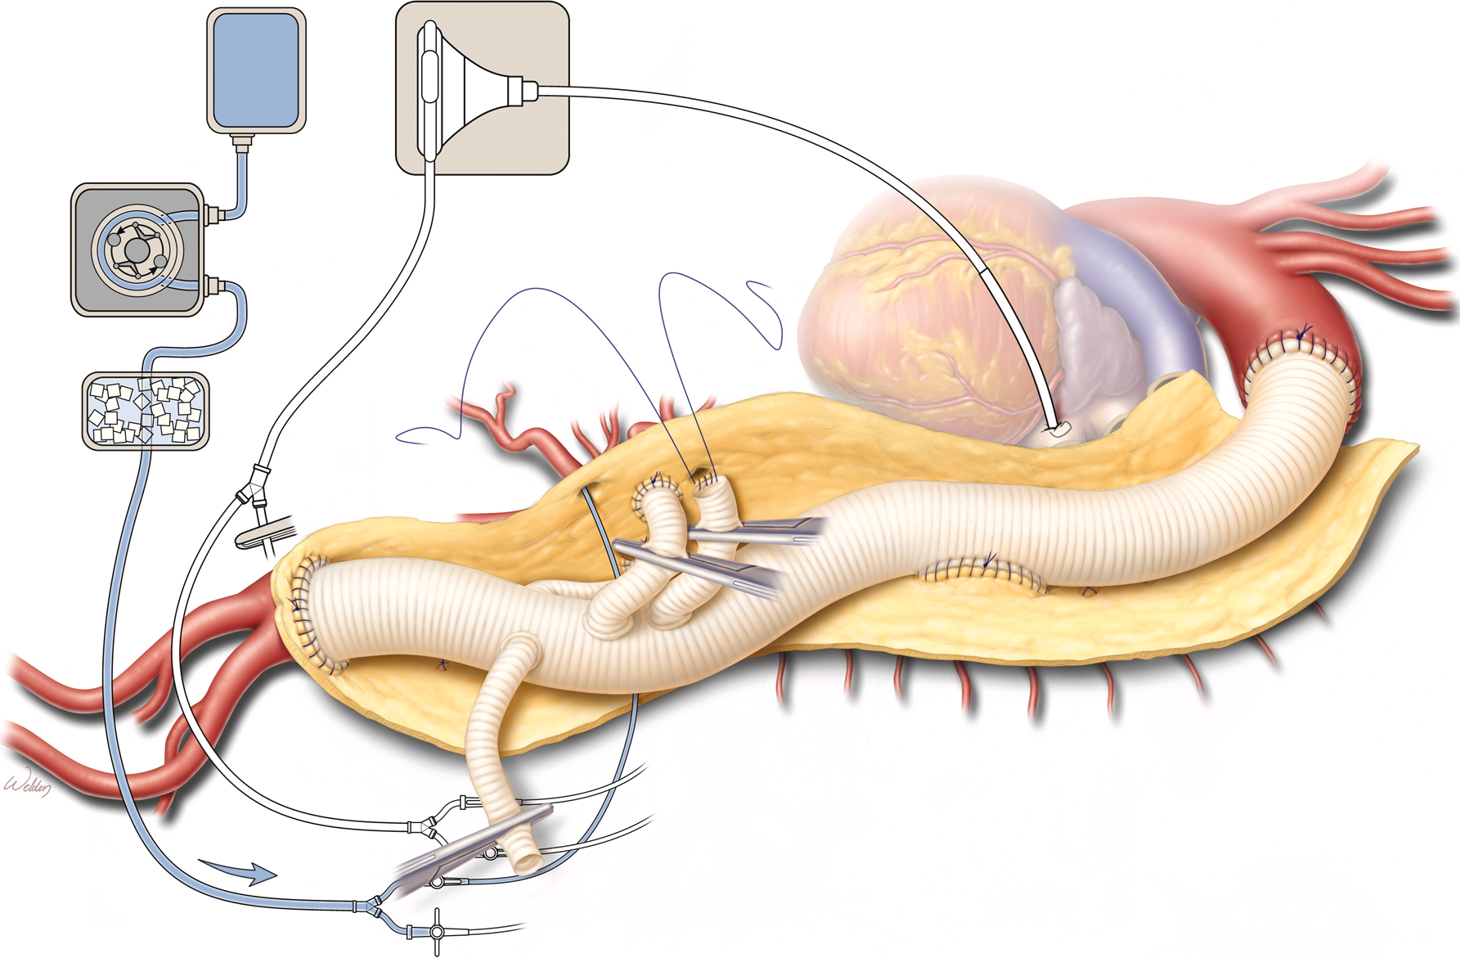
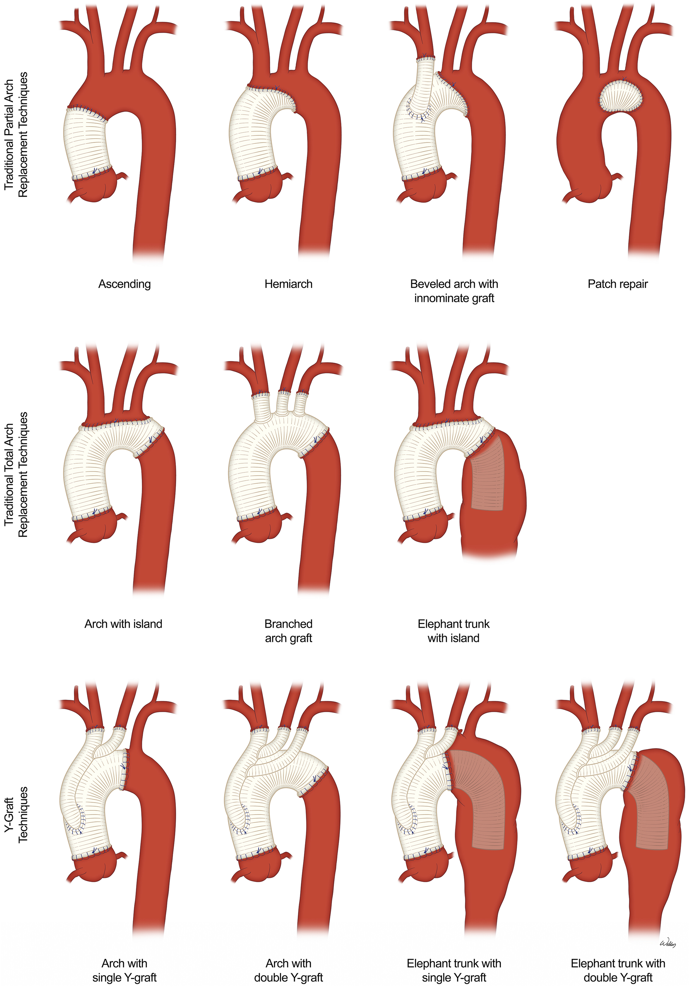
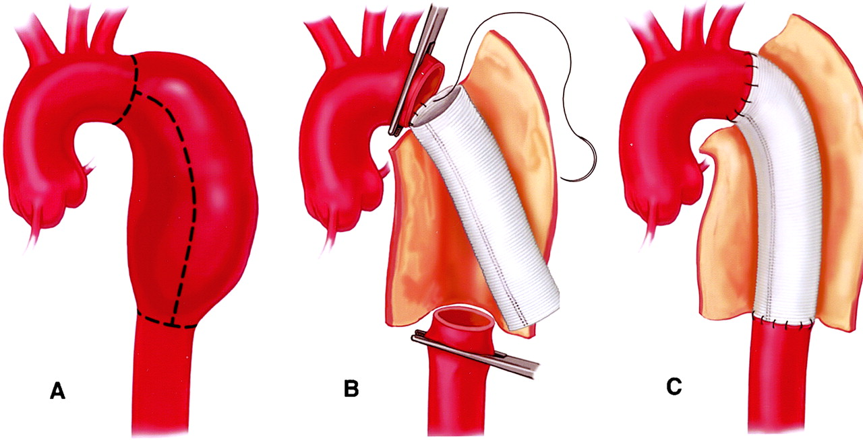
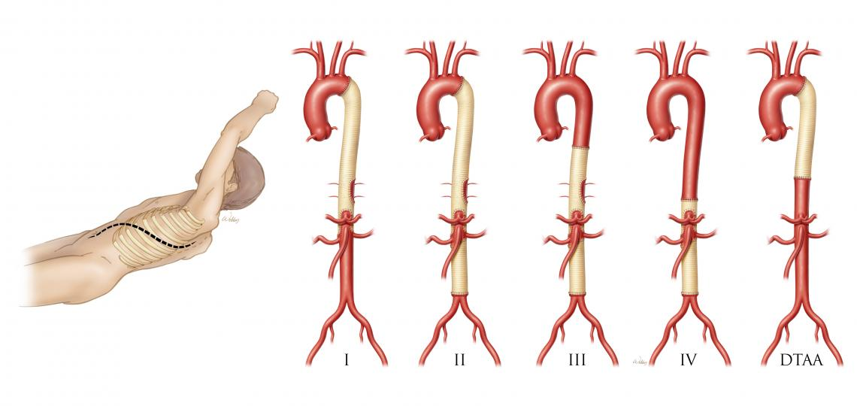
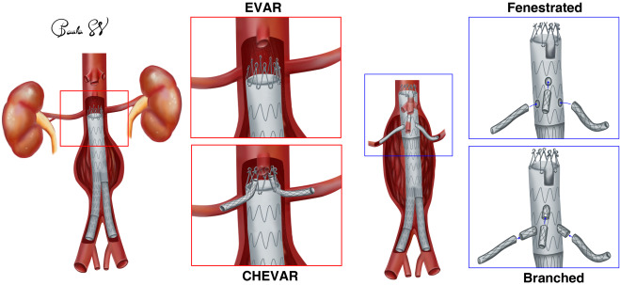
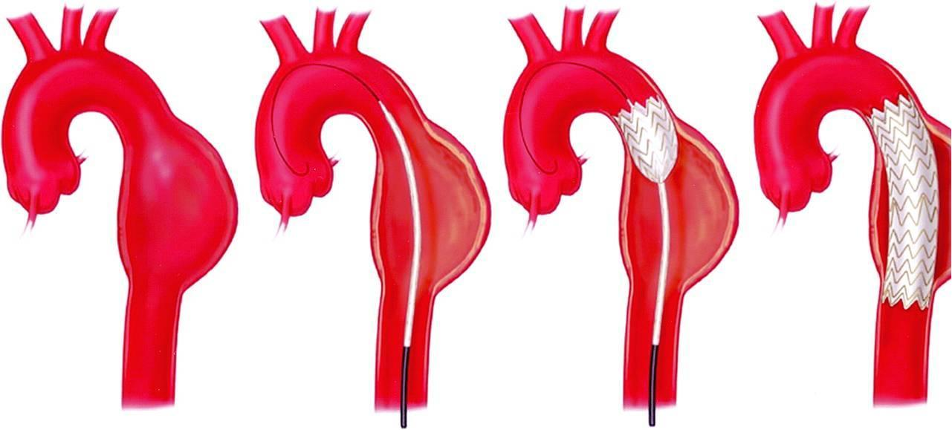
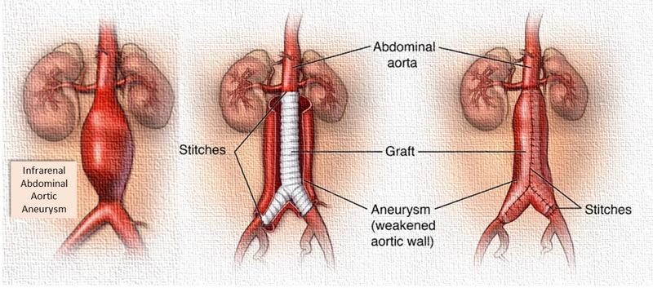
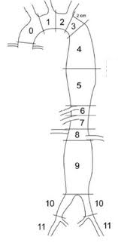
Intervention
Indications:
Ruptured
Symptomatic
>5.5cm in males
>5cm in females
Rapid Growth; >1cm/yr or >0.5cm/6mo
Saccular Morphology
Medical Tx
Antiplatelet
Statins
Beta-blockers
ACEi
Doxycycline
Surgical Repair
Endovascular Repair
Open Repair
Hybrid Repair
Notes:
Antiplatelet – Used to reduce thrombus burden. In rat models showed reduced AAA expansion but not in human trials.
Statins – In animal models showed to slow expansion but not in humans. Human trials did show 22% relative reduction in major adverse cardiovascular events.
Beta-blockers – In animal models stopped expansion but not in humans.
ACEi – In animal models slowed growth. Human trials have been mixed including increased growth rate.
Doxycycline – inhibits multilple MMPs, effective in animal models, in humans a decrease in inflammation is shown but not in growth rate.

Slide 7
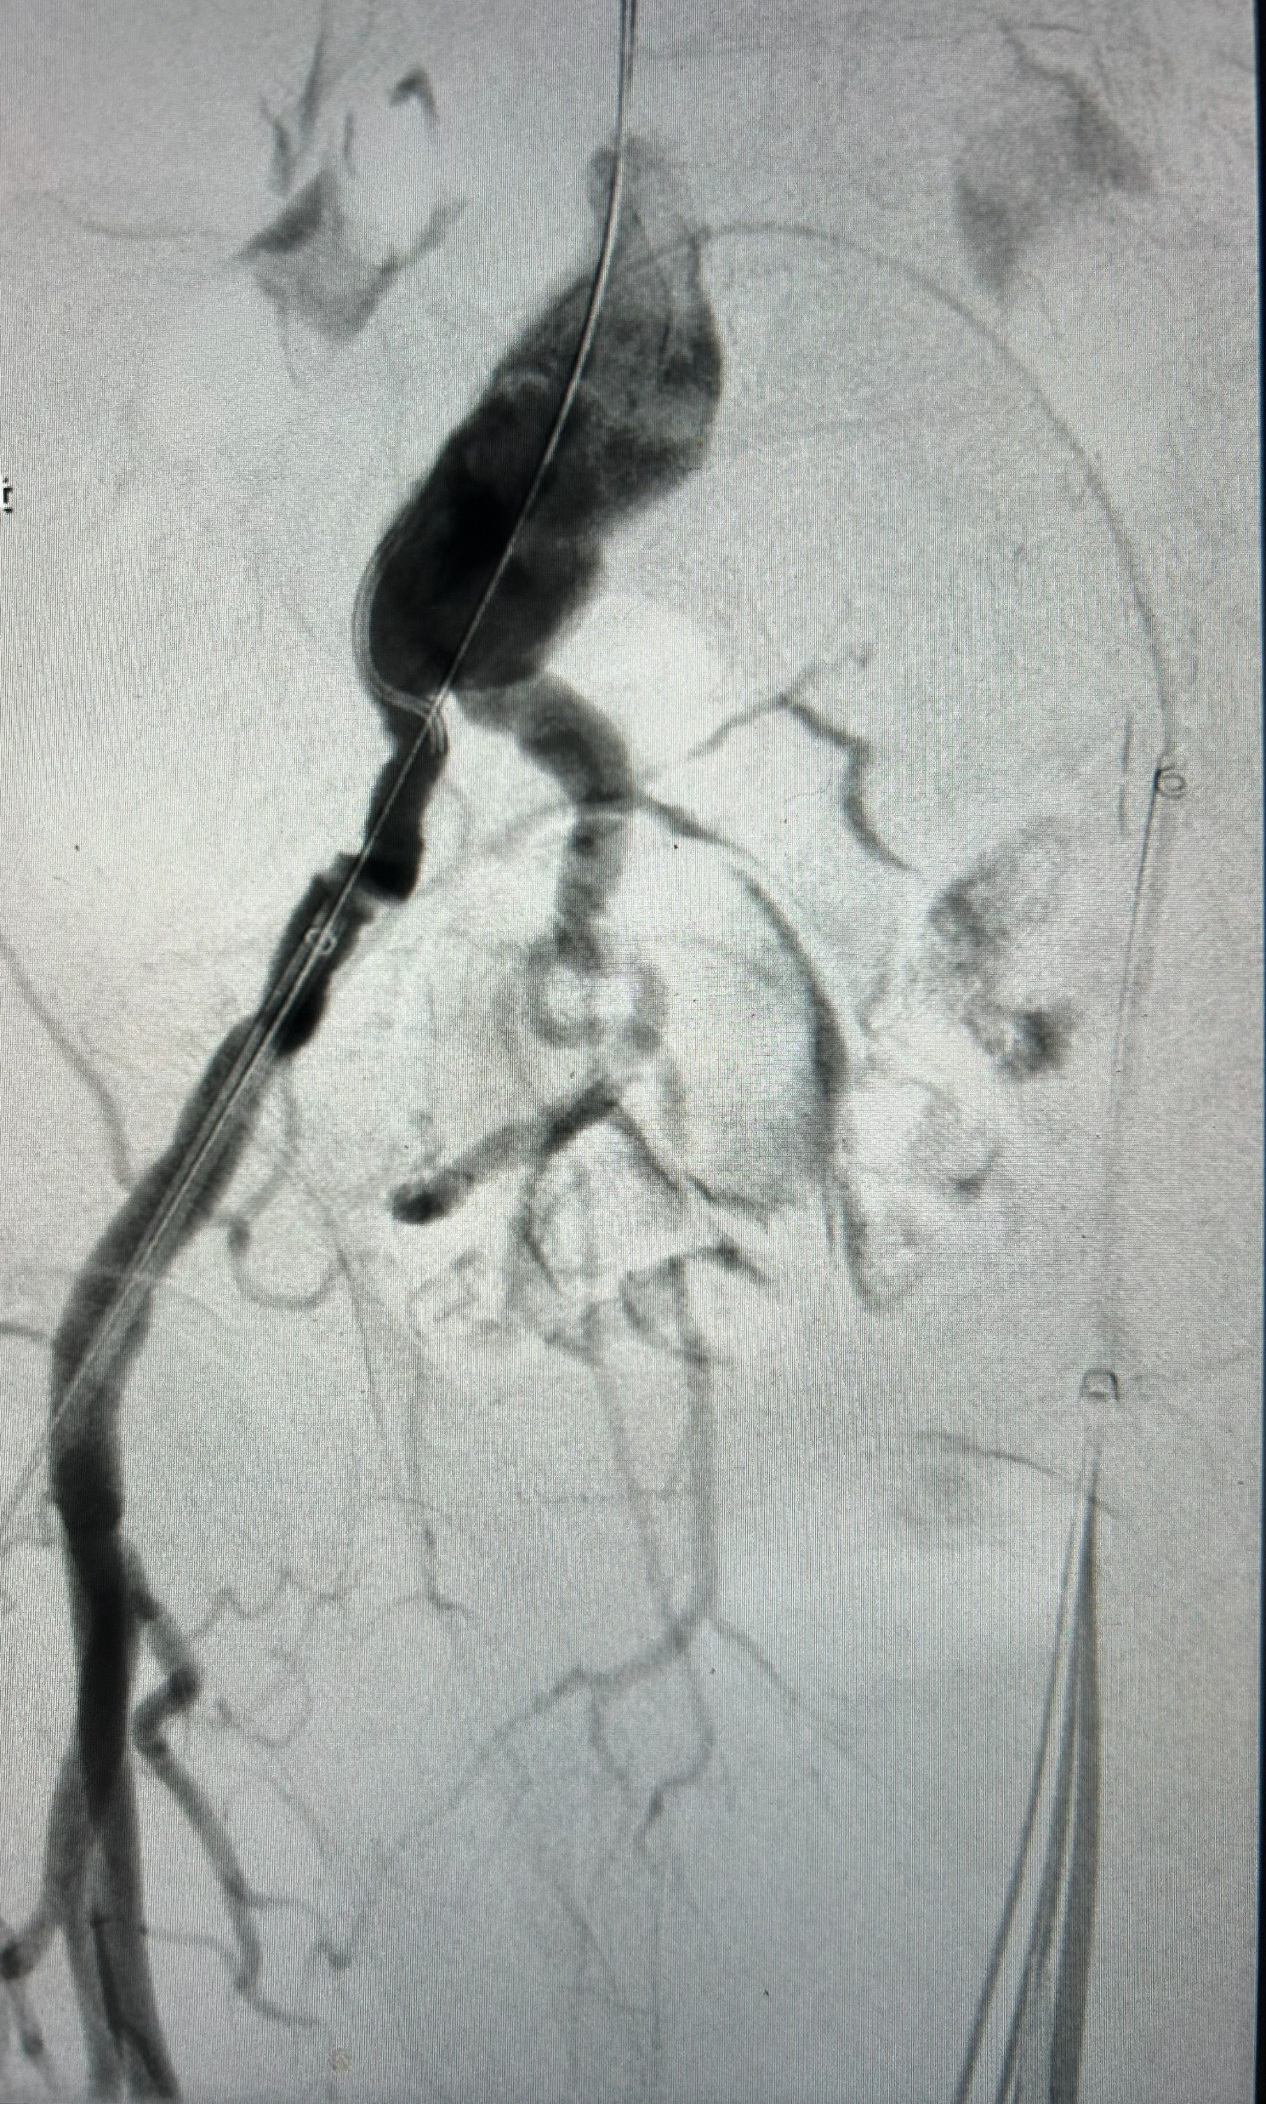
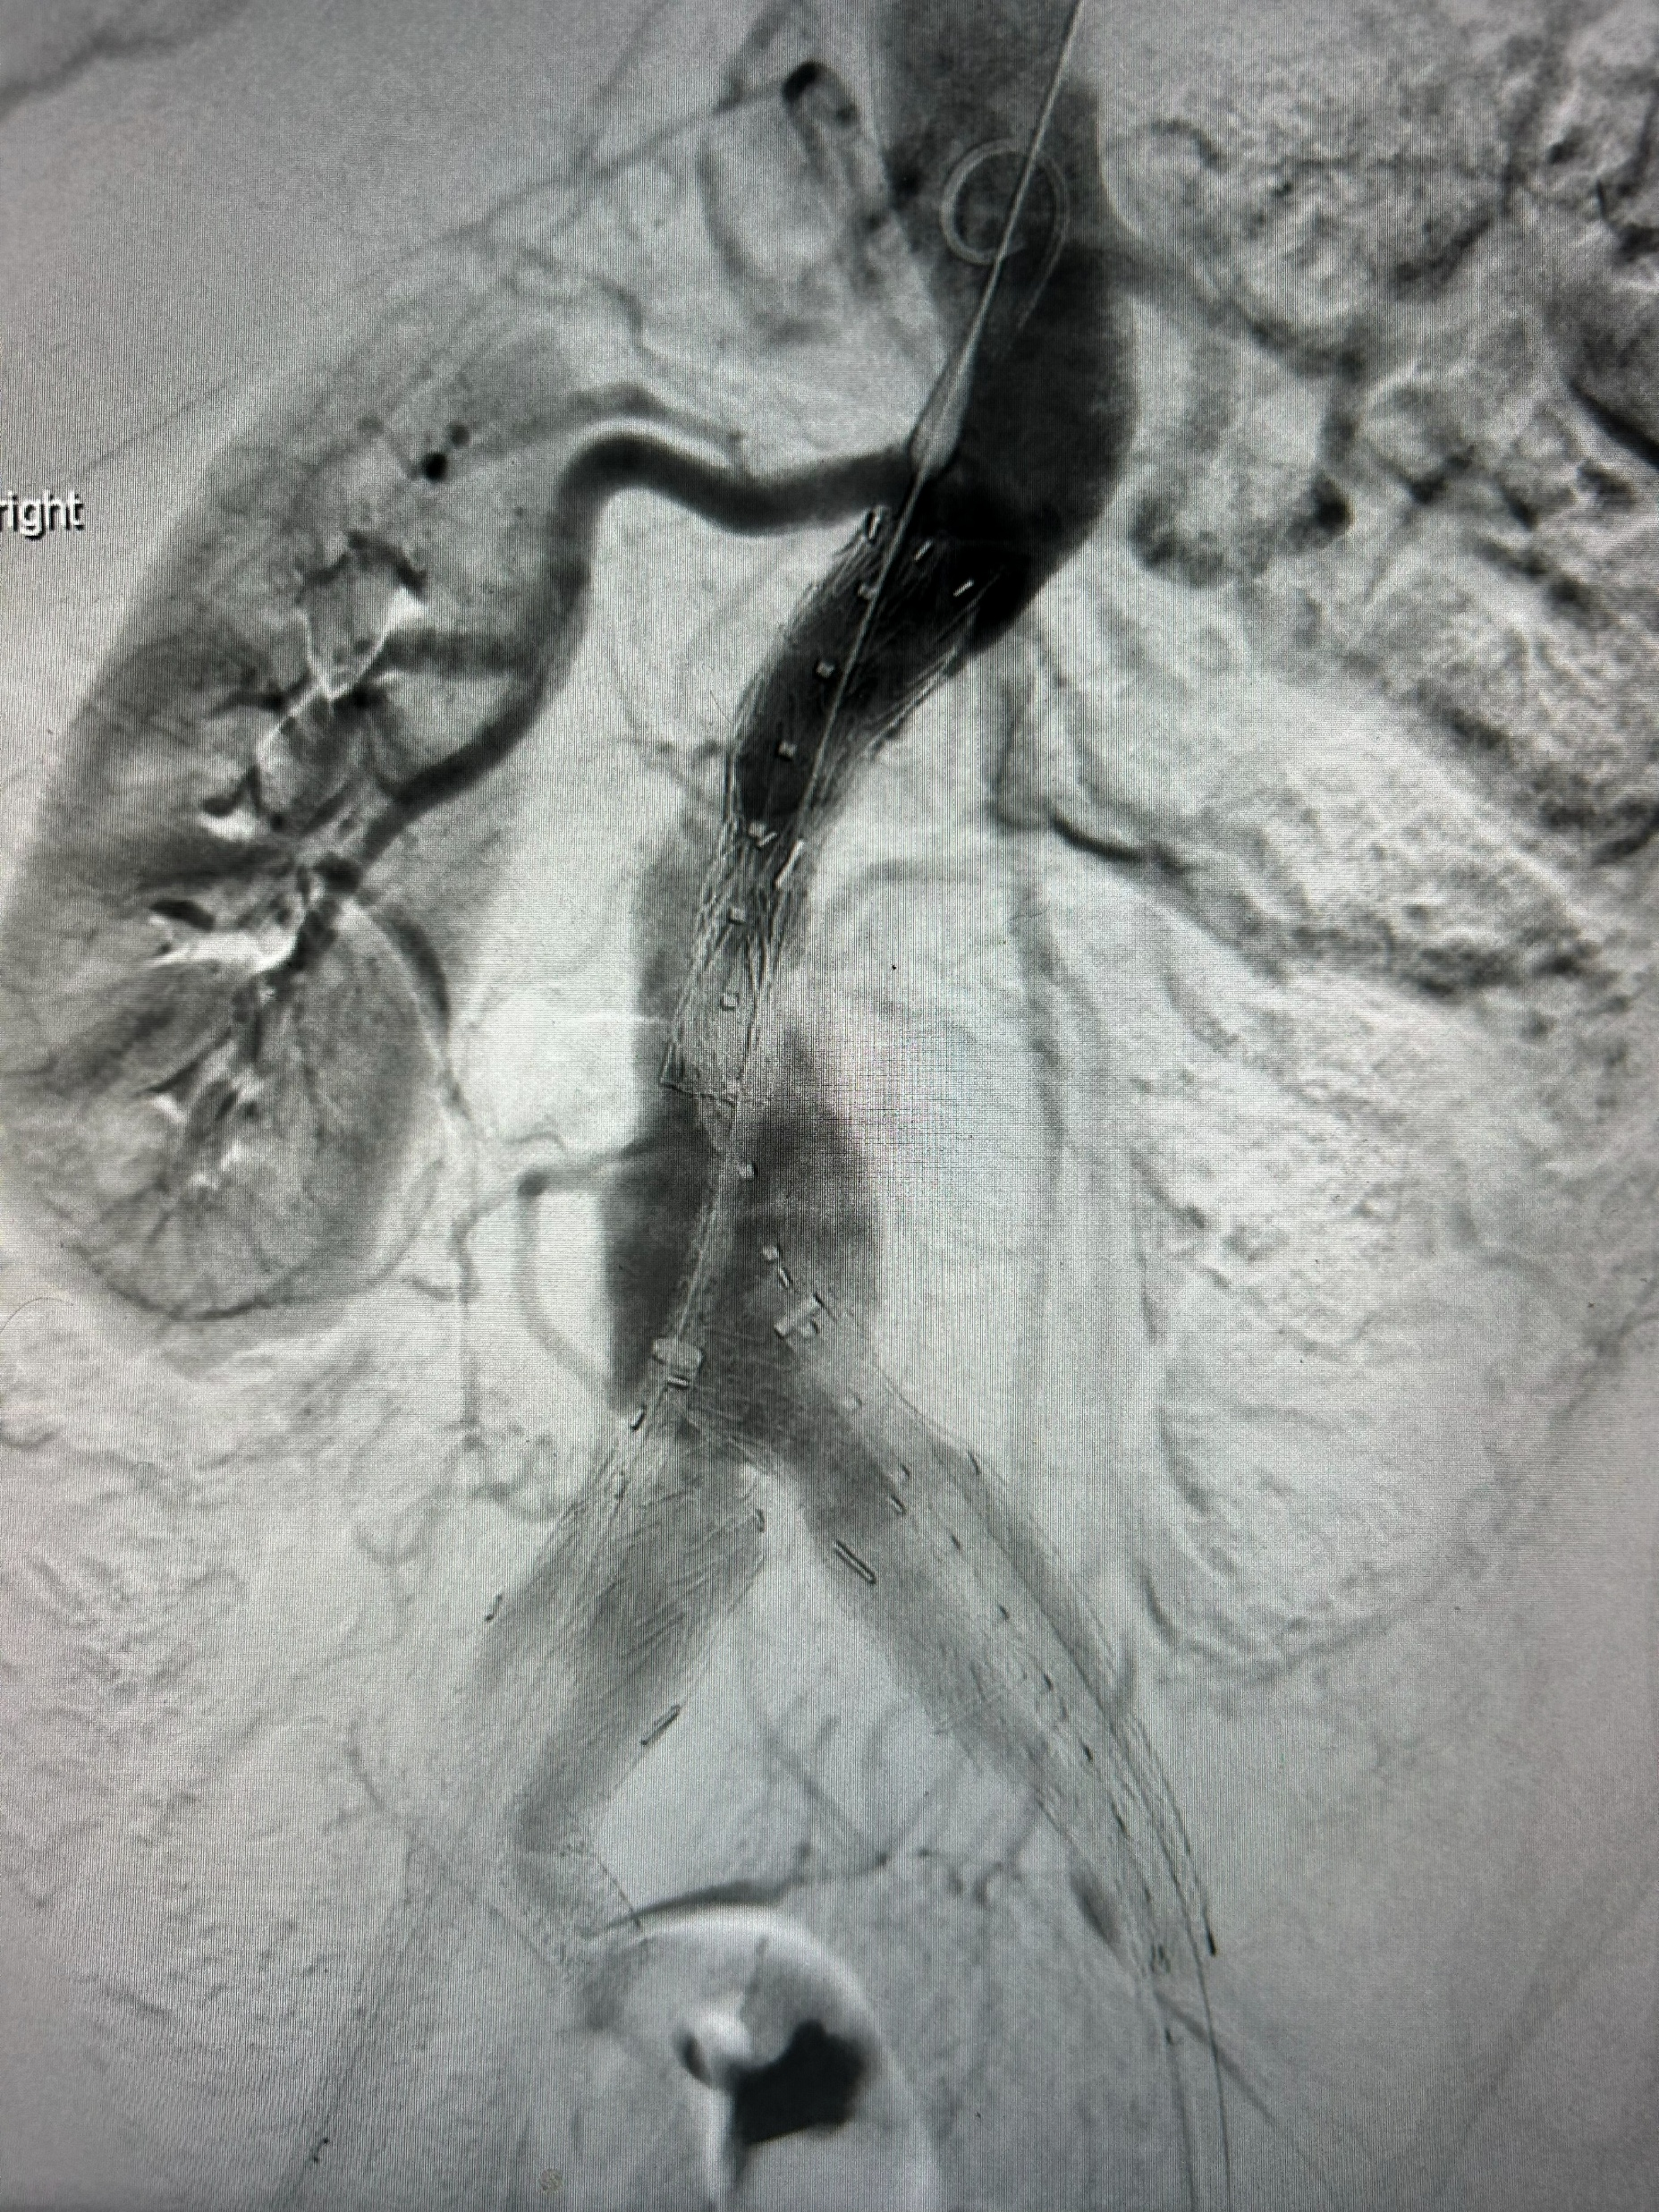
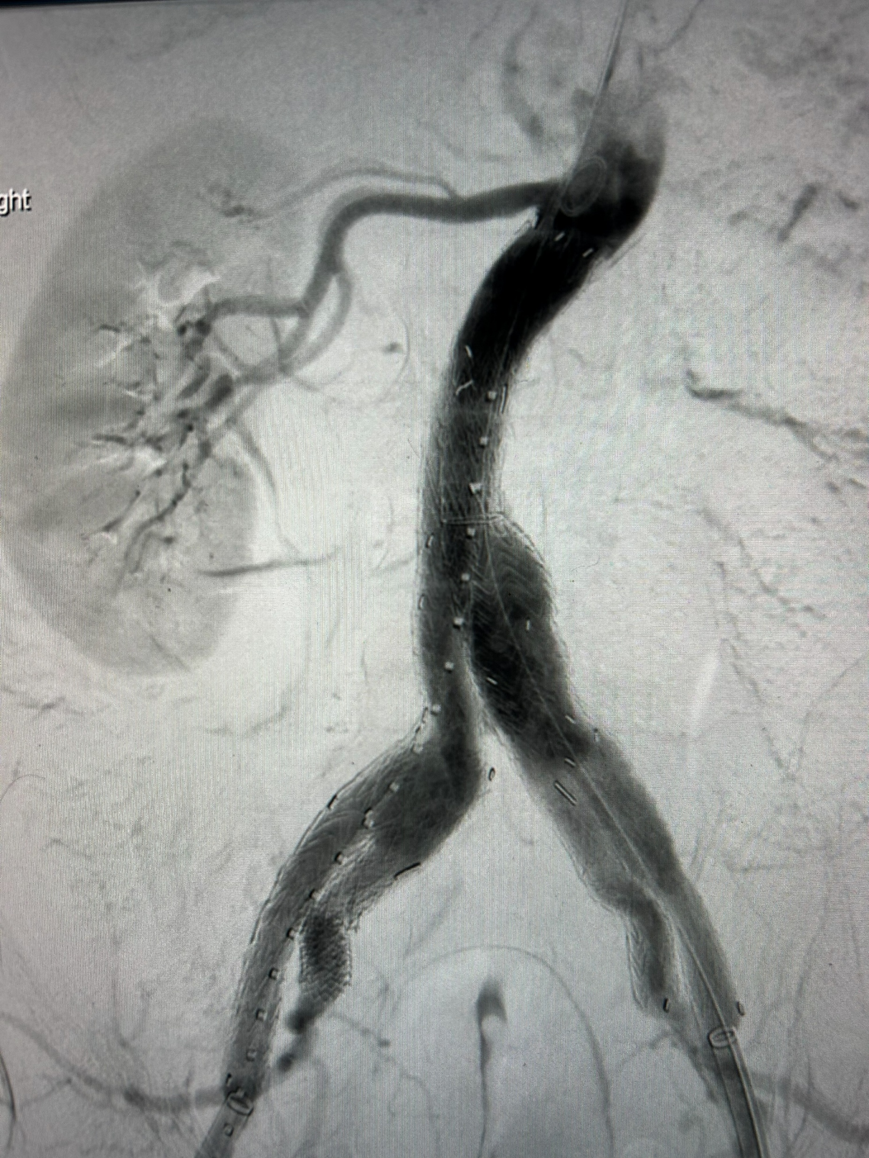
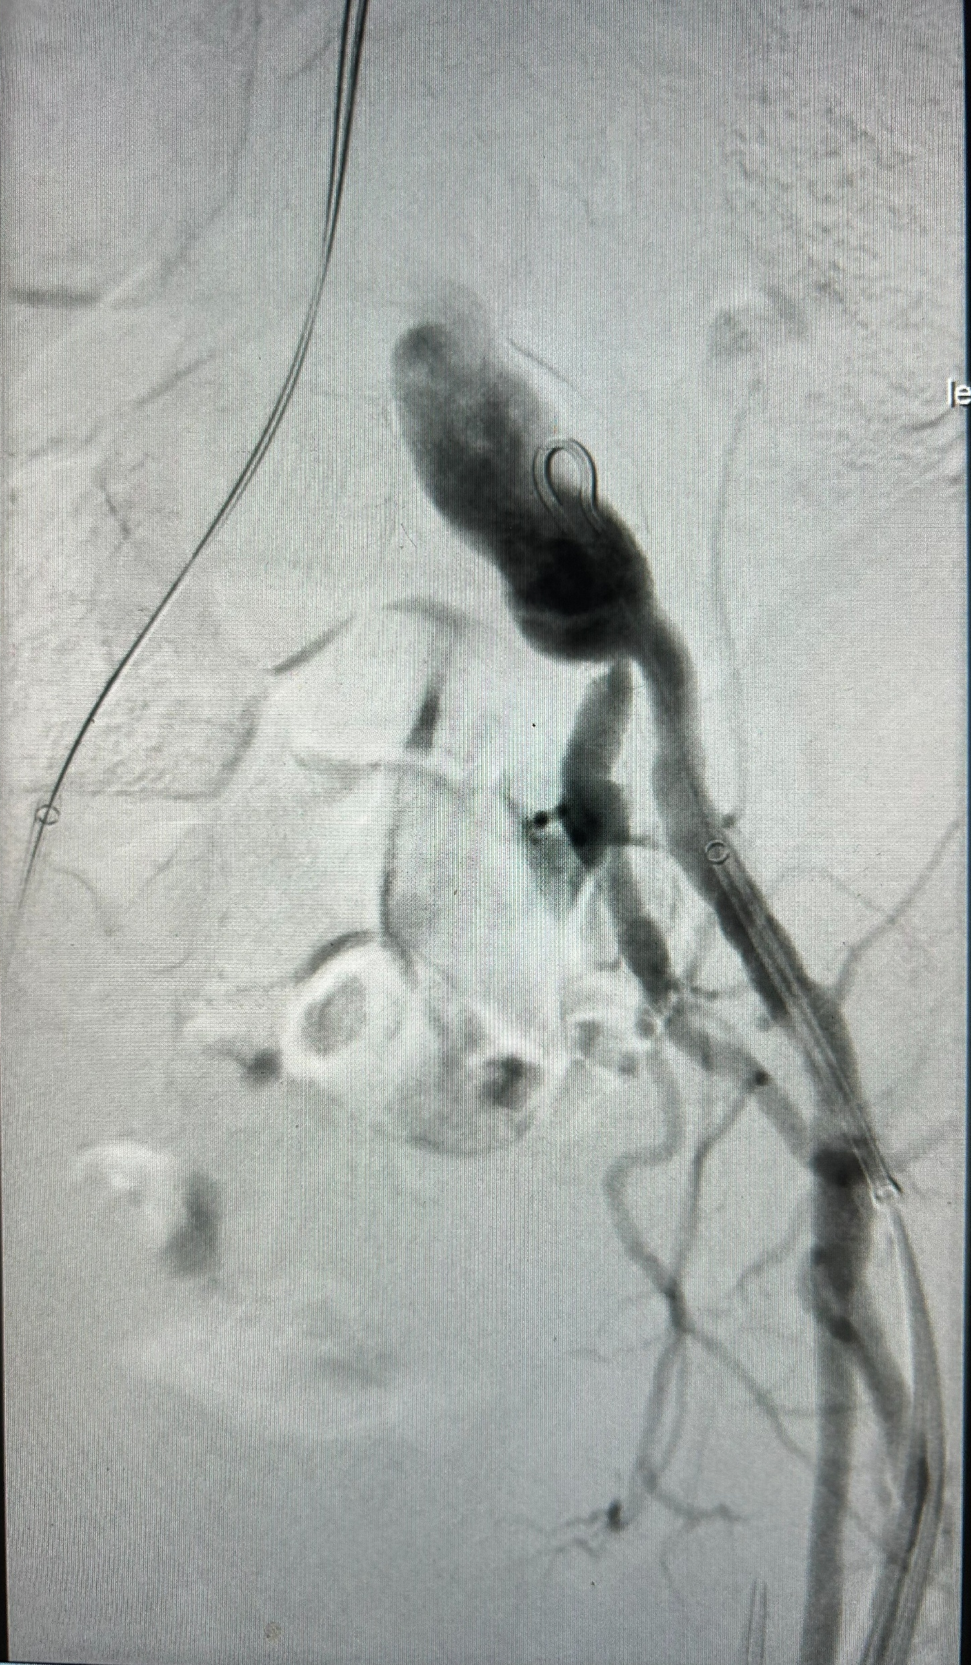
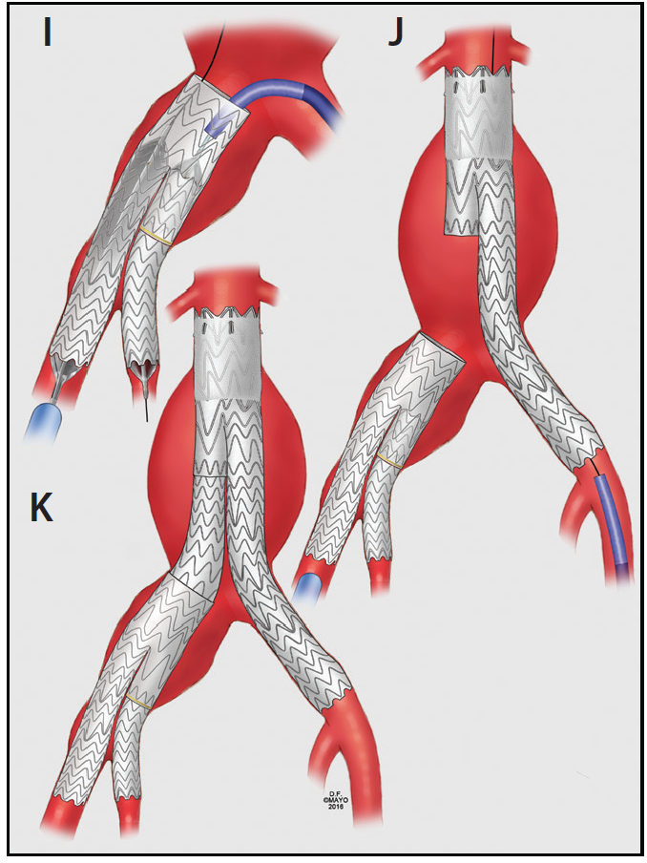
IBE
Preserve flow through Hypogastric A.
Prevent Pelvic Ischemia

Slide 8
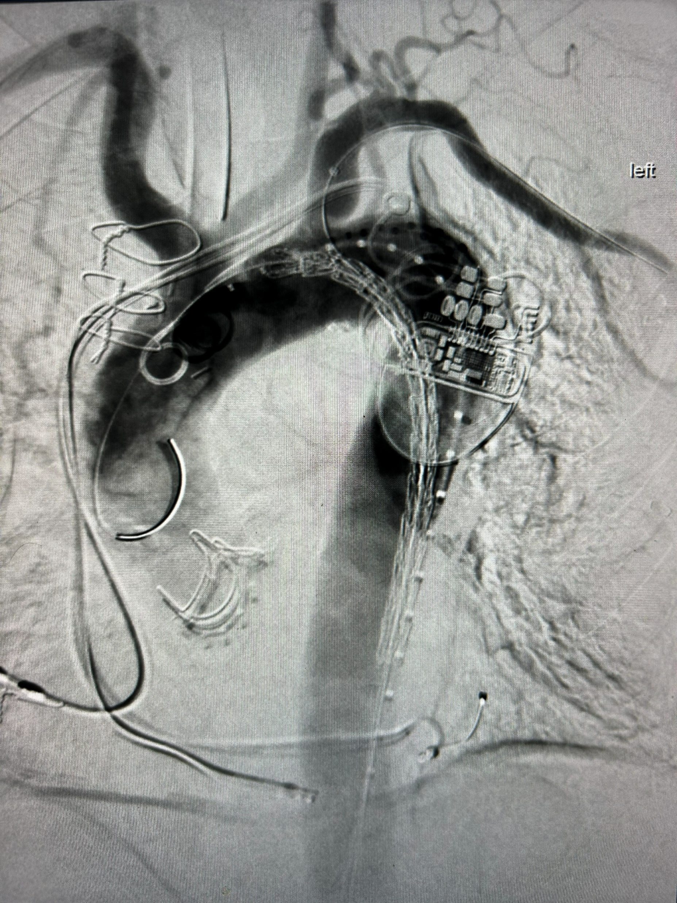
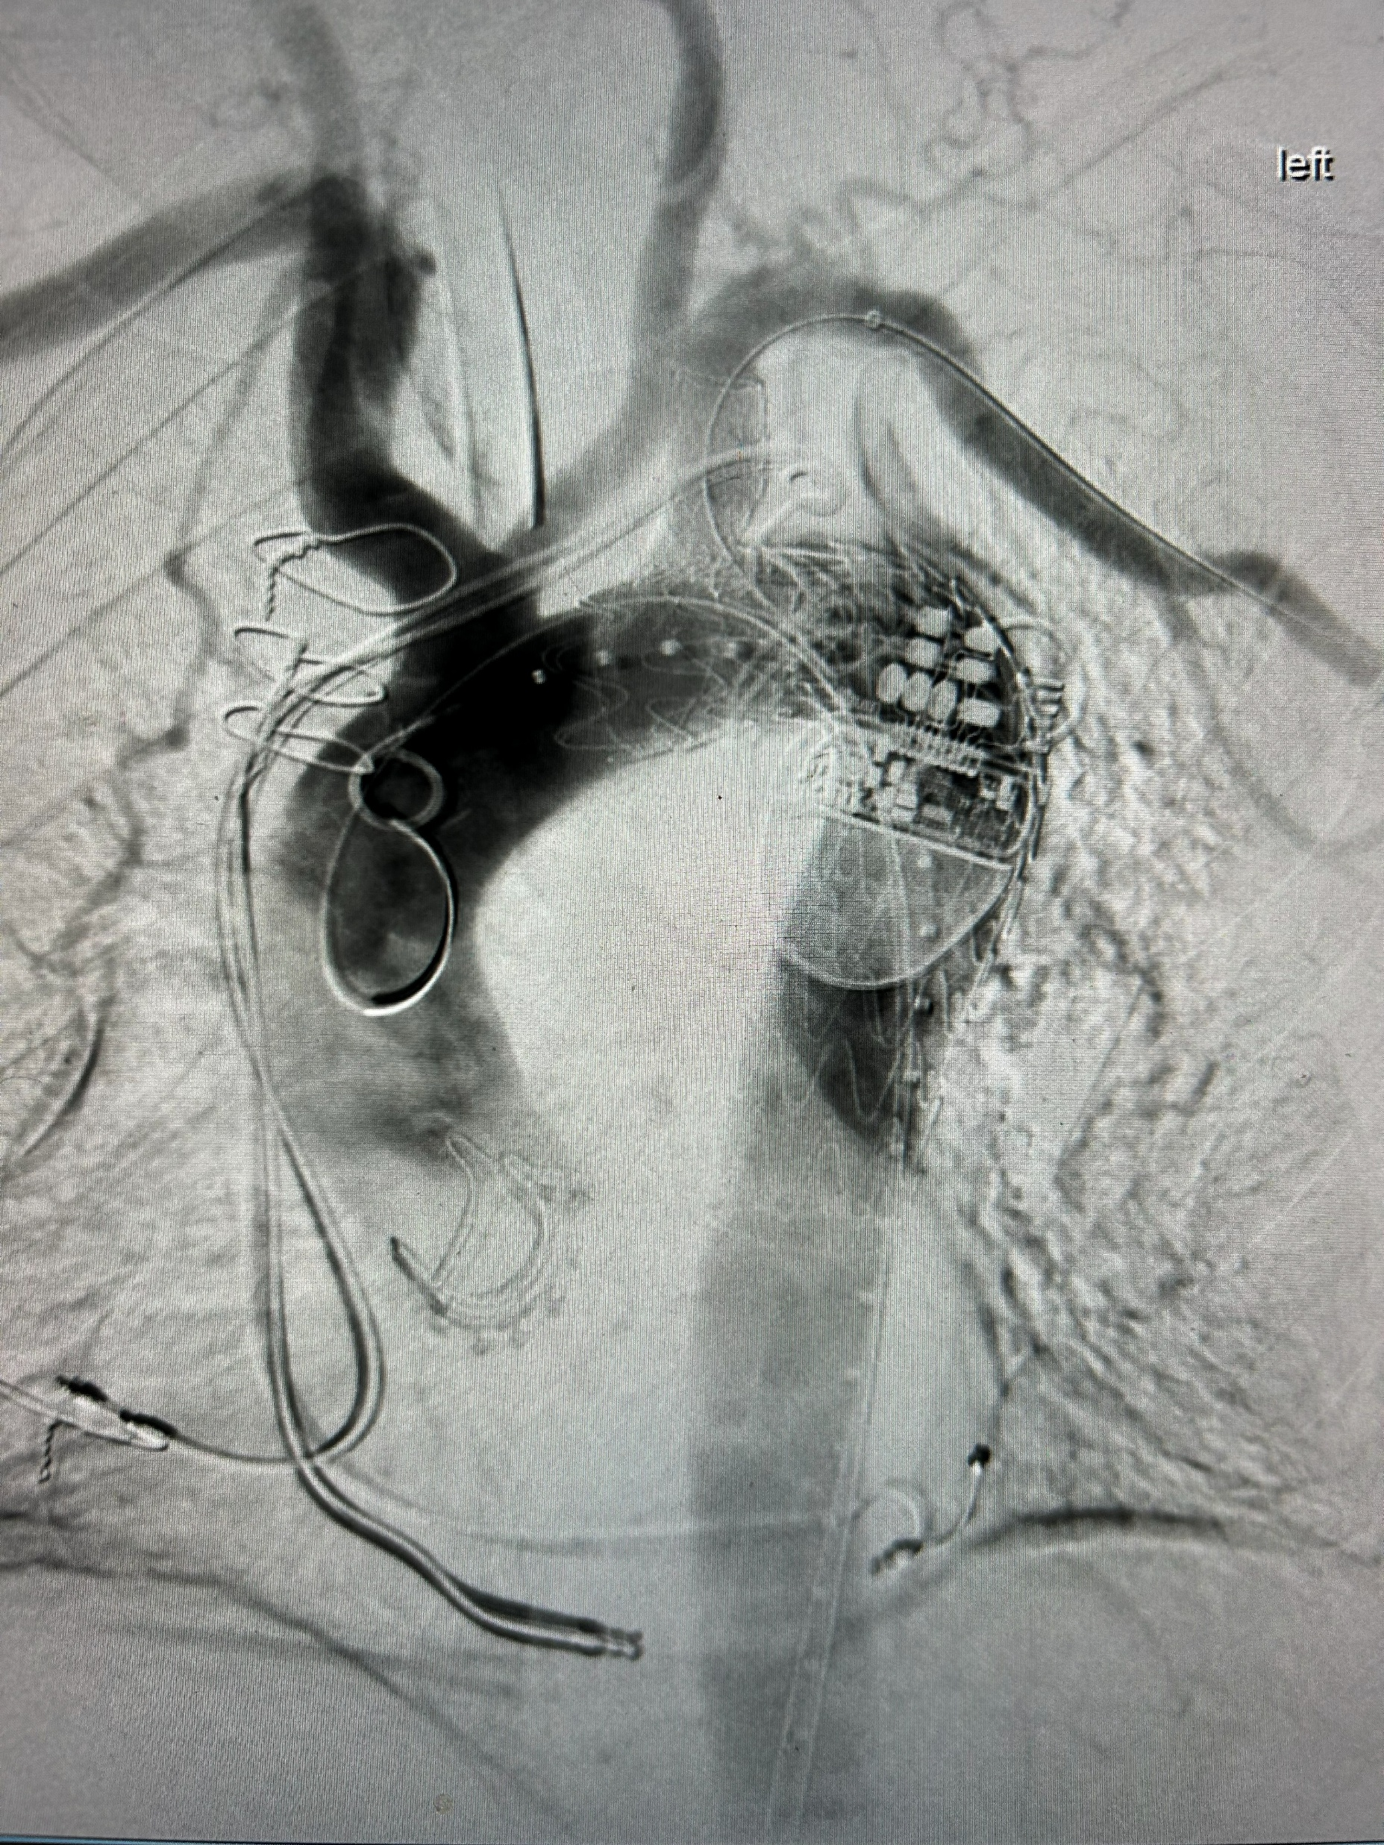
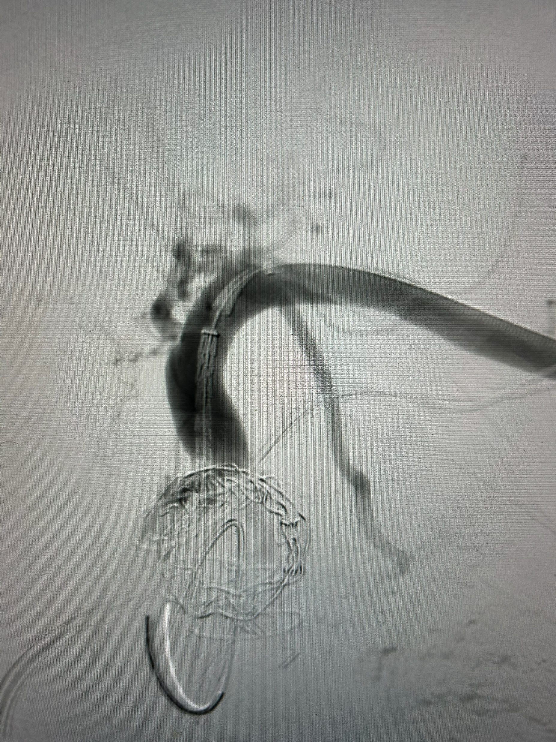
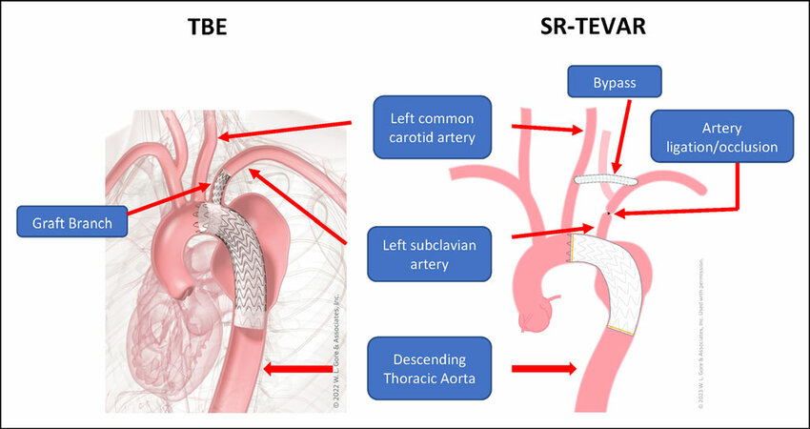
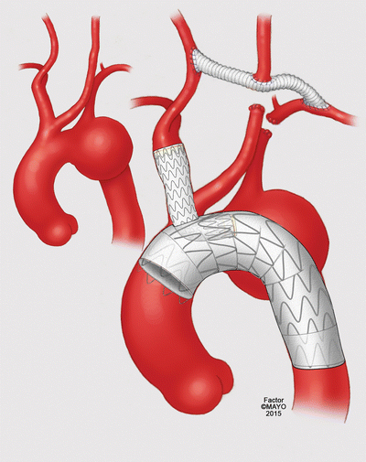
TBE
Avoid or minimize extra-anatomical BP
Less risk of SCI

Slide 9
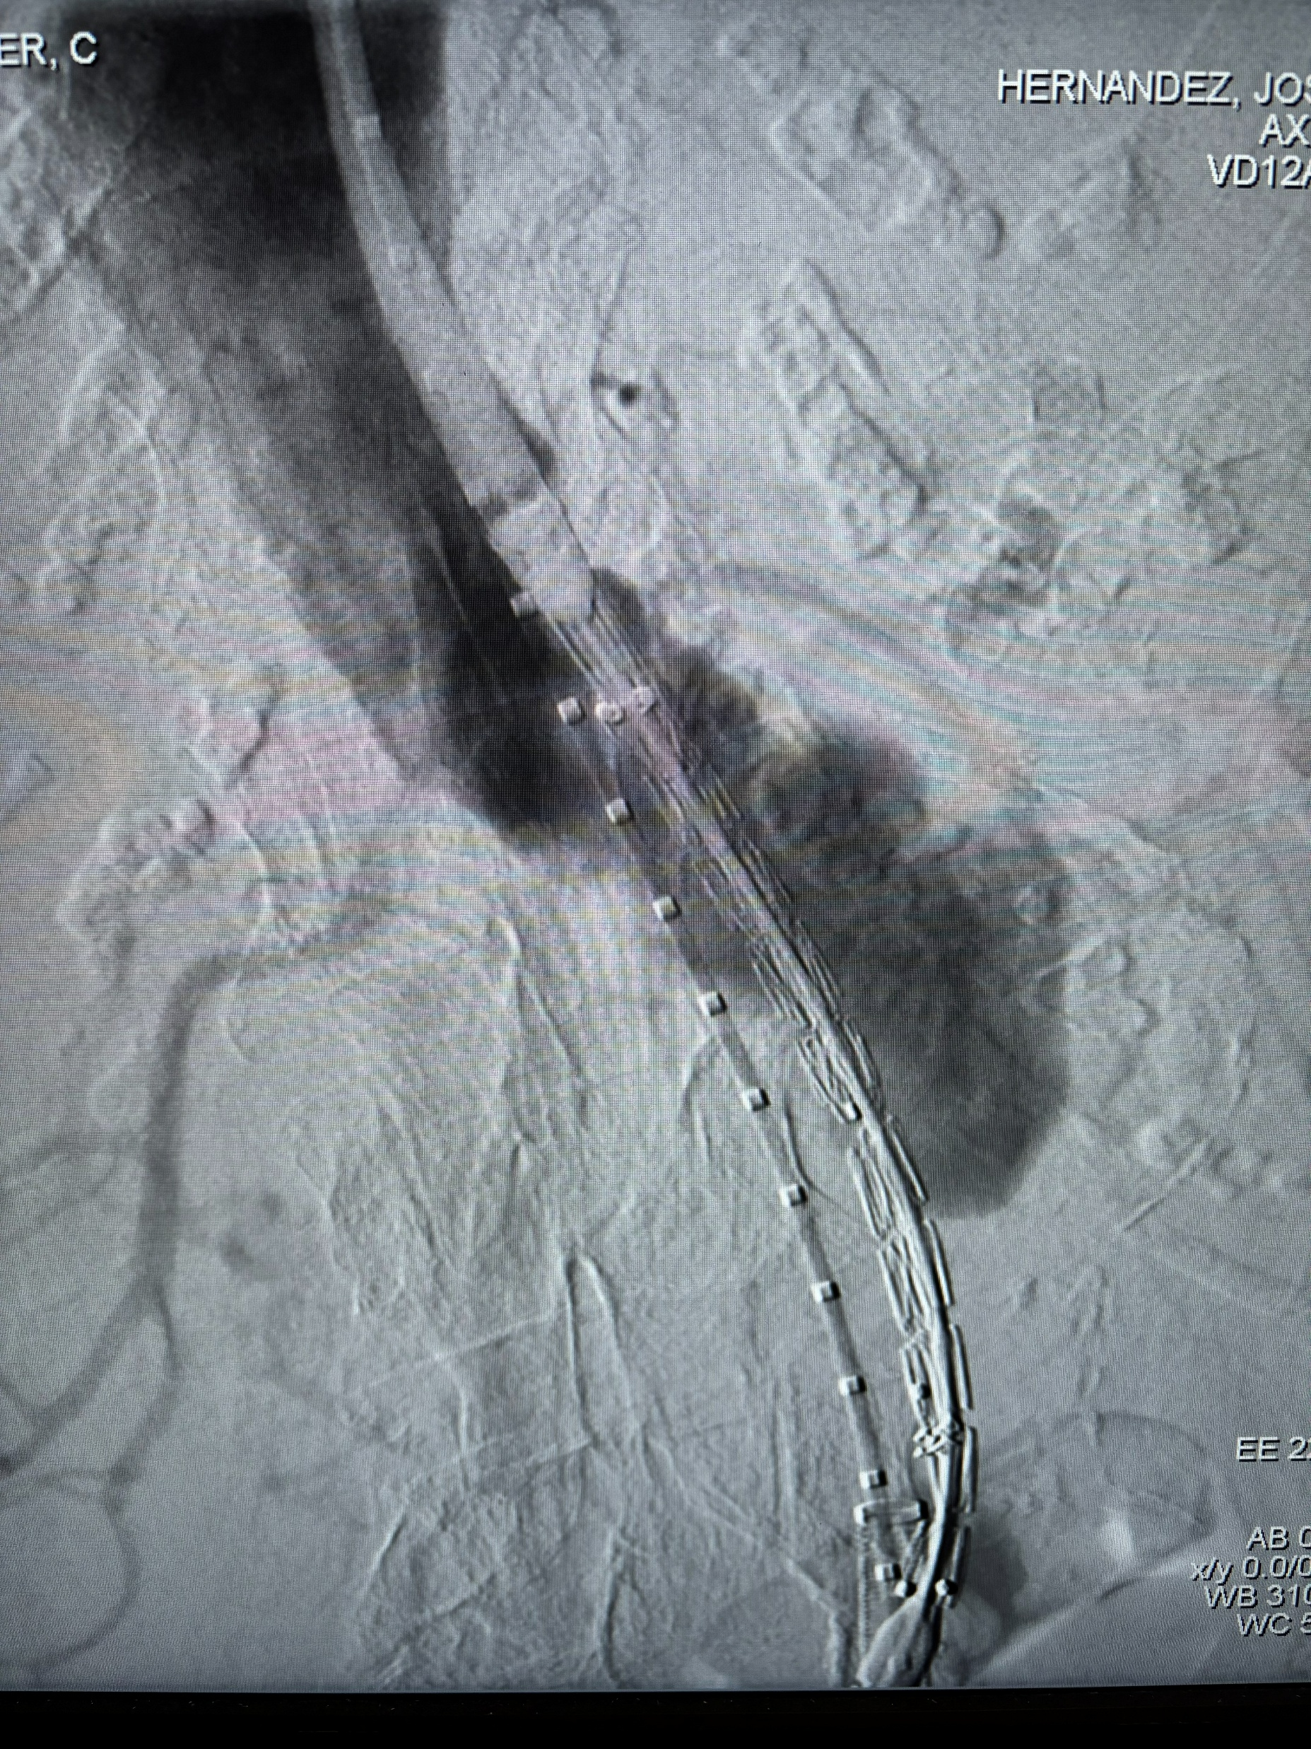
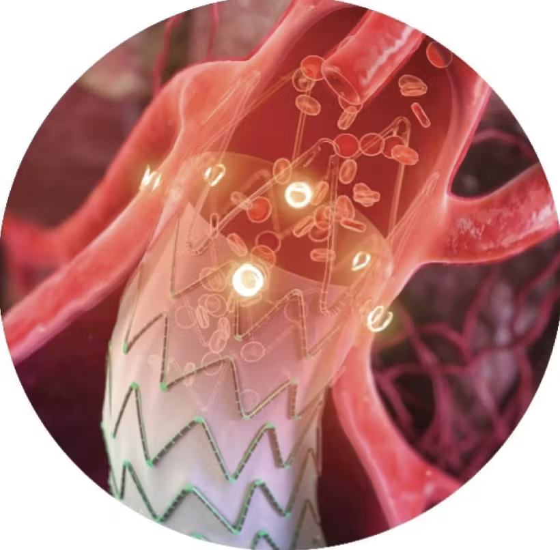
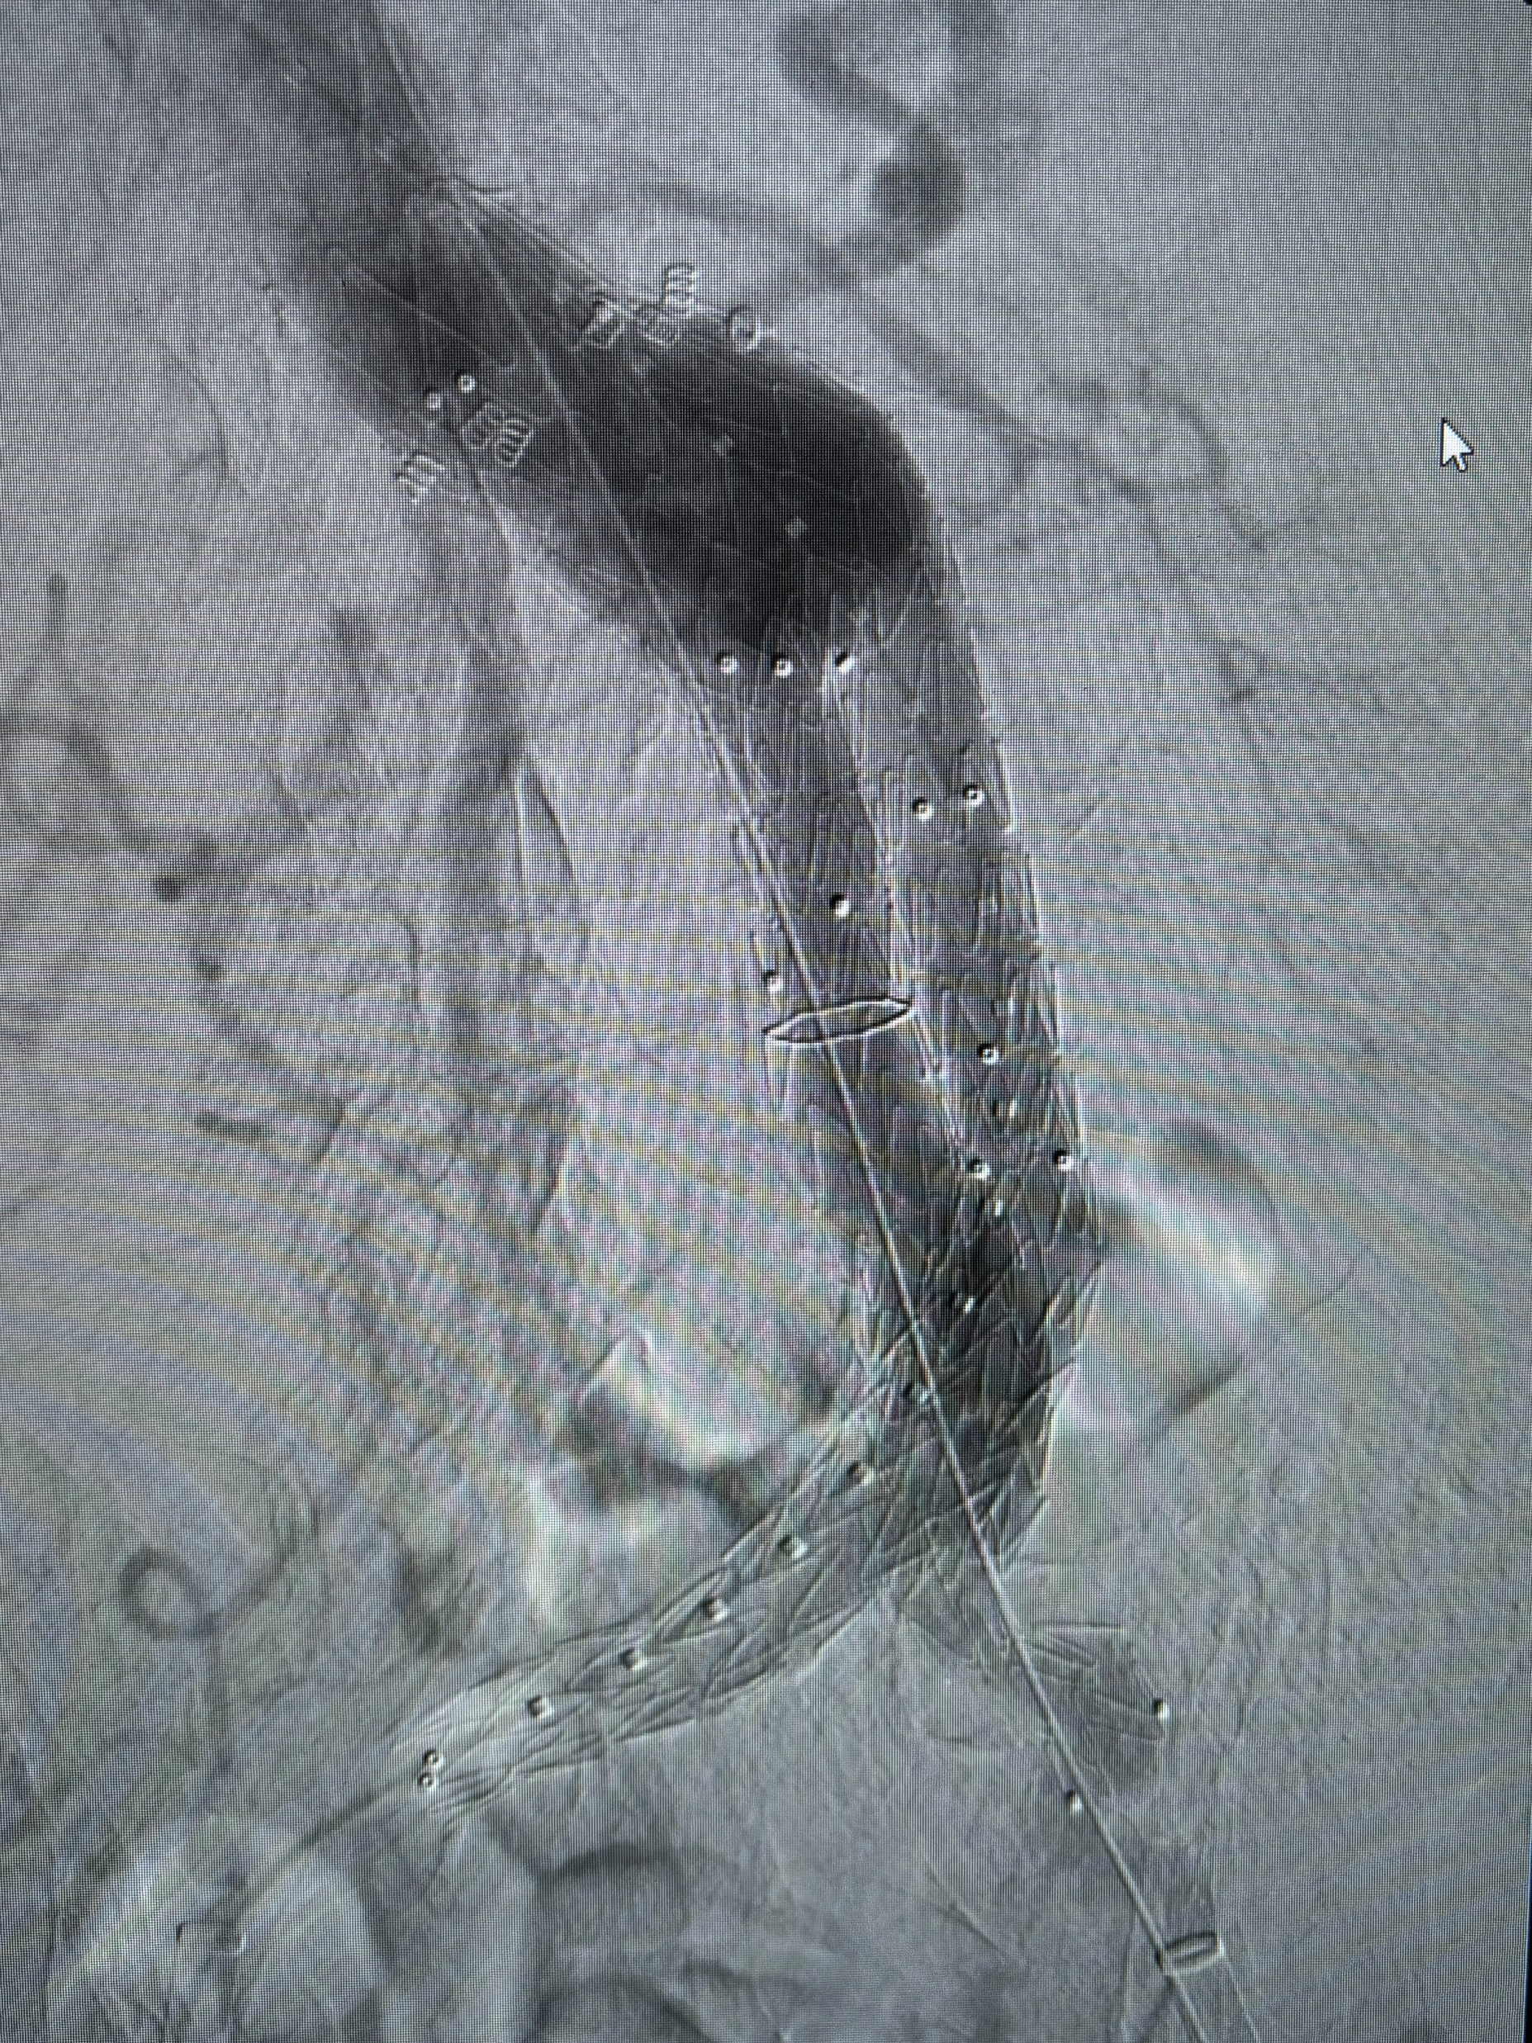
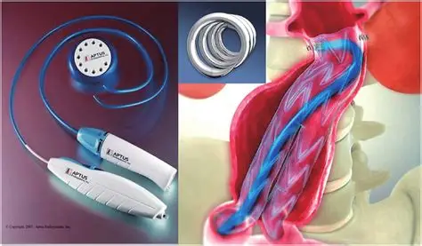
ESAR
Hostile Necks
Conical
Wide
Short
Angulated
Migration
Type IA Endoleak
Associated with sack regression
With Endurant suprarenal fixation can treat up to 4mm necks

Slide 10
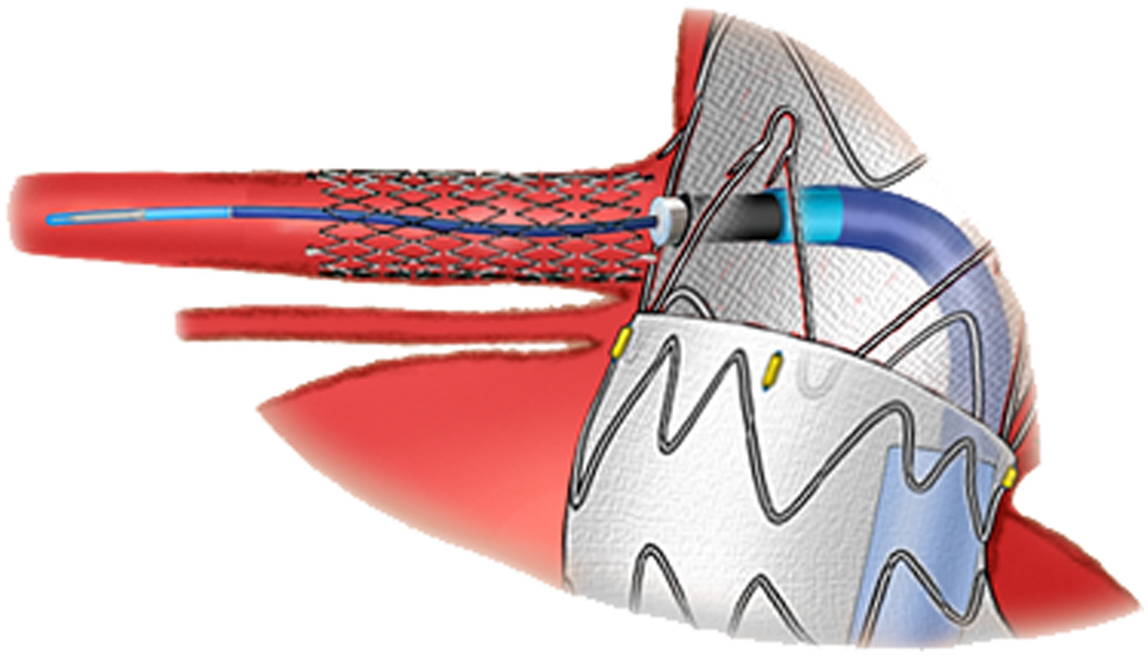
Laser Fenestration
Method to deal with complex anatomy including pararenal and paravisceral aneurysms.
Great bail-out option.

Slide 11
Post-Operative Care
S/P Open Repair
Cardiovascular; most common cause of mortality
Renal Failure; Aortic cross-clamp time (>35mins)
Pulmonary dysfunction; reduced w/RP approach
Abdominal Compartment Syndrome; w/significant resuscitation => bowel edema
Ureteral Injury/transection; 0-5d immediate repair, >10d perc Neph w/delayed repair
Ischemic Colitis; sigmoid/colonoscopy ASAP, limited = supportive, transmural = ex-lap +/- bowel resection
Spinal Cord Ischemia; ***
Acute Limb Ischemia; Embolization (iliacs 1st, then aorta)
S/P Endovascular Repair
Endoleak; type I, II, III, IV, & V
Migration
Progressive aneurysmal degeneration; ~25%, assoc w/mural thrombus in neck
Limb occlusion; AIOD, small bif, tortuosity, EIA limb extension
Renal Artery Occlusion
Graft infection; 0.5% incidence, 30% mortality, E. coli, S. epidermidis
Pelvic Ischemia; buttock claudication 15% (unilateral) 65% (bilateral); gluteal necrosis, SCI
Solid Organ Infarction; assoc w/mural thrombus
Conversion to Open; 30% mortality if emergent vs 13% if electively w/in 30d
Notes:
ACS: >20mmHg (bladder pressure while paralyzed) w/evidence of end-organ ischemia; elevated peak airway pressures, decreased tidal volumes, decreased urine output, tense abdomen.

Slide 12
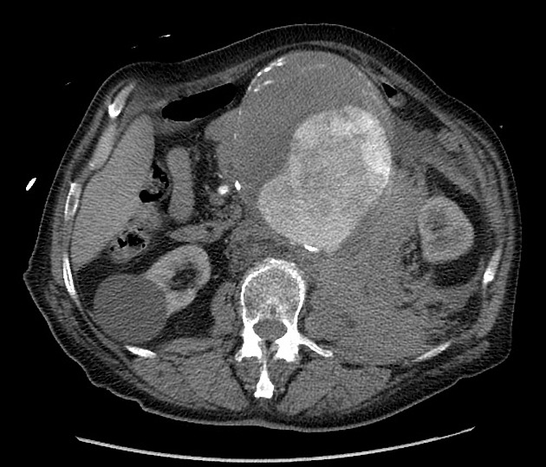
Ruptured AAA
Surgical Emergency; ~85% mortality; ~50% in the field, ~40% mortality postintervention
Sx: Abd/back pain + Hypotension + Pulsatile abd mass
Contained vs Free
Harborview Prediction Model: Cr>2, pH<7.2, Age>76, initial SBP<70; 3 variables = 70% mortality, 4 = 100%.
Dx: CTA
Tx:
Permissive Hypotension; consciousness, prevent ST-depression, SBP goal 70-80
OR emergently; prepped & drapped prior to Anesthesia
Only local anesthesia if possible
Induce Anesthesia once balloon occlusion in place or decide to open

Slide 13
Thank you

Slide 14

Questions?

