Slide 1

Cardiovascular Risk Factor Management
Steven Mould, MD FHP Cardiology

Slide 2
Disclosures
None

Slide 3
Objectives
To review hypertension thresholds, lifestyle modification options and pharmacotherapy
To discuss cholesterol goals for primary prevention based on risk profile
To evaluate treatment options for cholesterol control
Treatment strategies for the statin intolerant

Slide 4

Hypertension

Slide 5
Hypertension – ACC 2017
Definitions & Blood Pressure Categories
Normal: <120/<80 mmHg
Elevated: 120–129/<80 mmHg
Stage 1 Hypertension: 130–139 or 80–89 mmHg
Stage 2 Hypertension: ≥140 or ≥90 mm

Slide 6
Hypertension – How do we check?
Out-of-office BP monitoring (home BP monitoring or ambulatory BP monitoring) is increasingly recommended to confirm diagnosis and better assess true BP than single clinic readings.

Slide 7
Hypertension – Lifestyle Management
Diet
DASH eating plan
Reduced sodium intake
Physical activity
Weight loss
Alcohol moderation
Smoking cessation
Stress and sleep management

Slide 8
Hypertension – Pharmacologic Treatment
Treatment goals
Common target: <130/80 mmHg
PREVENT Score (replacing ASCVD score)
Individualization for elderly/complex cases
First-line medications
Thiazide diuretics
ACE inhibitors / ARBs
Calcium channel blockers
Use of combination therapy (fixed-dose preferred)
Reassessment for resistant hypertension

Slide 9
Hypertension – The Take Away
Early and aggressive BP control
Lifestyle modification is foundational
Individualized treatment approach
Home BP monitoring is invaluable

Slide 10
Lipid Management

Slide 11
Lipids – Old Guidelines
2018 AHA/ACC Guideline on the Management of Blood Cholesterol
Goal LDL < 70 mg/Dl for secondary prevention
Consider non-statin therapy if on maximally tolerated statin
Step-wise approach to therapy
Ezetimibe as first additional non-statin
PCSK9 inhibitor after Ezetimibe
Primary prevention patients with borderline or intermediate risk should have risk benefit discussion
Consider coronary artery calcium (CAC) for non-diabetic ASCVD 7.5% - 20% if uncertain about statin therapy

Slide 12
Lipids – Newer Guidance
2022 ACC Expert Consensus Decision Pathway
Goal LDL < 55 mg/dL in “very high” risk groups and secondary prevention
Goal LDL < 70 mg/dL for not “very high” risk groups and secondary prevention
Goal LDL <70 mg/dL for primary prevention, diabetes, and ASCVD risk >7.5%
Goal LDL <100 mg/dL for primary prevention, diabetes, and ASCVD risk <7.5%
Earlier initiation of combination therapy
Use of ezetimibe in high-risk primary prevention
Use of PCSK9 in very high-risk primary prevention
Guidelines for statin intolerance management

Slide 13
Lipid Management Secondary Prevention

Slide 14
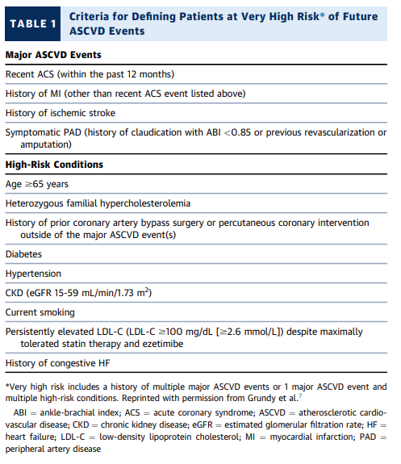
Lipids
2022 ACC Expert Consensus Decision Pathway
Goal LDL < 55 mg/dL in “very high” risk groups and secondary prevention
Very High Risk is 1 major and 2 High-Risk
If you don’t meet this criteria, then goal is < 70 mg/dL

Slide 15
Lipid Management Primary Prevention

Slide 16
Lipid – Newer Guidance
If LDL is >190 then be aggressive
If you’re 40 and have DM, you should be on a statin. But what is your LDL goal?
2022 ACC Expert Consensus Decision Pathway
Goal LDL <70 mg/dL for primary prevention, diabetes, and ASCVD risk >7.5%
Goal LDL <100 mg/dL for primary prevention, diabetes, and ASCVD risk <7.5%

Slide 17
Lipid Management: How do we get there?

Slide 18
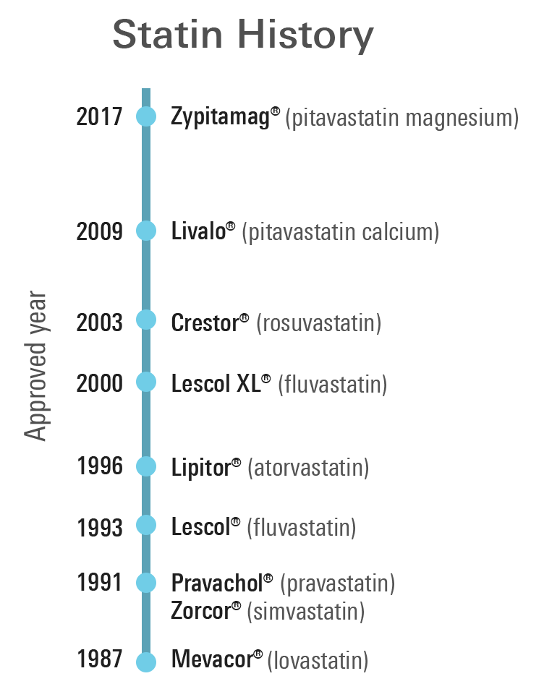
First Line – Still Statins
Affordable, effective
Expect a 50% reduction in LDL when starting high intensity
Reduced benefit from max dose statin

Slide 19
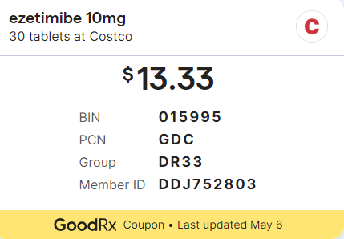
Second Line - Ezetimbe/Zetia
Affordable
Zetia alone ~18% reduction in LDL
Zetia + Statin: ~25% reduction in LDL

Slide 20
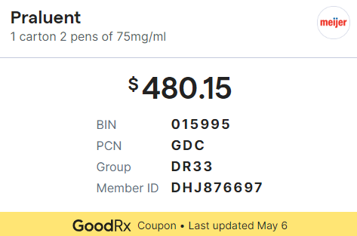
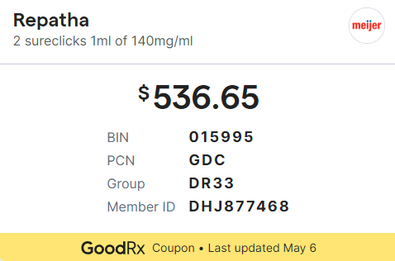
Third Line – PCSK9
Insurance can be a pain
Statin + Zetia and not at goal
If statin intolerant, want to see intolerance of 2 statins at low doses
Injection every 2 weeks
Comes from specialty pharmacy
Can expect a 50% reduction in LDL
Mortality benefit

Slide 21
But there’s more!

Slide 22
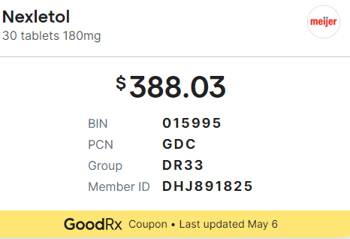
The Others
Bempedoic acid
Incliseran
Evinacumab
Lomitapide

Slide 23
Statin Intolerance

Slide 24
Strategies for Statin Intolerance
Option 1
Start Crestor/Rosuvastatin 2.5 mg one day out of the week.
After 2 weeks, have them take it two days out of the week.
Continue to increase frequently every two weeks. Escalate as tolerated. Decrease frequency if intolerance develops
Option 2
Zetia and then likely PCSK9

Slide 25
Thank you

