Slide 1
Surgical Treatment of Valvular Heart Disease
James Obney, MD Cardiothoracic Surgeon Fairfield Medical Center

Slide 2
Valvular Heart Disease
Aortic Stenosis
Aortic Regurgitation
Aortic Valve Disease + Aortic Aneuruysm
Mitral Stenosis
Mitral Regurgitation
Tricuspid Regurgitation

Slide 3
Aortic Stenosis
Acquired Aortic Stenosis
Age-related degenerative stenosis
Congenital Aortic Stenosis
Calcified BICUSPID aortic valve
Rheumatic Aortic Stenosis
Usually occurs in conjunction with mitral valve disease

Slide 4
Aortic Regurgitation
Results from improper/inadequate coaptation of the aortic valve leaflets during DIASTOLE
Numerous causes:
Distortion of valve leaflets
Calcific aortic disease
Idiopathic degenerative disease
Active or chronic aortic valve endocarditis
Rheumatic disease
Anorectic medications (fenfluramine, phentermine)
Aortic annular dilatation
Aortic dissection
Aneurysmal disease involving the aortic root
Connective tissue disorders (Marfan’s, Ehlers-Danlos, Reiter’s disease)

Slide 5
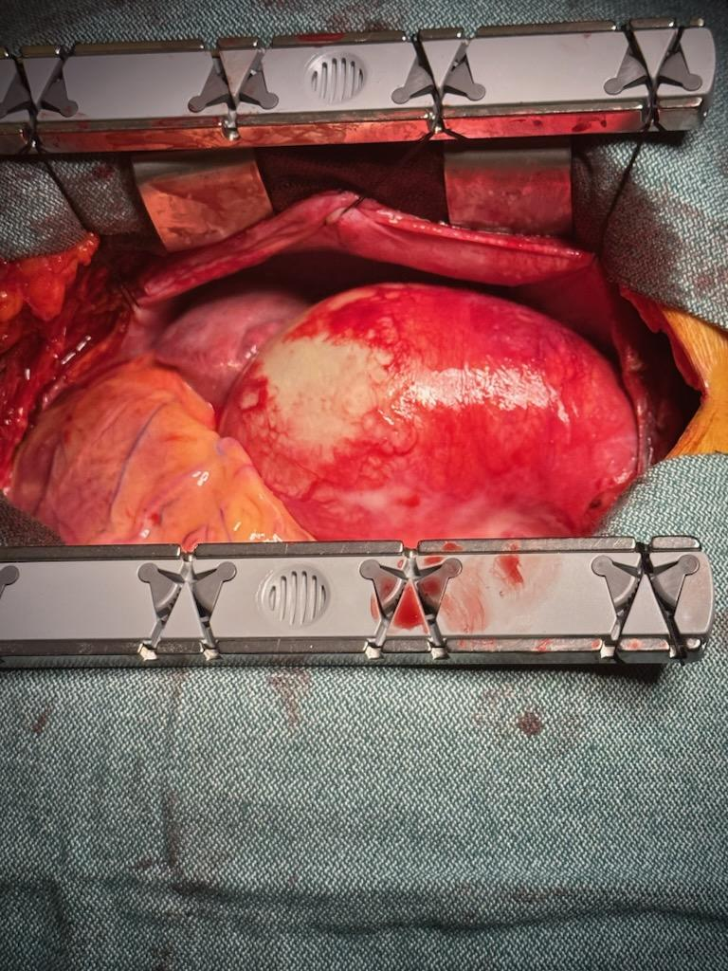
Aortic Valve + Aneurysm

Slide 6
Surgical Valve Replacement – Choice of Prosthesis
Tissue Valves
Mechanical Valves
Autologous tissue
Cadaveric tissue

Slide 7
Mechanical Heart Valves
Several companies produces surgically implanted mechanical valves
Starr-Edwards ball-in-cage
St. Jude Medical
Carbomedics
On-X (Artivion)
Over the past 50 years, there has been a significant evolution of mechanical heart valves:
Ball-in-cage
Non-tilting disc
Tilting disc (Bjork-Shiley)
Bileaflet valves
Pyrolytic carbon
Disadvantage: Need for life-long anticoagulation

Slide 8
On-X Mechanical Heart Valves
Product Highlights
The only aortic mechanical valve with FDA, Health Canada, and CE Mark approval for Low INR of 1.5 – 2.0.^{1*}
Clinically proven to be safer with less anticoagulation resulting in 87% reduction in bleeding, with no increase in thromboembolism and no valve thrombosis.^{2*}
Unique material and design provide optimal hemodynamics compared with other mechanical and bioprosthetic aortic valves at ≥1 year. ^{1,3-7}
*Reduce INR after 3 months of standard therapy.¹

Slide 9
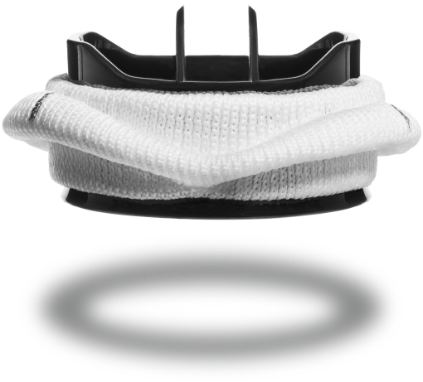
On-X Mechanical Heart Valve

Slide 10
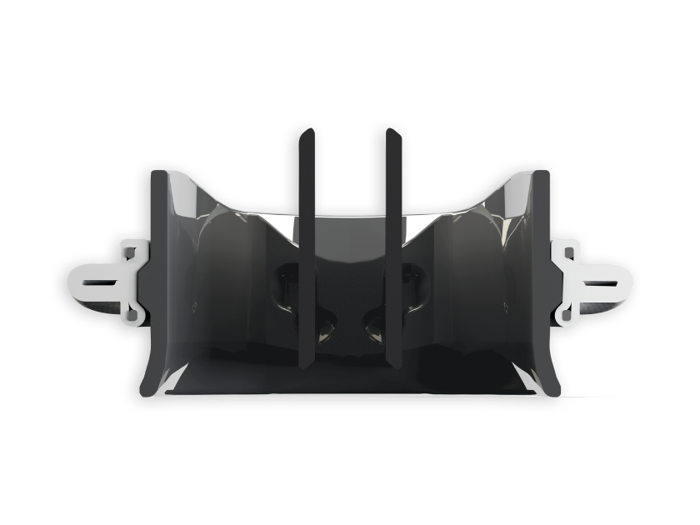
90-degree leaflet opening:
organizes blood flow, reduces turbulence and thrombogenicity
Pure pyrolytic carbon
Complete annular support: flared annulus prevents pannus ingrowth

Slide 11

On-X® Aortic Heart Valve - Artivion

Slide 12
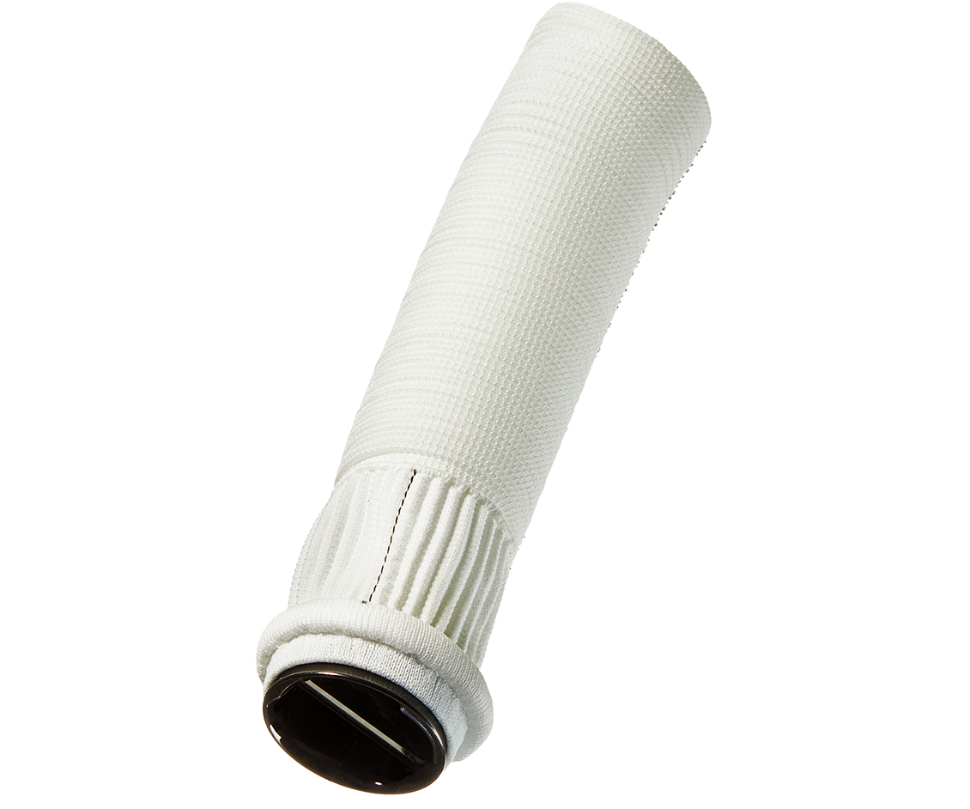
ON-X Mechanical Valved Conduit (the most advanced aortic valved conduit)
Vascutek Gelweave Valsalva graft
Mimics the natural sinus of Valsalva making coronary artery re-implantation easier and helps prevent kinking or tension.
Conformn-X sewing ring: provides optimal hemodynamics and ease of suturing

Slide 13
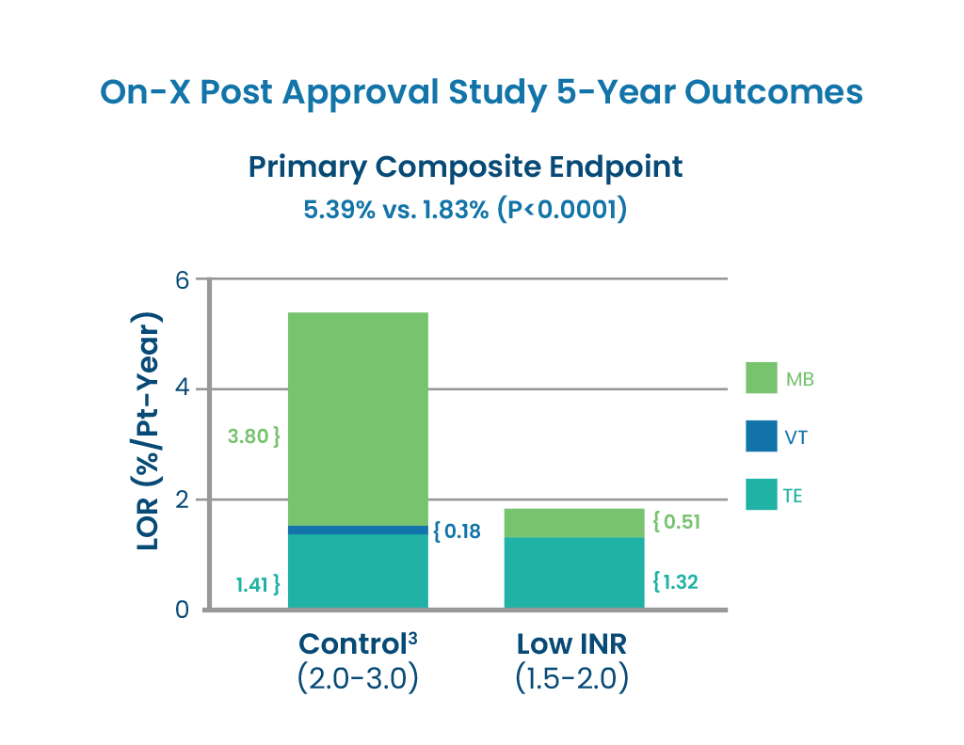

Slide 14
Tissue Valves
A large variety of tissue valves exist on the market.
Similar to mechanical valves, tissue valves have undergone an extensive evolution over the past 50 years, essentially aimed at increasing long-term durability.
Current valves are all treated with some process to increase their long-term durability and eliminate the need for anticoagulation.
Disadvantage: STRUCTURAL DEGENERATION

Slide 15
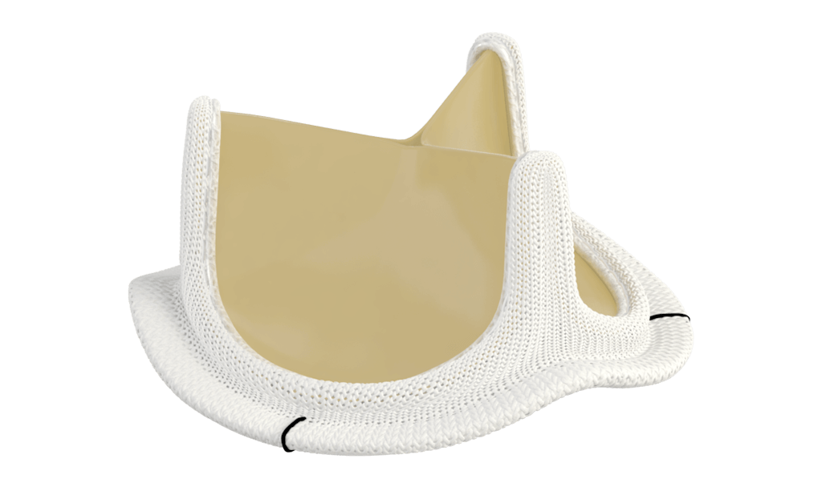
Edwards Inspiris Resilia aortic valve

Slide 16
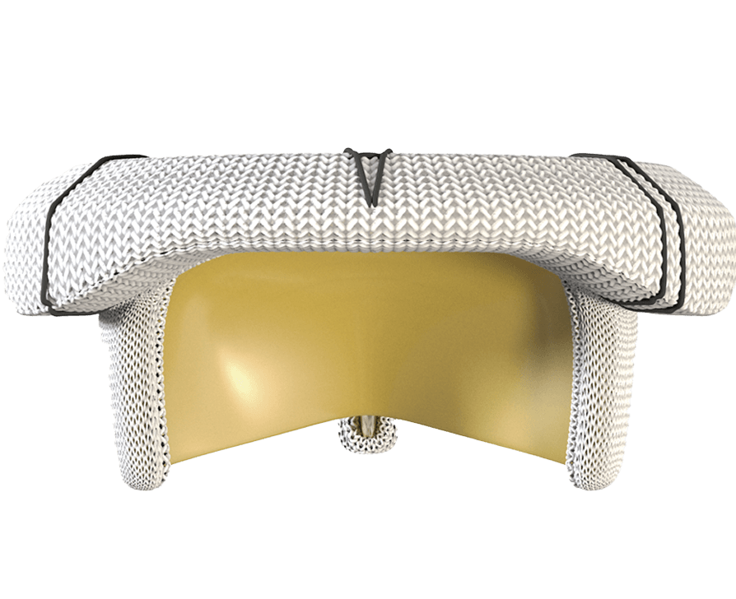
Edwards Mitris Resilia mitral valve

Slide 17
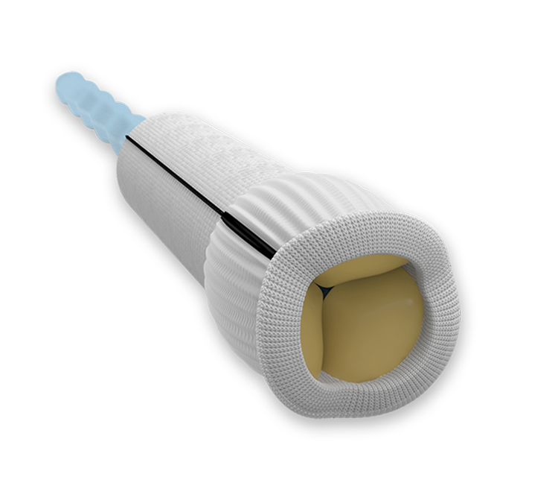
Edwards Konect tissue valved conduit

Slide 18
Take Home Points
Earlier referral for surgical intervention leads to IMPROVED outcomes.
Collaboration amongst cardiologist and cardiac surgeon is the key for a successful program.
A variety of treatment options exist which can be tailored to meet an individual’s specific needs.

Slide 19
References
Cardiac Surgery in the Adult. Cohn and Edmunds. 2003.
Mechanical heart valves: 50 years of evolution. Gott et al. The Annals of Thoracic Surgery 2003, vol. 76 (6), p2230-2239.

Slide 20
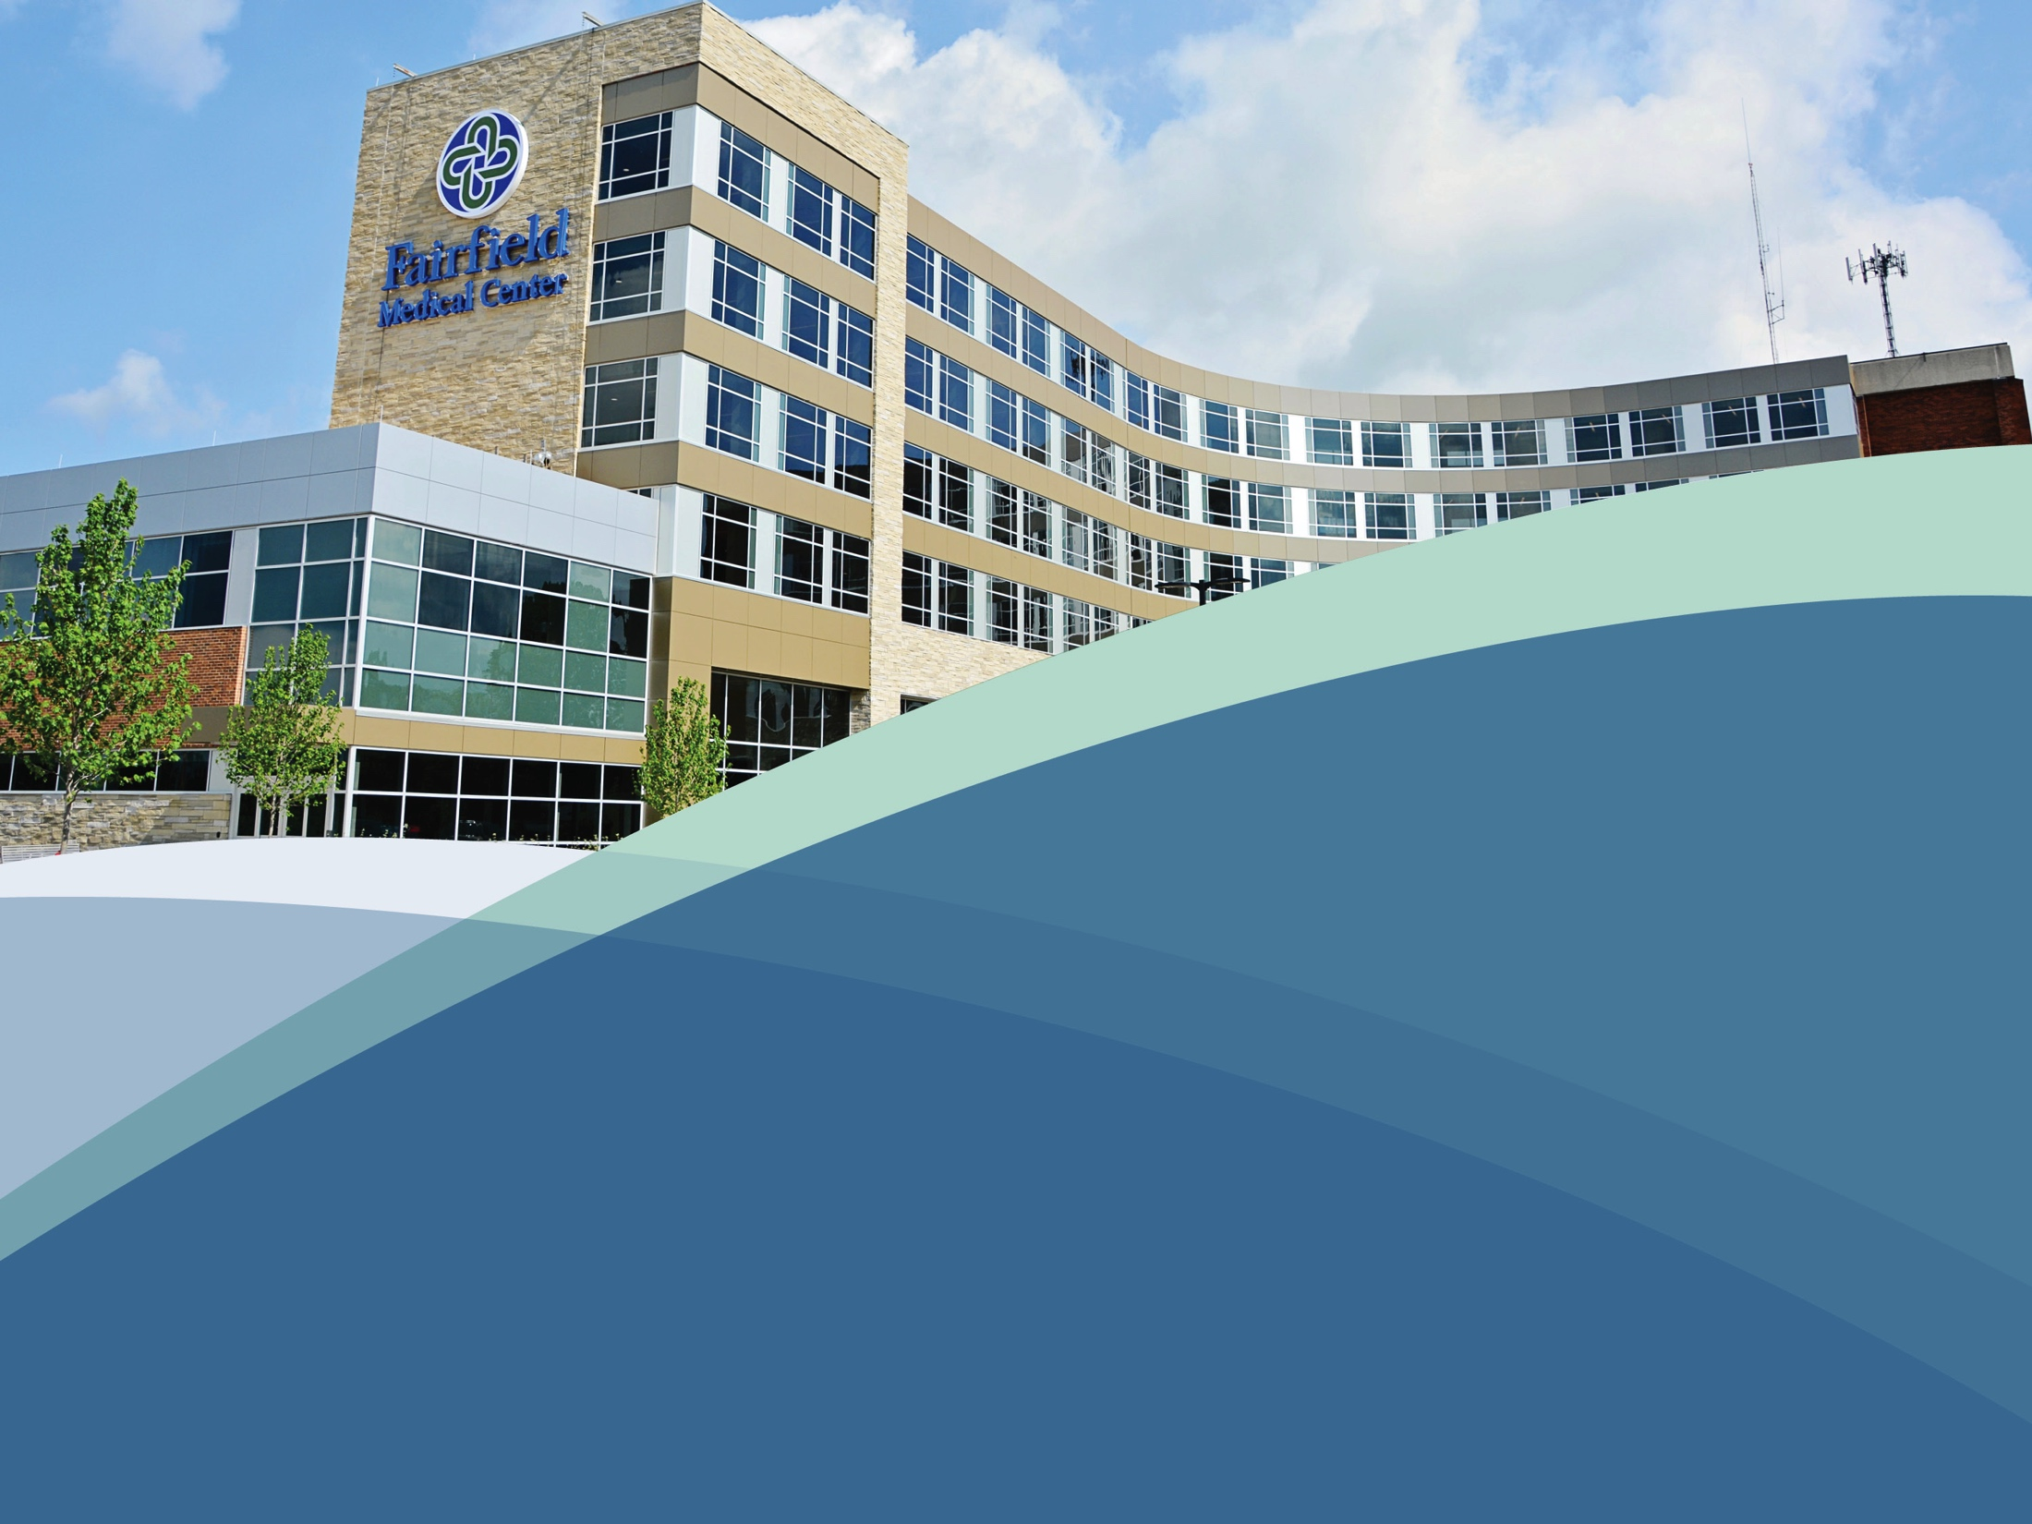
Thank You

