Slide 1
Rethinking the Standard of Care:
GLP-1, Beta-Blockers, and the Rhythm-Integrated Cardiology
A 2025 Review of Landmark Cardiovascular Trials — SELECT, SUMMIT, SOUL, REBOOT-CNIC, BETAMI-DANBLOCK and OPTION Trials
Michael Reinig, DO, FACC
FHP Cardiology

Slide 2
Obesity in the United States: Scope and Cardiovascular Impact
Epidemiology
• ~42% of U.S. adults are obese ; ~9% have severe obesity (BMI ≥40 kg/m²)
• Rates have tripled since 1980
Pathophysiologic Effects on the Heart
• ↑ Blood volume & cardiac output → LV hypertrophy → diastolic dysfunction → HFpEF
• LA enlargement & fibrosis → ↑ AF and ventricular arrhythmia risk
• Obesity doubles risk of MI and stroke (core of metabolic syndrome)
Clinical Impact
• Shortens life expectancy by 5–10 years, mainly due to CVD
• Worsens HTN control, HF progression, procedural outcomes (PCI, ablation, device)

Slide 3
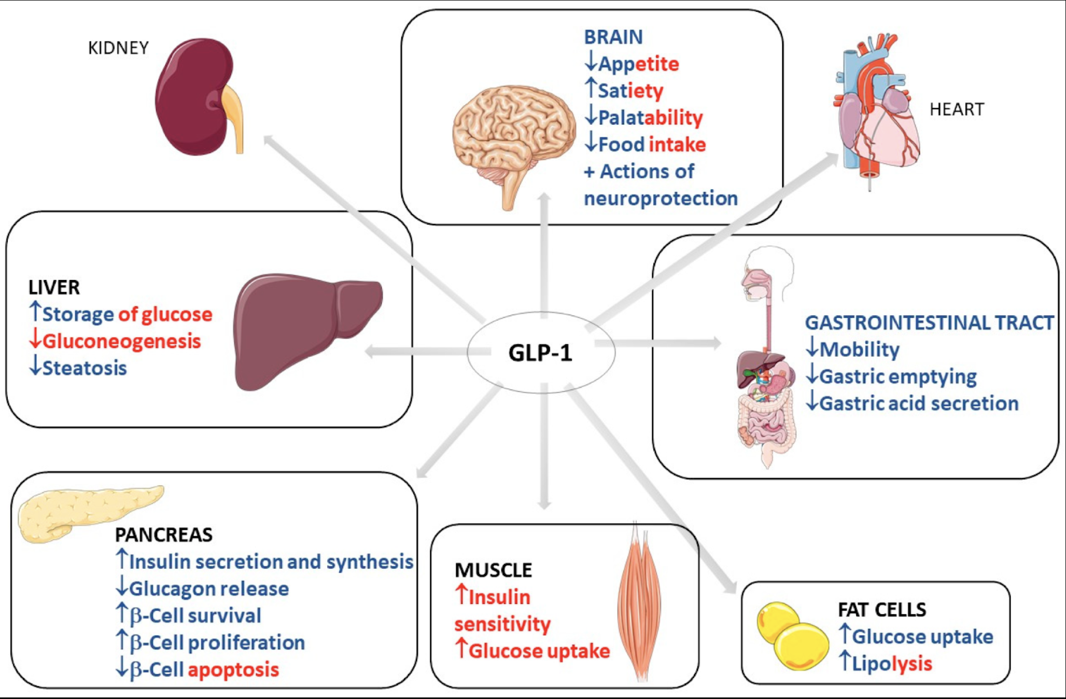

Slide 4
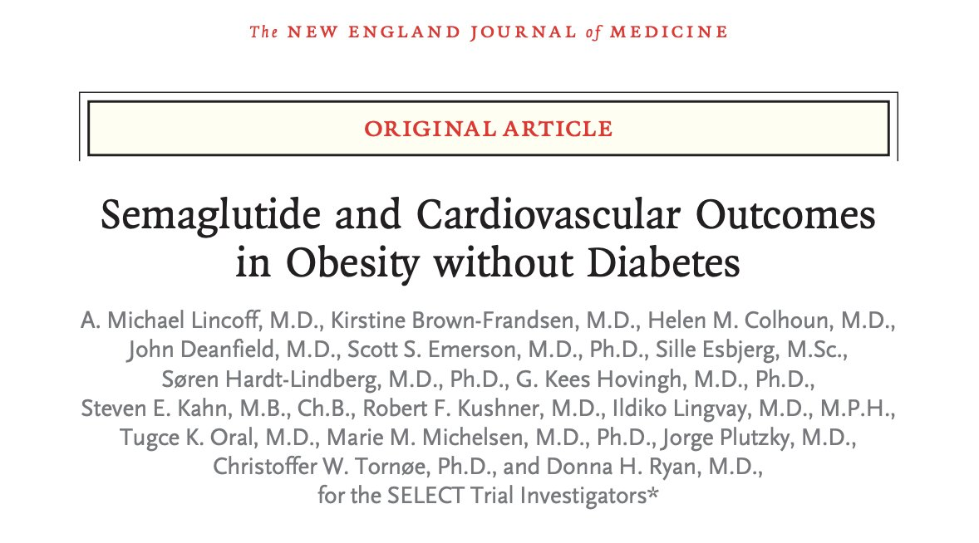
SELECT Trial

Slide 5
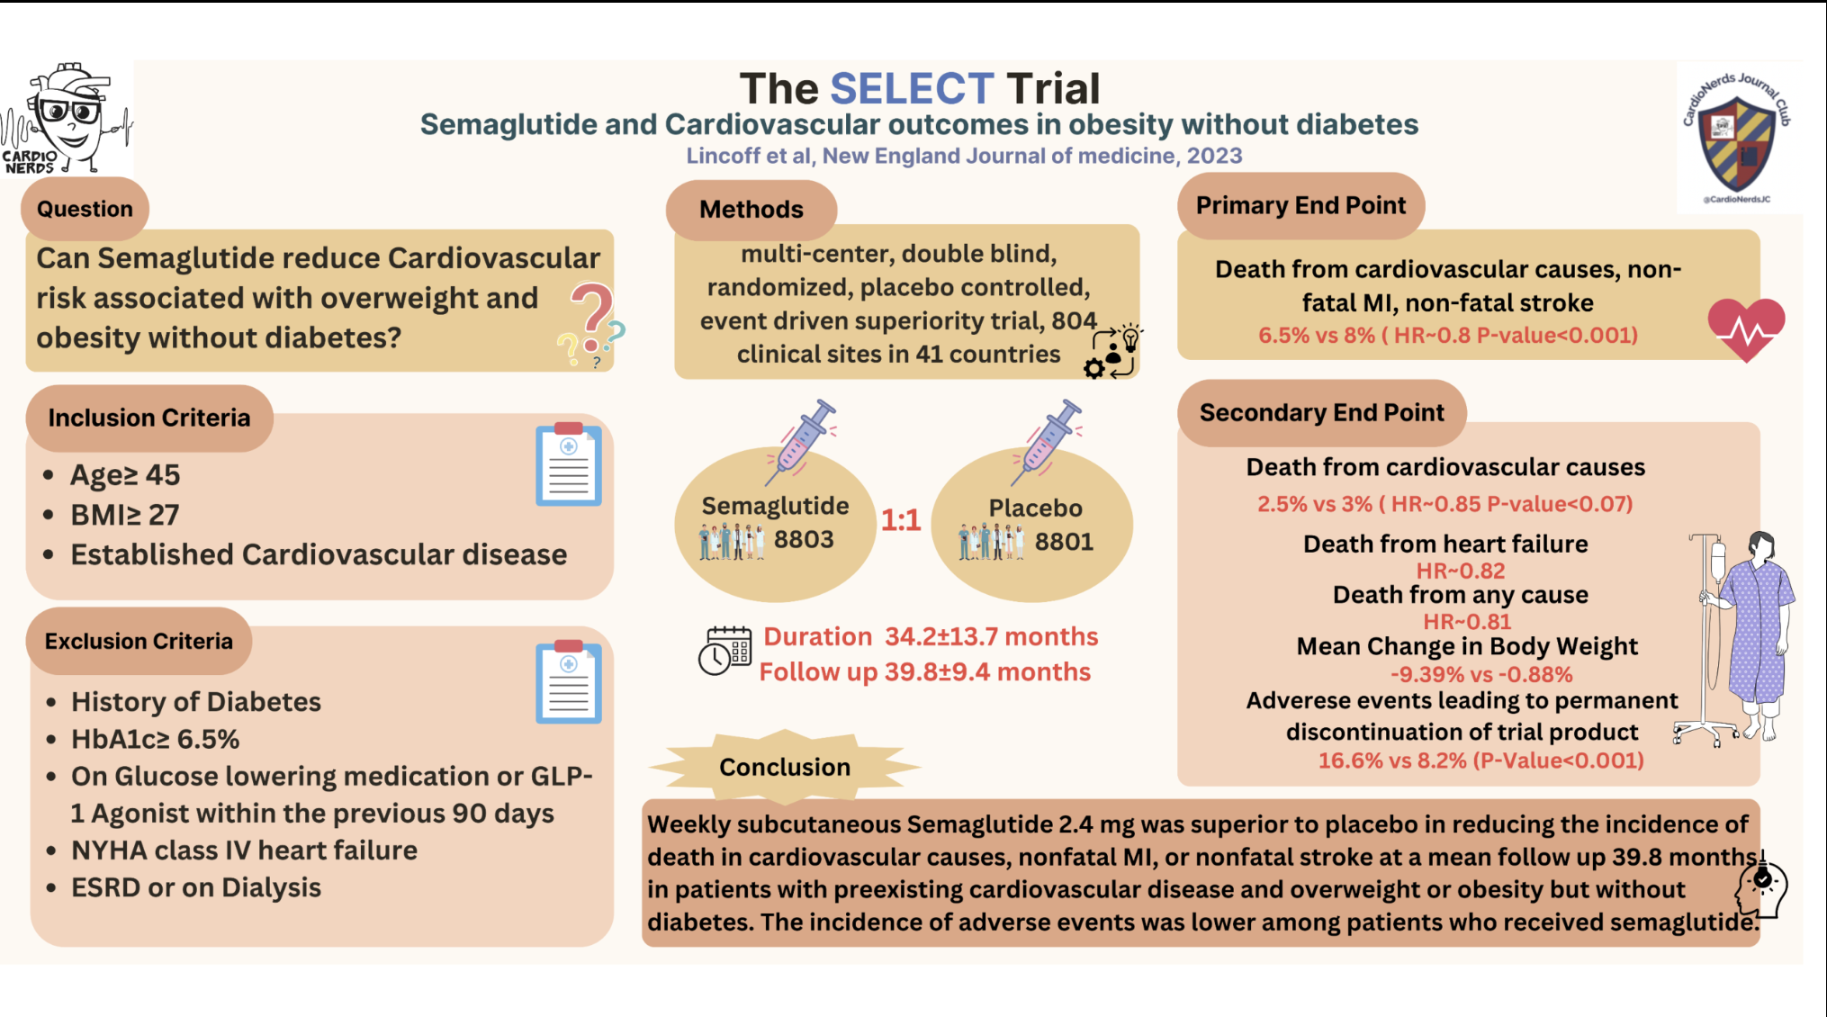

Slide 6
SELECT Trial Dosing Strategy
Titration Protocol:
Week 0: 0.24 mg SC weekly
Week 4: 0.5 mg
Week 8: 1.0 mg
Week 12: 1.7 mg
Week 16: 2.4 mg (maintenance dose)
Tolerability Adjustment:
Slower up titration permitted if GI side effects occurred.
Lower maintenance doses allowed if unable to tolerate 2.4 mg.
Duration:
Participants were followed for a median of ~40 months (mean treatment ~2 years).
Key Point:
Gradual escalation to target 2.4 mg mitigated GI intolerance while maintaining cardiovascular risk reduction benefits.
SELECT Trial – N Engl J Med, 2023;389:2095–2107

Slide 7
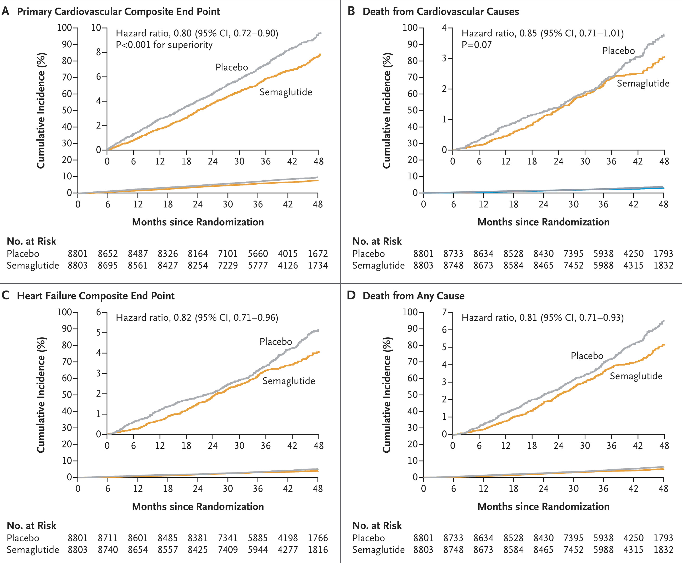

Slide 8
Key Takeaways
SELECT is the first trial showing CV event reduction in
non-diabetic obese patients with ASCVD.
20% reduction in MACE; significant mortality benefit.
Reframes obesity as a treatable cardiovascular condition.
Sets stage for future GLP-1 use in primary prevention populations.

Slide 9
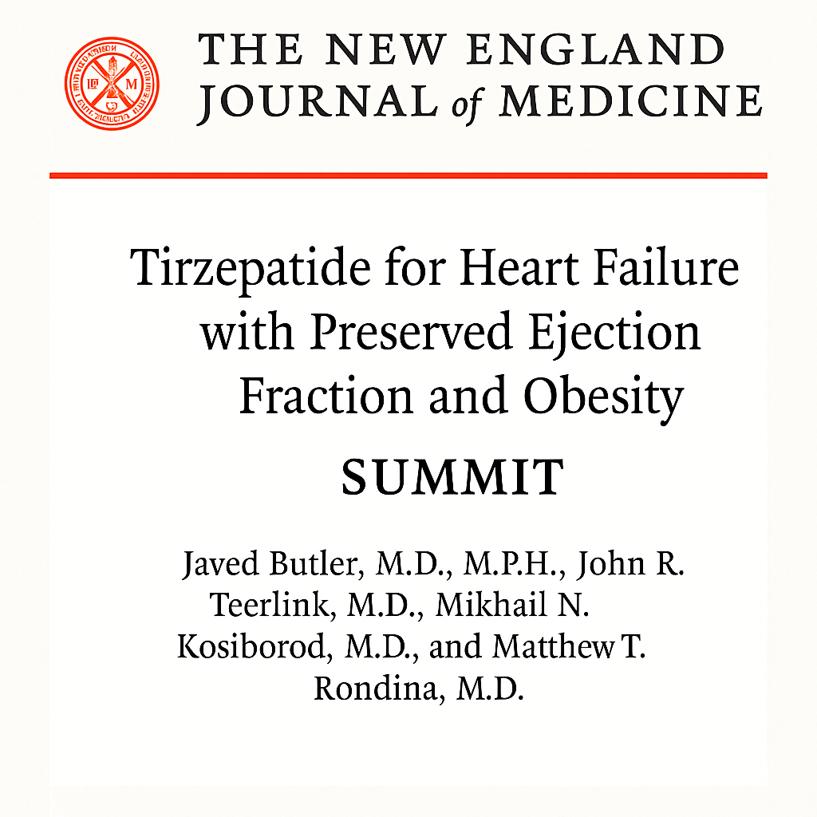
SUMMIT Trial

Slide 10
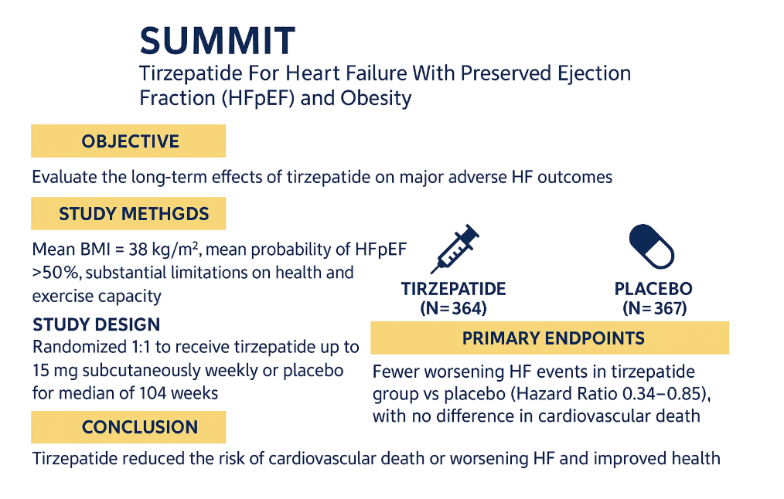

Slide 11
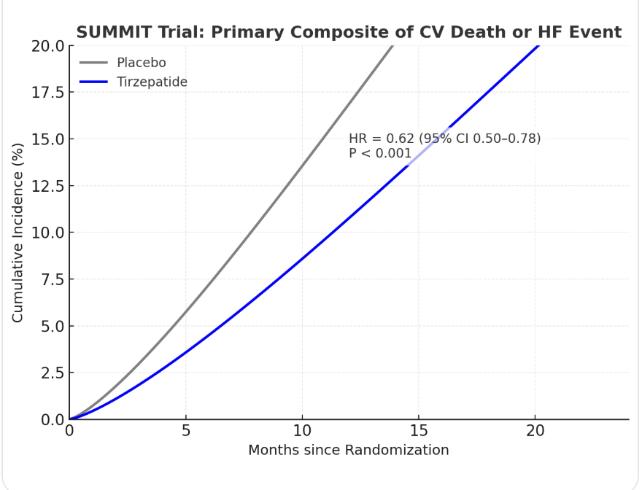
731 adults with BMI ≥30 kg/m² and LVEF ≥50%
Tirzepatide (up to 15 mg weekly) vs placebo
Median follow-up ≈ 2 years

Slide 12
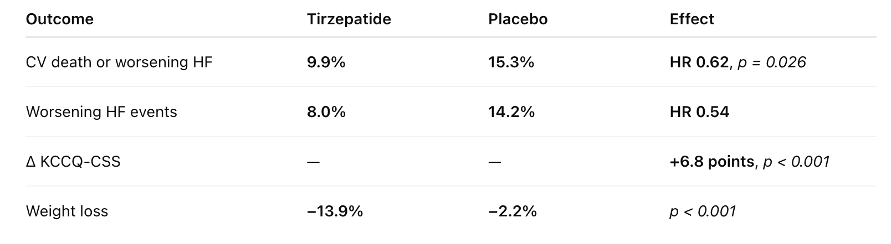
Key Results: SUMMIT Trial
Secondary endpoints
6-min walk: +24.6 m improvement
NT-proBNP ↓ 23%
↓ LV mass (−11 g), ↓ pericardial fat (−45 mL)

Slide 13
SUMMIT Trial: Benefits Beyond Weight Loss
Substantial benefit even in <5% weight-loss subgroup

Slide 14
Key Takeaways: SUMMIT Trial
First trial showing GLP-1/GIP agonist reduces HF events
in obese HFpEF
38% RRR in HF hospitalizations
Improved quality of life and exercise capacity
SUMMIT confirms metabolic therapy can reduce HF events and improve QoL

Slide 15
SUMMIT Trial Substudy: Cardiac MRI
Reduction in LV mass and paracardiac fat irrespective of Wt. loss
Paracardiac adipose tissue may play key role in obesity related HFpEF
Acts in Paracrine manner releasing proinflammatory and profibrotic adipocytes leading myocardial inflammation and fibrosis
Exerts extrinsic restraint impairing ventricular relaxation
Changes in LV Mass lead to elevated RA pressure & LV filling pressure
JACC Heart Failure 2020;8(8)657-666

Slide 16
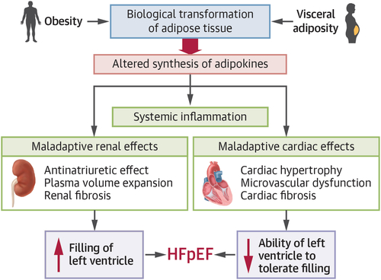
JACC: 86(16) 1297 October 2025

Slide 17
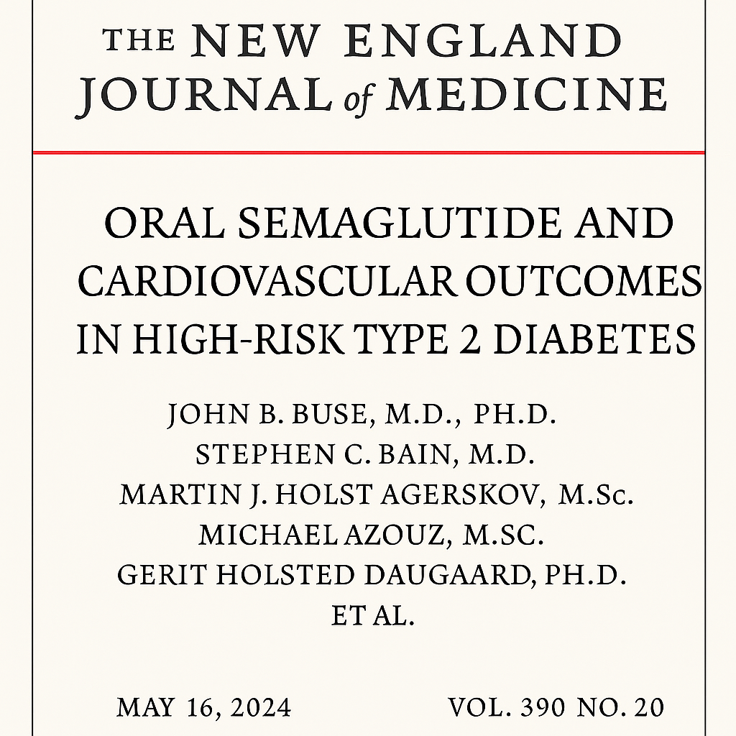
SOUL Trial

Slide 18
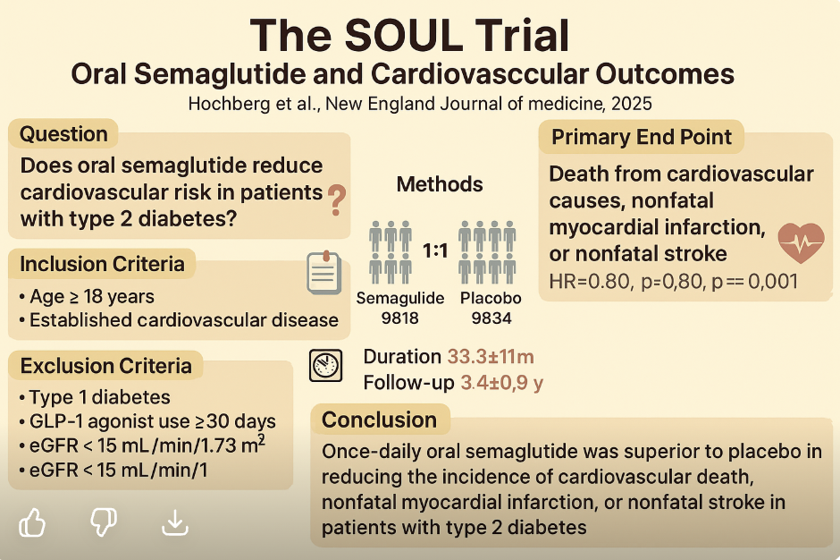

Slide 19
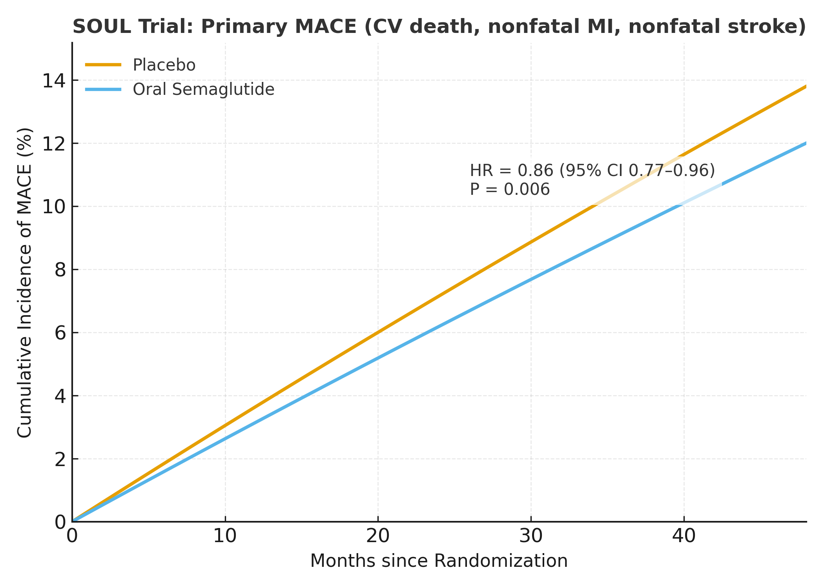
9,650 adults ≥50 years with T2DM (HbA1c 6.5–10%) and established ASCVD
Oral semaglutide (up to 14 mg daily) vs. placebo
Mean follow-up ≈ 47.5 months

Slide 20
GLP-1 Trials — Summary & Clinical Implications
SELECT:
Semaglutide in patients with obesity and established CVD (no diabetes)
Showed a 20% reduction in cardiovascular death, MI, or stroke
→ First proof that weight-loss therapy lowers CV events
SUMMIT:
Tirzepatide in obese patients with HFpEF
Reduced HF events and improved quality of life and exercise capacity
→ Demonstrates that treating obesity improves heart failure outcomes
SOUL:
Oral semaglutide in type 2 diabetes with ASCVD/CKD
Reduced major CV events by 14%
→ Shows oral GLP-1 therapy also provides cardiovascular protection
Notes:
Key Takeaway
Obesity is now the dominant driver of cardiovascular disease in the U.S.—fueling ASCVD, HFpEF, and AF epidemics, and positioning metabolic therapies (GLP‑1/GIP agents) as core cardiovascular tools

Slide 21
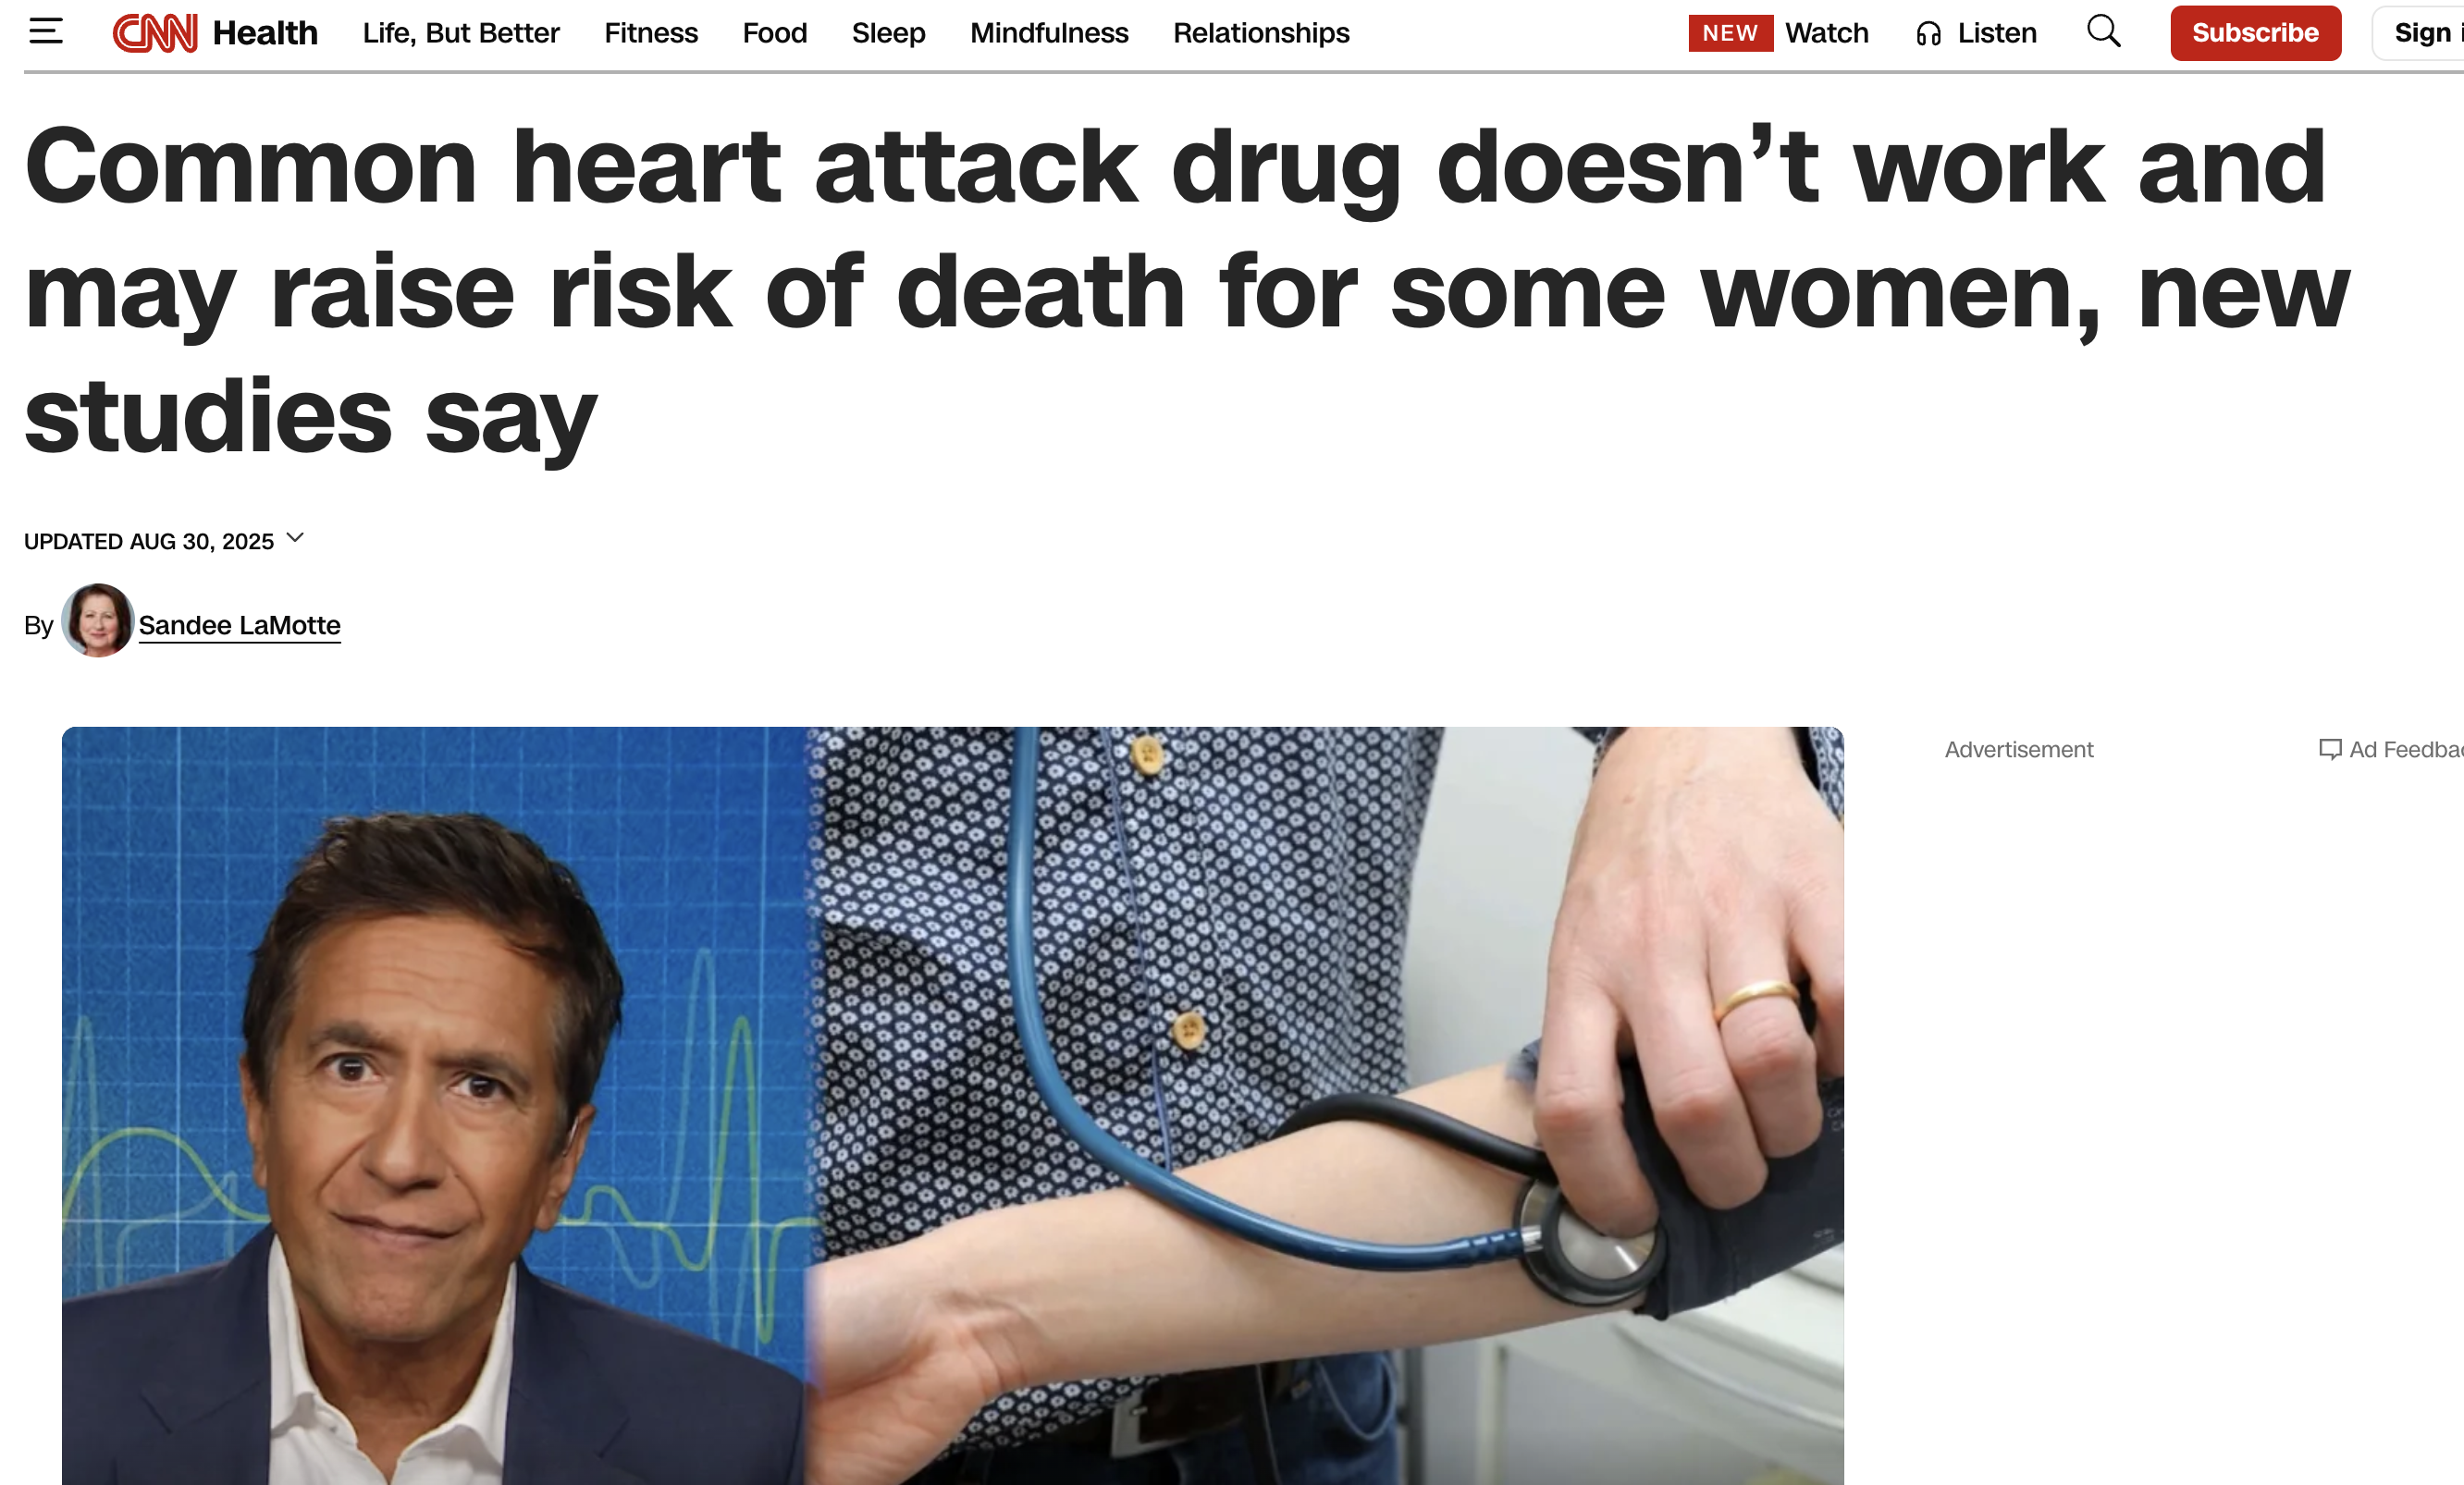

Slide 22
Beta-Blockers After MI — Why Re-Examine an Old Standard?
Background
• Beta-blockers have been standard post-MI therapy since the 1970s–1980s (BHAT, TIMI).
• Early studies showed ~20–30% mortality reduction — but those were pre-reperfusion, pre-statin, pre-ACE inhibitor eras.
• Today’s MI patients receive early PCI, statins, DAPT, and revascularization
The Question
• Do all post-MI patients still benefit from chronic beta-blockade, or only those with LV dysfunction or heart failure?
• Could routine therapy in patients with LVEF >40% and no HF be unnecessary or even harmful?
Clinical Rationale
Revisiting a long-standing dogma — asking whether 'routine beta-blockers for everyone' still holds true in the era of PCI, statins, and optimized secondary prevention.

Slide 23

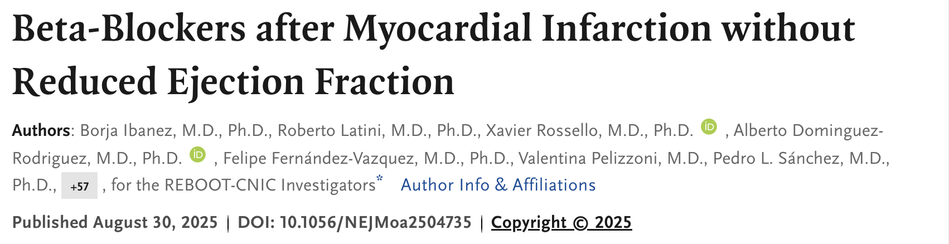
REBOOT-CNIC Trial

Slide 24
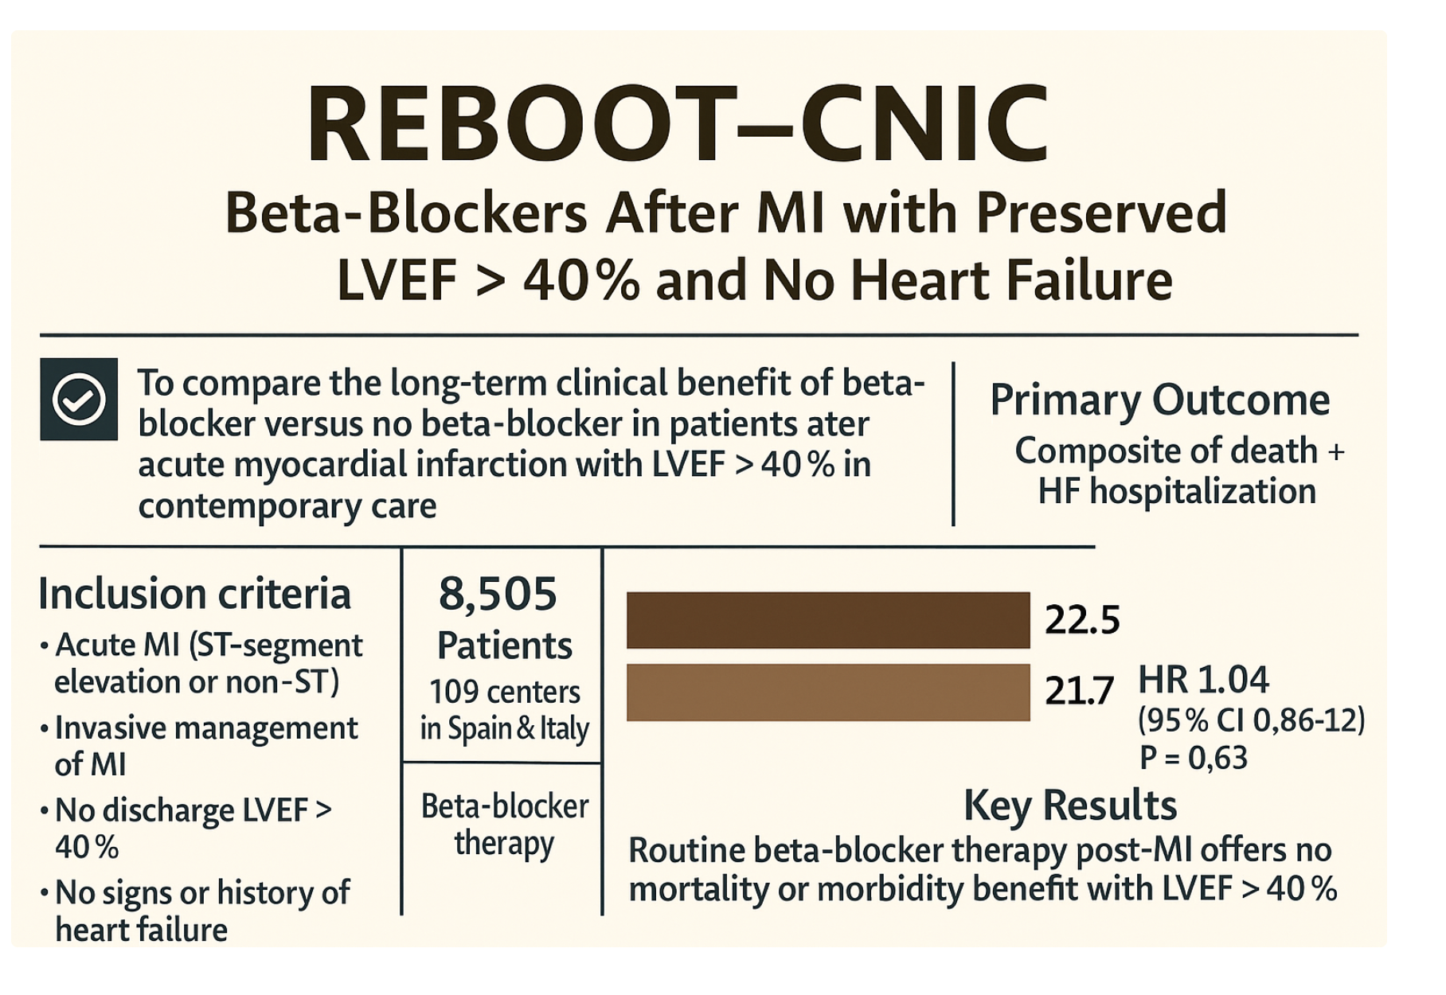

Slide 25
Study Design & Population
• n = 8,505 patients from 109 hospitals.
• Inclusion: Recent STEMI/NSTEMI, invasive management, LVEF >40%, no HF.
• Exclusion: LVEF ≤40%, chronic HF, or contraindications to beta-blockers.
• Follow-up: Median 3.7 years.
• Beta-blocker group: Standard doses of bisoprolol, carvedilol, or metoprolol.
• Control group: No beta-blocker therapy post-discharge.
• Background therapy: nearly universal DAPT, statins, ACEi/ARB, revascularization.

Slide 26
Baseline Characteristics
• Mean age: 61 years; 19% women.
• 10% prior MI; median LVEF 55%.
• 97% received PCI; >95% on statin and DAPT.
• Represents well-treated modern MI population.

Slide 27
Primary Endpoint Results
• Composite endpoint (death, reinfarction, HF hospitalization):
– 22.5 vs 21.7 per 1,000 patient-years (Beta-blocker vs Control)
– HR 1.04 (95% CI 0.89–1.22; p=0.63)
• No difference in all-cause mortality (HR 1.06).
• No reduction in recurrent MI or HF hospitalization.

Slide 28
Clinical Implications & Summary
• Beta-blockers may not be mandatory in MI patients with preserved EF.
• Reinforces evidence-based tailoring of post-MI therapy.
• Suggests individualized approach based on LV function, symptoms, arrhythmia risk
• Guidelines may evolve for routine use to LVEF ≤40% or symptomatic patients.
• REBOOT-CNIC redefines post-MI secondary prevention in the modern era.

Slide 29
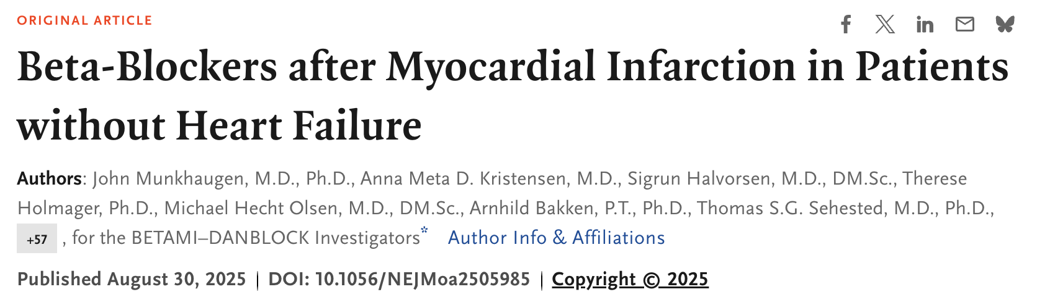
BETAMI-DANBLOCK Trial

Slide 30
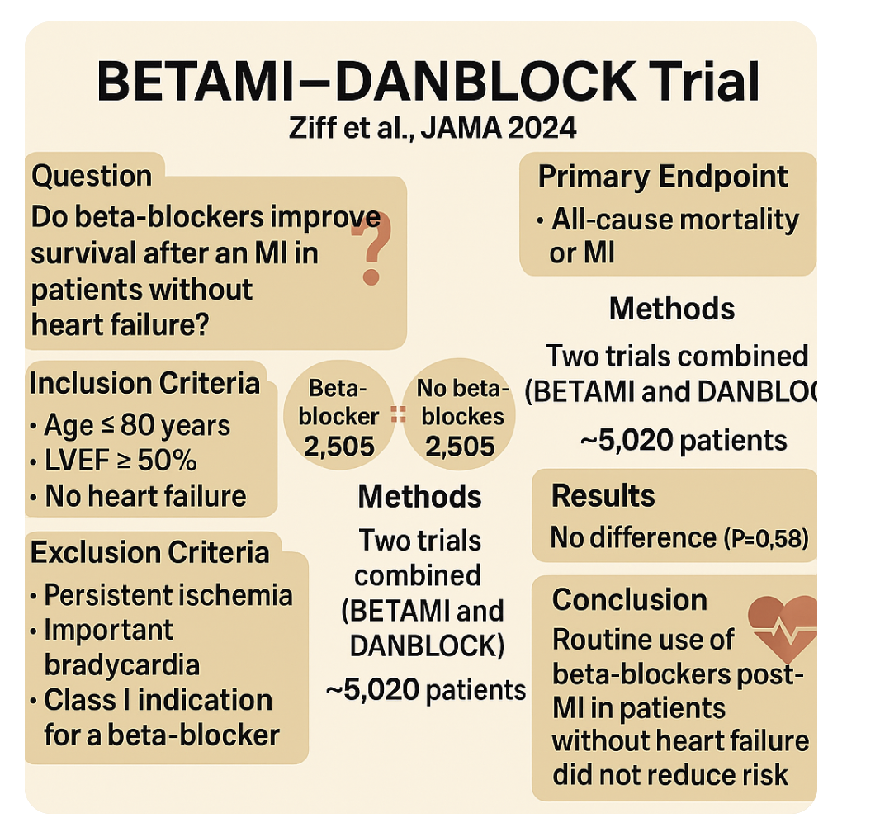

Slide 31
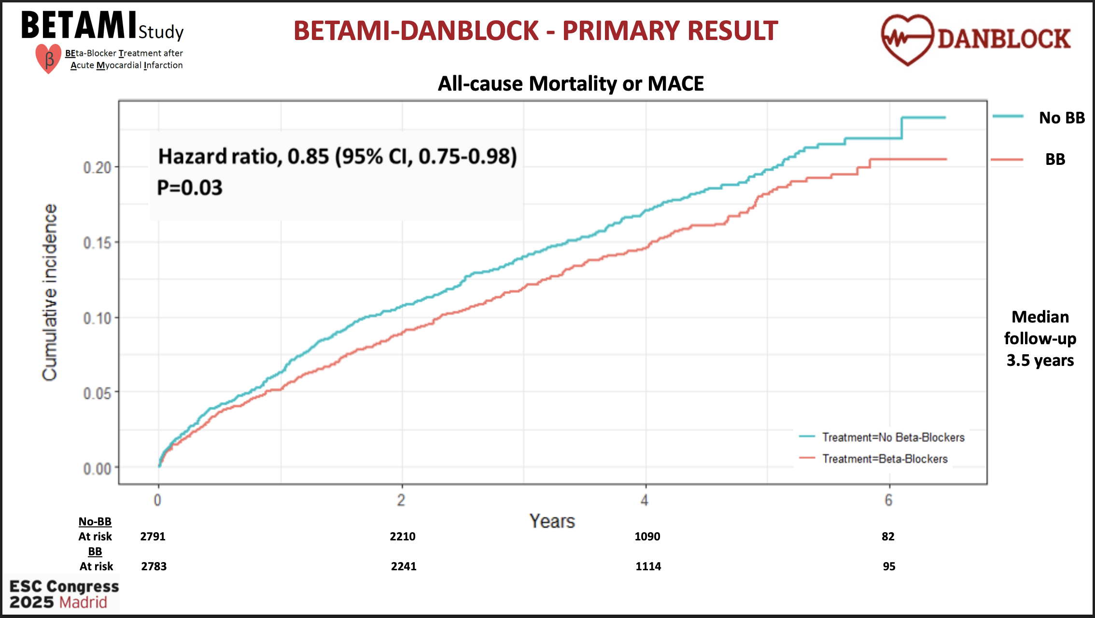

Slide 32
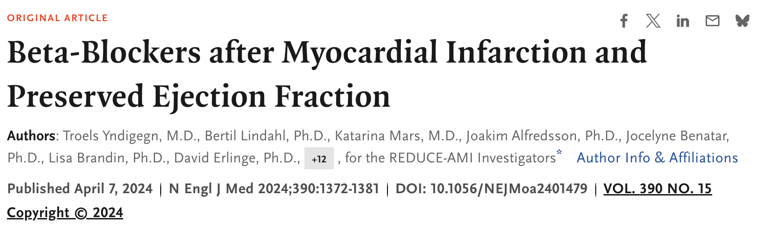
REDUCE-AMI Trial

Slide 33
REDUCE-AMI:
Beta-blockers after Myocardial Infarction and Preserved Ejection Fraction
RESULTS: In patients with AMI with preserved LVEF, long-term use of beta-blockers didn't lower the risk of death or new heart attacks compared to those who didn't take beta-blockers.
PURPOSE: To examine if long-term oral beta-blocker use in patients with acute myocardial infarction (AMI) and preserved preserved left ventricular ejection fraction (LVEF) reduces the risk of death or new heart attacks compared to not using beta-blockers.
TRIAL DESIGN: Registry-based, prospective, randomized, open-label, parallel group clinical trial (n=5020).
 | Beta-Blockers (N=2508) | No Beta-Blockers (N=2512) | Hazard Ratio (95%CI) | P value
Primary endpoint
All-cause death or myocardial infarction, no (%) | 199 (7.9) | 208 (8.3) | 0.96 (0.79 - 1.16) | 0.64
Secondary endpoints
All-cause death, no (%) | 97 (3.9) | 103 (4.1) | 0.94 (0.71 – 1.24)
Death from cardiovascular causes | 38 (1.5) | 33 (1.3) | 1.15 (0.72 – 1.84)
Myocardial infarction | 112 (4.5) | 117 (4.7) | 0.96 (0.74 – 1.24)
Key Takeaways: Starting oral beta-blocker treatment early after a heart attack in patients with normal heart function didn't result in a lower combined occurrence of death or new heart attacks.

Slide 34
Beta-Blockers Post-MI in the Modern Era
Summary and Clinical Implications
REBOOT-CNIC • BETAMI-DANBLOCK • REDUCE-AMI
REBOOT-CNIC (NEJM 2024)
5,020 pts, LVEF ≥50%
❌ No reduction in death, MI, or HF hosp.
🧠 Do beta-blockers still help after MI in patients with preserved EF?
• Modern PCI era
• Preserved EF (≥50%)
• On full GDMT
REDUCE-AMI (NEJM 2024)
5,020 pts, LVEF ≥50%
❌ No benefit on death or recurrent MI
BETAMI-DANBLOCK (Circulation 2023)
3,500 pts, LVEF >40%
❌ No difference in death or MI
Routine β-blocker therapy not beneficial in revascularized, preserved-EF post-MI.
Continue only if EF ≤40%, HF, or arrhythmia risk.

Slide 35
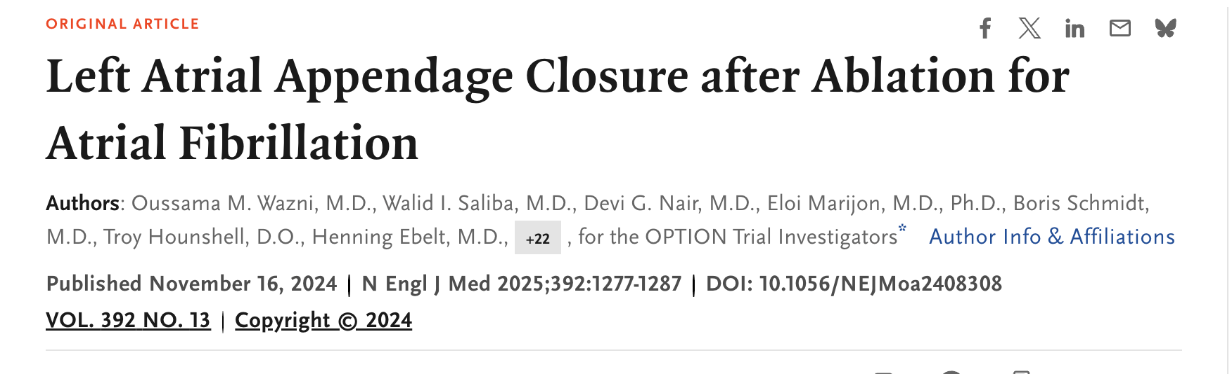
OPTION Trial

Slide 36
Background & Rationale
• AF ablation does not eliminate long-term stroke risk
• OAC reduces stroke but increases bleeding
• LAAC may offer similar stroke prevention with less bleeding
• OPTION trial tested LAAC vs continued OAC post-ablation

Slide 37
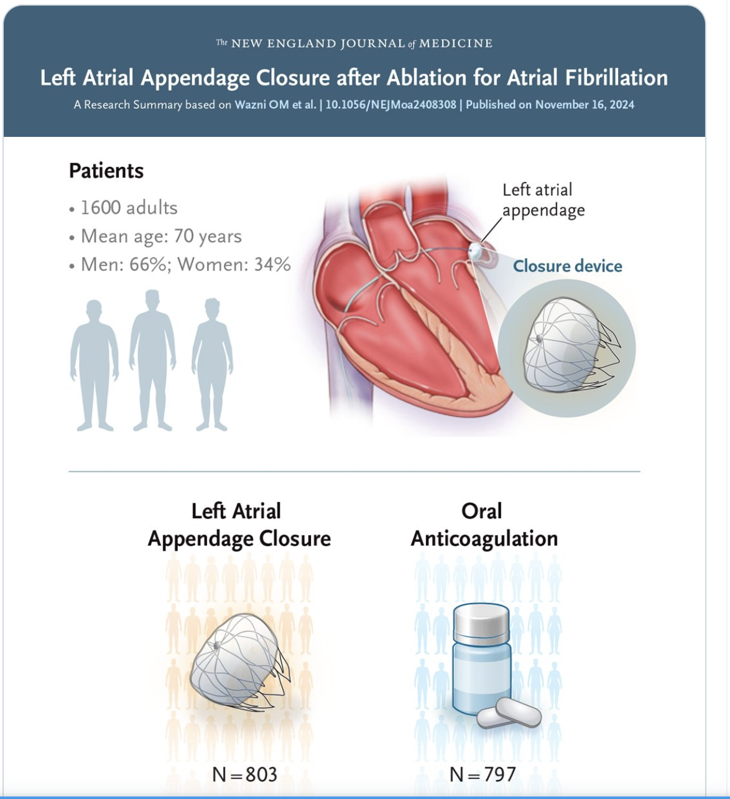
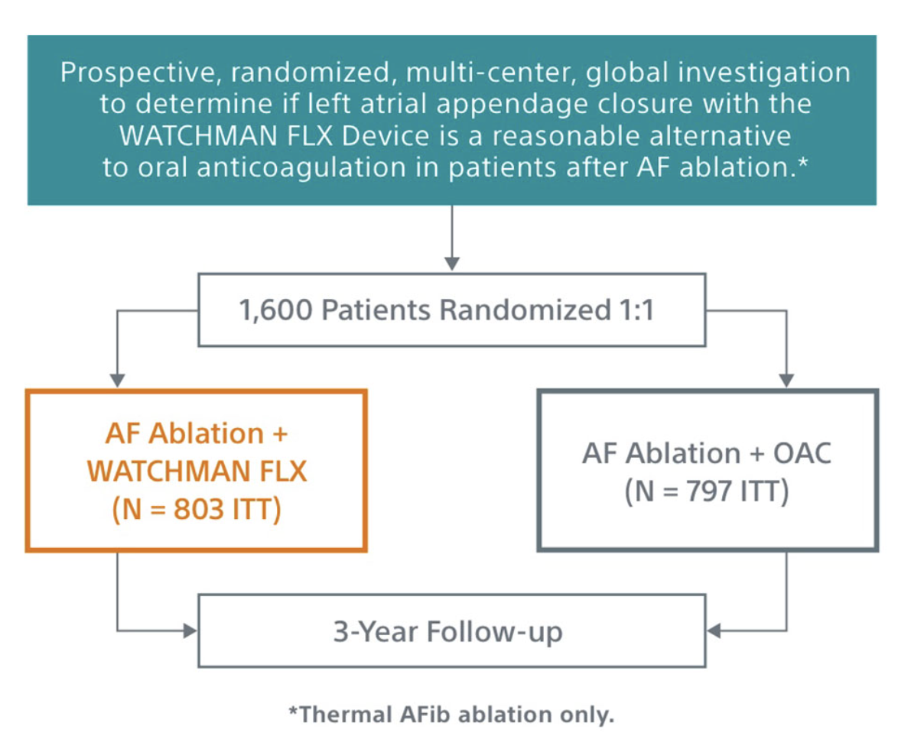

Slide 38
Procedural Outcomes
• Device success: 98.8%
• Concomitant LAAC with ablation common
• Periprocedural complication rate ≈2.7%
• Imaging confirmed closure in >95% at follow-up

Slide 39
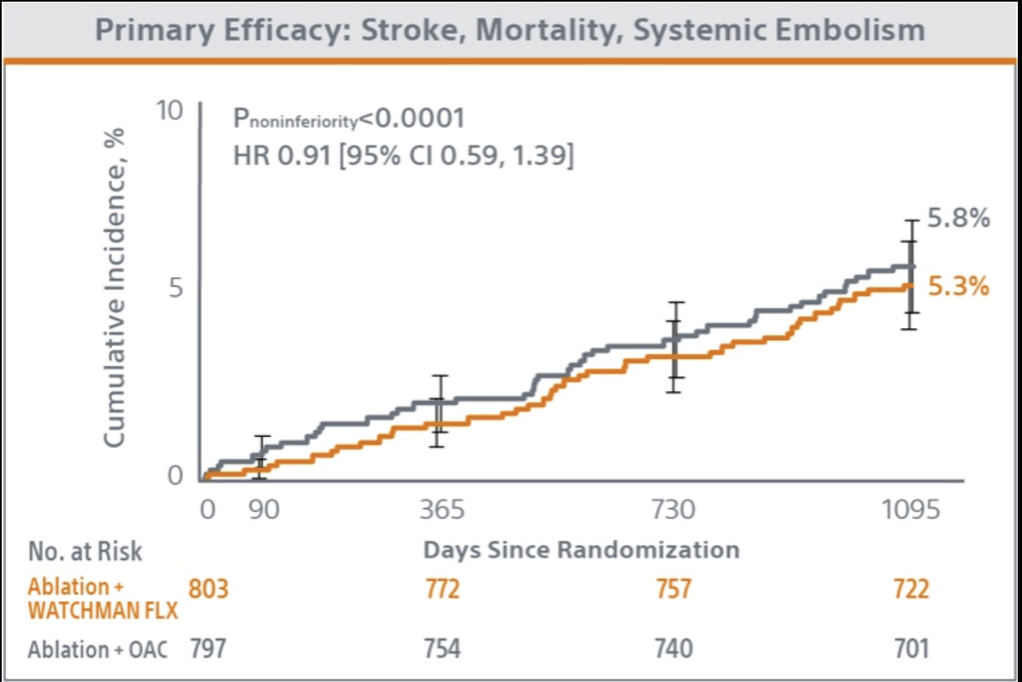
• 1,600 patients • Watchman FLX LAAC (concomitant or staged) vs DOAC
• CHA₂DS₂-VASc ≥2 (men), ≥3 (women) • 36 months

Slide 40
Primary Results
• Efficacy endpoint: 5.3% (LAAC) vs 5.8% (OAC)
• Non-inferior for death/stroke/systemic embolism
• Ischemic stroke: 1.2% vs 1.3%
• Equivalent thromboembolic protection
• Major + clinically relevant non-major bleeding: 8.5%(LAAC) vs 18.1%(OAC)
• 55% relative reduction in bleeding
• Fewer late bleeds; no increase in thrombotic events

Slide 41
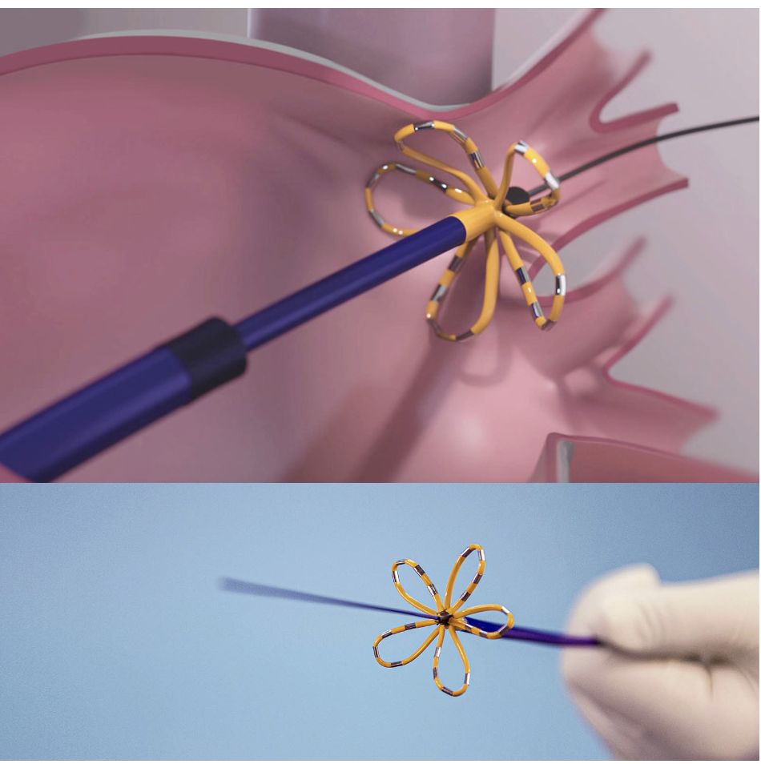
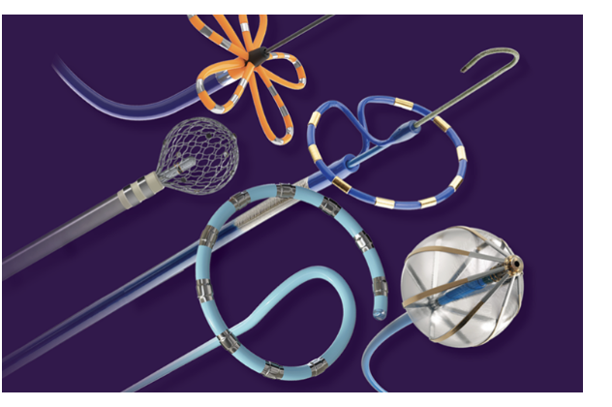
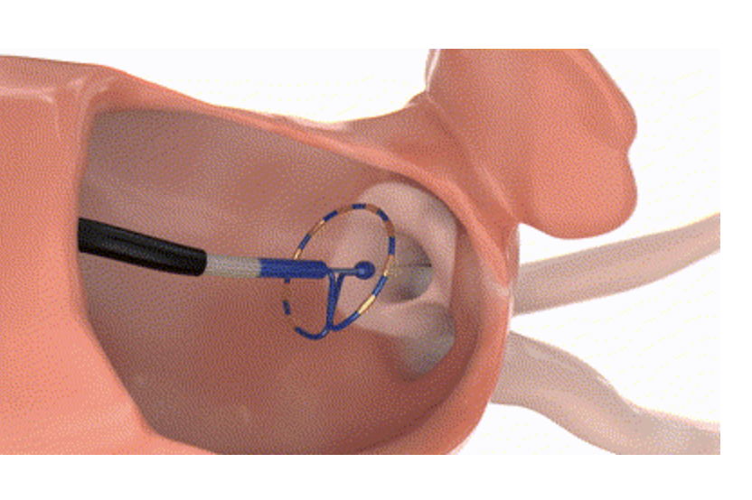
Notes:
Pulsed field ablation releases a series of high-amplitude electrical field lasting for several microseconds to the target tissue. Strong electric field will make irreparable electrical pores in cell membrane, and the contents of the cell will flow out slowly, finally the cell is destroyed

Slide 42
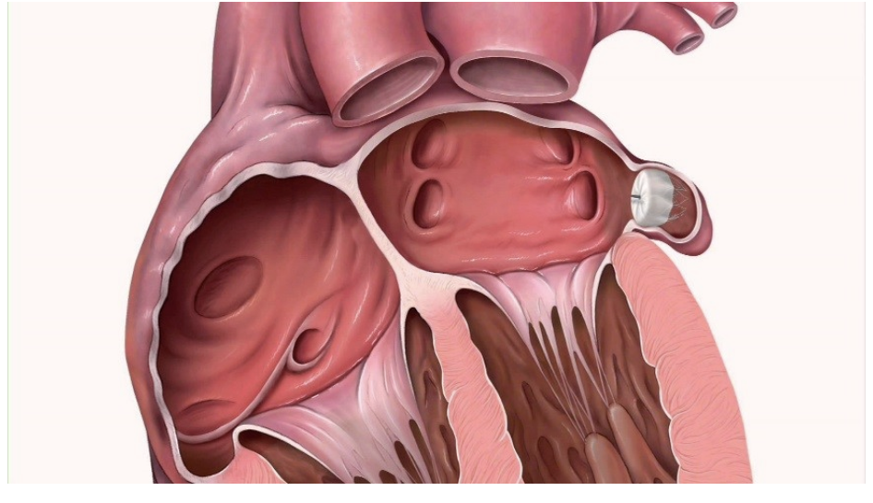

Slide 43
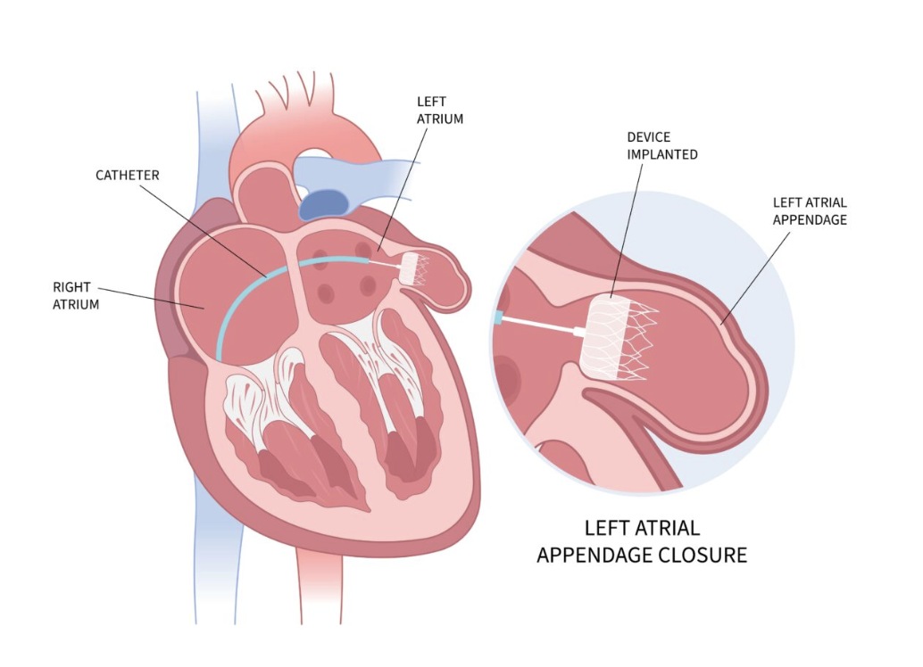

Slide 44
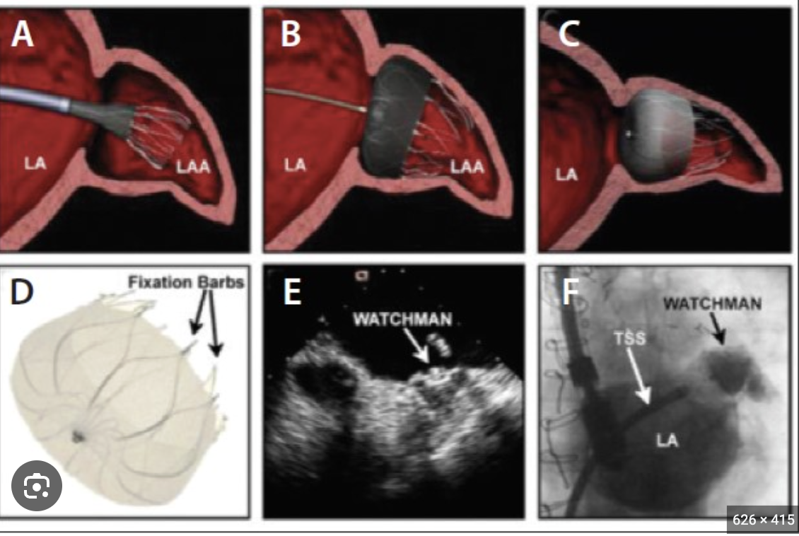

Slide 45
OPTION Trial
Summary & Clinical Implications
• LAAC offers stroke prevention comparable to OAC with less bleeding
• Appropriate for post-ablation patients with bleeding risk or OAC intolerance
• Low procedural risk with experienced operators
• OPTION broadens indication for Watchman FLX
• Shared decision-making essential

Slide 46

Thank You

