Slide 1
Lung Cancer Screening
12 Nov 2025
Avneet Singh, MD

Slide 2
Agenda:
Background
The Data
Current recommendations
Shared decision making
Insurance coverage
A brief aside on nodules

Slide 3
Background
Lung cancer is one of the leading causes of death in the U.S.
Overall 5 year survival rate is 19%
Earlier stage diagnoses are associated with improved survival
  The clinical outcome for NSCLC is related to stage
Prior screening modalities: chest X ray (CXR) and Sputum Cytology
  Studies in the 1980s evaluated screening with CXR; no significant mortality benefit identified for the population screened
  More stage I lung cancers were identified

Slide 4
The Data!
NSLT: randomized trial, funded by the National Cancer Institute. Data collected from 2002 to 2009, focused on a defined population of known high risk individuals (smokers, ages 55-74)
  The first of its kind to use LDCT in high risk populations, > 53,000 people enrolled
  Randomized between LDCT and standard CXR
  The relative reduction in mortality from lung cancer with LDCT screening was 20.0% (95% CI: 6.8–26.7; p = 0.004) as compared with CR
  3 annual LDCTs resulted in 20% lower mortality in patients with lung cancer
  At 5.5 year follow up, confirmed mortality as much as 19% lower in the population that underwent screening
NELSON trial: Dutch/Belgian; in high-risk individuals, lung cancer mortality was significantly reduced among those who underwent screening with CT
  In part attributed to the diagnosis of earlier stage cancers

Slide 5
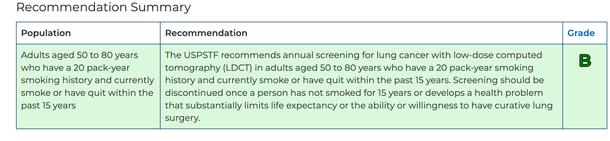
Current recommendations: USPSTF

Slide 6
Recommendations for screening
Age: 50-80 years
Smoking history: current smoker OR former smoker who quit within the past 15 years
Pack year history: 20+ pack year
  Pack year calculation: Pack per day X Years smoking
  Example: 1 PPD x 20 years = 20 pack years

Slide 7
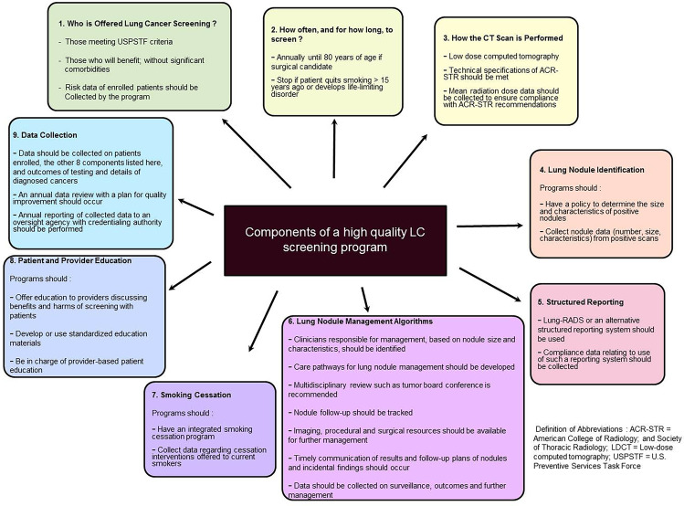
https://pmc.ncbi.nlm.nih.gov/articles/PMC8976270/

Slide 8
Shared decision making
Radiation exposure:
  Less radiation than a traditional CT (1.5 vs 7 mSv)
  No contrast administration needed
  10 minutes, single breath hold
Invasive diagnostics and the risk of a false positive
  Emotional burden
  Radiation exposure associated with additional testing, follow up scans
  Risk of complications from biopsy, surgical resection
  The risk of invasive diagnostics for a slowly growing BAC that would not impact mortality

Slide 9
Insurance coverage
Medicare has decided that there is sufficient evidence to cover annual low-dose CT lung cancer screening coverage among Medicare beneficiaries who fit the following criteria:
Age 50-77 years
No current signs or symptoms of lung cancer
Tobacco smoking history of at least 20 pack-years (pack-years are calculated by multiplying the number of packs smoked per day by number of years smoked)
Currently smoke or have quit within the last 15 years

Slide 10
Insurance coverage
Physicians must provide an order for screening to Medicare after having a lung cancer screening counseling and a shared-decision making discussion with the patient. This visit includes:
Confirmation that patients meet the high-risk definition
A discussion with the Medicare patient regarding the benefits and harms of screening; information regarding follow-up to the screening; the risks of over-diagnosis and radiation exposure; and a warning that a false positive diagnosis could occur
Counseling on the importance of being screened each year and the impact of other possible causes of death with lung cancer
Counseling on the importance of quitting smoking, or staying quit, including information on Medicare-covered cessation services

Slide 11

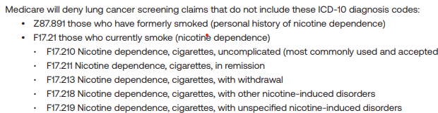
Lung Cancer Screening Billing Guide

Slide 12
Nodules
Solitary pulmonary nodule malignancy risk score (next slide)
High risk characteristics:
  Upper lobe
  Spiculated
  Size and growth rate
  PET positive
Differential for benign nodules: granulomatous disease, rheumatoid nodules, infectious etiologies (fungal, abscess)
Following nodules:
  Fleischner criteria
When to refer: whenever
  We have a protocol for assessing how quickly a patient needs to be seen

Slide 13
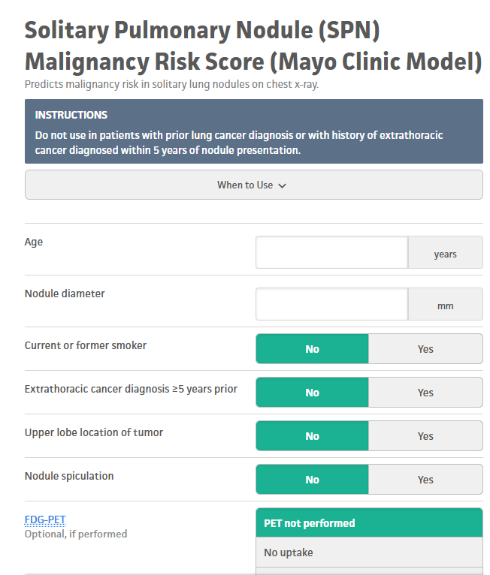
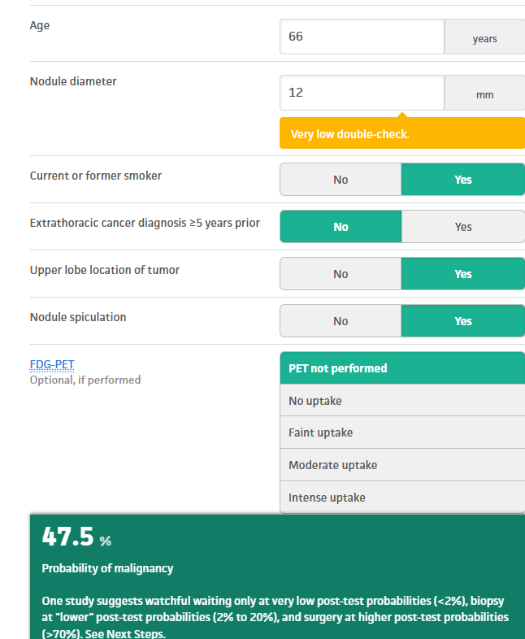
SPN Malignancy Risk Score

Slide 14

Questions?

Slide 15
Works cited
https://jamanetwork.com/journals/jamainternalmedicine/fullarticle/2819820
https://pubmed.ncbi.nlm.nih.gov/39469231/
https://pmc.ncbi.nlm.nih.gov/articles/PMC8976270/
https://www.nejm.org/doi/full/10.1056/NEJMoa1911793
https://www.lung.org/lung-health-diseases/lung-disease-lookup/lung-cancer/screening-resources/medicare-coverage-faq
https://pmc.ncbi.nlm.nih.gov/articles/PMC4102106/
The CMS Requirement for Shared Decision Making for Lung Cancer Screening - PMC

