Slide 1
Updates in Pulmonary Hypertension 2025
Christian Tencza, MD FHP Pulmonology & Critical Care

Slide 2
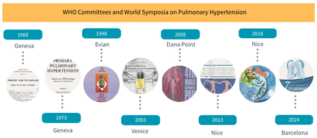

Slide 3
Topics
Classification updates
Methamphetamine induced PAH

Slide 4
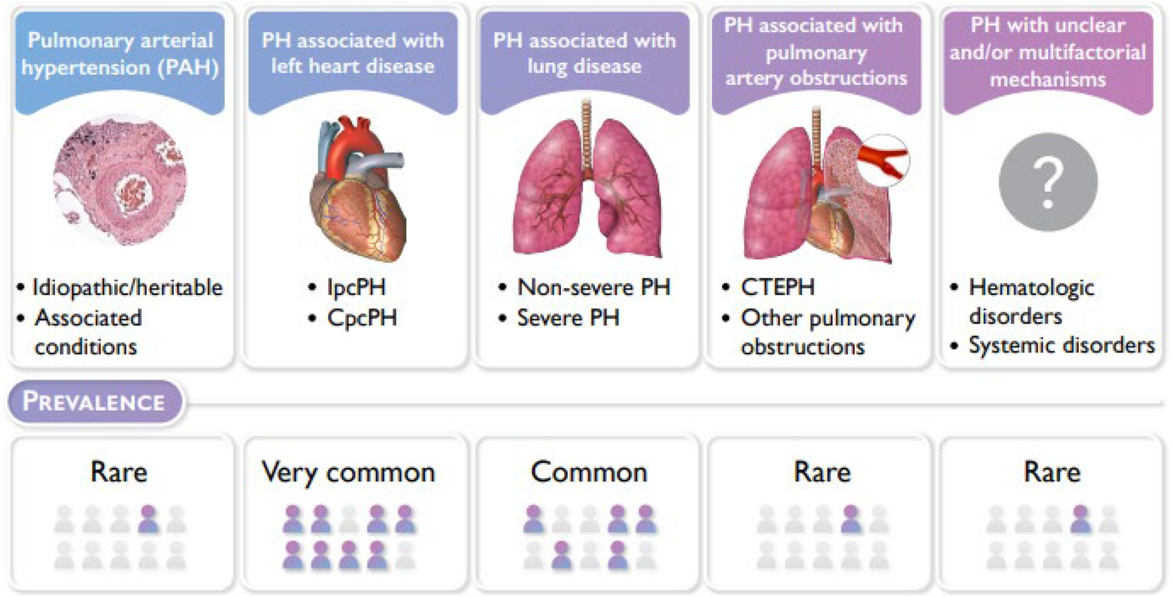

Copyright © 2023 The Authors. Published on behalf of the American Heart Association, Inc., by Wiley Blackwell
Bradley A. Maron. Journal of the American Heart Association. Revised Definition of Pulmonary Hypertension and Approach to Management: A Clinical Primer, Volume: 12, Issue: 8, DOI: (10.1161/JAHA.122.029024)
Notes:
There are 5 broad PH clinical groups that reflect the circumstances underlying elevated pulmonary artery pressure and other pathogenic cardiopulmonary hemodynamic findings on right heart catheterization (RHC). In pulmonary arterial hypertension (PAH), fibromuscular and plexigenic remodeling of distal pulmonary arterioles is caused by interplay between genetic and molecular events, induced by certain toxic drugs (eg, methamphetamines, desatinib, or anorexigens) or observed in association with systemic sclerosis, liver disease, HIV, or other predisposing conditions. Patients with PH attributable to left heart disease present with pulmonary venous hypertension, manifest by postcapillary PH on RHC, whereas PH severity in patients with underlying lung disease is variable. Thrombotic mechanical obstruction to normal pulmonary blood flow is the cornerstone feature of chronic thromboembolic PH (CTEPH). Reproduced from Humbert et al4 with permission. Copyright ©2023 European Society of Cardiology and European Respiratory Society. Cpc indicates combined precapillary+postcapillary PH; and Ipc, isolated postcapillary PH.

Slide 5
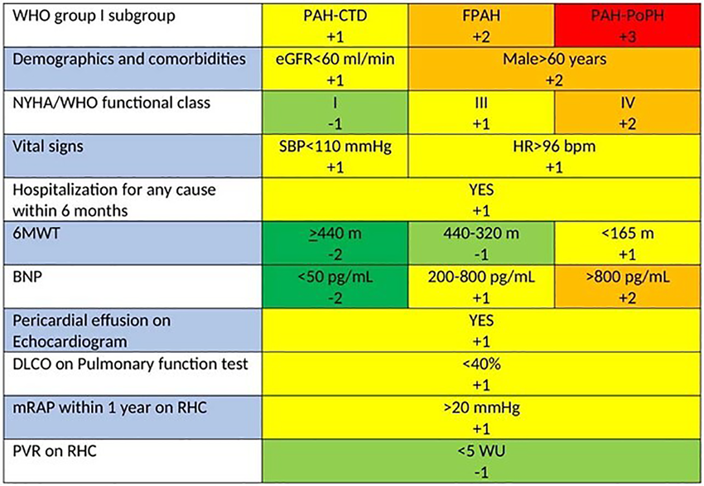
Reveal 2.0 Risk Calculator

Slide 6
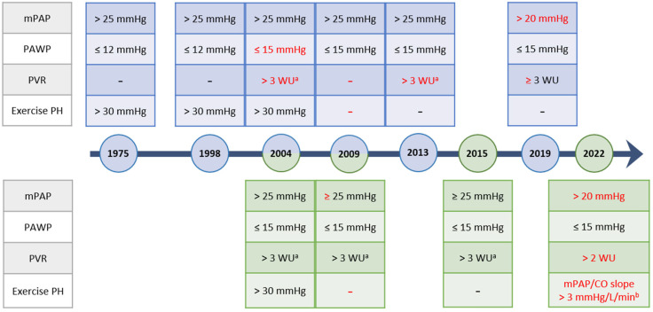
Diagnostic Threshold Timeline

Slide 7
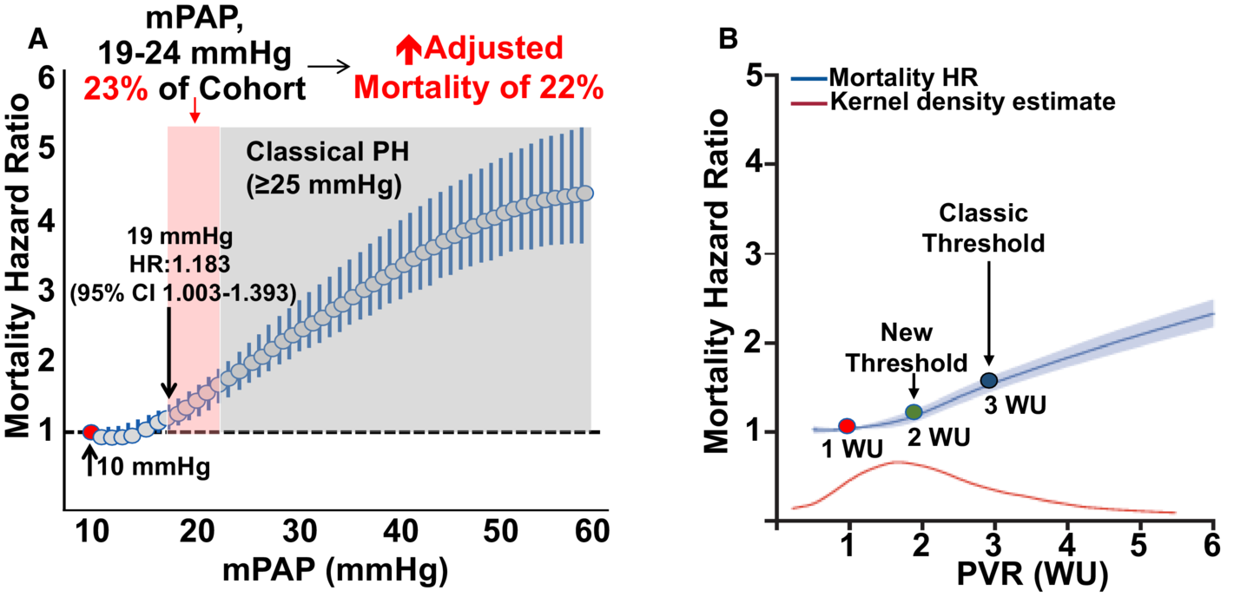
Copyright © 2023 The Authors. Published on behalf of the American Heart Association, Inc., by Wiley Blackwell
Bradley A. Maron. Journal of the American Heart Association. Revised Definition of Pulmonary Hypertension and Approach to Management: A Clinical Primer, Volume: 12, Issue: 8, DOI: (10.1161/JAHA.122.029024)
Notes:
In a national cohort of patients referred for right heart catheterization, mean pulmonary artery pressure (mPAP) (N=21 727) (A) and pulmonary vascular resistance (PVR) restricted to patients with mPAP ≥19 mm Hg (N=32 725) (B) were modeled continuously, and the association with all‐cause mortality risk is shown. These results converge with normative data,18, 19 suggesting that the upper limits of normal for mPAP and PVR are ≈20 mm Hg and 2 WU, respectively. Taken together, these data establish an evidence‐based framework for the new hemodynamic definition of PH. The red disc represents the referent group. Adapted with permission from Maron BA, et al16 © 2016, American Heart Association, Inc (A); and Maron BA, et al17 © 2020, Elsevier Ltd (B). HR indicates hazard ratio; and WU, Wood units.

Slide 8
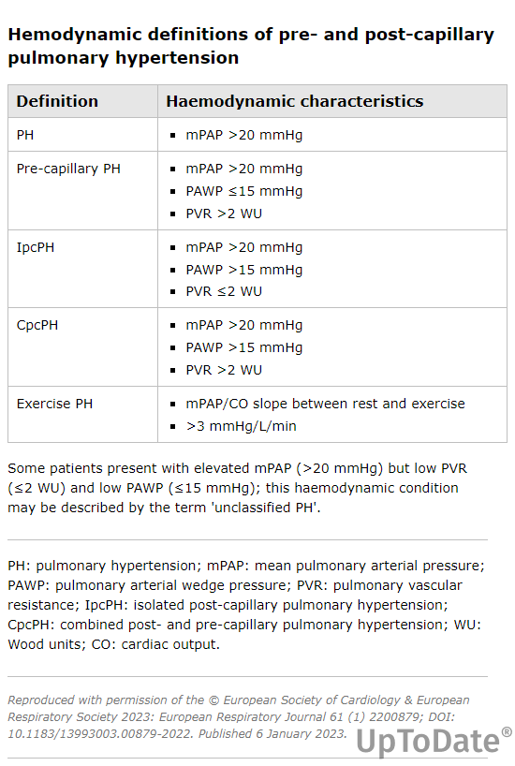
A pulmonary capillary wedge pressure (PCWP) ≥15 mmHg at rest or >18 mmHg immediately after fluid challenge is considered diagnostic of LHD

Slide 9
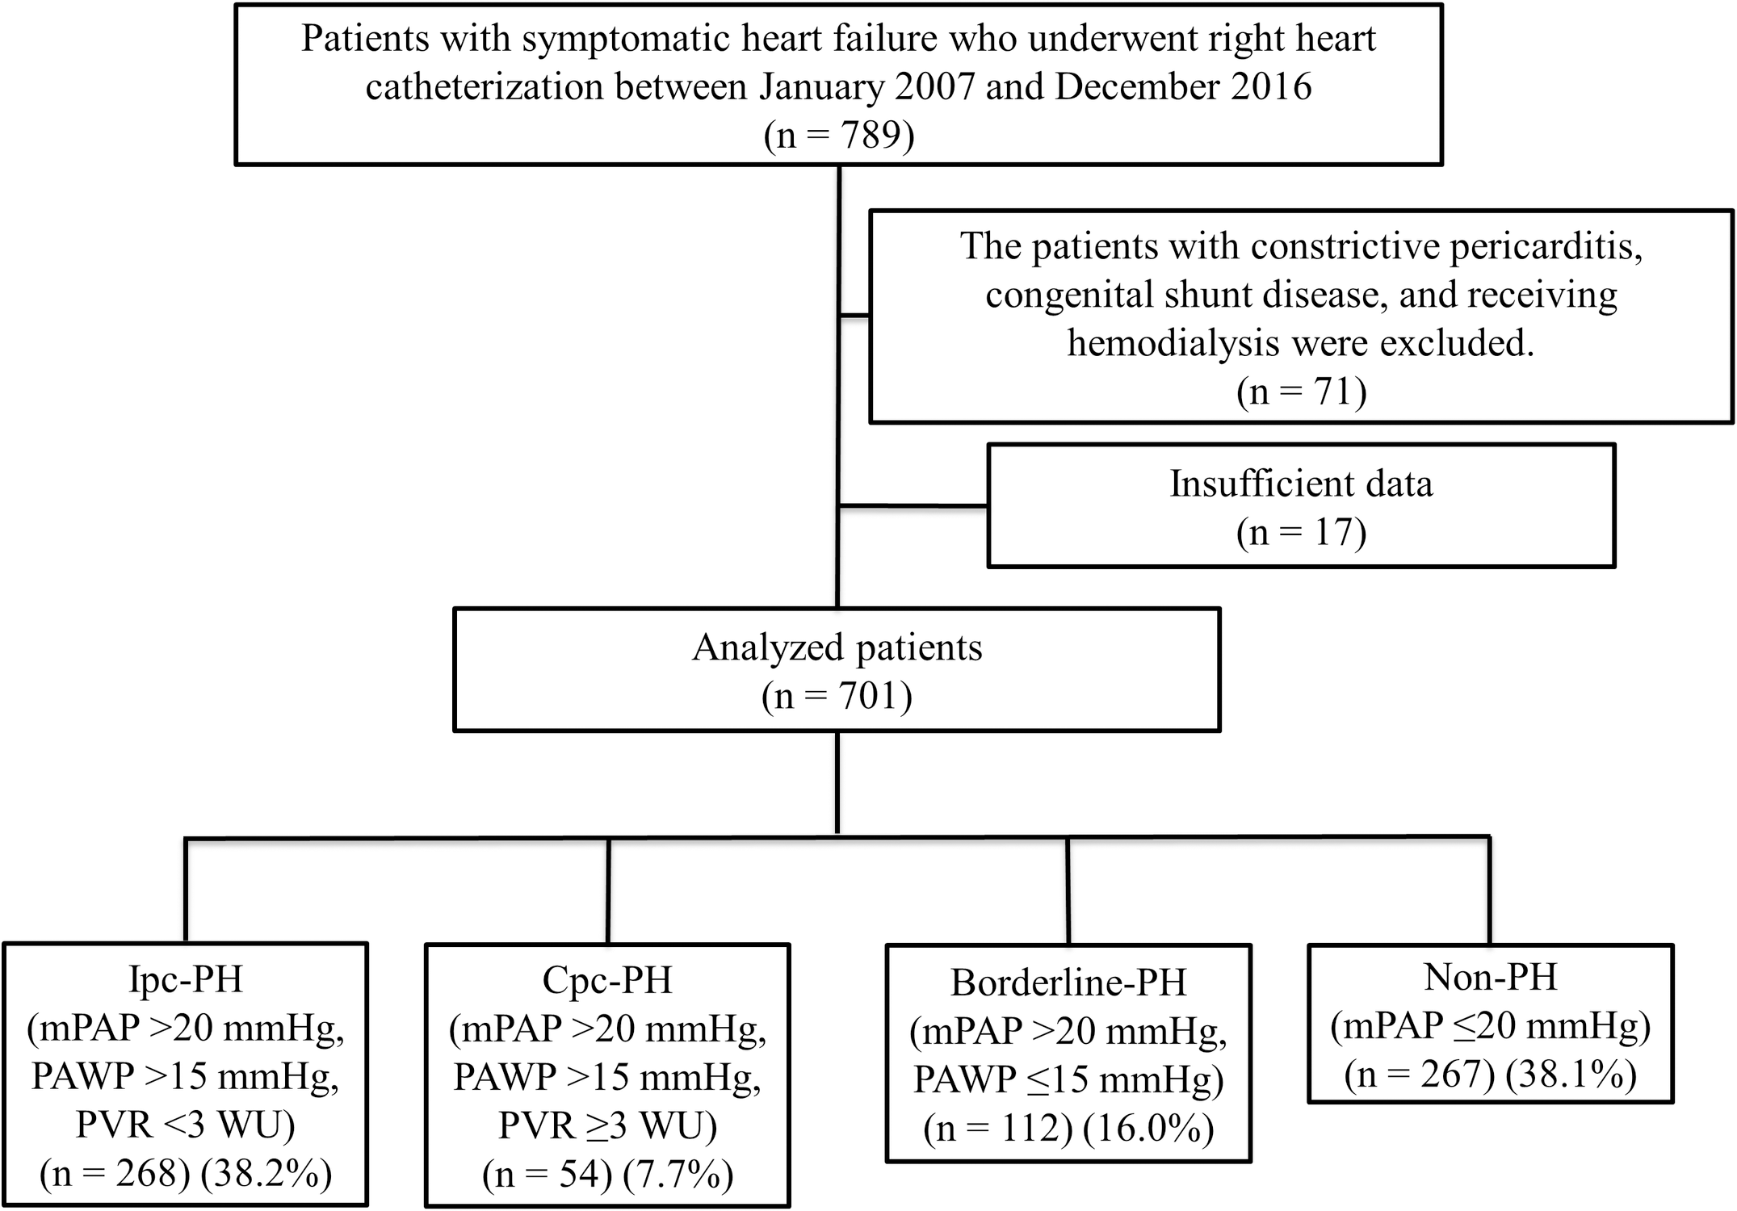
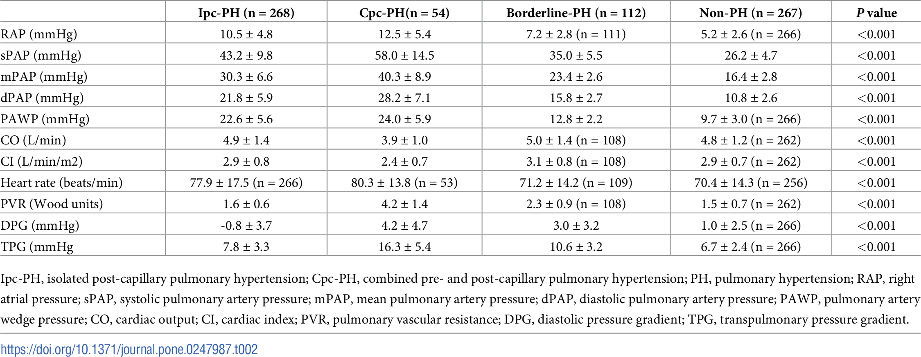
https://doi.org/10.1371/journal.pone.0247987

Slide 10
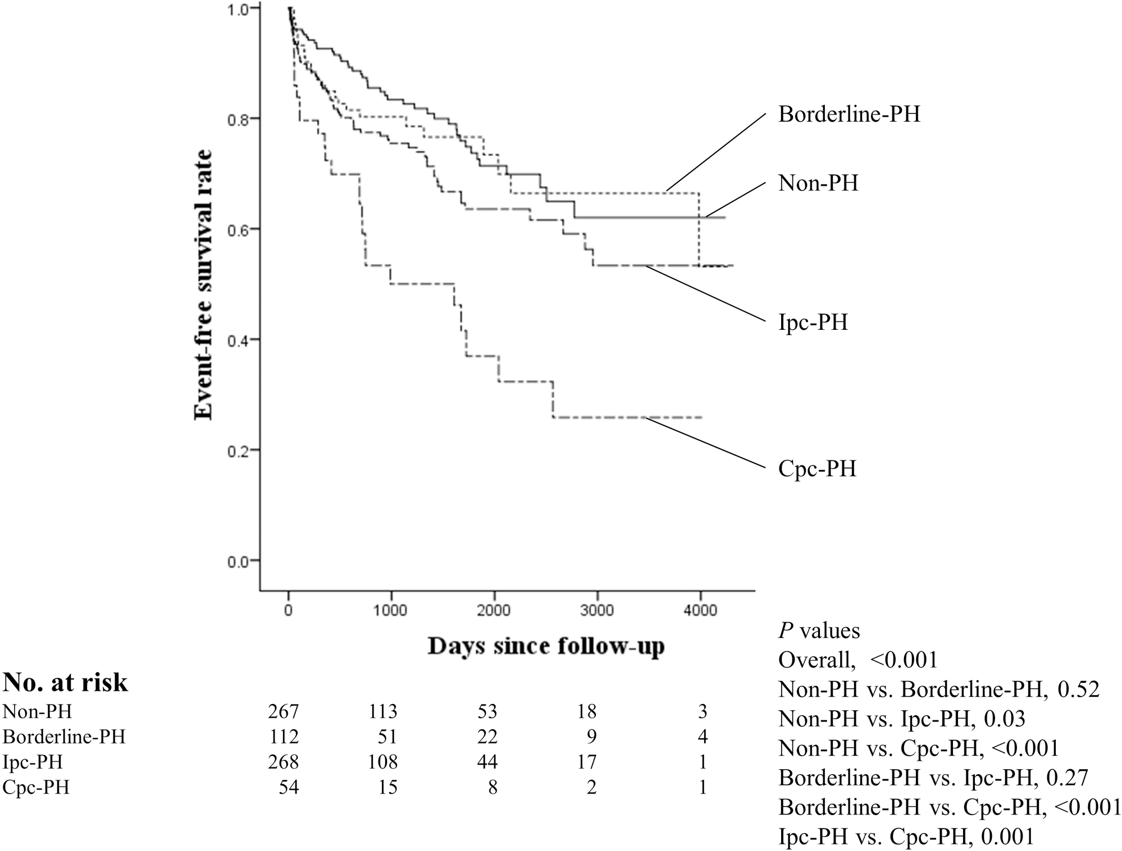
Combined Pre and Post Pulmonary Hypertension
Universally worse outcomes for combined pre and post capillary PH
https://doi.org/10.1371/journal.pone.0247987

Slide 11
Therapeutics for Combined Pre and Post
MELODY-1 (ERA)
HEART (ERA)
EARTH (ERA)
RELAX
SOVIAC
FREEDOM
TRIMUMPH1
FIRST
STEP
GRIPHON
PATENT-1
PATENT -2
CHEST-1
CHEST-2
SOCRATES-REDUCED
SOCRATES-PRESERVED
LEPHT
VICTORIA
VITALITY
DILATE

Slide 12
Key Takeaways for WHO Group 2 Pre and Post Capillary Pulm htn…..
New subset of WHO 2 patients representing 7-15% of WHO 2 patients
DPG replaced by PVR in diagnosis
Worse clinical outcomes including mortality and variety of usual CHF endpoints
No clear therapeutic benefit of directed PAH medications
Future considerations for Sotatercept (Activin signal pathway (SOTERIA, HYPERION, ZENITH, CADENCE, MK - 7962-020, and MOONBEAM, PULSAR)

Slide 13
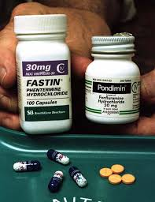
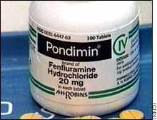

Methamphetamine
1972 Aminorex removed from market in Europe (WHO)
10-year follow up studies showed half of patients died of RHF
Fen-Phen 1996, removed 1997
20% of 73 pt in 1993 review suggested Fen use
HP Gurtner Core Vasa 1985;27(2-3):160-71
Brenot et al Br Heart Journal 1993 Dec;70 (6);537-41

Slide 14
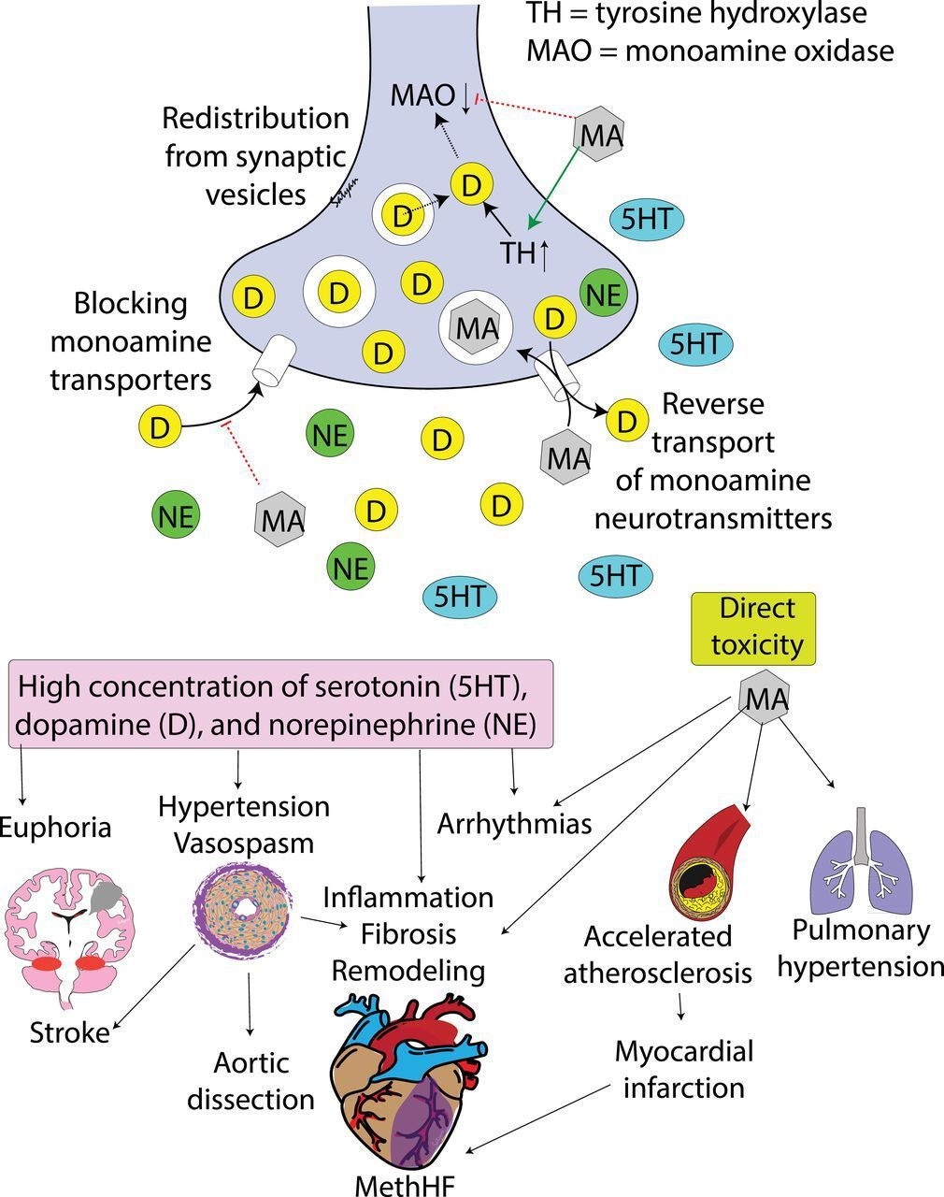
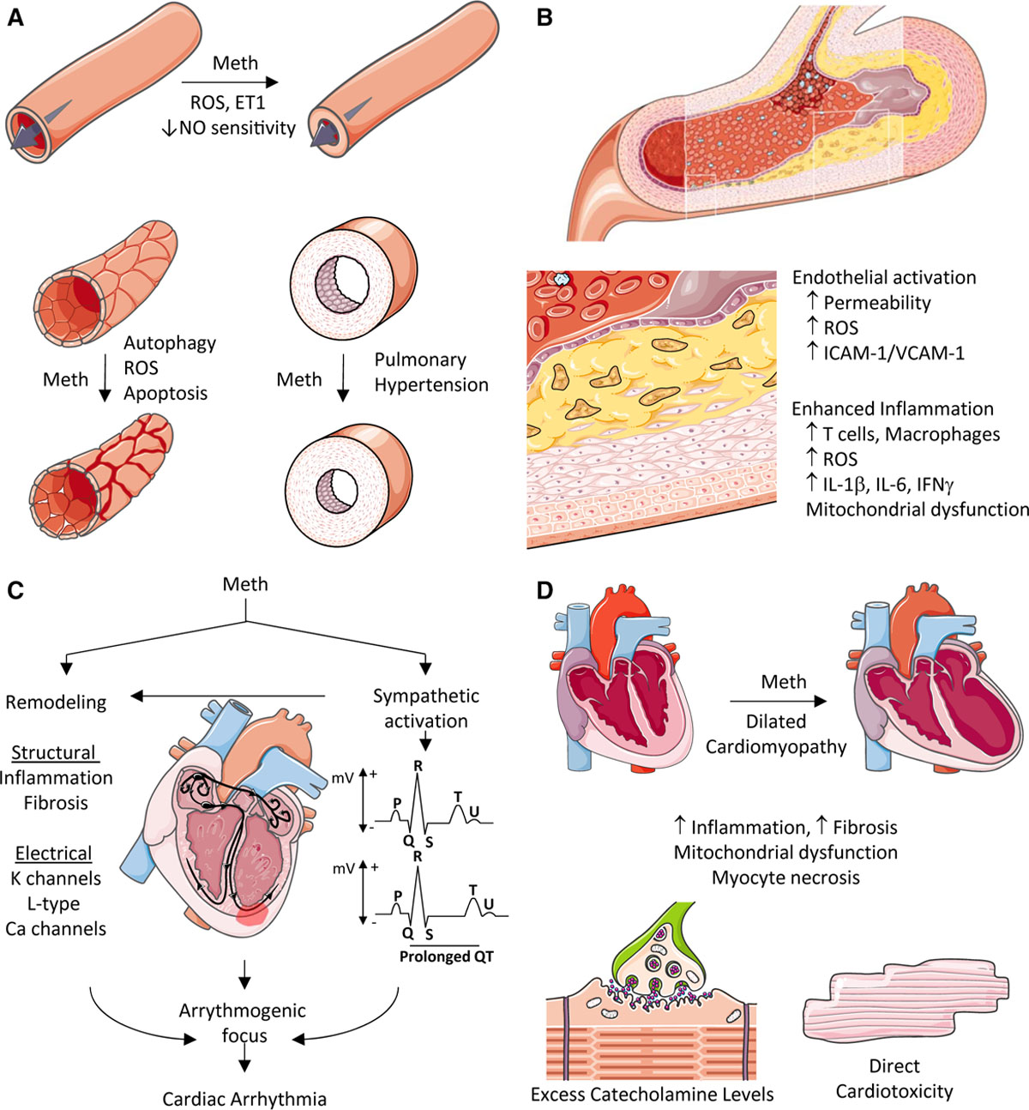
Physiology

Slide 15
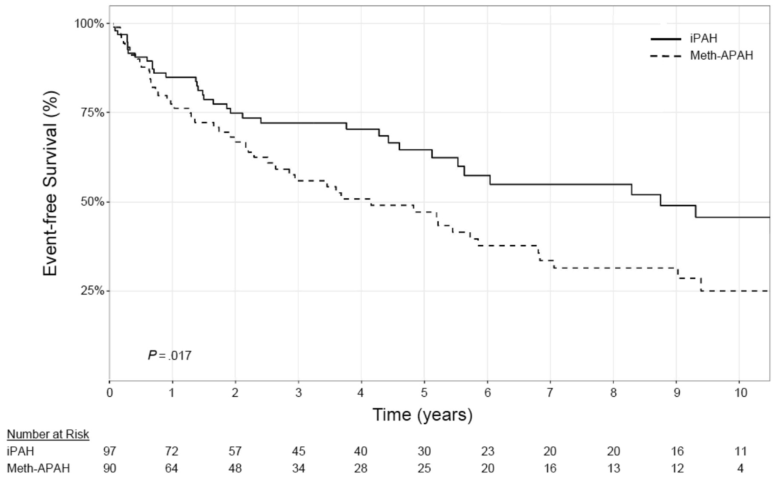
Zamanian 2018. American Journal Resp and Crit Care Medicine Vol 197 Number 6

Slide 16
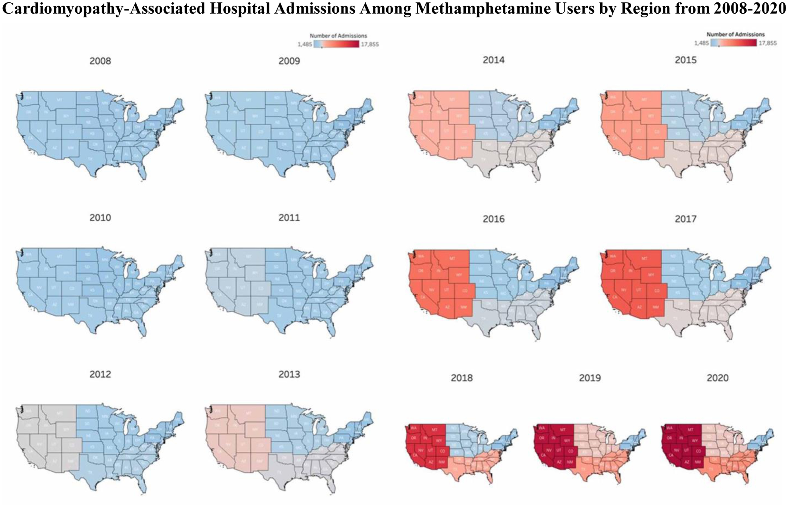

Slide 17
Case Presentation
38 yo female presents to ED with sob and abd distension.
Smoker, Asthma
Notes 20lbs weight gain over last 2m
RV markedly increased, systolic function markedly reduced, RVSP 99 mmHg, TAPSE 1.1, EF 65%, LA normal size.
mPAP 54mmHg
Wedge 4 mm Hg
PA sat 59%
RA 10 mmHg
CI 1.66 (Fick)

Slide 18
Case Presentation
3 separate admissions at local facilities
Liver eval suggested cirrhosis
Saw PCP 4x in last two years with inhalers changes, smoking discussion
Cholecystectomy
Currently on triple therapy
Dry weight
Zero admissions
Still struggling with meth use and missed appointments

Slide 19

Methamphetamine-PAH Takeaways
Use on the rise
Worse outcomes vs IPAH
Can persist even with cessation of drug
Similar physiology to PAH
Unique care perspectives from PH clinic (i.e. give a little grace)
“In my younger years and more vulnerable years, my father gave me some advice that I’ve been turning over in my mind ever since. ‘Whenever you feel like criticizing anyone, just remember that all the people in this world haven’t had the same advantages that you’ve had.’”

Slide 20

Thank You

