Slide 1
New kids on the block:
GLP-1 agonists and SGLT2 inhibitors
William A. Wilmer, MD, FNKF
Kidney Specialists, Inc.
Columbus, LANCASTER, NEWARK - Ohio

Slide 2
GLP-1 agonists and
SGLT2 inhibitors:
In this talk we will discuss these medications in reference to cardiovascular health and CKD.

Slide 3
These drugs are “overnight successes” that took years to develop (e.g. exenatide – Byetta - released 2005)
FDA requires new DM drugs to look at CV disease impact
Serendipity - The CVD and CKD benefits of these medications could not be predicted

Slide 4
GLP-1 RA
Incretins - gut hormones released after a meal
GLP-1 – glucagon-like peptide-1
GIP – glucose-dependent insulinotropic polypeptide
Origin:
GLP-1 is made by L-cells of the small bowel with interaction via microbiome
GIP is made from enteroendocrine K-cells in the upper small intestine, also with microbiome interactions

Slide 5
Stimulate insulin release
GIP receptors:
beta islet cell, small bowel, brain
GLP-1 receptors: beta islet cells, brain, afferent vagal nerve, ”other”
Incretins:
GLP-1, GIP
Inhibit glucagon
Lower blood glucose
Inhibit appetite
Slow gastric motility
DPP-4 enzyme
rapidly inactivates incretins
DPP-4 inhibitors block DPP-4:
Januvia, Tradjenta

Slide 6
GLP-1 is a transient compound
GLP-1 RA are peptide receptor agonists
Each generation with improved half-lives and receptor affinity.
AHA and KDIGO (renal advisory board) remind us the benefits of GLP-1 RA are NOT group effects but vary by medication.
Each needs to prove their worth.
For example, exenatide (Byetta) avg weight loss 2.5- 3 kg after 24 weeks, no CVD risk reduction.

Slide 7

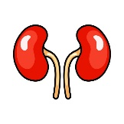
CVD:
Meta-analysis of 99,592 patients (21 trials) found that MACE , CV death and CVA reduced by 13% (NNT = 66)
(Mattia Galli, et al, J AM Coll Cardiol, 2025)
CKD:
Meta-analysis of 8 trials shows 15-19% risk reduction in CKD (GFR loss, progression to ESRD<, kidney-related death, albuminuria). Albuminuria reduction was driving force
Semaglutide (FLOW study was a CKD study) – 24% reduction in kidney failure, >50% GFR loss, death from CKD or CVD over 3.4 years
Tirzepatide (SUMMIT, SURPASS-4 trials) – 42% reduction vs insulin, mostly studied CKD III
SUMMARY OVERVIEW of GLP-1 RA

Slide 8

GLP-1 RA FDA approved for CVD reduction: liraglutide (Victoza)
LEADER trial – CV reduction 13% vs 14.9% placebo over 3.8 years dulaglutide (Trulicity)
REWIND trial, 12% reduction – many primary prevention semaglutide (Ozempic / Wegovy)
SUSTAIN-6 trial, 26% reduction in MACE in obese diabetics
SELECT trial –non diabetic BMI > 27 kg/m2, 20% reduction over 40 months tirzepatide (Mounjaro / Zepbound) ? - not yet FDA approved; GLP-1 / GIP combination, several real-world experience to suggest success

Slide 9
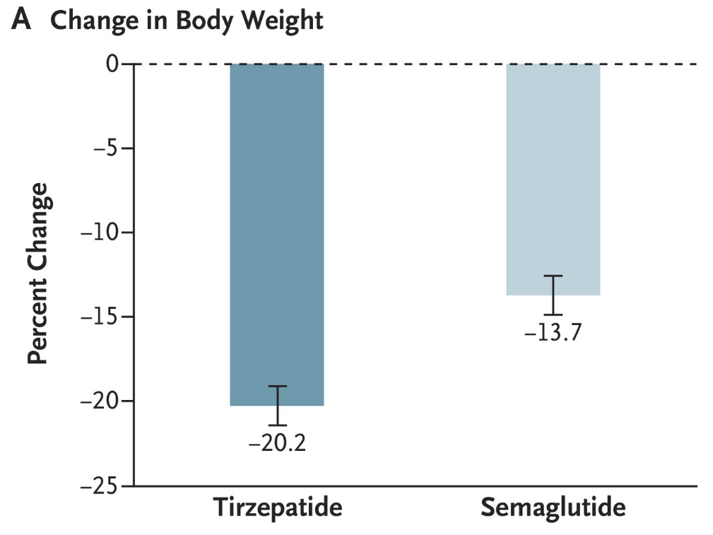
The Battle of the Heavyweights: Semaglutide vs Tirzepatide
Tirzepatide as Compared with Semaglutide for the Treatment of Obesity: Louis J. Aronne, M.D., et al. N Engl J Med 2025;393:26-36 VOL. 393 NO. 1

Slide 10

The Battle of the Heavyweights: Semaglutide vs Tirzepatide
Weight loss may not translate into CVD risk reduction:
CVD reduction:
Surpass – CVOT trial:
Tirzepatide (with superior weight loss) was shown non-inferior to dulaglutide (Trulicity) but not superior
STEER trial: Reports from European Society of Cardiology Congress, September 2025 : semaglutide superior to tirzepatide (obesity and non diabetic use) *(not published)
SELECT – Wegovy improved MACE within 3 months of a cardiac event , prior to significant weight reduction.
Hazard reduction 63% vs control in the first 3 months.
(so start ASAP post MI)

Slide 11
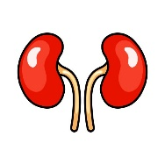
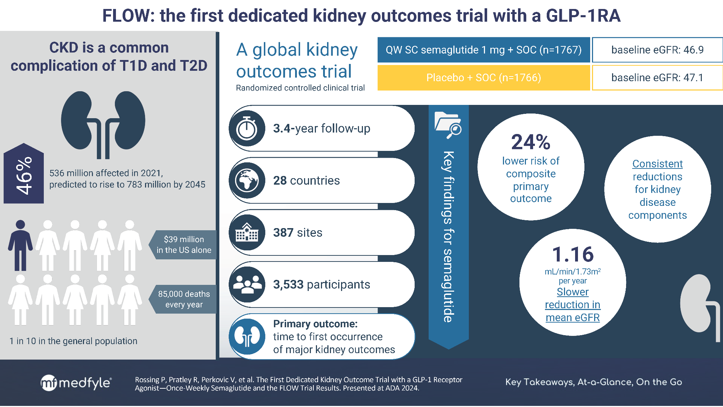
Effects of semaglutide on chronic kidney disease in patients with type 2 diabetes, Perkovic et al, NEJM: 2024: 391:109-121
* versus placebo: slower GFR loss - GFR 3.3 ml/min better after 2 years, albuminuria reduced 40%, CVD events 18% lower, death of any cause 20% lower

Slide 12
CKD improvements
Semaglutide (non diabetics with obesity):
SELECT trial - 22% relative risk reduction in albuminuria,
eGFR decline of 50%, kidney failure or death due to kidney – hazard
ratio 0.78
Only 21% Select had eGFR < 60 – so main goal was CKD development / not progression
Benefits occurred independent of weight loss (as also in FLOW study)
Tirzepatide:
Surpass-4 trial post hoc analysis
Reduced GFR decline, UACR reduced ~ 7% vs 24% increase with insulin use (Lancet Diabetes Endocrinol, Nov 2022, Heerspink, et al.)
Not powered for hard endpoints

Slide 13
Mechanisms of GLP-1 RA effects on CKD & CV disease risk reduction:
Weight loss
DM control
BP control
Lipid control
GLP-1 receptors in the heart and kidney (GIP not):
Cardiomyocytes especially at the SA node but also ventricles
Renal vascular smooth muscles and mesangial cells of the glomerulus.
mTOR pathway inhibition -> reduces collagen expression
Downregulates angiotensin II, upregulates AT2 receptors and downregulates AT1 receptors. May slow angiotensin- induced fibrosis.
Improves glucose use of cardiomyocytes in ischemia – shifts from fatty acid use that occurs in DM and ischemia.

Slide 14
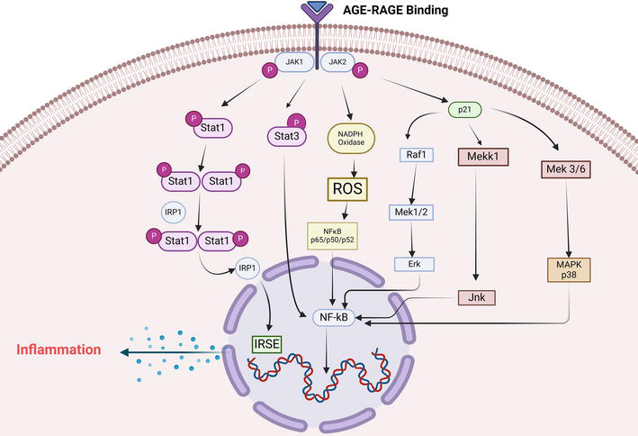
  GLP-1 RAs inhibit the RAGE (Receptor of AGE)
  AGE: advanced glycosylated endproducts
  (aka Amadori products – proteins and lipids that are glycated)
GLP-1 RA
Decrease receptor expression
Promote cell shedding or receptor
Fibrosis

Slide 15
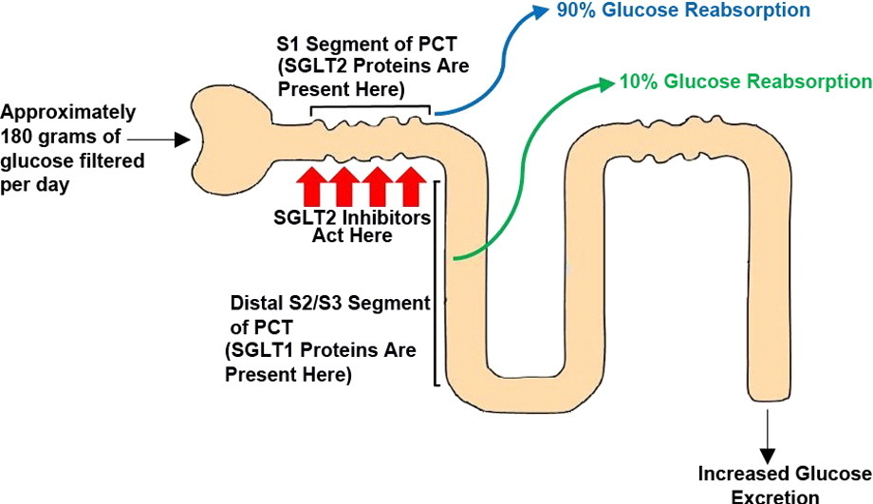
Sodium Glucose Transporter -2 Inhibitors
GLOM
Increased glucose and sodium / chloride excretion

Slide 16
SGLT2i create an osmotic diuresis and a sodium losing state.
These effects do not seem to have a “braking” phenomenon as traditional diuretic therapy
Addition of SGLT2 I to loop diuretic increases natriuesis by > 35%
Intravascular depletion DOES NOT activate RAAS

Slide 17
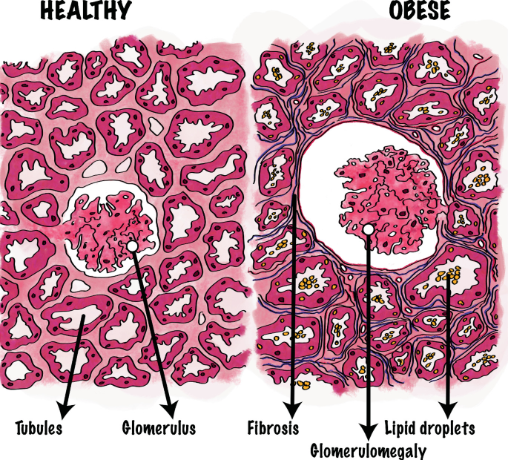
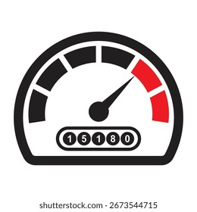
Glomerular Hyperfiltration -> CKD
Clinical states:
Obesity
Poor nephron development (prematurity), loss of a kidney as a child
Nephron loss of CKD (remaining nephrons work harder = ablative nephropathy)
DM with hyperglycemia – via SGLT2 receptors
Anatomical change: glomerulomegaly

Slide 18
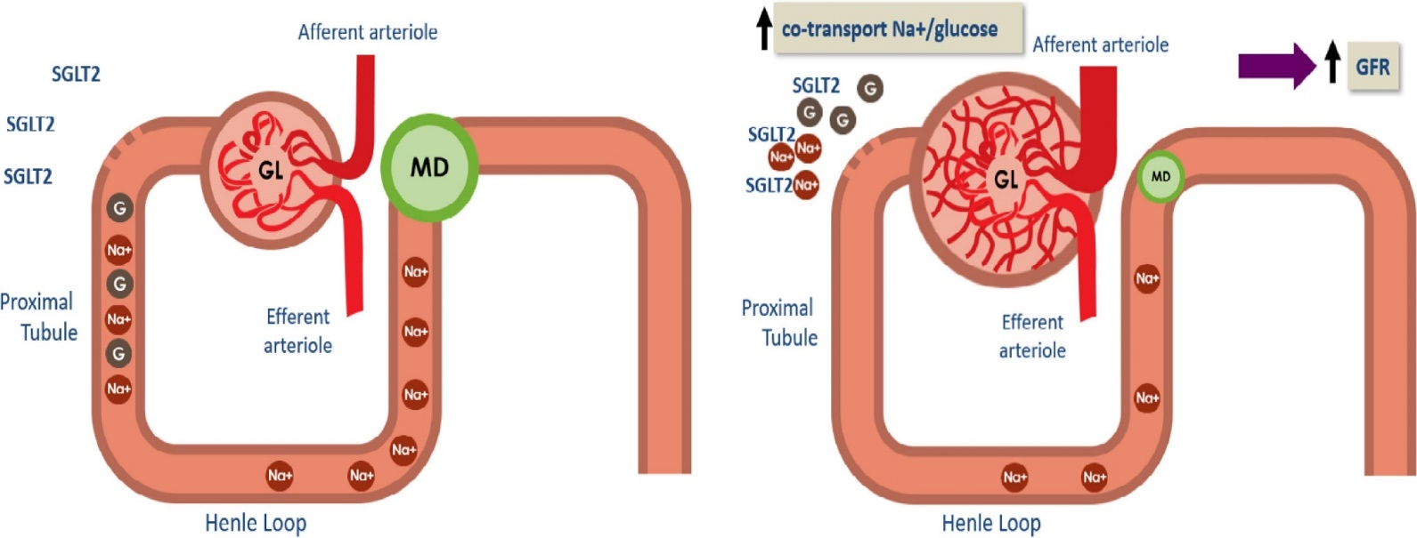
Macula densa – senses chloride
and communicates to JG apparatus -> renin release and afferent tone.

Slide 19
Diabetes causes hyperfiltration and glomerular injury
MD senses less chloride and opens the afferent -> GFR climbs

Slide 20
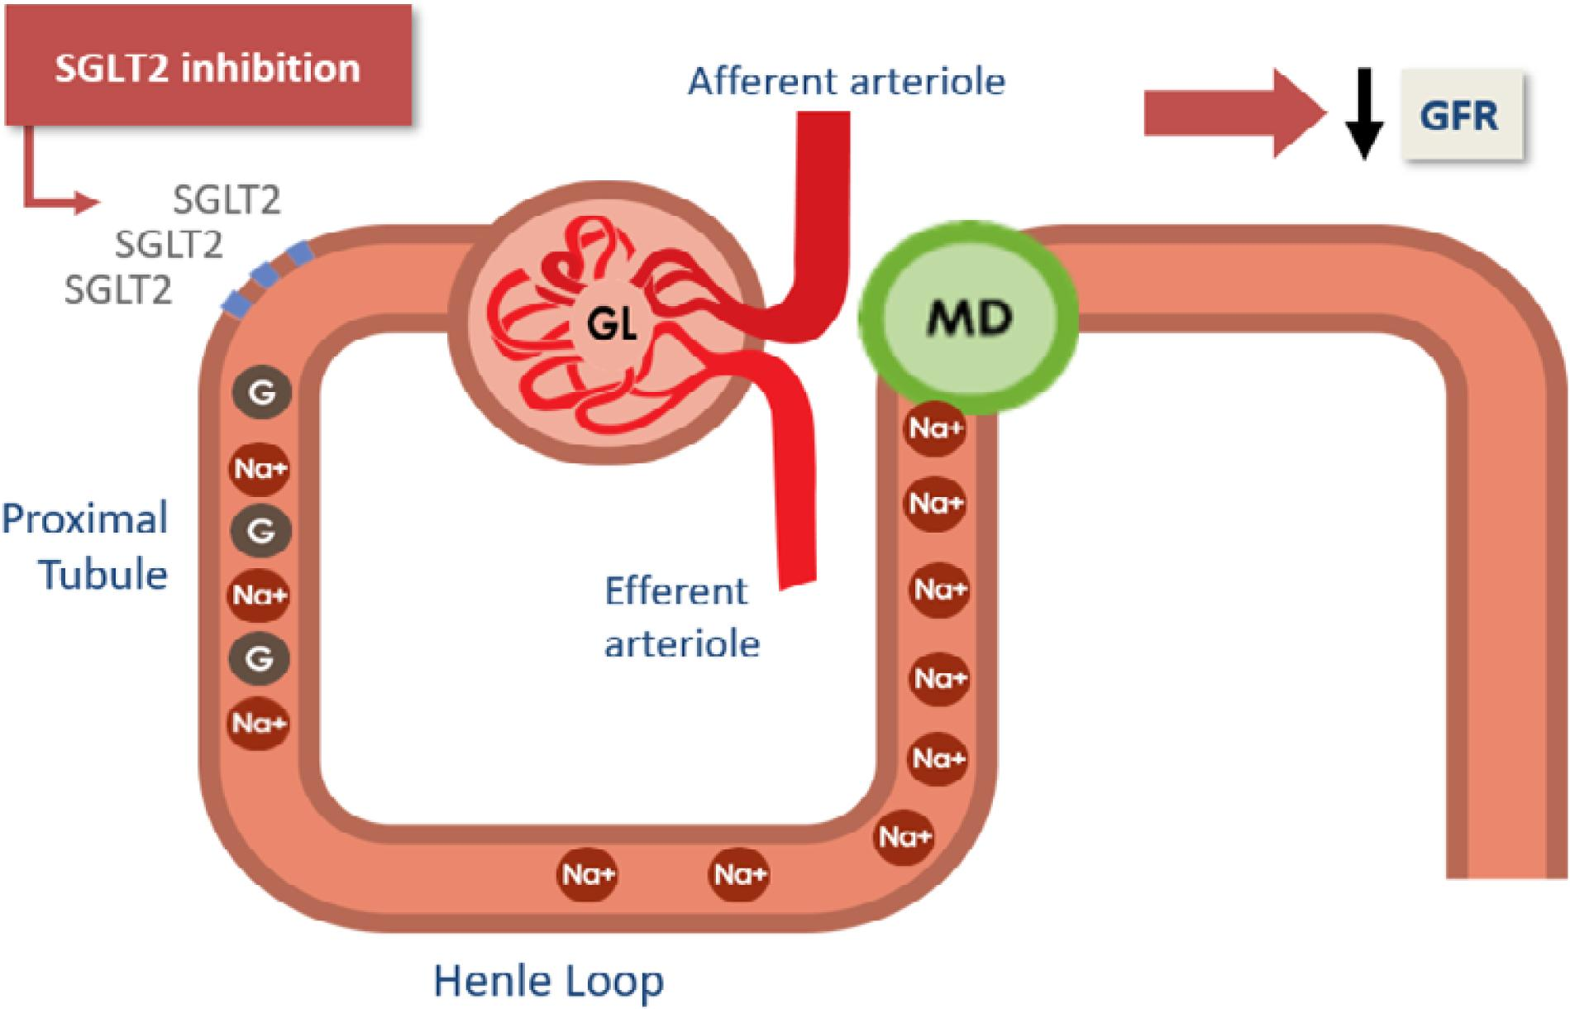
GFR stabilizes
Albuminuria decreases
Glucose and weight
BP / volume
Renin and AII
Fibrosis better

Slide 21
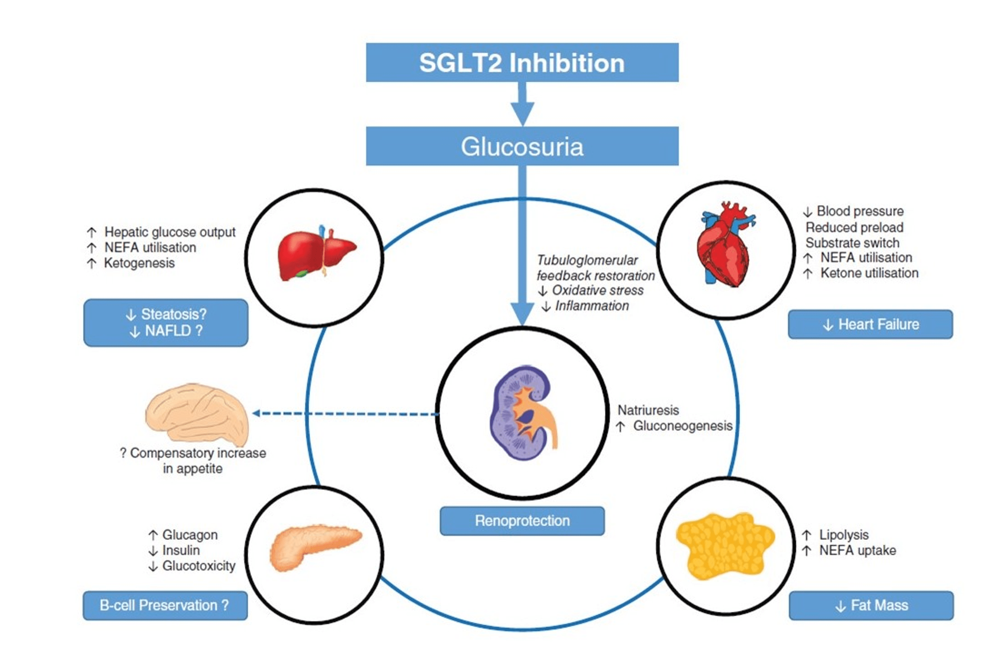

Slide 22
SGLT2i Trials
Improvement in MACE, including CV death, HF hospitalizations (diabetics and non-diabetics)
HFrEF: reduce risk of CV death, all cause mortality, HF
admissions (DAPA-reduced trial)
HFpEF: reduce HF admissions, neutral benefit of death
(DAPA- preserved trial)
Improvement of GFR loss in diabetics and non-diabetics: CREDENCE, EMPA-REG, EMPEROR trials

Slide 23
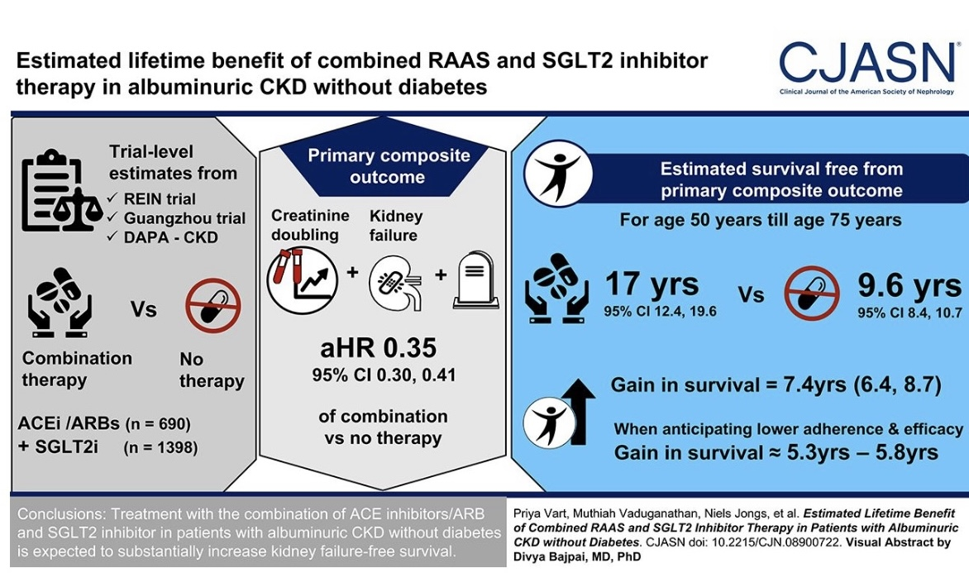
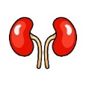

Slide 24
Combination Therapy: Is more….better?

Slide 25
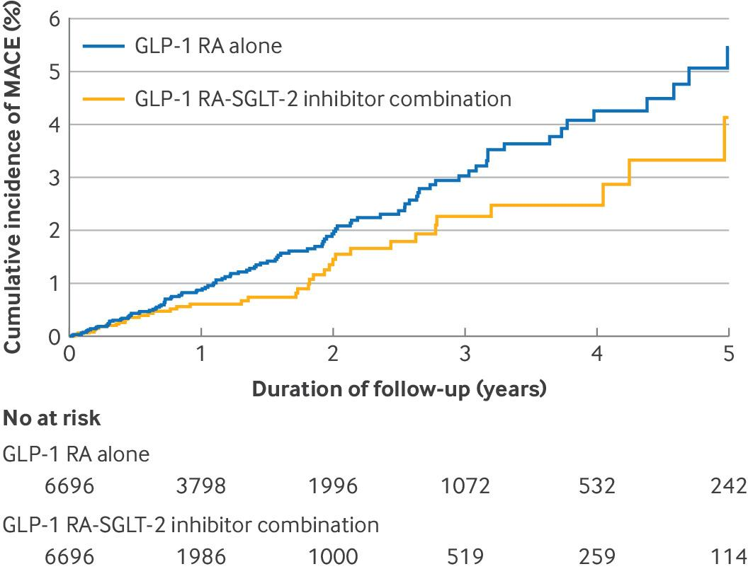

Cumulative incidence curves of major adverse cardiovascular events (MACE) for glucagon-like peptide-1 (GLP-1) receptor agonist (RA)-sodium-glucose cotransporter-2 (SGLT-2) inhibitor combination versus GLP-1 RAs.
30%
(CKD: 57%
using both )
Nikita Simms-Williams et al. BMJ 2024;385:bmj-2023-078242
©2024 by British Medical Journal Publishing Group
Notes:
Cumulative incidence curves of major adverse cardiovascular events (MACE) for glucagon-like peptide-1 (GLP-1) receptor agonist (RA)-sodium-glucose cotransporter-2 (SGLT-2) inhibitor combination versus GLP-1 RAs

Slide 26
Thank you

